Slide 1
Microsoft Photogrametry Vexcel Imaging Austria Camera Panel ASPRS 2012 Michael Gruber michgrub@microsoft.com

Slide 2
Innovation Path
UCXp WA
UCXp
UCD
UCX
UCL
UCLp
2003/2004 2006 2008 2009 2010

Slide 3
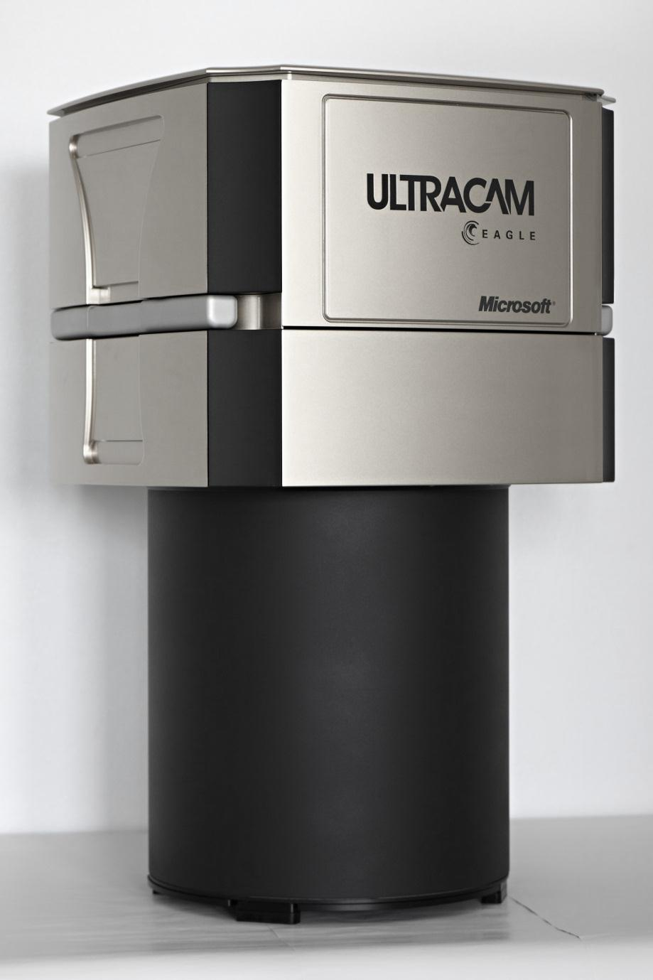
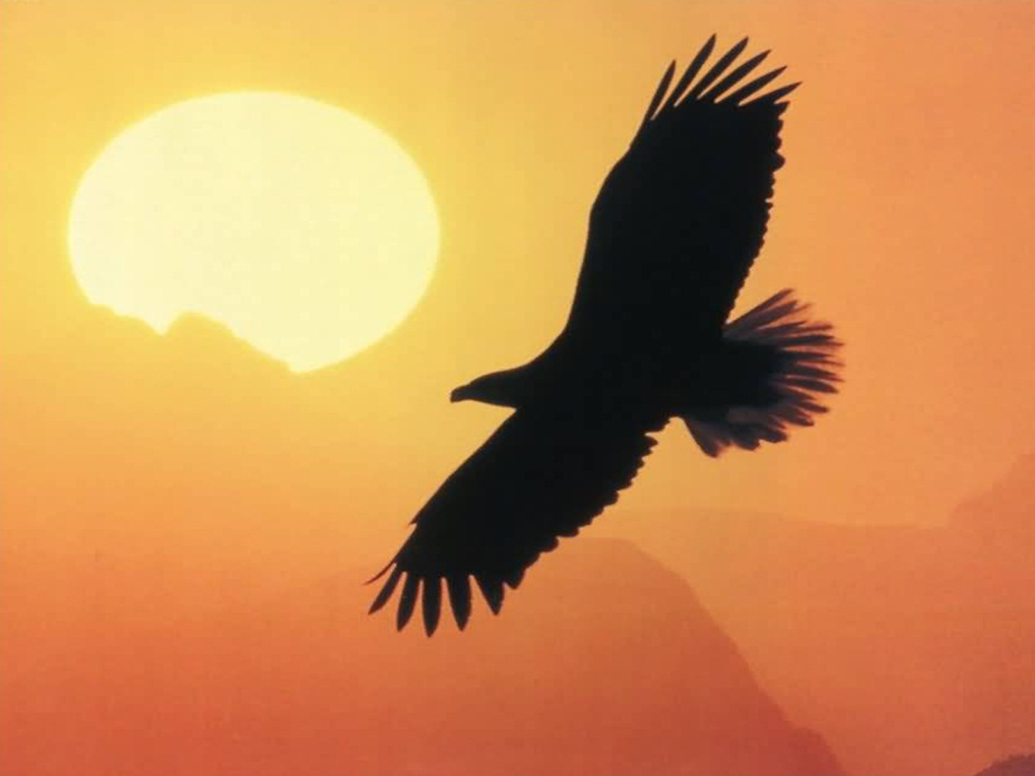
UltraCam Eagle

Slide 4
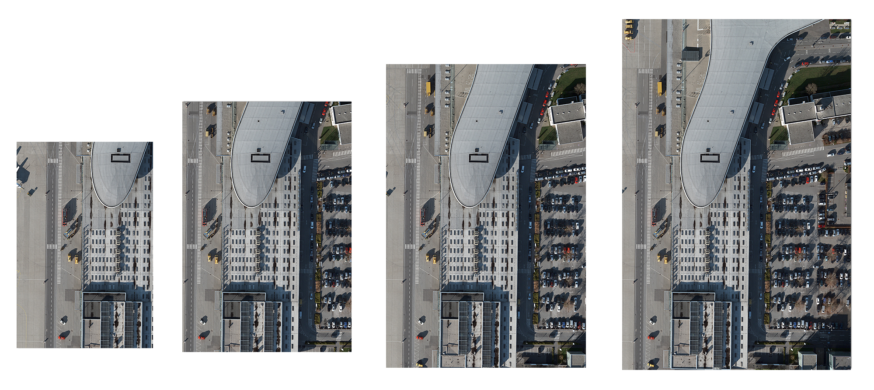
Formats
Largest format available (260 Megapixels)
20,010 across track, 13,080 along track
Short frame interval allows multi-ray set up
UCLp UCX UCXp Eagle
90 136 196 260 MPixel

Slide 5
Software Roadmap
UltraMap
3.x
UltraMap
2.x
Dense Matching
PointCloud/DSM/DTM
DTMOrtho/DSMOrtho
UltraMap
1.x
Monolithic Core
Rich AT Features
Rich Radiometry
OPC
Distributed
Processing
Level 0-2, 2-3
2003/2004 2010 2011 2012

Slide 6
