Slide 1
Multi-Scale Ground Filtering of Dense Lidar Point Clouds for Modeling Shrub Mangrove Canopies in Coastal Environments
Travis Meyer
Advisor: Karen Schuckman
Notes:
Intro: Good morning! My name is Travis Meyer and today I’ll be presenting my capstone project through Penn State University on developing an accurate method for 3-dimensional feature extraction of mangroves in coastal wetlands using remotely-collected geospatial datasets and advanced image & elevation processing software.

Slide 2
Presentation Outline
Why Mangroves Are Important
Research Issues
Project Goals
Study Area & Data
Methodology & Workflow
Project Goals & Results
*Quick* Q & A

Slide 3
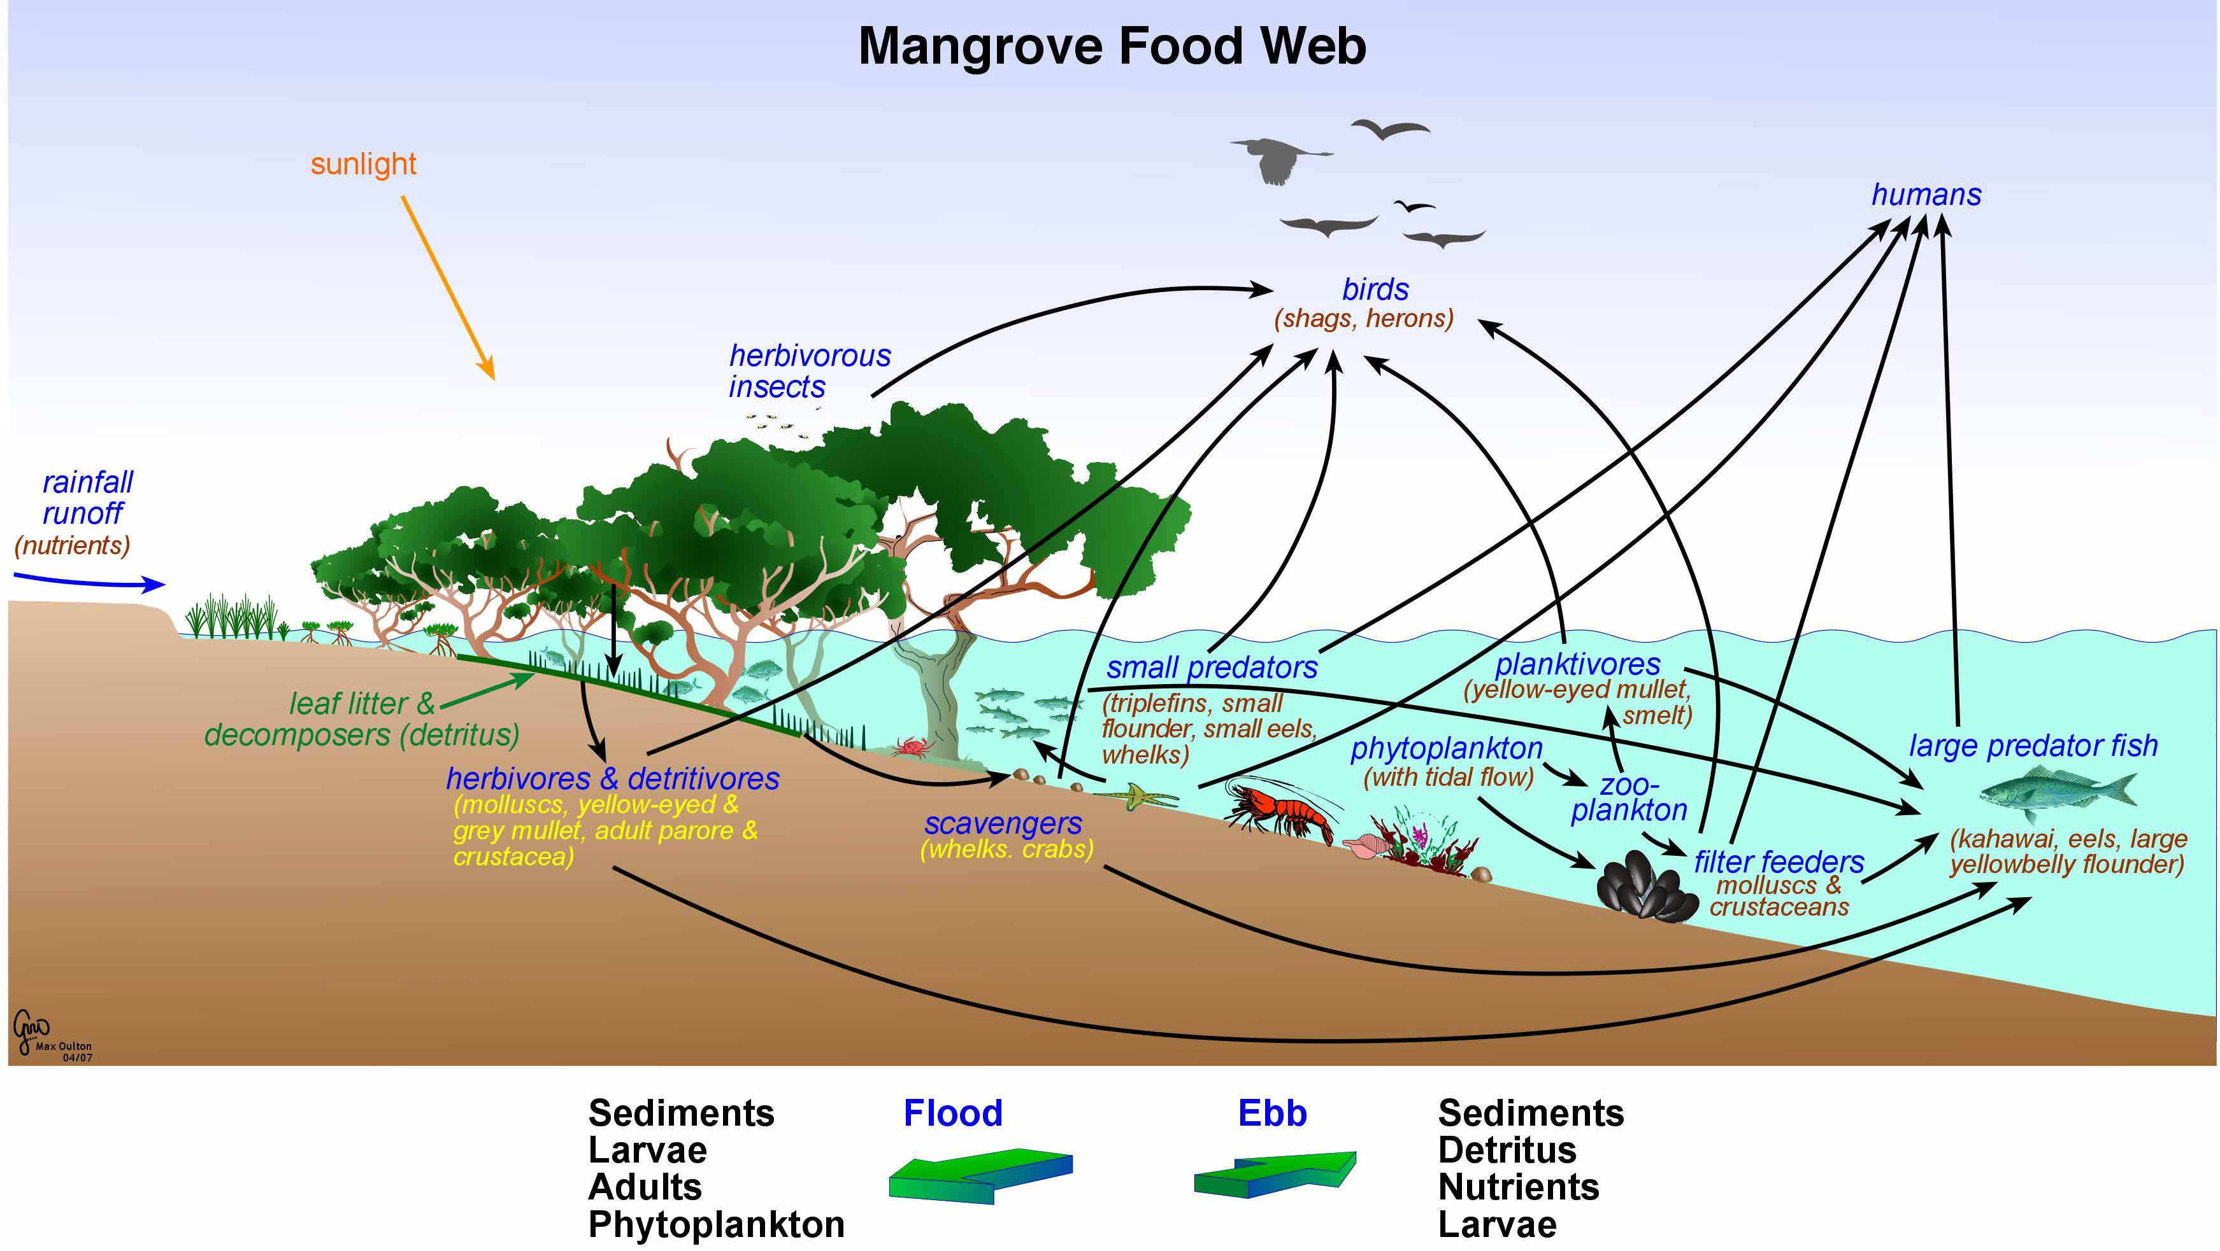
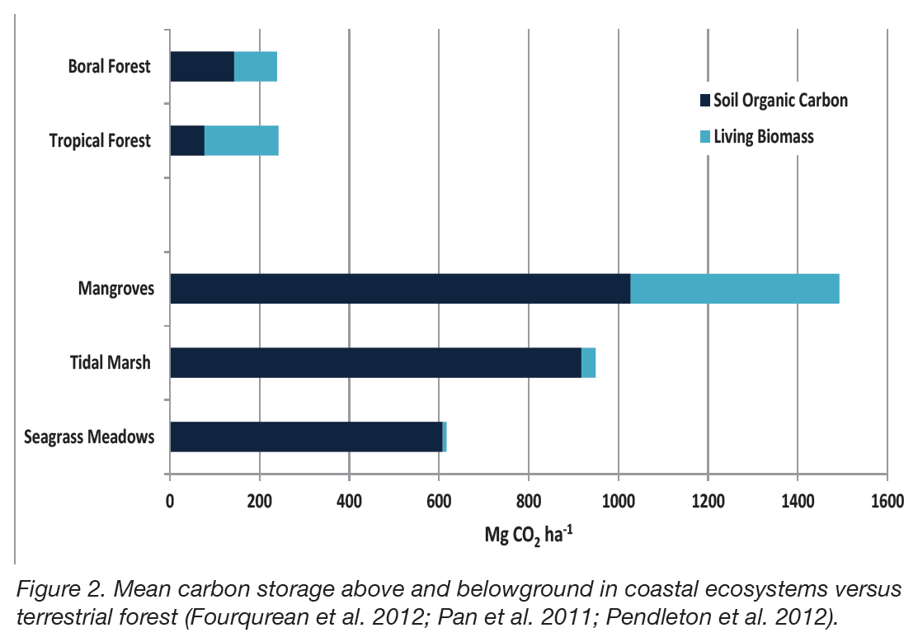
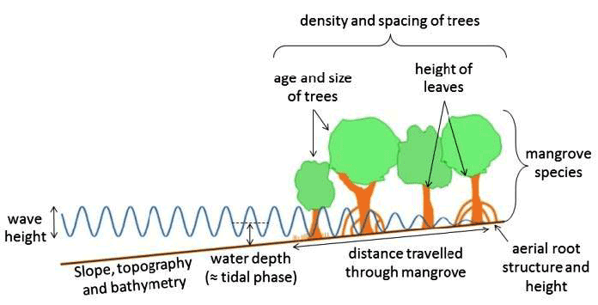
Why Mangroves?
1) Vegetative structure creates a habitat for fishery food webs to flourish in devoid of predation.
2) Mangroves sequester ~5x the amount of carbon per acre as mature tropical forests.
3) Mangroves rebuild coastal sediment loss and prevent destruction by storm surge.
Notes:
Mangroves:
Sustain local ecology by providing a nursery for offspring relatively safe from predation.
Sequester close to 5 times the amount of carbon emissions sequestered by mature tropical forests.
Play an important role in preventing coastal sediment erosion.
Store nutrients and act as a “biological filter” for harmful compounds present in estuaries.
Can diminish the strength of wave action and prevent storm surge along coastlines.
And:
Very few studies on quantifying vertical Mangrove biomass metrics with remotely sensed data.
Even fewer studies on the use of lidar to aid in the classification and assessment of Mangrove forests.
Lidar has the potential to accurately measure Mangrove canopies and heights over very large areas over a relatively short time period.
BLUF: ALTHOUGH MANGROVES MAKE UP A VERY SMALL NICHE ECOSYSTEM THEY SEQUESTER MORE CARBON TON FOR TON THAN ANY OTHER MATURE FOREST TYPES DUE TO UNIQUE DYNAMICS SPECIFIC TO THEIR ENVIRONMENT

Slide 4
Shrub Mangrove Locations in the US
Locations of Shrub Mangroves in Southeastern US
Environmental Constraints on Mangroves:
Water Salinity
Water Temps
Competition
Climate
Seed Propagation
Map Source: https://databasin.org/maps/new#datasets=6ec804f5250a483abd9bdb200939247f
Data for map derived from “Increase in Black Mangrove Abundance in Coastal Louisiana,” Michot, et. al (2010)
https://www.researchgate.net/publication/319573839_Increase_in_black_mangrove_abundance_in_coastal_Louisiana
Notes:
BLUF: Discuss species distribution and environmental constraints that select for black mangroves in Louisiana.

Slide 5
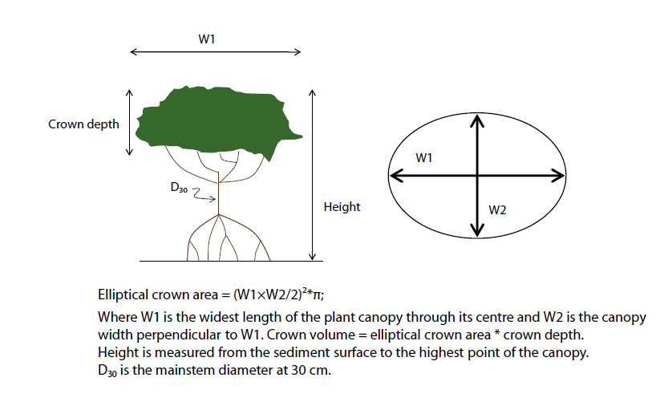
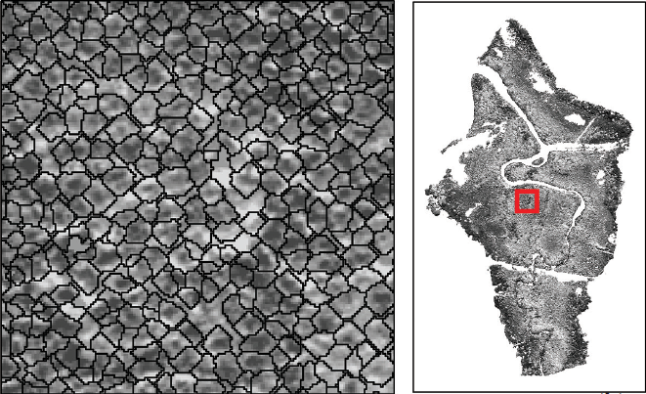
Research Issues
Carbon Stock Monitoring for Coastal Mangroves
Allometric Measurements Collected at Large Scale
Allometric measurements commonly used by Biologists & Ecologists studying shrub mangroves in the wetlands. (Image Source: CIFOR)
Automated feature extraction methods can potentially allow researchers to collect allometric data remotely at large scale for regional analyses of mangrove stocks. (Image Source: Heenkenda, et al., PE&RS, 2015)
Notes:
Large-Scale Allometric data collection is the issue ----- this research will build upon existing research (DEFINE ALLOMETRIC)
***Combined approaches from prior research combining OBIA classification and allometric field data collection
The problem is that individual mangrove plots may not be representative of the surrounding areas where the allometric properties of mangroves may change.
Remote sensing and GIS have the potential to automate the monitoring of mangroves. Object-Based Image Analysis (OBIA) of airborne and satellite imagery has been used to delineate individual mangrove plots within images of large coastal mangrove stands, but the extent of individual mangrove plots tell us little about the 3-dimensional structure of the plants for allometrics.
BLUF: GIS & REMOTE SENSING CAN BE USED TO GREATLY ENHANCE THE ACCURACY OF DATA COLLECTION AND FIELD INTERPOLATION FOR MAKING LARGE-SCALE WETLAND ASSESSMENTS.
Refs:
Heenkenda, Muditha K., Karen E. Joyce, and Stefan W. Maier. "Mangrove tree crown delineation from high-resolution imagery." Photogrammetric Engineering & Remote Sensing 81.6 (2015): 471-479.
Kauffman, J. Boone, and Daniel C. Donato. Protocols for the measurement, monitoring and reporting of structure, biomass, and carbon stocks in mangrove forests. Bogor, Indonesia: CIFOR, 2012.

Slide 6
Object-Based Image Classification
Object-Level Image Segmentation
Object-Based Image Classification
Object Outlines
Classified Image
Original Image
Original Image
Notes:
Training the computer to do what the human eye can do using the 9 elements and classification rulesets based on feature thresholds
9 Elements of Image Interpretation:
Tone (Radiometric)
Texture (Rough/Smooth)
Shadow
Pattern (Recurring Forms)
Association (Occurrence)
Shape (Allometrics)
Size (Relative Scale)
Site (Topographical Position)
The classification ruleset in eCognition automates detection, delineation, and extraction of object-level data related to features of interest on the ground using Object-Based Imagery Analysis methods (OBIA).

Slide 7
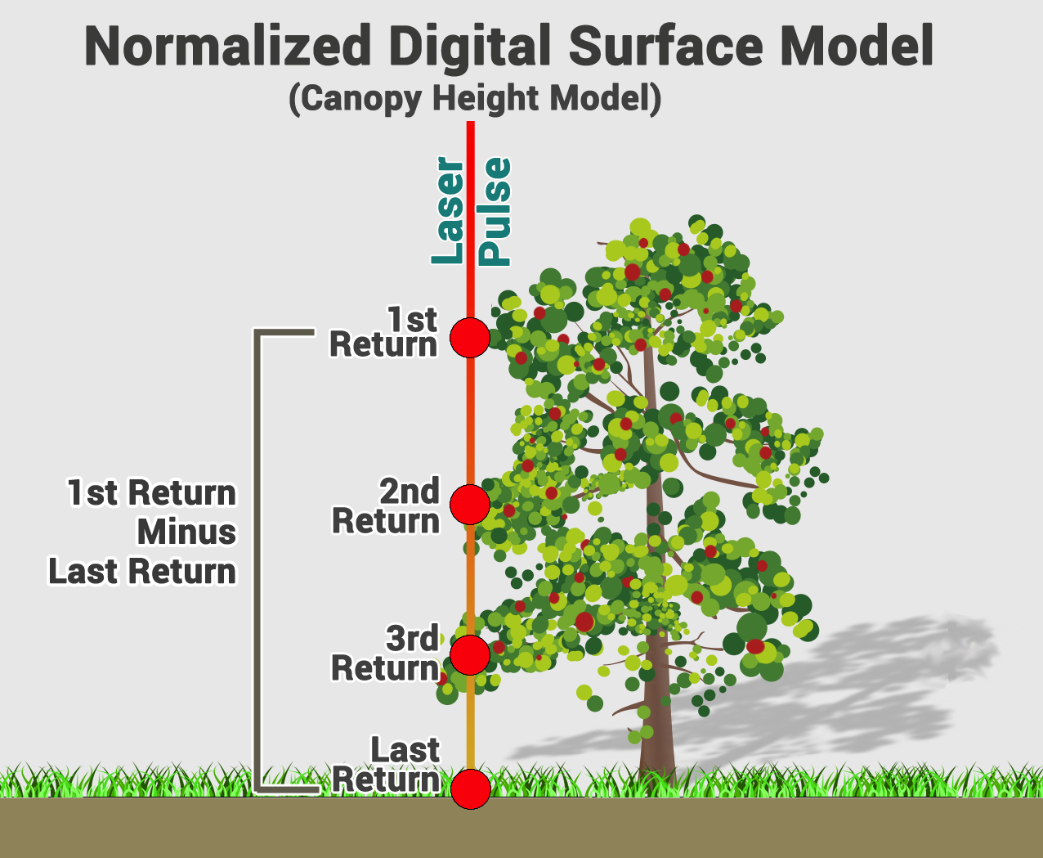
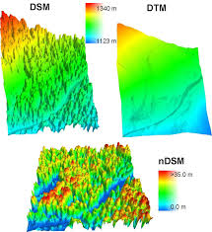
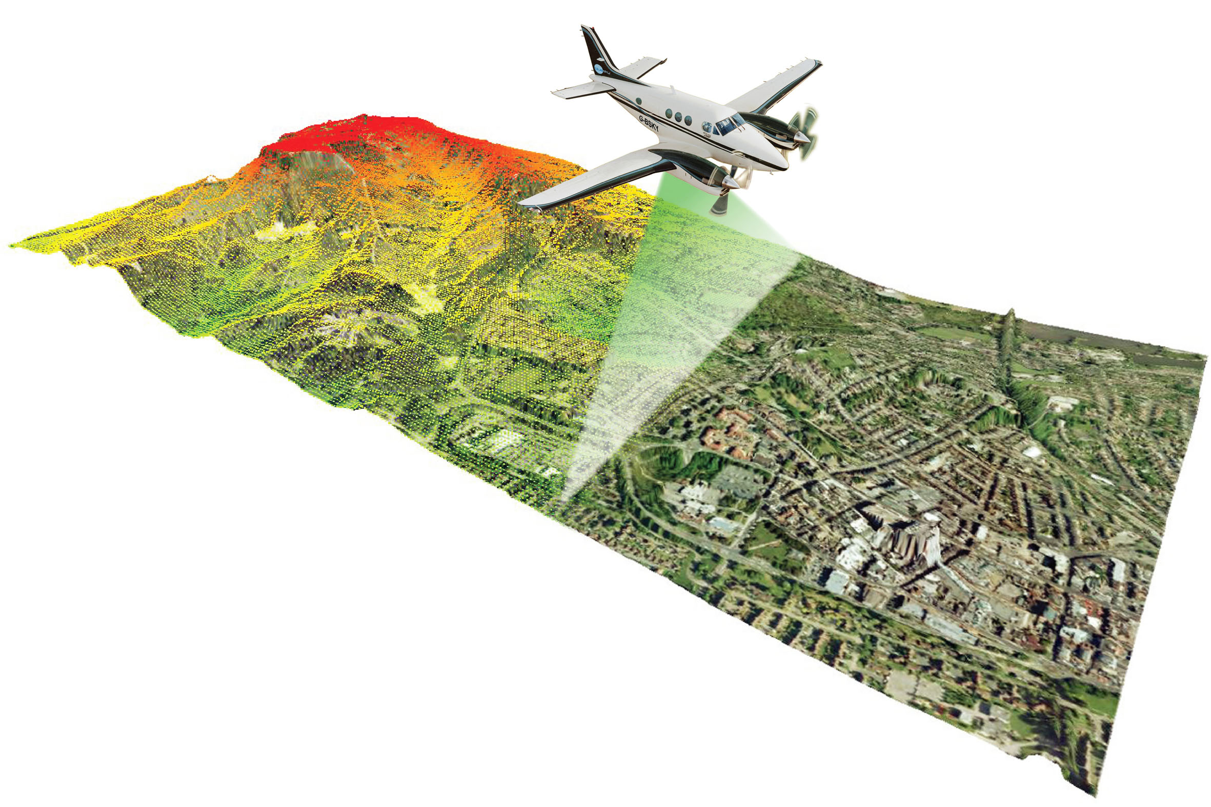
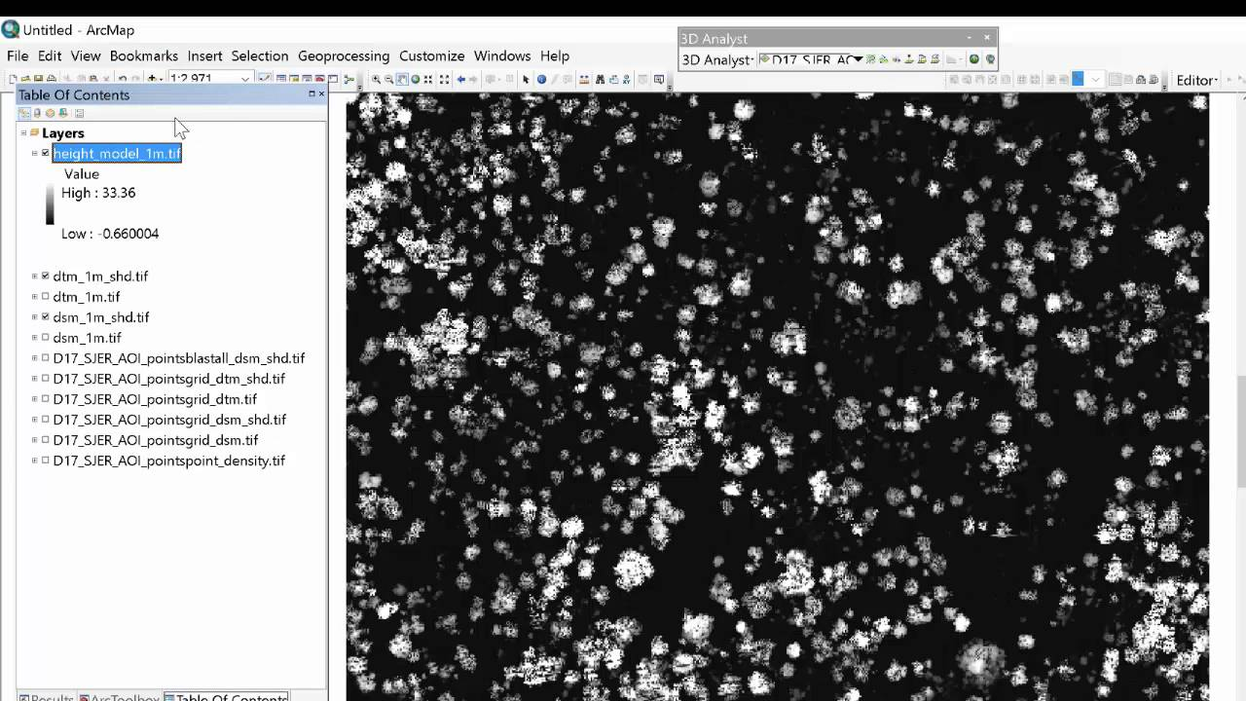
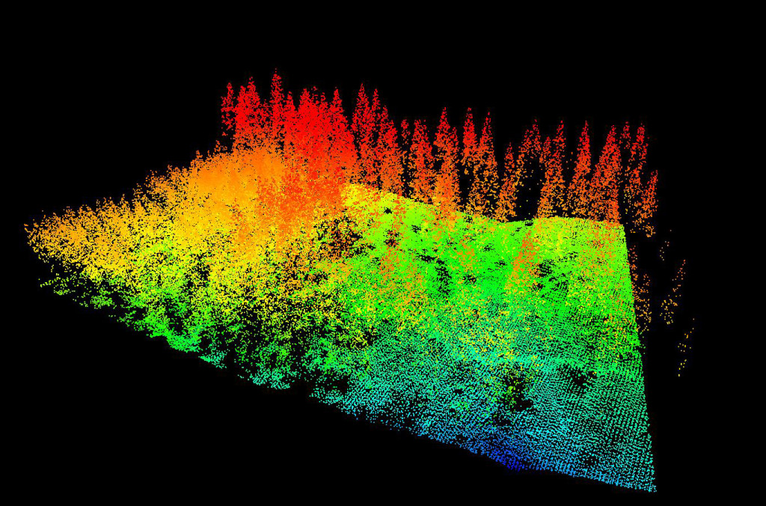
Canopy Height Models
Lidar point cloud over vegetated area collected
Digital Surface Model (DSM) and Digital Terrain Model (DTM) created
DTM subtracted from DSM to create a Canopy Height Model (CHM)
Lidar point cloud processed and classified
Notes:
A Canopy Height Model (CHM) can be thought of as a 3-dimensional representation of the canopy of vegetated ground features that can be expressed as an irregular line network, a classified raster, or point cloud.
The extraction process begins with the collection of the lidar data over the vegetated area. This data is then processed and classified to separate ground points from canopy points. The classified point cloud is then used to generate a digital representation of a combination of the surface features and the ground called a Digital Surface Model (DSM). It is also used to generate a digital representation of the bare earth surface called a Digital Terrain Model (DTM). Once these two rasters are produced, the DEM can be subtracted from the DSM in a geoprocessing environment to extract the Canopy Height Model (CHM). The final CHM product represents a volumetric field that can clue researchers in on where to take allometric measurements in the field and to determine the extent of representation that would be agreeable in the data.
BLUF: BY COLLECTING AND PROCESSING AIRBORNE LASER ALTIMETRY DATA OVER VEGETATED AREAS, RESEARCHERS CAN GENERATE REPRESENTATIVE MODELS OF THE CANOPY STRUCTURE THAT CAN BE USED TO RELATE FOREST HEALTH TO CARBON STOCK MONITORING. WHILE EXISTING RESEARCH DOCUMENTS CANOPY EXTRACTION WORKFLOWS FOR TRADITIONAL TEMPERATE/TROPICAL FORESTS, AND EVEN MATURE MANGROVES TO A CERTAIN DEGREE, NONE ARE WELL-DOCUMENTED FOR SHRUB MANGROVES ON THE FRINGES OF BORDERING CLIMATE ZONES SUCH AS THOSE PRESENT ALONG THE NORTHERN GULF COAST.

Slide 8
Vertical Return Structure Issues
Open ground point among several mangroves
Mangroves
Notes:
One of the main issues with processing point clouds collected over shrub-mangrove dominated wetlands is the lack of ground points present beneath the canopy. This is due to the fact that the shrub mangrove vegetation is so thick that hardly any laser pulses get through the dense canopy and onto the ground floor. The resulting point cloud will have single returns only and it is difficult to extract a CHM using traditional methods applied to terrestrial forests.
In theory, if the collection flights lines were designed in such a way as to derive very dense point clouds, enough ground points might emerge to derive a bare earth surface for use in generating a DTM and derivative CHM. One of the primary goals of this project is to determine if that can be accomplished with a sufficiently dense point cloud.

Slide 9
Goals of the Project
Goals of the Project:
Develop an accurate method for extracting mangrove features over coastal wetlands using Object-Based Imagery Analysis (OBIA) in eCognition Developer.
Develop an accurate method for creating Canopy Height Models (CHM) of shrub mangroves using feature extraction tools and lidar data in LP360.
Determine the degree of influence that scale plays in OBIA image classification and point cloud classification of shrub mangroves.
Determine if these methods could be used to improve the study of global carbon budget estimates for coastal environments.

Slide 10
Study Area
Coastal Louisiana
Port Fourchon AOI
Image Source: Google Earth
Image Source: USDA NAIP
Notes:
The study area is located in the Terrebonne Parish of coastal Louisiana adjacent to Port Fourchon. The area consists of shrub-mangrove dominated wetlands with brackish water, salt grass, and black mangroves. The study area is covered by 6 lidar tiles and an NAIP image from the corresponding year.

Slide 11
Data Sources
NAIP Imagery
Collection Date: | 20150430
Sensor: | Leica ADS100
Platform: | Cessna Conquest / Cessna 414
Altitude: | 16,000ft AGL
Ground Sample Distance (GSD): | 1-meter
Spatial Reference System: | NAD83 UTM Zone 15N
Bands: | 4, R/G/B + NIR
Bit Depth: | 8-bit, 0-255
Data Format: | JPEG 2000
Lidar Point Cloud
Collection Date: | 20150213
Data Format: | LAS v1.2
Assigned Classes: | 1, 2, 7, 9, 10, 17, 18
Nominal Point Spacing: | 0.39 meters
Nominal Point Density: | 6.36 pts / square meter
Spatial Reference System: | NAD83 UTM Zone 15N
Vertical Datum: | NAVD88 (Geoid 12B)
Sensor: | Leica ALS70-HP
Vertical Accuracy Class: | 9.25cm (ASPRS ’14 Standard)
Notes:
***Leaf-on conditions vs leaf-off collection
***Due to date offset, ground points flagged may not appear legit when checked on imagery

Slide 12
Software Packages & Tools
ArcGIS Desktop v10.6
Reclassify Raster
Raster to Polygon Conversion
Raster Calculator
Surface Volume
eCognition Developer v9.3
Multi-Resolution Segmentation
Image Object Classification
Object Merge
Region Grow
Threshold Class Assignment
Export Vector Layer
LP360 Advanced
Point Cloud Task (PCT) Macro
Classify by Feature PCT
2D/3D Breakline Tools
Classify by Statistics PCT
Conflation PCT
Filtering PCTs
Export Wizard (DSM/DEM Products)

Slide 13
Workflow Overview
Segment NAIP Image into Large Scale Objects and Classify Image
In eCognition
Segment Large Scale Objects into Smaller Scale Objects and Classify Mangroves
Export Mangrove Shapefile for Use in LP360
Accuracy Assessment of Classification
Classify Mangrove Points by Feature Using Polygons from OBIA Export
In LP360
Generate DSM & DEM Using Classes 2, 9, and Custom Mangrove Class
Generate nDSM for Mangrove Canopy Height Model
In ArcGIS
Calculate Area Coverage & Above Ground Biomass Volume for Tables
Generate Derivative Cartographic Products
Notes:
BLUF: Pre-processing of images in ArcMap, image classification and 2D feature extraction in eCognition, accuracy assessment in ArcMap to validate 2D classification & extraction, point cloud classification and 3D feature extraction in LP360, canopy height model generation, baseline comparisons, above ground biomass estimation (volume differencing via nDSM), and derivative graphics generated in ArcMap.

Slide 14
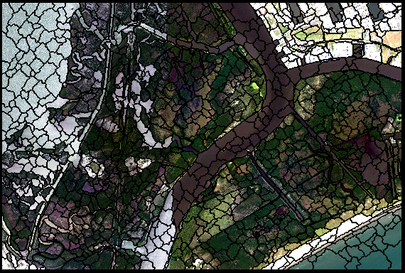
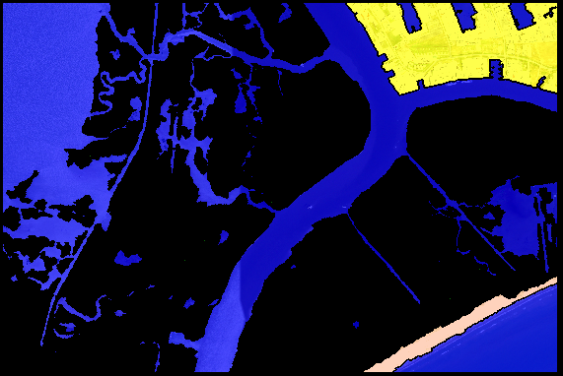
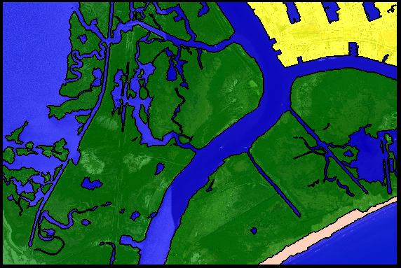
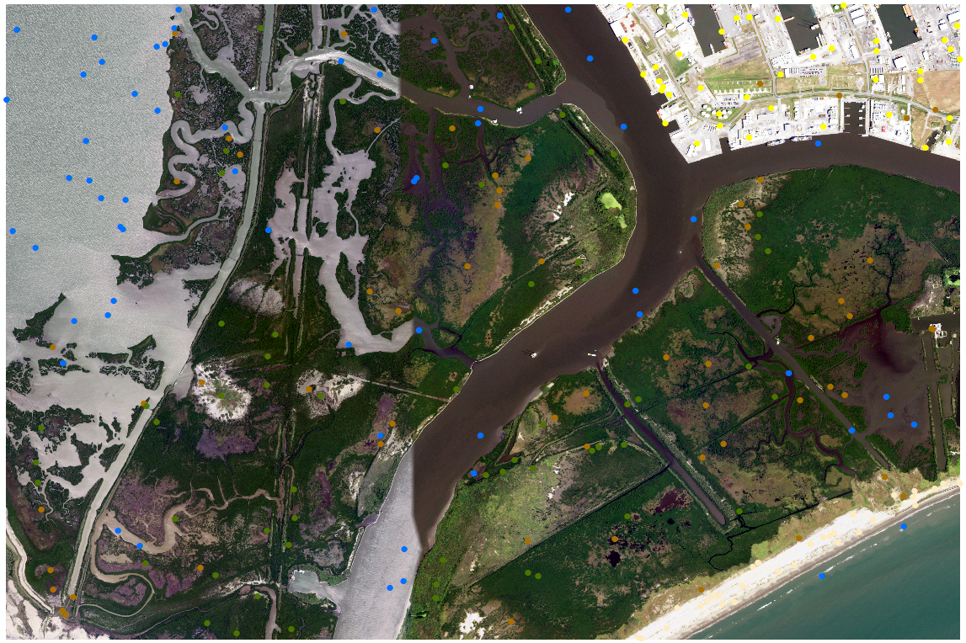
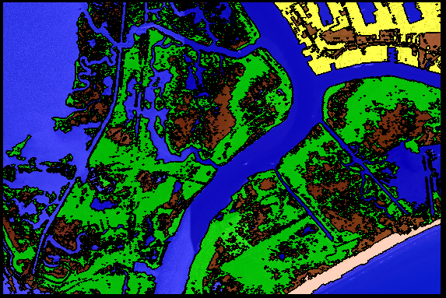
Image Classification Methodology
Multi-Resolution Segmentation (Initial Objects)
Multi-Resolution Segmentation (Wetland Objects)
3
1
In eCognition
In ArcGIS
2
Classify Initial Objects
Classification Accuracy Assessment
Classify Second-Order Objects
5
4
Export Classified Polygons:
Final Merged Objects Exported as Polygon Shapefile
Import Polygons in ArcGIS
1/15/2019
Travis Meyer
14
Notes:
1) Multi-Resolution Segmentation (Initial Objects):
RGB: 1
NIR: 2
Scale: 50
Shape 0.8
Compactness 0.5
2) Classify Initial Objects
Classify Water: NDWI, VBNIR
Classify Mangroves: NDVI, CIR Ratio, GRVI
Classify Earth/Grass: Mean Brightness < 150, Mean NDVI < 0
Missed Objects / Reclassified Objects
Merge Objects by Class
3) Export Classified Polygons
Final Merged Objects Exported as Polygon Shapefile
4) Classification Accuracy Assessment
300 Accuracy Test Points
Earth/Grass-100, Mangrove-100, Water-100 (Stratified, equal area)
Randomly Distributed Test Points

Slide 15
Classification Accuracy
Notes:
Classification Accuracy Assessment
250 Accuracy Test Points
Stratified Distribution (Beach-30, Built-40, Earth/Grass-60, Mangrove-60, Water-60)
Randomly Distributed Test Points

Slide 16
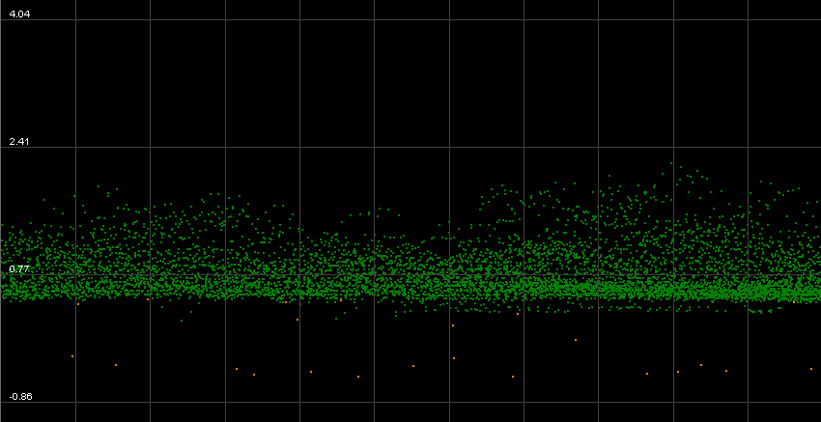
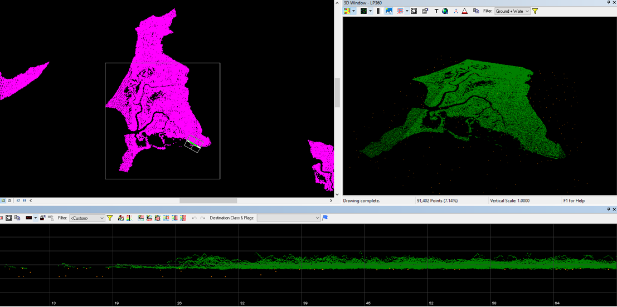
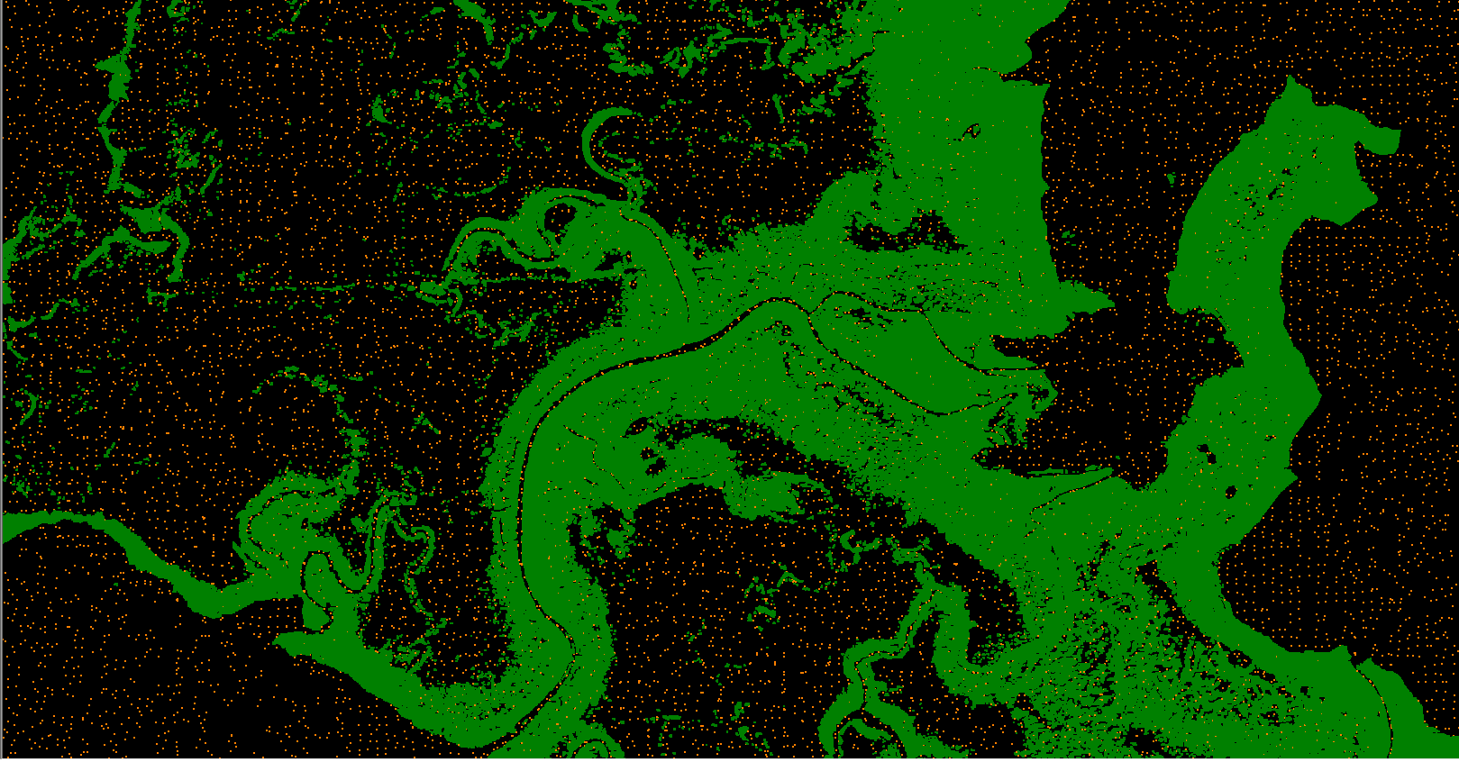
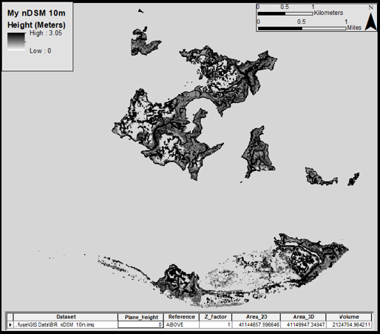
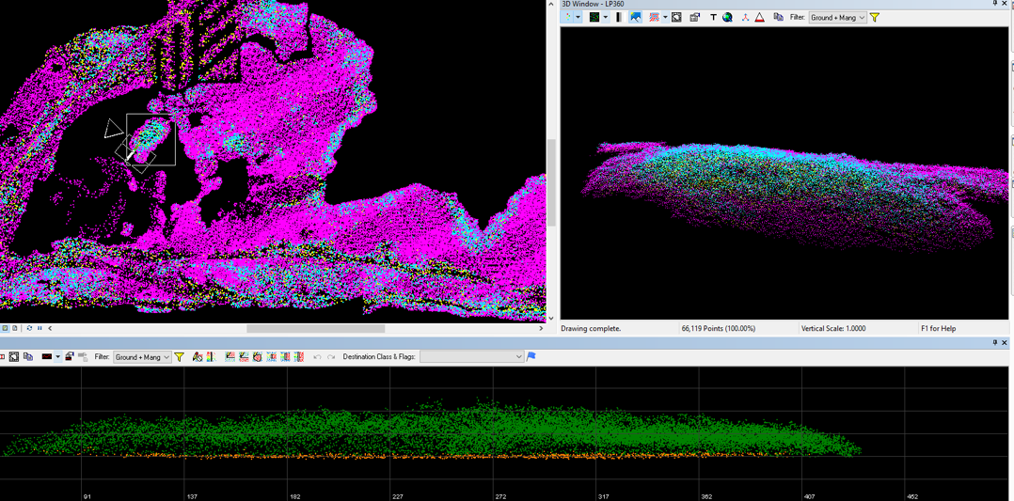
Canopy Extraction Methodology
Classify Ground Seed Points
1
LP360
In ArcGIS
2
Generate DSM
Classify By Feature
5
4
Generate Canopy Height Model
Generate DEM
3
Export Elevation Models
Export DEM & DSM in .img format
Import to ArcGIS
1/15/2019
Travis Meyer
16
Notes:
1) Classify Ground Seed Points:
Classify by Statistics
5m, 10m, 20m Grid, Min Z Value
x5 iterations per grid, 6 min points per grid square
2) Classify By Feature:
Mangrove Polygon from eCognition Export
Classifies all Mangrove Points and Assigns them to Mangrove Class
Scale of 3, 5, 10 shapefiles for point classification
3) Generate DSM
Class 2 (Ground) & 3 (Mangroves) Points Only
Inverse Distance Weighted, 1m*
4) Generate DEM
Class 2 (Ground) Only
Inverse Distance Weighted, 1m*
5) Export Elevation Models:
Export DEM & DSM in .img format
6) Generate Canopy Height Model
Subtract the DEM from the DSM to Generate the Canopy Height Model
Calculate Areal Extent & Above-Ground Biomass Volume

Slide 17
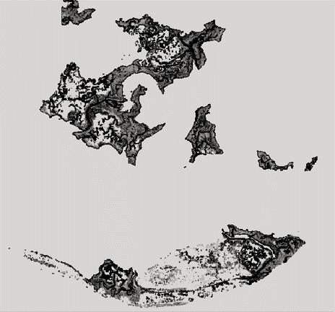
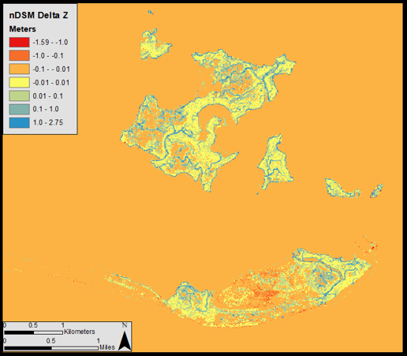
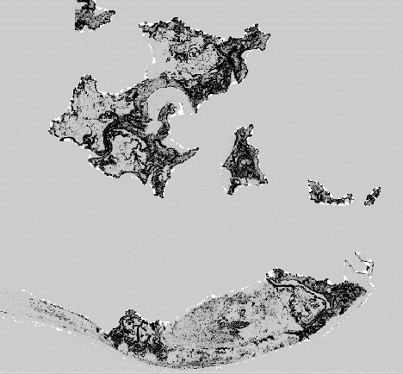
Canopy Height Model Comparison
Surface Volume Differencing Operation in ArcGIS
Notes:
Differencing operations between the surface volume of one CHM and another can be used to determine the influence of ground filtering and scale on CHM generation
By quantifying the degree of departure from the most accurate CHM model, the other 8 CHMs can be used to determine which aspect of scale—whether in the OBIA process or the ground filtering process—plays the biggest role in determining the model accuracy.

Slide 18
Baseline Comparisons
 | 5m Ground Sampling | 10m Ground Sampling | 20m Ground Sampling
OBIA Scale of 3 | Area: 10,633 sqr km Volume: 773,801 cu m | Area: 10,700 sqr km Volume: 848,588 cu m | Area: 11,074 sqr km Volume: 2,493,347 cu m
OBIA Scale of 5 | Area: 10,633 sqr km Volume: 756,300 cu m | Area: 10,881 sqr km Volume: 1,520,329 cu m | Area: 11,073 sqr km Volume: 2,391,254 cu m
OBIA Scale of 10 | Area: 10,693 sqr km Volume: 633,495 cu m | Area: 11,034 sqr km Volume: 1,280,187 cu m | Area: 11,097 sqr km Volume: 2,000,656 cu m
Notes:
BLUF: There is substantially more degradation in accuracy via opening the ground filtering window than increasing the scale of objects.

Slide 19
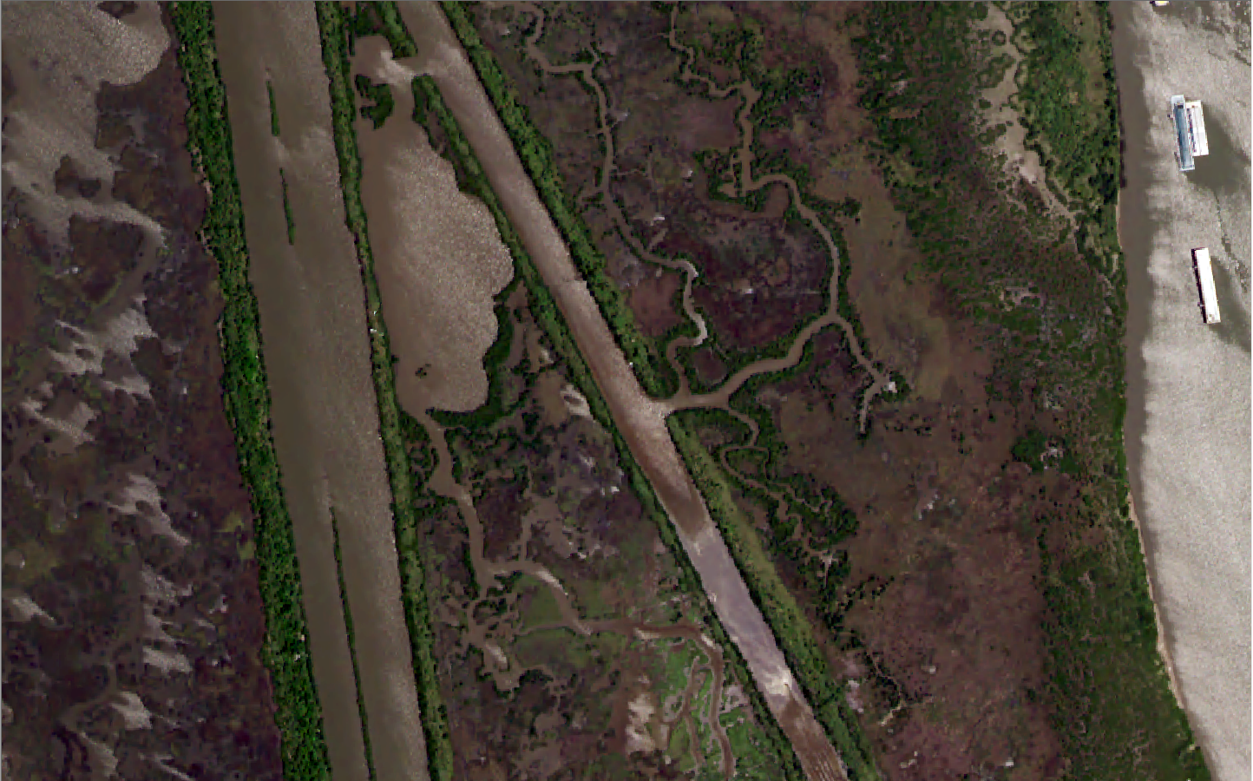
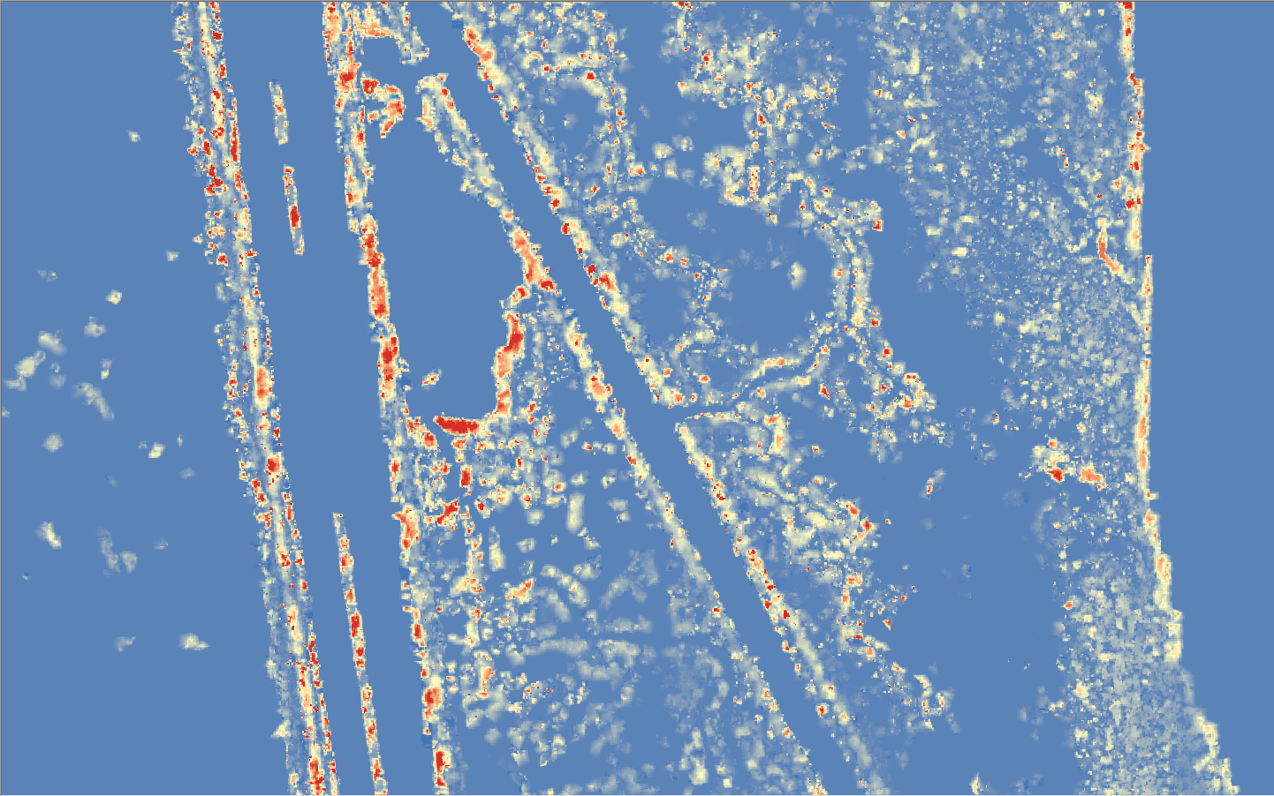
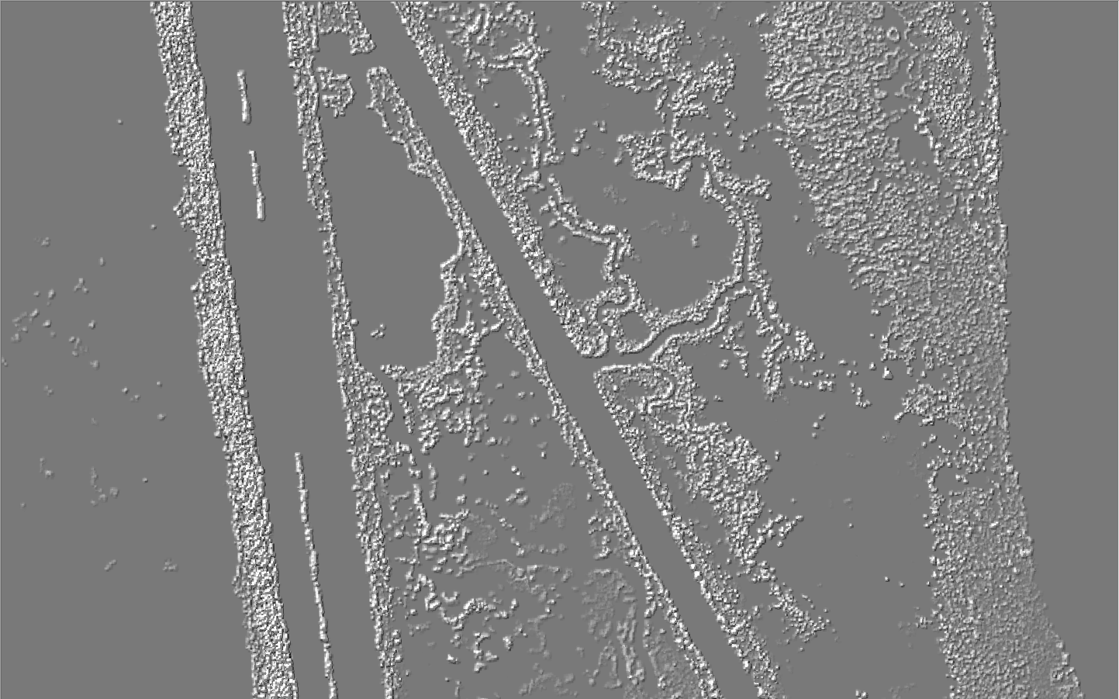
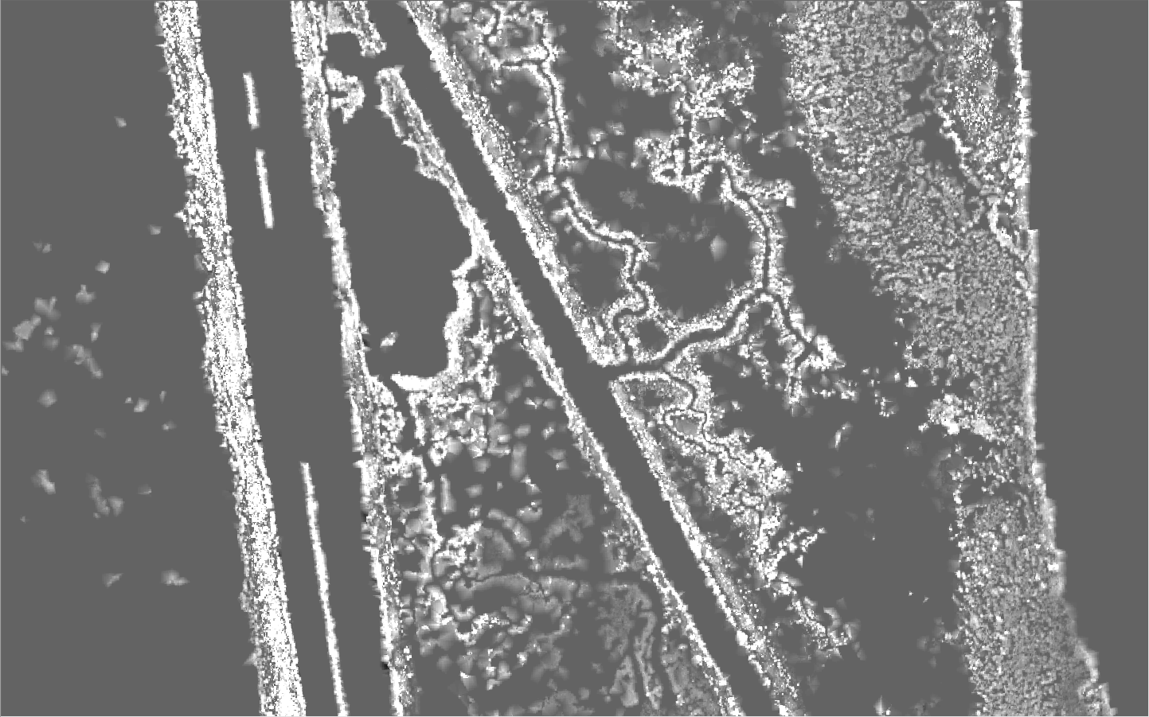
Baseline Comparisons: S3 10x5
Original NAIP Image Subset
S3 10x5 vs Baseline
Δ Area: 67 sqr km
Δ Volume: 848,588 cu m
Baseline S3 5x5 w/ Hillshade
S3 10x5 CHM
Area: 10,633 sqr km
Volume: 773,801 cu m
Area: 10,700 sqr km
Volume: 848,588 cu m
Notes:
BLUF: Highlight what each quad represents and then keep it moving. Remember that ground filtering scale affects accuracy more than object scale.

Slide 20
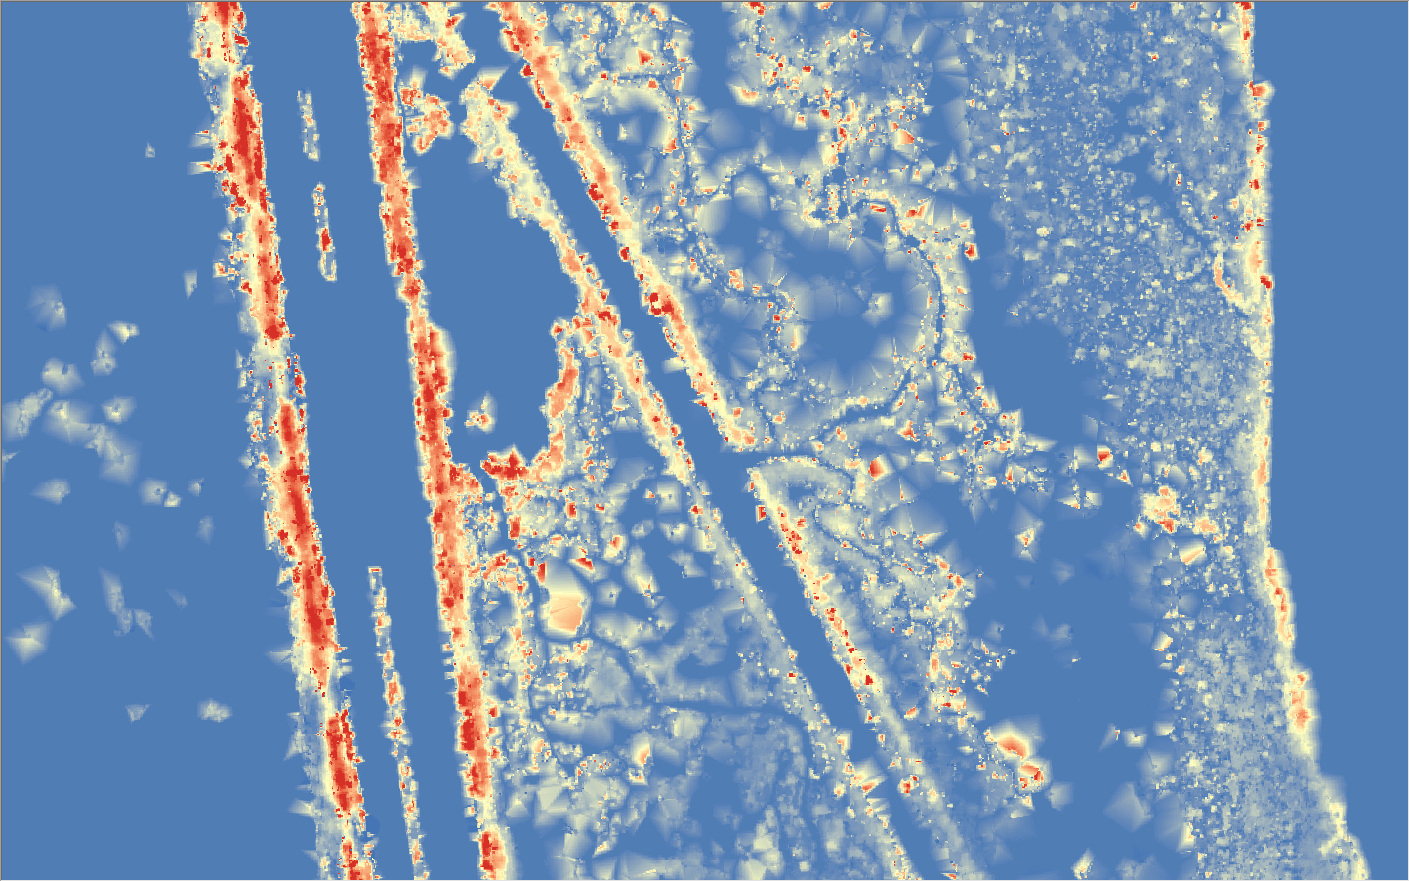
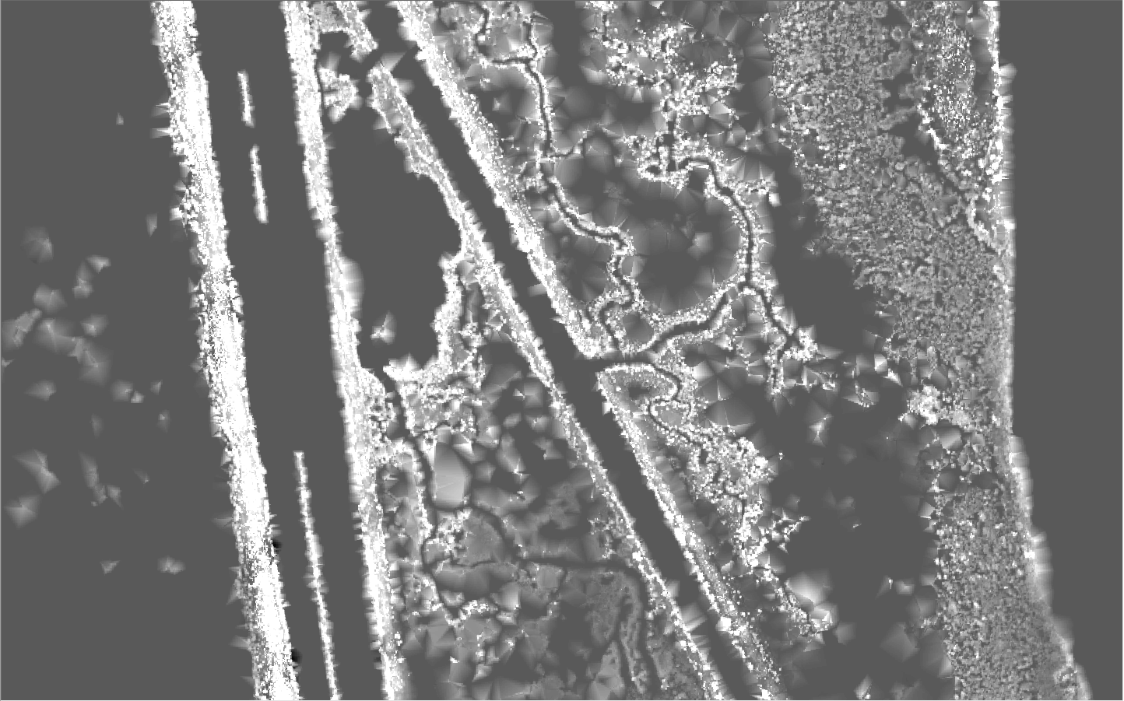
Baseline Comparisons: S3 20x5
Original NAIP Image Subset
S3 20x5 vs Baseline
Δ Area: 441 sqr km
Δ Volume: 1,719,546 cu m
Baseline S3 5x5 w/ Hillshade
S3 20x5 CHM
Area: 10,633 sqr km
Volume: 773,801 cu m
Area: 11,074 sqr km
Volume: 2,493,347 cu m

Slide 21
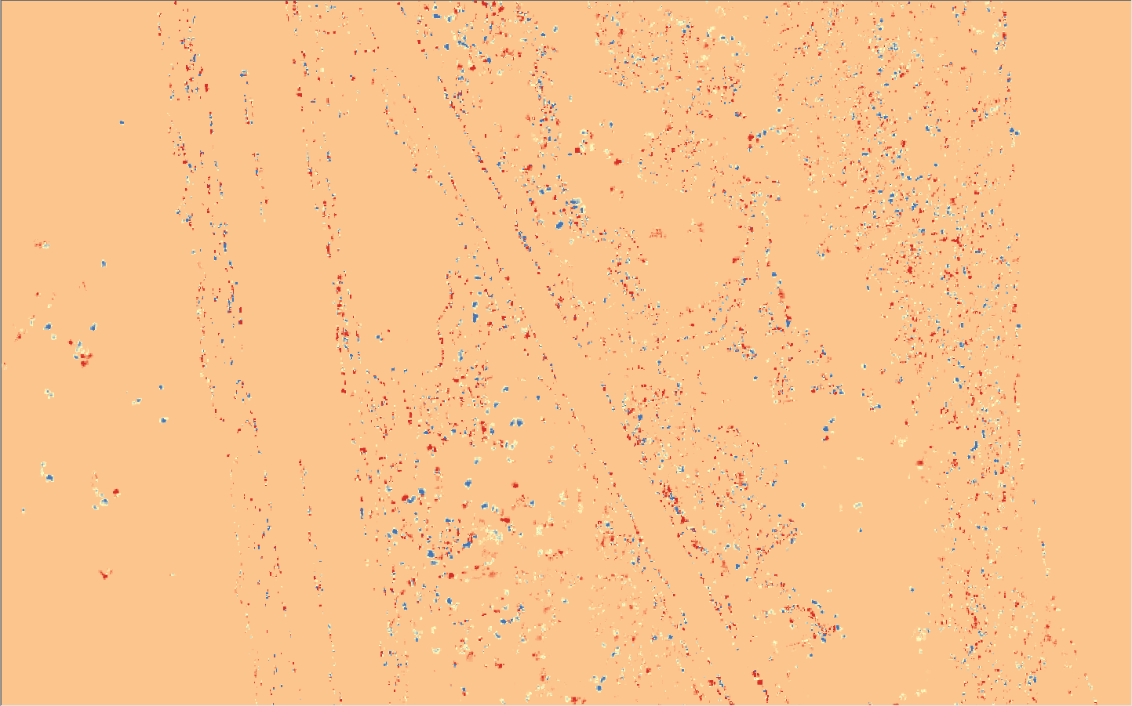
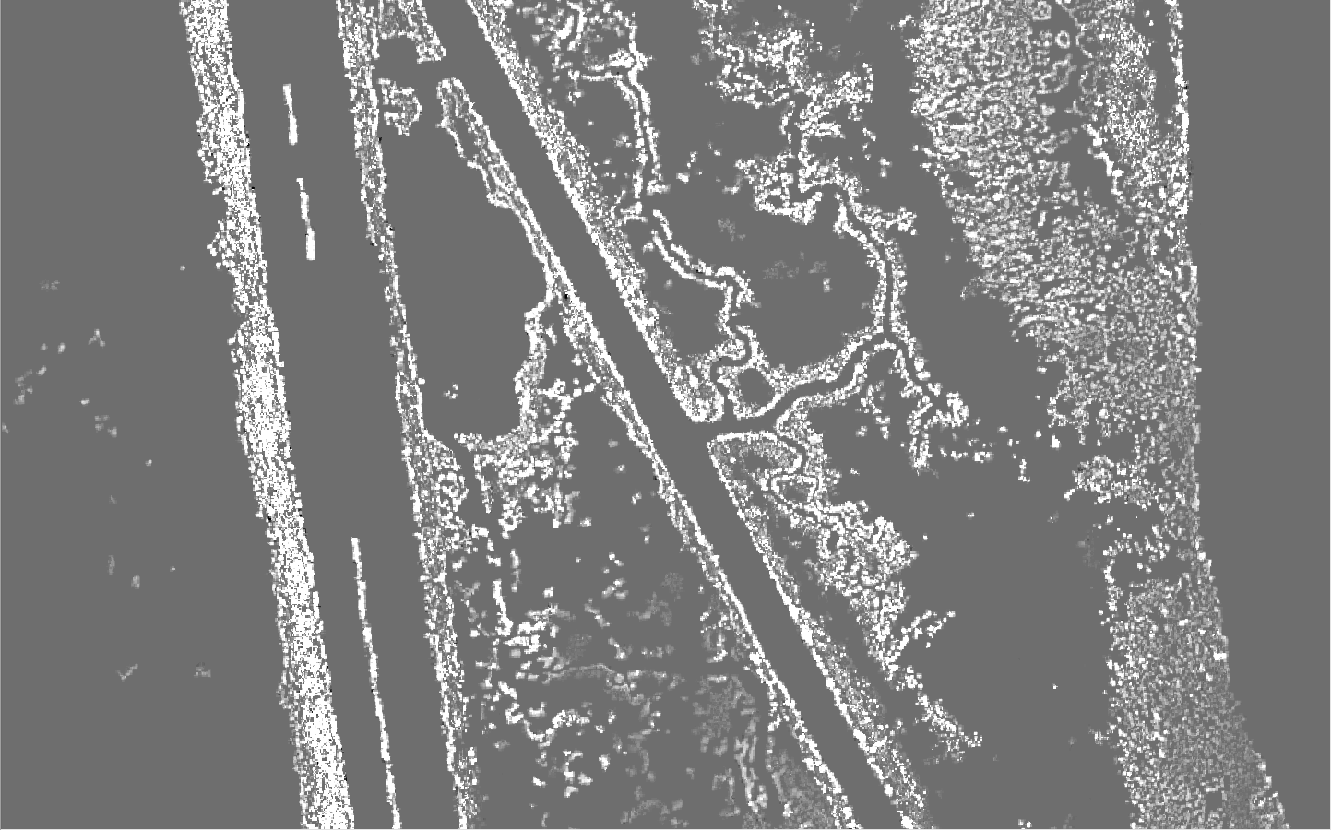
Baseline Comparisons: S5 5x5
Original NAIP Image Subset
S5 5x5 vs Baseline
Δ Area: 0 sqr km
Δ Volume: -17,501 cu m
Baseline S3 5x5 w/ Hillshade
S5 5x5 CHM
Area: 10,633 sqr km
Volume: 773,801 cu m
Area: 10,633 sqr km
Volume: 756,300 cu m

Slide 22
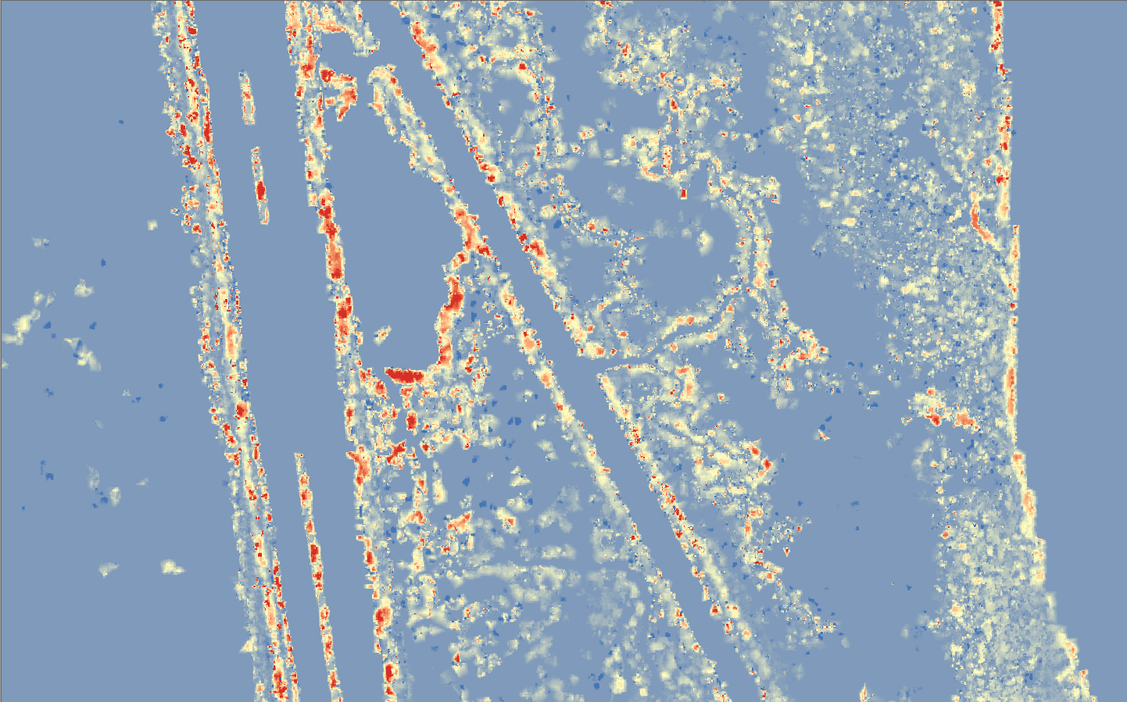
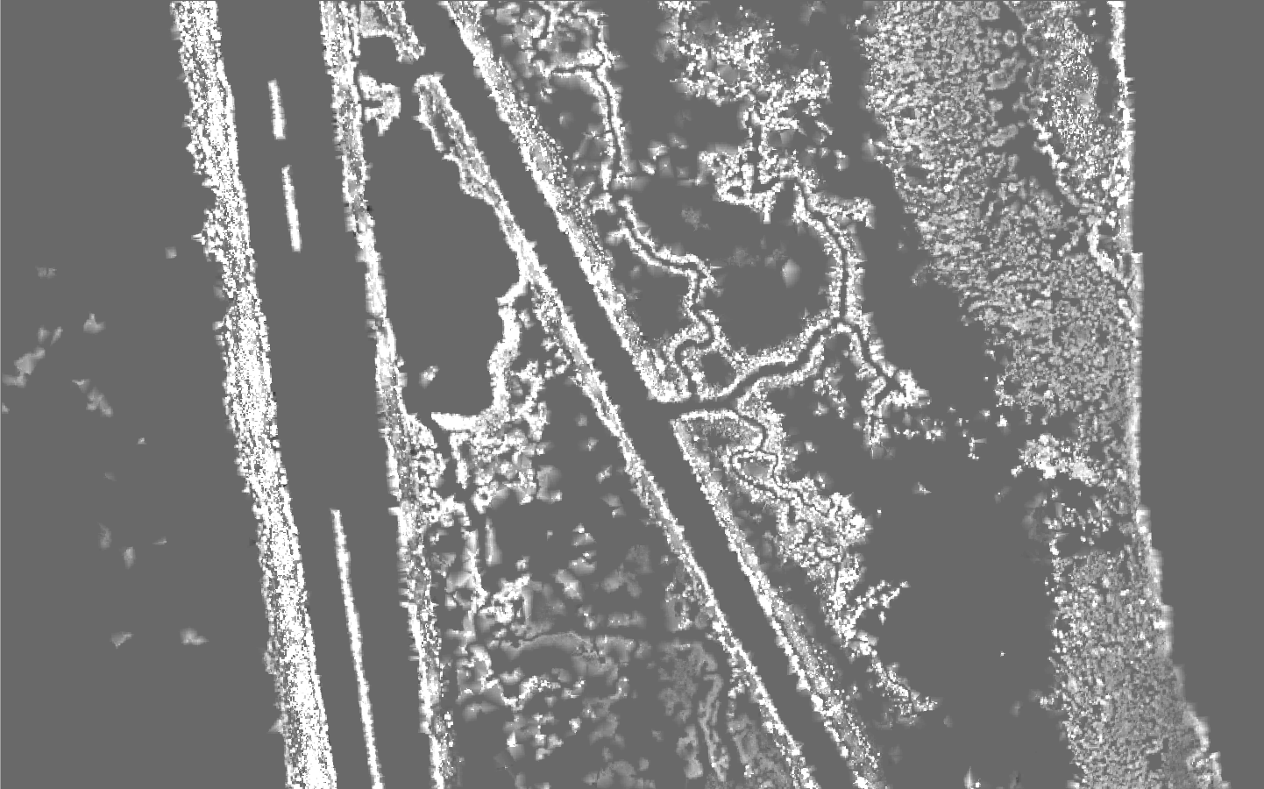
Baseline Comparisons: S5 10x5
Original NAIP Image Subset
S5 10x5 vs Baseline
Δ Area: 254 sqr km
Δ Volume: 746,528 cu m
Baseline S3 5x5 w/ Hillshade
S5 10x5 CHM
Area: 10,633 sqr km
Volume: 773,801 cu m
Area: 10,881 sqr km
Volume: 1,520,329 cu m

Slide 23
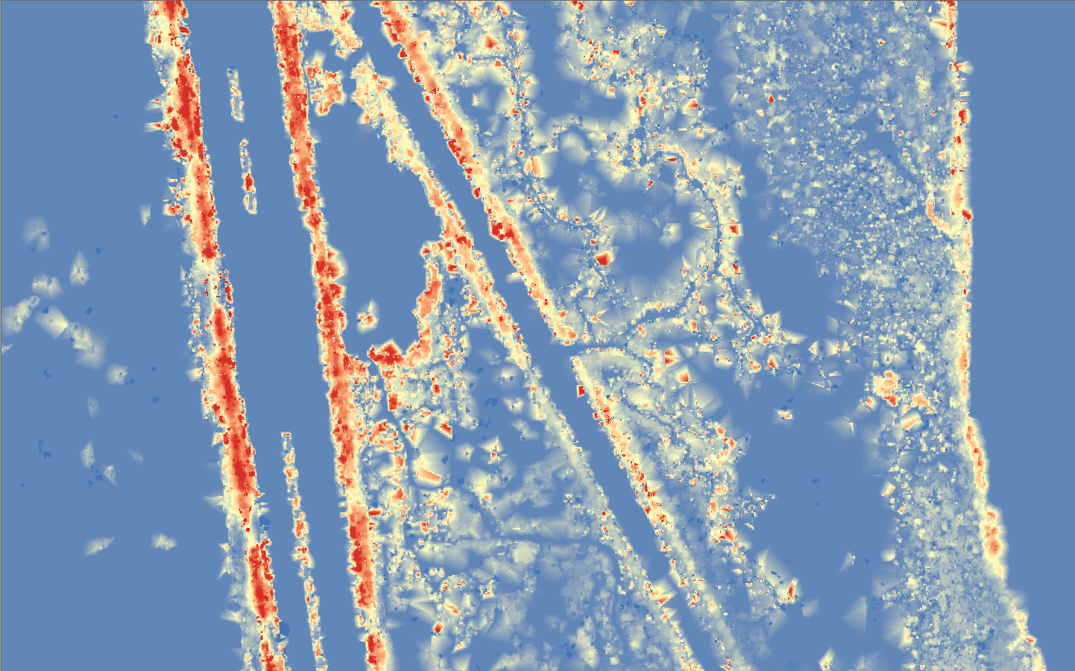
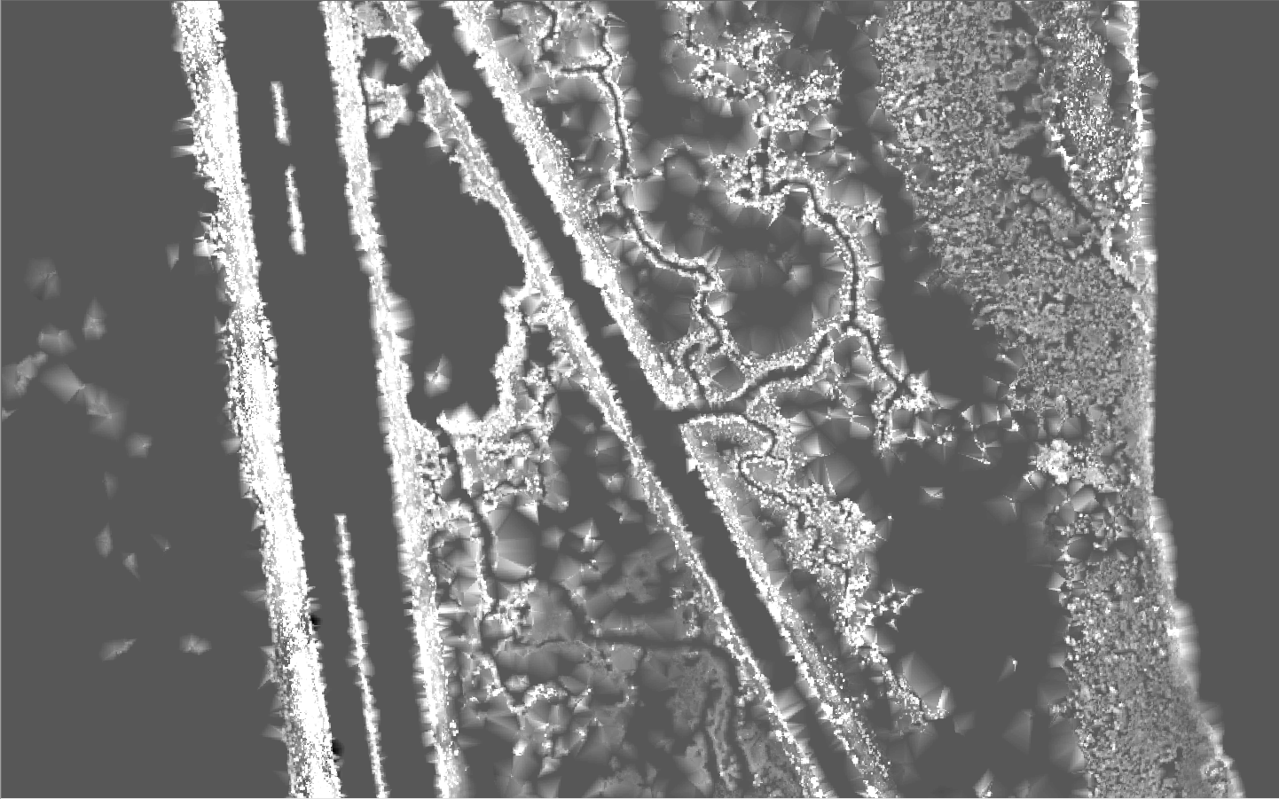
Baseline Comparisons: S5 20x5
Original NAIP Image Subset
S5 20x5 vs Baseline
Δ Area: 440 sqr km
Δ Volume: 1,617,453 cu m
Baseline S3 5x5 w/ Hillshade
S5 20x5 CHM
Area: 10,633 sqr km
Volume: 773,801 cu m
Area: 11,073 sqr km
Volume: 2,391,254 cu m

Slide 24
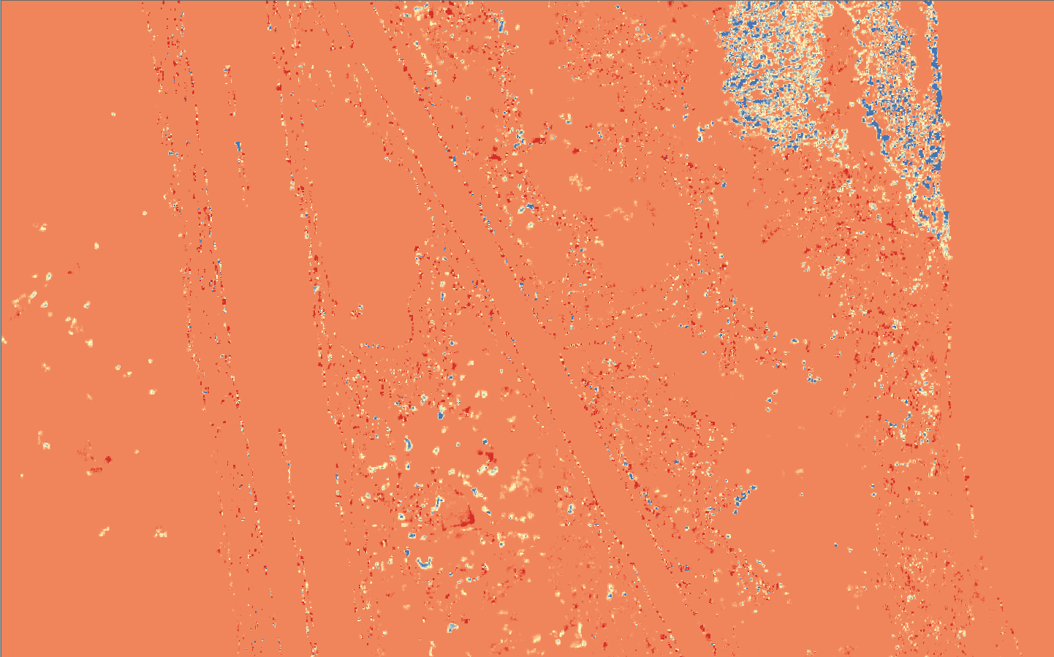
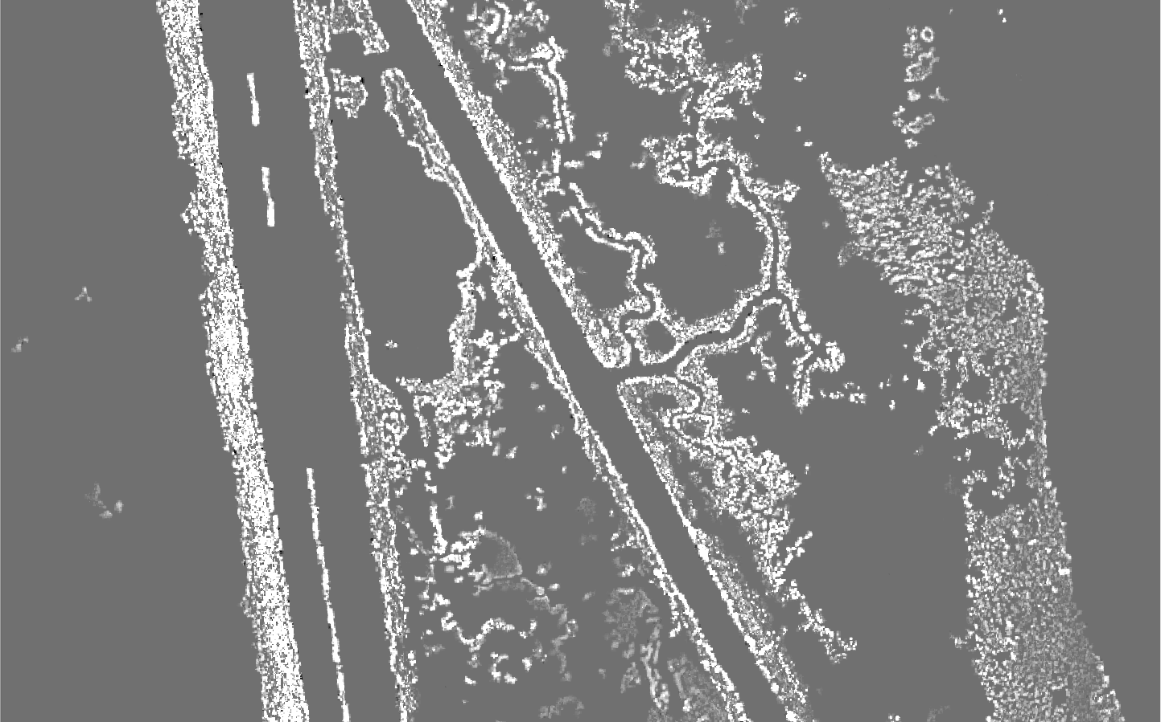
Baseline Comparisons: S10 5x5
Original NAIP Image Subset
S10 5x5 vs Baseline
Larger scale size for OBIA resulted in misclassified water
Δ Area: 60 sqr km
Δ Volume: -100,306 cu m
Baseline S3 5x5 w/ Hillshade
S10 5x5 CHM
Area: 10,633 sqr km
Volume: 773,801 cu m
Area: 10,693 sqr km
Volume: 633,495 cu m

Slide 25
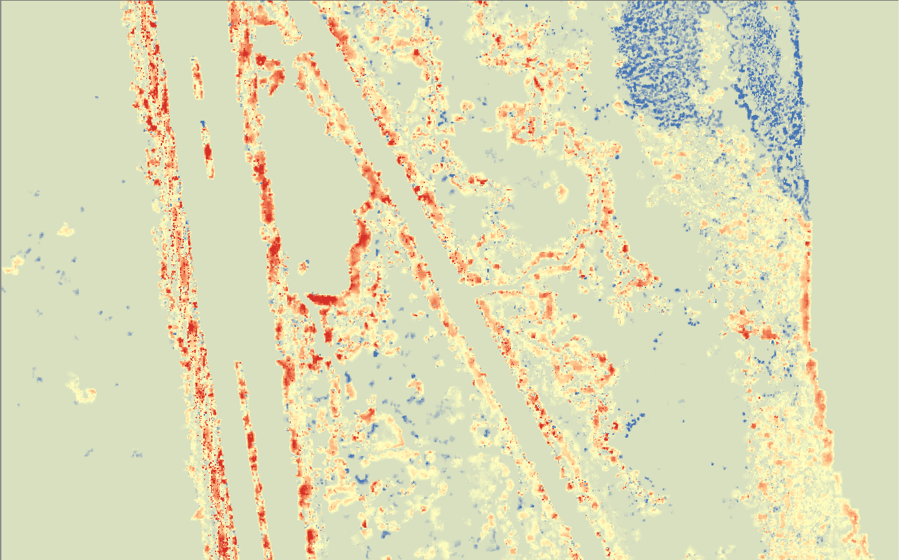
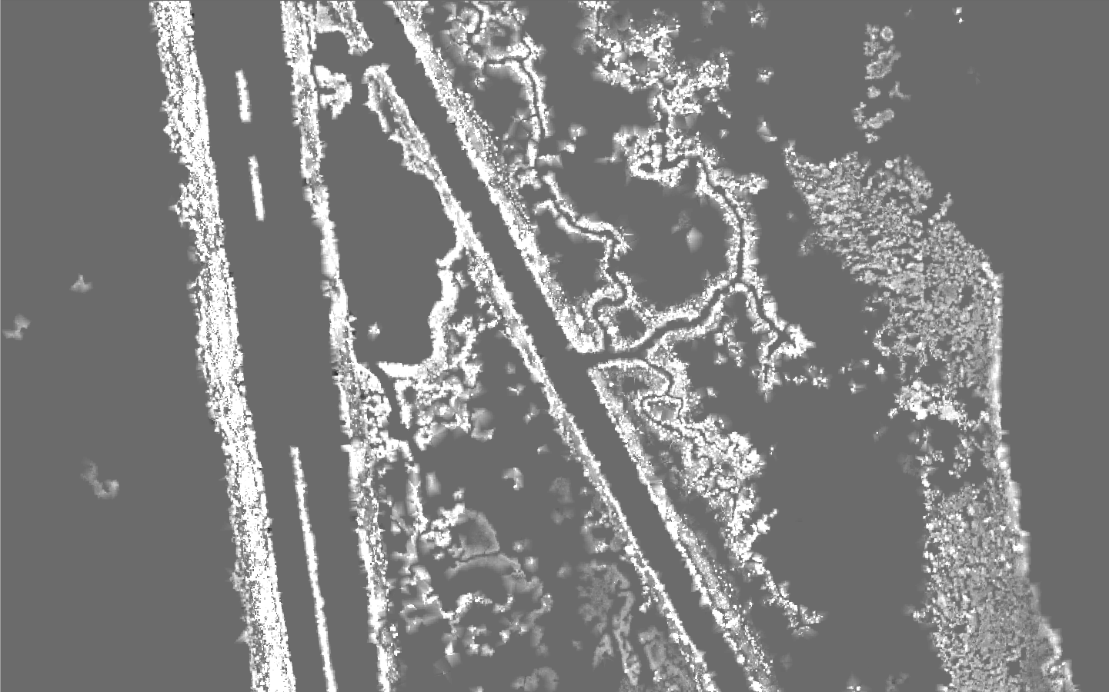
Baseline Comparisons: S10 10x5
Original NAIP Image Subset
S10 10x5 vs Baseline
Larger scale size for OBIA resulted in misclassified water
Δ Area: 401 sqr km
Δ Volume: 506,386 cu m
Baseline S3 5x5 w/ Hillshade
S10 10x5 CHM
Area: 10,633 sqr km
Volume: 773,801 cu m
Area: 11,034 sqr km
Volume: 1,280,187 cu m

Slide 26
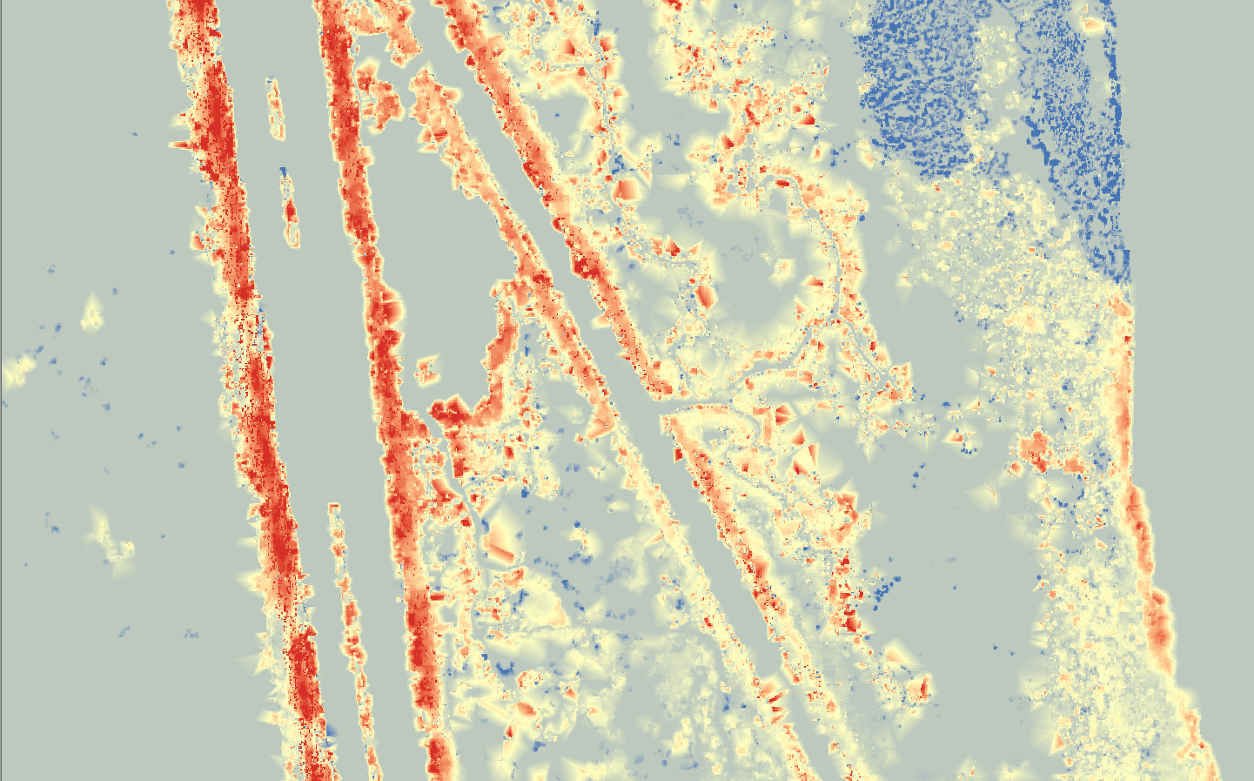
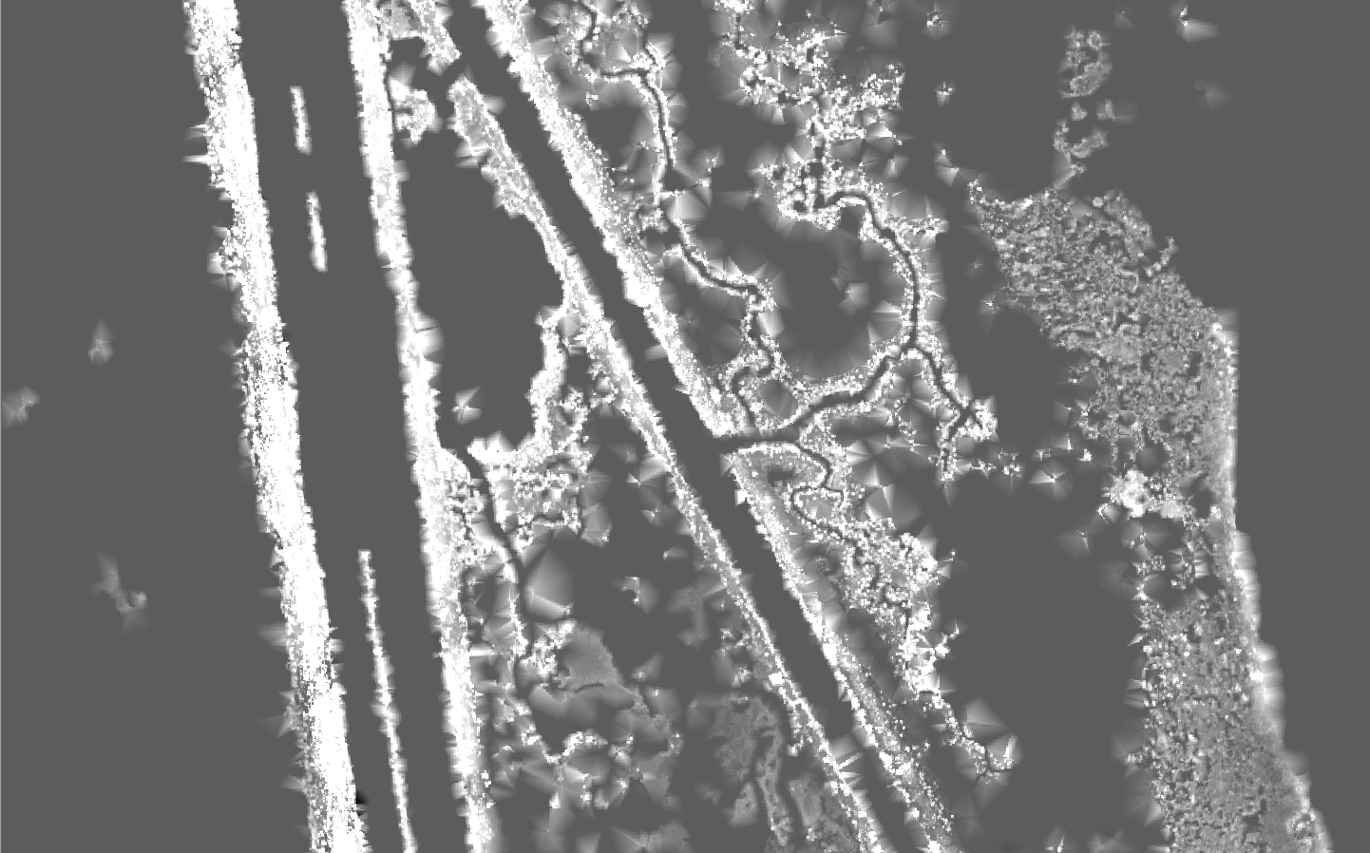
Baseline Comparisons: S20 10x5
Original NAIP Image Subset
S10 20x5 vs Baseline
Larger scale size for OBIA resulted in misclassified water
Δ Area: 464 sqr km
Δ Volume: 1,226,855 cu m
Baseline S3 5x5 w/ Hillshade
S10 20x5 CHM
Area: 10,633 sqr km
Volume: 773,801 cu m
Area: 11,097 sqr km
Volume: 2,000,656 cu m

Slide 27
Project Goals & Results
Develop an accurate method for extracting mangrove features over coastal wetlands using ground filtering of dense point clouds and OBIA.
Results: The methods developed successfully extracted mangroves.
Define the degree of influence that scale plays in generating an accurate CHM.
Results: Scales of ground filtering are more significant than scales of object classification. Object classification should be kept at scales below 5 in eCog.
Determine if these methods could be used to improve the study of global carbon budget estimates for coastal environments.
Results: These methods *can* be used to improve the study of global carbon budget estimates for coastal environments.

Slide 28
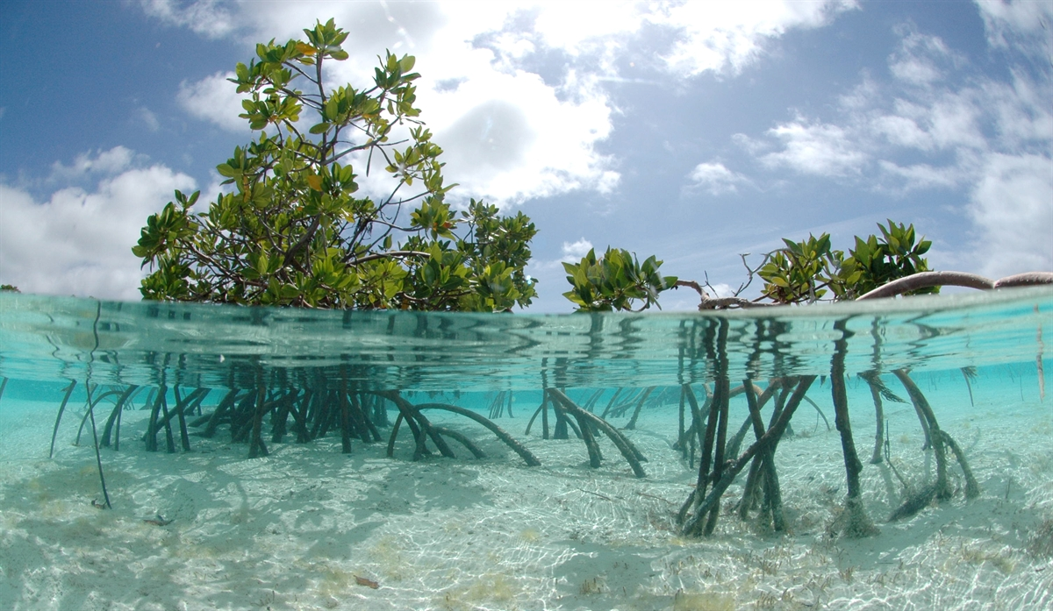
Questions?
Questions?
Notes:
Possible Questions:

Slide 29
References
OBIA & Mangrove Forests
Alatorre, Luis C., et al. "Identification of mangrove areas by remote sensing: The ROC curve technique applied to the northwestern Mexico coastal zone using Landsat imagery." Remote Sensing 3.8 (2011): 1568-1583.
Alsumaiti, Tareefa. "Structure, Aboveground Biomass, and Soil Characterization of Avicennia marina in Eastern Mangrove Lagoon National Park, Abu Dhabi." (2014).
Boegh, Eva, et al. "Airborne multispectral data for quantifying leaf area index, nitrogen concentration, and photosynthetic efficiency in agriculture." Remote sensing of Environment 81.2-3 (2002): 179-193.
Bouillon, Steven, et al. "Mangrove production and carbon sinks: a revision of global budget estimates." Global Biogeochemical Cycles 22.2 (2008).
Dronova, Iryna. "Object-based image analysis in wetland research: A review." Remote Sensing 7.5 (2015): 6380-6413.
Everitt, J. H., et al. "Using high resolution satellite imagery to map black mangrove on the Texas Gulf Coast." Journal of Coastal Research (2008): 1582-1586.
Fatoyinbo, Lola. "Remote characterization of biomass measurements: case study of mangrove forests." Biomass. InTech, 2010.
Feliciano, Emanuelle A. "Multi-Scale Remote Sensing Assessments of Forested Wetlands: Applications to the Everglades National Park." (2015).
Giri, Chandra, Jordan Long, and Larry Tieszen. "Mapping and monitoring Louisiana's mangroves in the aftermath of the 2010 Gulf of Mexico oil spill." Journal of Coastal Research 27.6 (2011): 1059-1064.
Heenkenda, Muditha K., et al. "Mangrove species identification: Comparing WorldView-2 with aerial photographs." Remote Sensing 6.7 (2014): 6064-6088.

Slide 30
References
OBIA & Mangrove Forests Continued
Kamal, Muhammad, Stuart Phinn, and Kasper Johansen. "Characterizing the spatial structure of mangrove features for optimizing image-based mangrove mapping." Remote Sensing 6.2 (2014): 984-1006.
Karlson, Martin, Heather Reese, and Madelene Ostwald. "Tree crown mapping in managed woodlands (parklands) of semi-arid West Africa using WorldView-2 imagery and geographic object based image analysis." Sensors 14.12 (2014): 22643-22669.
Kauffman, J. Boone, et al. "Carbon stocks of intact mangroves and carbon emissions arising from their conversion in the Dominican Republic." Ecological Applications 24.3 (2014): 518-527.
Kauffman, J. Boone, and Daniel C. Donato. Protocols for the measurement, monitoring and reporting of structure, biomass, and carbon stocks in mangrove forests. Bogor, Indonesia: CIFOR, 2012.
Khosravipour, Anahita, et al. "Generating pit-free canopy height models from airborne lidar." Photogrammetric Engineering & Remote Sensing 80.9 (2014): 863-872.
Krause, G.; Bock, M.; Weiers, S.; Braun, G. Mapping land-cover and mangrove structures with remote sensing techniques: A contribution to a synoptic GIS in support of coastal management in North Brazil. Environ. Manage. 2004, 34, 429–440.
Lagomasino, David, et al. "A comparison of mangrove canopy height using multiple independent measurements from land, air, and space." Remote sensing 8.4 (2016): 327.
Luna, Donald A., et al. "Coastal Objects: Mangrove Area Extraction Using Remote Sensing and Aerial LiDAR Data in Roxas, Oriental Mindoro." Environment and Ecology Research 5.4 (2017): 282-288.
Maeda, Y., et al. "Estimating Carbon Stock Changes of Mangrove Forests Using Satellite Imagery and Airborne Lidar Data in the South Sumatra State, Indonesia." ISPRS-International Archives of the Photogrammetry, Remote Sensing and Spatial Information Sciences 41 (2016): 705-709.
Mcleod, Elizabeth, et al. "A blueprint for blue carbon: toward an improved understanding of the role of vegetated coastal habitats in sequestering CO2." Frontiers in Ecology and the Environment 9.10 (2011): 552-560.

Slide 31
References
Lidar & Mangrove Canopy Models
Khosravipour, Anahita, et al. "Generating pit-free canopy height models from airborne lidar." Photogrammetric Engineering & Remote Sensing 80.9 (2014): 863-872.
Krause, G.; Bock, M.; Weiers, S.; Braun, G. Mapping land-cover and mangrove structures with remote sensing techniques: A contribution to a synoptic GIS in support of coastal management in North Brazil. Environ. Manage. 2004, 34, 429–440.
Lagomasino, David, et al. "A comparison of mangrove canopy height using multiple independent measurements from land, air, and space." Remote sensing 8.4 (2016): 327.
Luna, Donald A., et al. "Coastal Objects: Mangrove Area Extraction Using Remote Sensing and Aerial LiDAR Data in Roxas, Oriental Mindoro." Environment and Ecology Research 5.4 (2017): 282-288.
Maeda, Y., et al. "Estimating Carbon Stock Changes of Mangrove Forests Using Satellite Imagery and Airborne Lidar Data in the South Sumatra State, Indonesia." ISPRS-International Archives of the Photogrammetry, Remote Sensing and Spatial Information Sciences 41 (2016): 705-709.
Ruiz, Luis A., et al. "Analysis of the influence of plot size and LiDAR density on forest structure attribute estimates." Forests 5.5 (2014): 936-951.
Simard, Marc, et al. "Mapping height and biomass of mangrove forests in Everglades National Park with SRTM elevation data." Photogrammetric Engineering & Remote Sensing 72.3 (2006): 299-311.
Streutker, David R., and Nancy F. Glenn. "LiDAR measurement of sagebrush steppe vegetation heights." Remote Sensing of Environment 102.1-2 (2006): 135-145.
Wannasiri, Wasinee, et al. "Extraction of mangrove biophysical parameters using airborne LiDAR." Remote Sensing 5.4 (2013): 1787-1808.

Slide 32
References
Above-Ground Biomass Estimation
Alsumaiti, Tareefa. "Structure, Aboveground Biomass, and Soil Characterization of Avicennia marina in Eastern Mangrove Lagoon National Park, Abu Dhabi." (2014).
Fatoyinbo, Lola. "Remote characterization of biomass measurements: case study of mangrove forests." Biomass. InTech, 2010.
Kauffman, J. Boone, and Daniel C. Donato. Protocols for the measurement, monitoring and reporting of structure, biomass, and carbon stocks in mangrove forests. Bogor, Indonesia: CIFOR, 2012.
Osland, Michael J., et al. "Aboveground allometric models for freeze-affected black mangroves (Avicennia germinans): equations for a climate sensitive mangrove-marsh ecotone." PloS One 9.6 (2014): e99604.
Twilley, Robert W., Ariel E. Lugo, and Carol Patterson-Zucca. "Litter production and turnover in basin mangrove forests in southwest Florida." Ecology 67.3 (1986): 670-683.

Slide 33
References
Estimating Carbon Sequestration
Bouillon, Steven, et al. "Mangrove production and carbon sinks: a revision of global budget estimates." Global Biogeochemical Cycles 22.2 (2008).
Kauffman, J. Boone, et al. "Carbon stocks of intact mangroves and carbon emissions arising from their conversion in the Dominican Republic." Ecological Applications 24.3 (2014): 518-527.
Kauffman, J. Boone, and Daniel C. Donato. Protocols for the measurement, monitoring and reporting of structure, biomass, and carbon stocks in mangrove forests. Bogor, Indonesia: CIFOR, 2012.
Maeda, Y., et al. "Estimating Carbon Stock Changes of Mangrove Forests Using Satellite Imagery and Airborne Lidar Data in the South Sumatra State, Indonesia." ISPRS-International Archives of the Photogrammetry, Remote Sensing and Spatial Information Sciences 41 (2016): 705-709.
Mcleod, Elizabeth, et al. "A blueprint for blue carbon: toward an improved understanding of the role of vegetated coastal habitats in sequestering CO2." Frontiers in Ecology and the Environment 9.10 (2011): 552-560.
Thapa, Rajesh Bahadur, et al. "Calibration of aboveground forest carbon stock models for major tropical forests in central Sumatra using airborne LiDAR and field measurement data." IEEE Journal of Selected Topics in Applied Earth Observations and Remote Sensing 8.2 (2015): 661-673.
Twilley, Robert W., Ariel E. Lugo, and Carol Patterson-Zucca. "Litter production and turnover in basin mangrove forests in southwest Florida." Ecology 67.3 (1986): 670-683.

