Slide 1
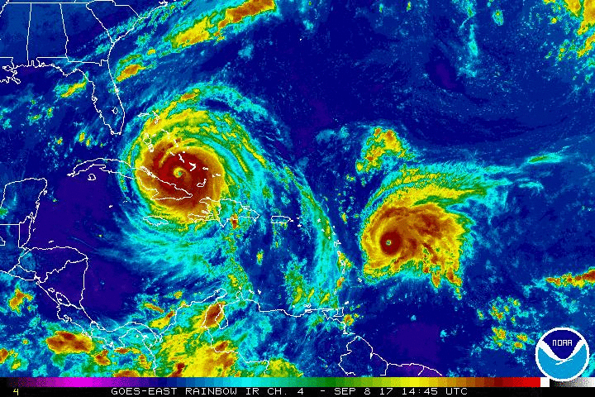
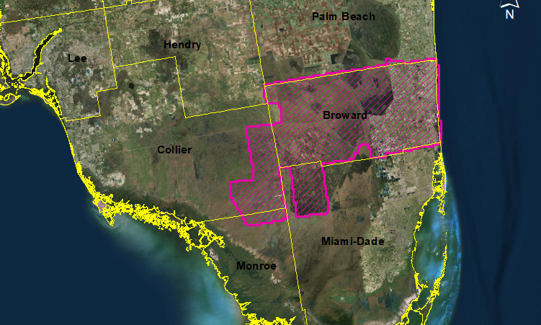
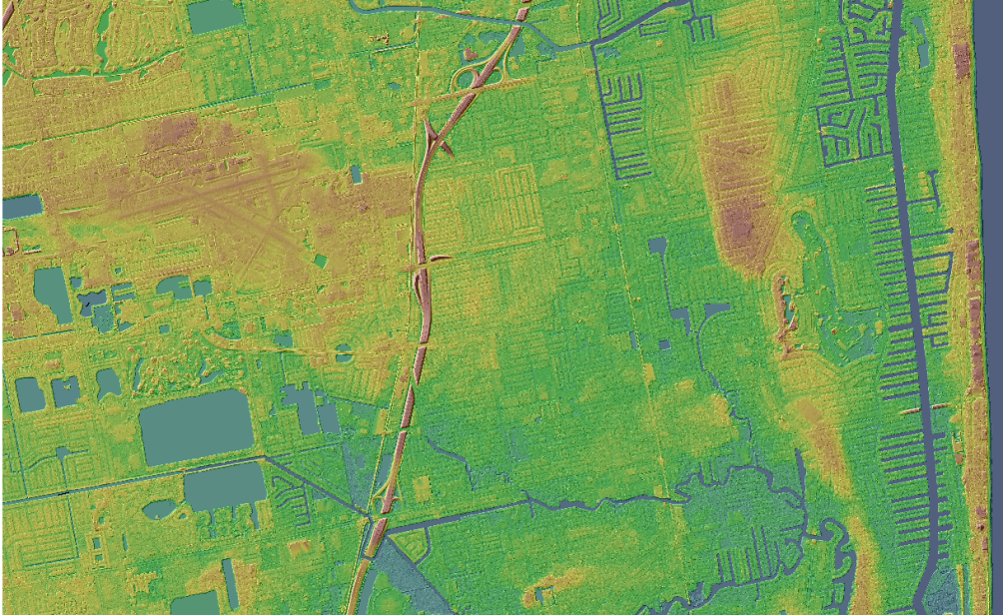
Producing Lidar Deliverables for Hurricane Supplemental Projects - A Case Study of Post-Irma
Emily Klipp, Project Manager, Dewberry

Slide 2
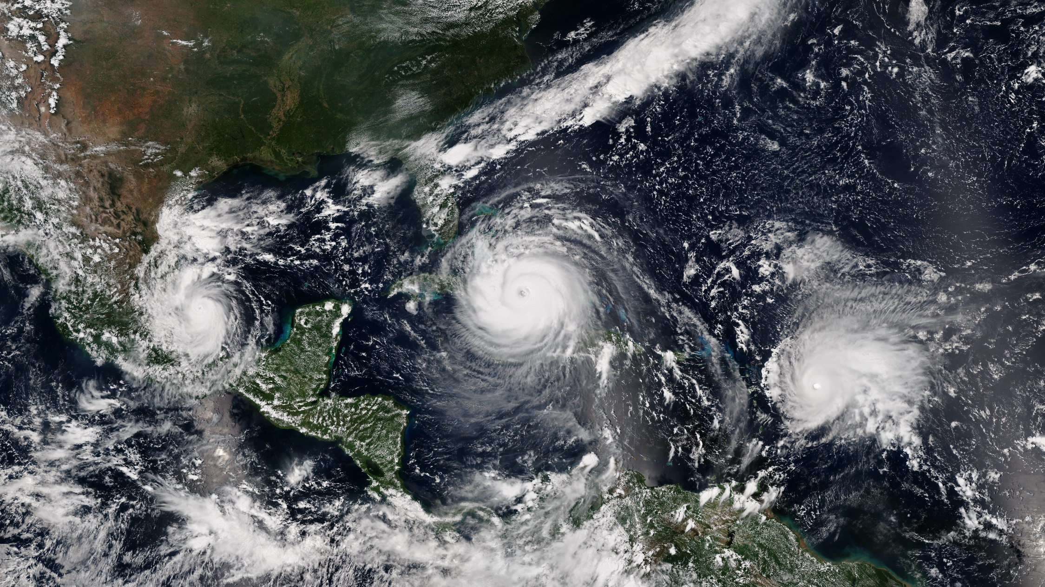
Introduction
Notes:
Most Americans living on the Atlantic and Gulf coasts of the US have at some time in their lives been impacted by a hurricane. As a FL native I have been impacted in various ways many times. For locals of these areas it is a fact of life. Hurricanes will continue to occur, so the better we can prepare, the better off we’ll be.
Three simultaneous hurricanes active on September 8, with Katia (left), Irma (center), and Jose (right), the first such occurrence since 2010. All three were simultaneously threatening land at the time.

Slide 3
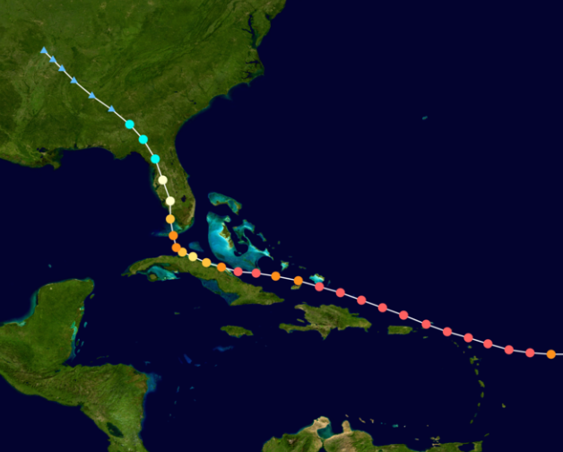
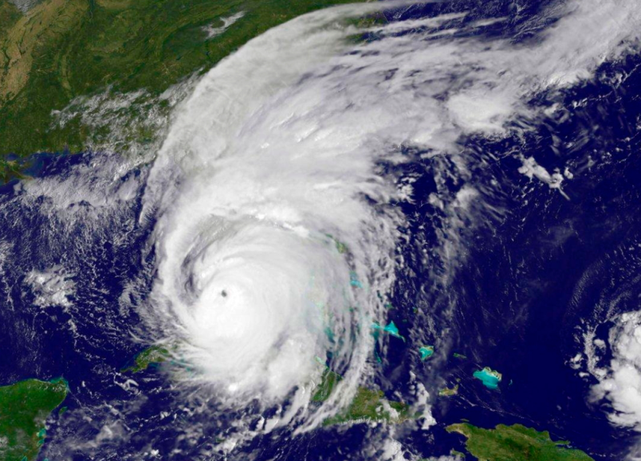
Introduction
Hurricane Irma Crossed over many Caribbean islands as a Cat 5
    BVI, USVI, Puerto Rico, Hispaniola, Turks & Caicos, Bahamas, Cuba
  Sep 10, 2017 – U.S. landfall at Cudjoe Key, FL as Cat 4
  2nd landfall at Marco Island, FL as Cat 3
Notes:
Sep 2017
It was also the most intense hurricane to strike the continental United States since Katrina in 2005
Hurricane Irma's path was such that its impact was both far-reaching and devastating

Slide 4
Introduction
In the aftermath of Hurricane Irma the U.S. Geological Survey (USGS) identified the need for updated high resolution elevation data for the State of Florida.
Data to be used for:
  post-hurricane modeling
  predicting coastal landscape change
  restoration of ecosystems
  mitigating risks associated with anthropomorphic and natural hazards
Notes:
Accurate, High resolution & current elevation data allows for preparation & response

Slide 5
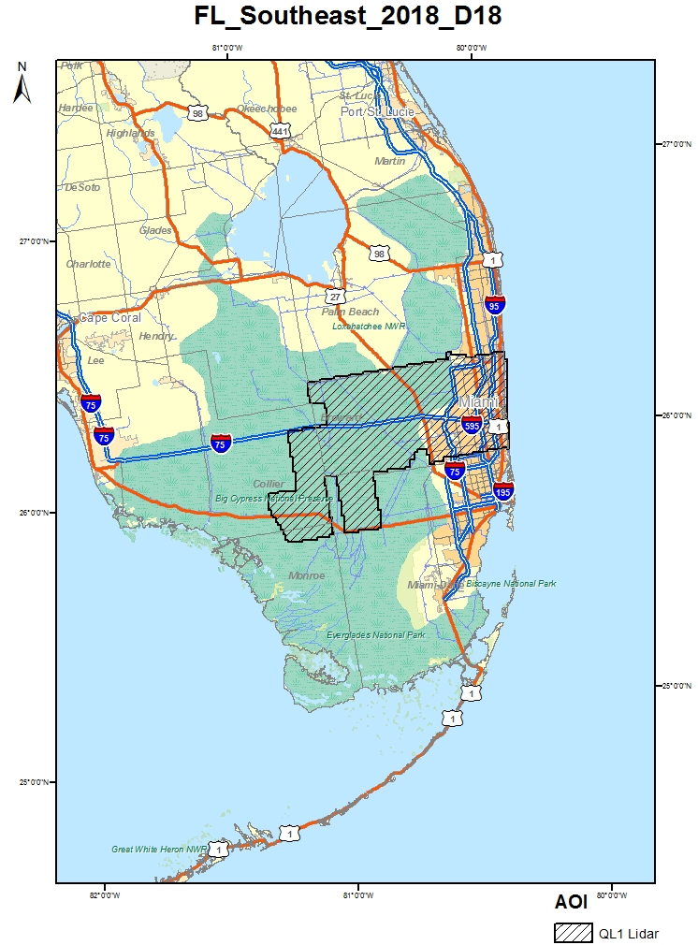
USGS - FL Southeast
1,641 mi² southeastern coast in Florida
  Deerfield Beach – Hollywood
  Everglades Wildlife Management Area - Water Conservation Area 3A
QL1
  8 ppsm NPD
  < 0.35 m NPS
USGS Base Spec v1.3
Tidally coordinated lidar
Notes:
As part of the need identified by USGS Dewberry was awarded TO for thr FL SE project
Pompano Beach, Fort Lauderdale, Hollywood and a portion of the Everglades

Slide 6
Acquisition Parameters
Parameter | Requirement
Sensors | Riegl 1560i
Nominal Pulse Spacing | QL1 – 0.35 m ANPS / 8 ppsm ANPD
Signal Strength | 16-bit fomat
Acquisition Window | The flight window extends from April 1 through June 30, 2018.
Overlap | Single Swath (30% overlap)
Atmospheric Conditions | Cloud and fog-free between the aircraft and ground
Ground Conditions | No unusual flooding or inundation
Vegetation Requirements | Leaf-off is preferred however leaf-on will be accepted. As numerous factors will affect vegetation condition at the time of any collection, the USGS NGP only requires that penetration to the ground must be adequate to produce an accurate and reliable bare-earth surface suitable for incorporation into the 3DEP 1 meter product holdings. Collections for specific scientific research projects may be exempted from this requirement, with prior approval.
Tidal Requirements | Tidally impacted waters within the AOI are expected to be acquired at Predicted MLW +- 2 hours exclusive of neap tides; collect at the lowest tide possible
Time of Day Requirements | Time of day is not of concern.

Slide 7
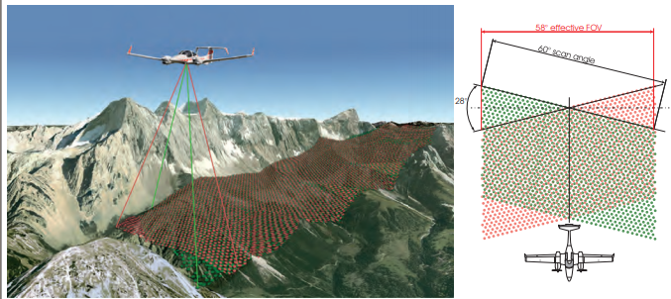
Riegl 1560i
Dual Channel Lidar
  excellent multiple target detection capability
Forward/Backward Scan
  enables capturing data from multiple angles more effectively and more accurately at high point density

Slide 8
Sensor Parameters
Item | Parameters
Systems | Riegl VQ1560i
Altitude (m. AGL) | 1300
Approx. Flight Speed (kts) | 160
Scanner Pulse Rate (KhZ) | 2000 True (1333.3 kHz Effective)
Scan Frequency (hz) | 375
Pulse Duration of the Scanner (microseconds) | 3
Pulse Width of the Scanner (m) | 0.9
Swath Width (m) | 1456
Central Wavelength of the Sensor Laser (nanometers) | 1064
Will the Sensor Operate with Multiple Pulses in The Air? (yes/no) | Yes
Laser Beam Divergence (milliradians) | 0.025
Nominal Swath Width on the Ground (m) | 1501
Swath Overlap (%) | 30
Total Sensor Scan Angle (degree) | 60
Computed Along Track Spacing (m) | 0.38
Computed Cross Track Spacing (m) | 0.43
Nominal Pulse Spacing (single swath), (m) | 0.31
Nominal Pulse Density (single swath) (ppsm), (m) | 10.7
Maximum Number of Returns per Pulse | 8

Slide 9
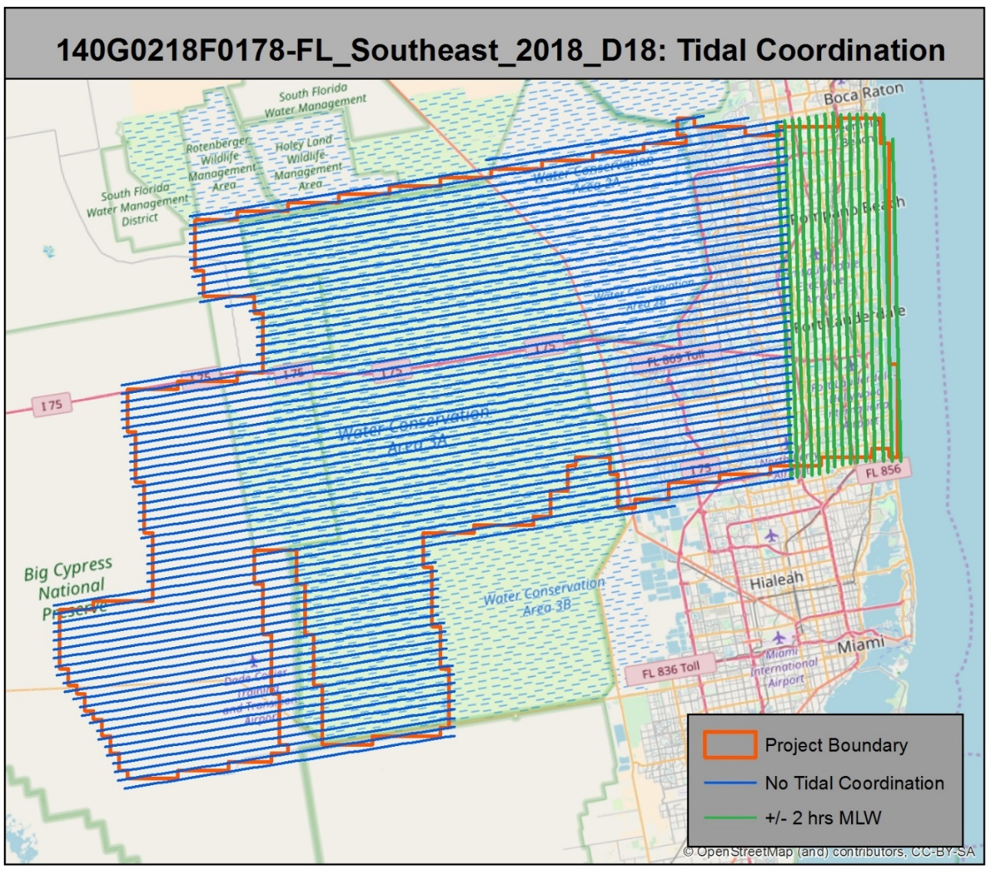
Tidal Requirement
Tidally Coordinated: : Tidally impacted waters within the AOI are expected to be acquired at Predicted MLW +- 2 hours exclusive of neap tides. It is requested that as a priority, the AOI be collected at the lowest tide possible during the acquisition window defined above.

Slide 10
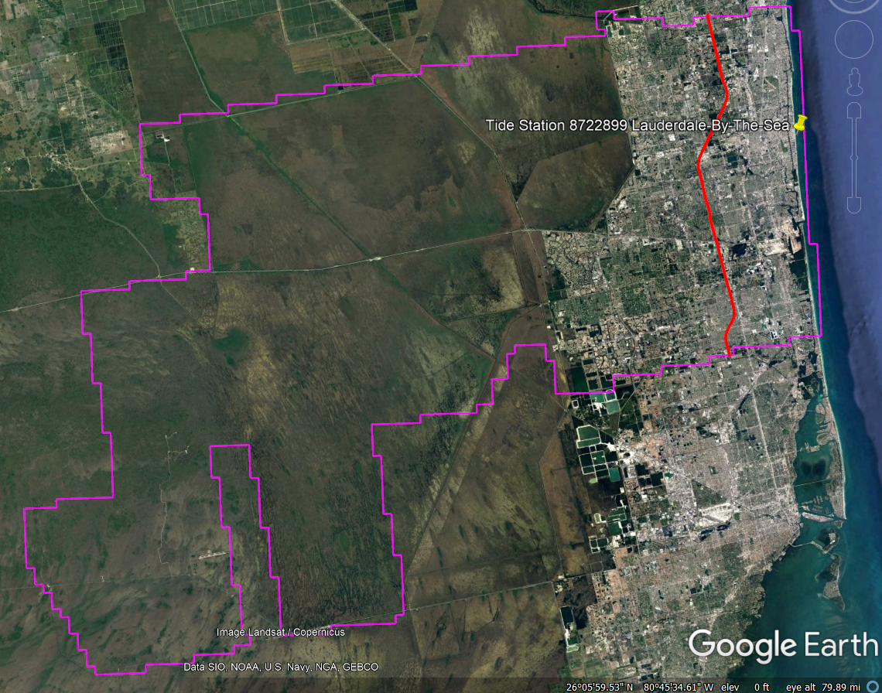
Tidal Requirement
Tidal collection extends from the coast inland to the Florida Turnpike.
Used tide station 8722899 (Lauderdale-by-the-sea) for tide predictions.

Slide 11
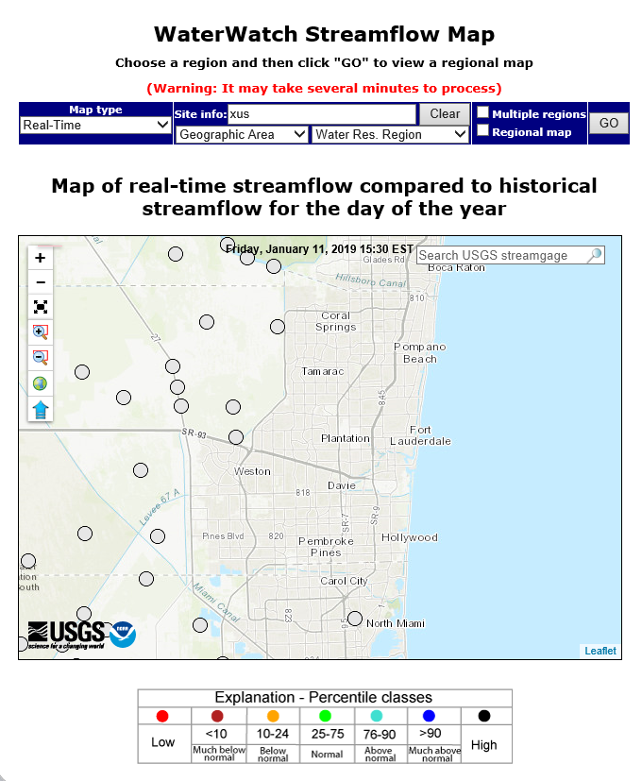
Flood Monitoring
Conduct monitoring efforts on current streamflow on a daily basis to ensure streams are within their normal banks following any rain events within the region. Current published stream discharge conditions can be found at the website below:
http://waterwatch.usgs.gov/

Slide 12
Delivery Specifications
Spatial Reference System: NAD83 (2011), Albers Equal Area, Meters; NAVD88 (Geoid12B), Meters.
Tile Size: 1000 meters x 1000 meters
Absolute Vertical Accuracy
  RMSEZ ≤ 10 cm (non-vegetated, Swath, DEM))
  NVA ≤ 19.6 cm 95% Confidence Level (Swath, DEM)
  VVA ≤ 30 cm 95th Percentile (DEM)
Absolute Horizontal Accuracy
  This data set was produced to meet ASPRS “Positional Accuracy Standards for Digital Geospatial Data” (2014) for a 0.6 (cm) RMSEx / RMSEy Horizontal Accuracy Class which equates to Positional Horizontal Accuracy =+/- 1.04 m at a 95% confidence level
Relative Swath Accuracy
  ≤ 6cm RMSE within individual swaths (smooth surface repeatability)
  ≤ 8 cm RMSDz within swath overlap (between adjacent swaths) with a maximum difference of ±16 cm

Slide 13
Delivery Specifications
POINT TYPES | LAND COVER CLASS |  | TOTALS
Totals based on 1641 sq mi | NVA Non-vegetated Vertical Accuracy | VVA Vegetated Vertical Accuracy
ASPRS Vertical Accuracy Checkpoints (CP) | 67 | 53 | 120
Extra Checkpoints – NVA & VVA | 4 | 4 | 8
Total ASPRS Checkpoint Survey | 71 | 57 | 128
Acquisition Calibration Control Points – Ground Control Points (GCP) | 20
Total Survey Points (CP & GCP) | 91 | 57 | 148

Slide 14
Production Process
Verify pulse density, vertical and horizontal accuracy, inter and intra swath accuracy
Initial classification using automated algorithms
Manually review and edit to ensure quality and accuracy
Collect detailed hydrographic breaklines using various derivatives created from the lidar data, including intensity imagery and terrain models
Use classified ground data and hydrographic breaklines to create a Bare Earth Hydroflattened DEM formatted to the USGS 3DEP National Indexing Scheme.
Notes:
Perform accuracy checks at various during production as well as final accuracy at completion

Slide 15
Deliverables
Classified Point Cloud (Version 1.4)
  Point Record Format 6 and in accordance with the required 1000m x 1000m tiling scheme
  Points classified to:
  Class 1 - Processed, but unclassified
  Class 2 - Bare-earth ground
  Class 7 - Low Noise (low, manually identified, if necessary)
  Class 9 - Water
  Class 17 - Bridge Decks
  Class 18 - High Noise (high, manually identified, if necessary)
  Class 20 - Ignored Ground
  Class 21 - Snow (if present and identifiable)
  Class 22 - Temporal exclusion
Breaklines (No changes to 1.2 specifications)
  2 acre ponds/lakes - flattened
  > 100 ft wide streams/rivers – monotonic
  Tidal Water
  Bridge Saddle Breaklines

Slide 16
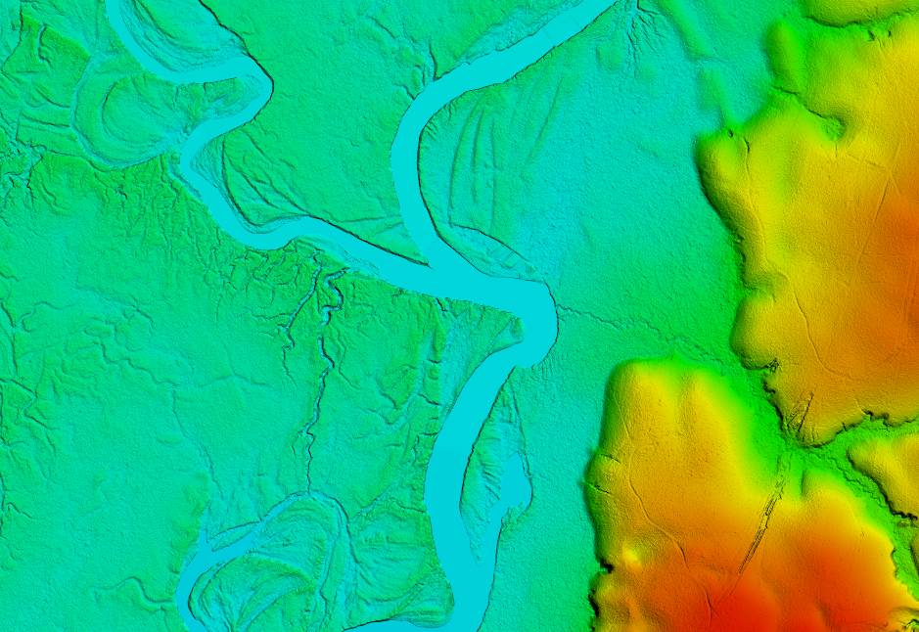
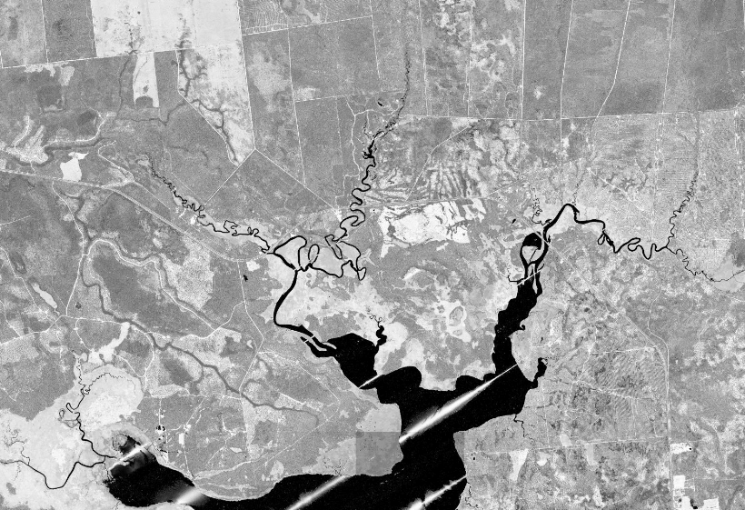
Deliverables
Bare Earth Surface (Raster DEM)
  Hydro-flattened (with inland ponds, lakes, streams and river stipulations from SOW)
  Tiled to 1000 meter x 1000 meter extents
  0.5 meter cell size ERDAS Imagine (.img) format
Intensity Images
  8-bit 256 color gray scale and GeoTIFF format
  Intensity values shall be 16-bit, linear rescaled
  Cell size shall be 0.5 meter and tiled to match the Classified LAS and DEM file

Slide 17
Deliverables
Metadata/Reports
  Compliant to USGS Lidar Base Specification Version 1.3 (Breakline, Classified LAS, DEM, Intensity)
  Acquisition Report detailing mission planning and flight logs
  Ground Survey Report
  Processing Report
  QA/QC Report
  Control and Check Points
Project Pilot
  no less than 4 tiles of the CLASSIFIED LAS, hydro-flattened Bare-Earth DEM tiles, and breaklines
  shall report the NVA of the UNCLASSIFIED point cloud and Bare-Earth DEM
Additional Products:
  Delivery Diagram with Blocks, Tile Index, Flight Line Index, Ground Control Points, Check Points

Slide 18





Challenge – Water Levels
Unusually high precipitation causing higher than normal water levels
May
June
November
December
https://waterwatch.usgs.gov
Notes:
on site between May 11th, 2018 – May 15th, 2018 and again from May 21st, 2018- June 2nd, 2018 and has collected 11.5% of the project area so far. Airborne Imaging was able to acquire all North-South flight lines for the tidally coordinated portion of this project. Due to heavy rains and steadily high water levels it was decided to delay further acquisition until Fall 2018.
Returned Nov 21. Completed Dec 18

Slide 19
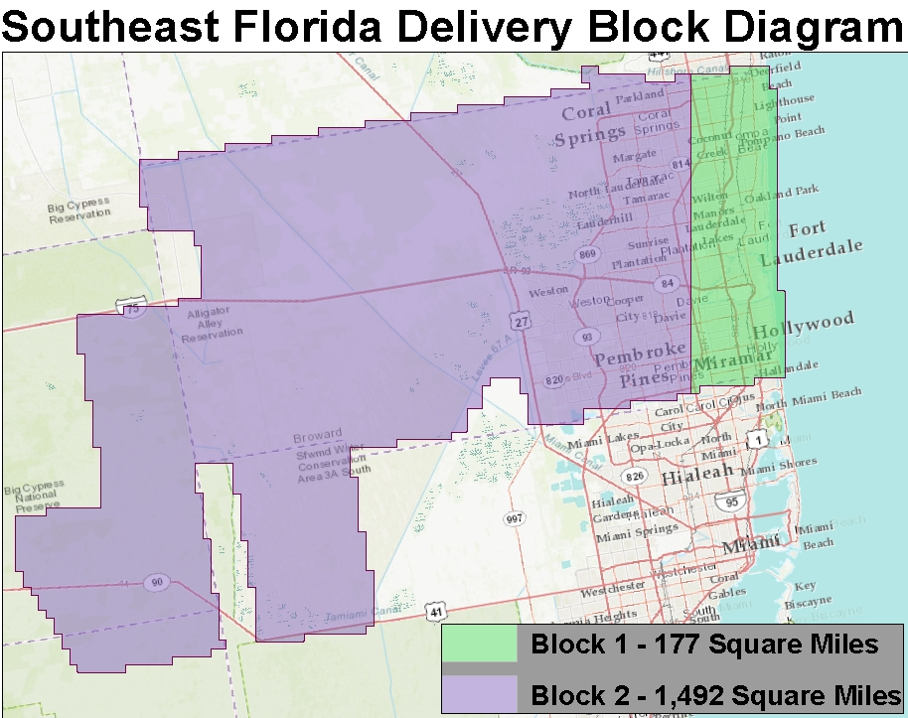
Challenge – Water Levels
Acquisition Block 1
  5/11/2018 – 6/2/2018
Due to heavy rains and steadily high water levels delayed further acquisition until Fall 2018
Acquired all North-South flight lines for the tidally coordinated portion of this project (Block 1)
Block 1 data shipped to USGS on 11/29/2018

Slide 20
Challenge – Water Levels
Acquisition Block 2
  11/9/2018 – 12/18/2018
Data current undergoing calibration
Deliver to USGS on 4/30/2019

Slide 21
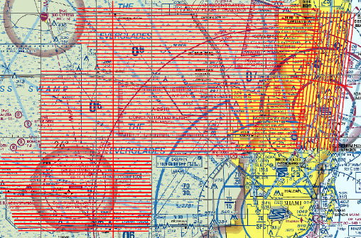
Challenge – Airport Restrictions
Flights restricted to night hours from 12:00am (midnight) to 5:00am as dictated by Air Traffic Control due to a number of executive and training airports in the region and congested airspace

Slide 22
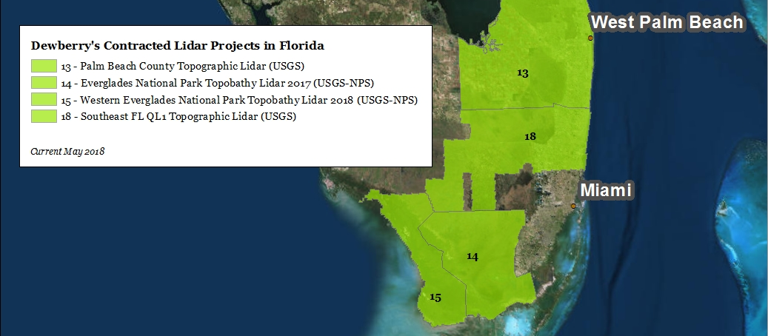
Adjacent AOIs
Adjacent AOIs already acquired by Dewberry
Dewberry will review the edge matching with adjacent data to ensure it is within the accuracy specifications.

Slide 23
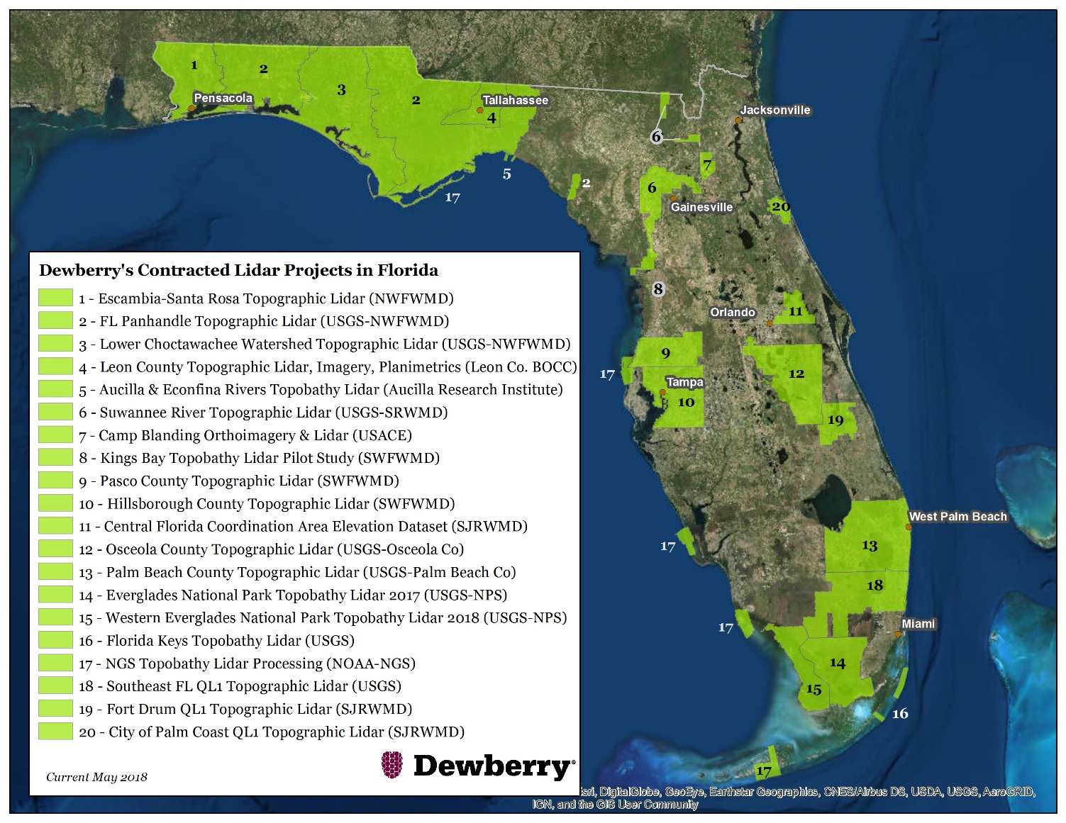
Dewberry’s existing lidar footprint in Florida
Over 22,000 square miles since 2015 for:
SWFWMD
SJRWMD
NWFWMD
Leon County
USACE
NOAA
USGS 3DEP (with several end clients)

Slide 24
FDEP Florida Statewide LiDAR Study
Study funded by Florida Geological Survey – FL DEP
Identify Florida’s Business Uses, requirements and benefits of topographic and bathymetric LiDAR
  Determine implementation scenarios with highest Net Benefits
  Identify potential funding partnerships
  Update changes to Florida since the National Enhanced Elevation Assessment (NEEA) that led to the 3D Elevation Program (3DEP)
  Serve as a pilot for the 2017-18 NOAA/USGS 3D Nation Requirements and Benefits Study
Cost-benefit analysis study resulted in:
  Net benefits of over $20M per year for QL1 topographic LiDAR acquired every 2-3 years, and
  Over $28M per year for QL0B bathymetric LiDAR acquired every 4-5 years

Slide 25
FL Peninsular
Approximately 34,873 square miles
Project includes planning, acquisition, processing, and derivative products of QL1 lidar
All acquisition planned with a minimum point density of 8 ppsm and an average density of 10 ppsm.
Lidar is being collected now and is planned to finish in April, 2019
Flying at low tide/lowest water level possible

Slide 26
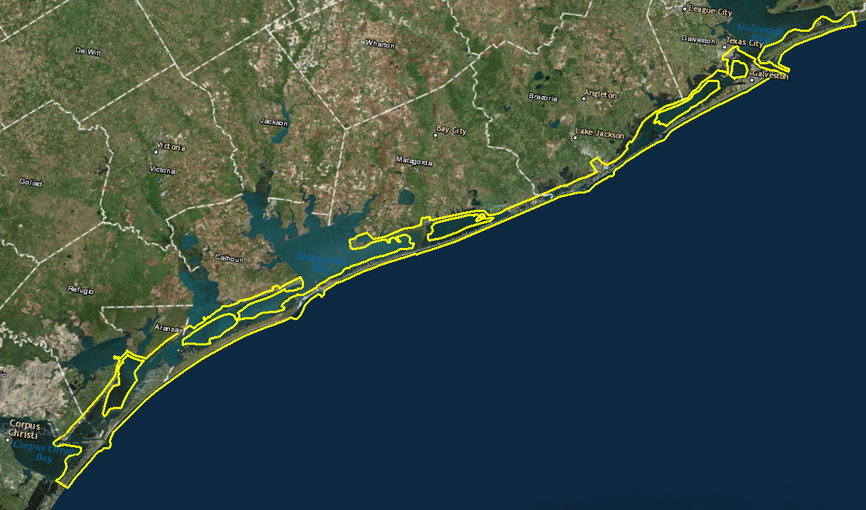
Hurricane Harvey Post Storm Topo-Bathymetry Project
942 square miles
Leica Chiroptera II
Acquisition > 50% complete
Notes:
Supplemental funding is provided to other agencies including NOAA.
Shorelines are constantly changing and there is a needs to maintain updated shoreline information
That change is even greater after storm events

Slide 27
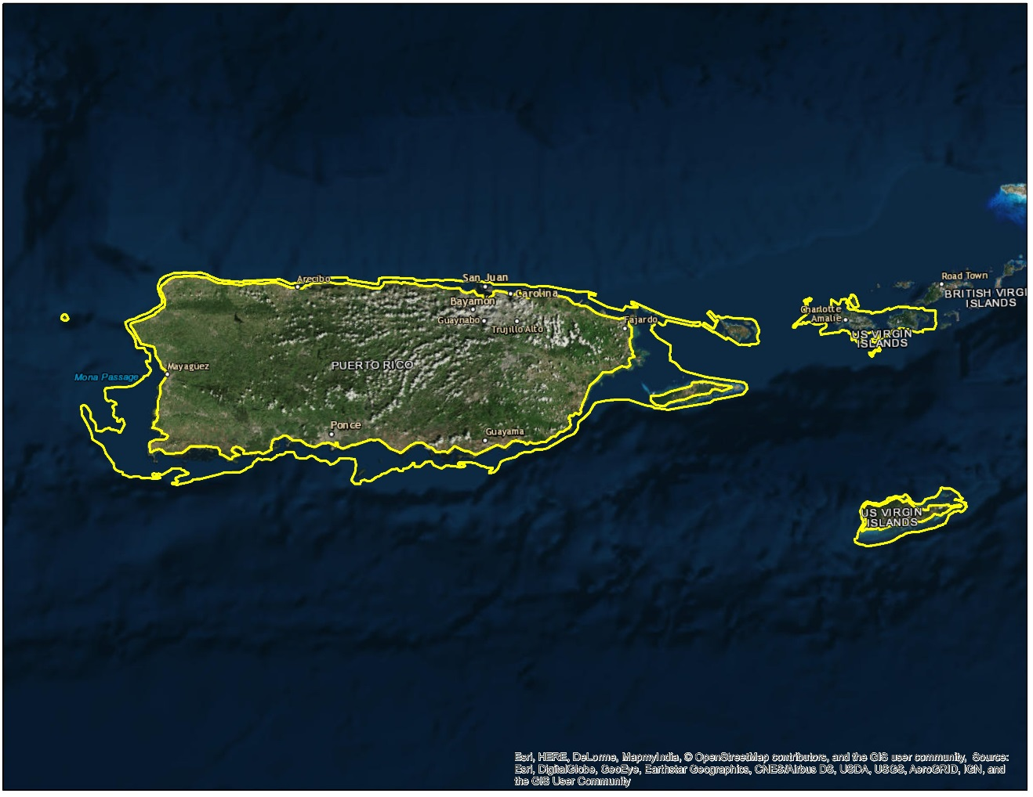
Hurricane Maria Post Storm Topo-Bathymetry, Imagery, Shoreline Mapping Project
1,400 square miles
RIEGL VQ-880-GII
Latest Generation
4-band Imagery
Photogrammetric mapping

Slide 28
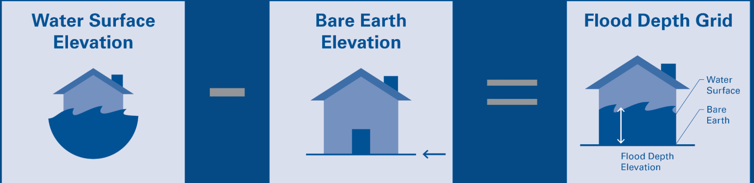
Geospatial Damage Assessments
Create preliminary flood depth grids using peak crest gauge data
Depict inundation levels and extent of impact from heavy rain & storm surges
  classifications of individual building damage levels
  analyses of infrastructure damage
  the location of isolated communities
  the extent and location of debris accumulation from flooding events.
Notes:
Prior to storm – collect topographic information for potential impact areas

Slide 29
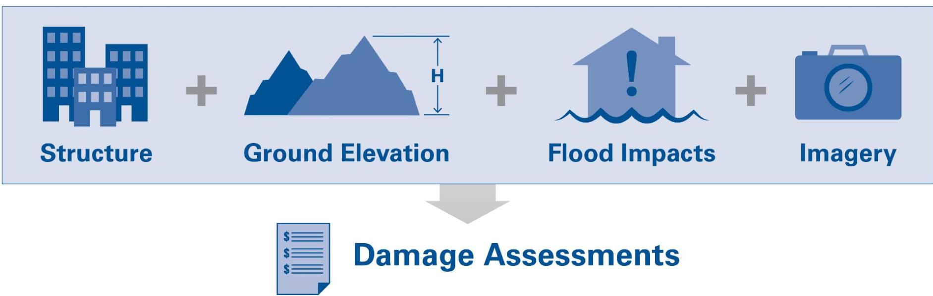
Geospatial Damage Assessments
Satellite and aerial imagery is used to validate the flood extents and damage assessments
Notes:
What does this data enable us to do?? Why is this data so important?

Slide 30
Geospatial Damage Assessments
Provide insight and allow for true, around-the-clock situational awareness of what the damage is likely to be or what it is already.
Better inform federal agencies, such as FEMA, and private non-profit organizations, such as the American Red Cross, on the number of people affected.
Helps make better informed decisions:
  Staffing
  Response
  Recovery
Provides more accurate numbers for the necessary amount of food, water, and shelters required for those that are displaced.
Helps expedite survivor benefits like mortgage assistance, rental assistance, and other forms of assistance payments.

Slide 31
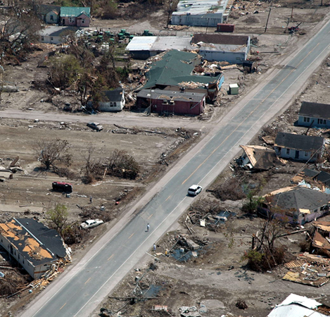
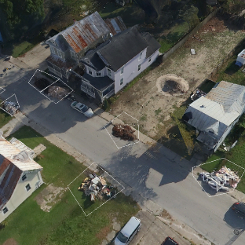
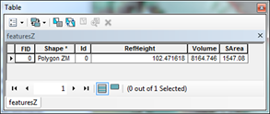
Geospatial Damage Assessments
Debris estimation
  Clearance
  Collection
  Disposal
Cost of debris removal often largest expense for communities impacted by disasters
Contractors are hired and paid based on accurate estimates of debris volumes to be removed
GIS analysts make measurements on lidar polygon changes…
then output the volume

Slide 32
Geospatial Damage Assessments
Helping FEMA evaluate damage to public infrastructure owned by state agencies, local communities, and private non-profit organizations
  Roads
  Bridges
  Buildings
  Utilities
  Water/Wastewater Facilities
  Schools
  Universities
  Hospitals
  Parks
  Recreational Facilities

Slide 33
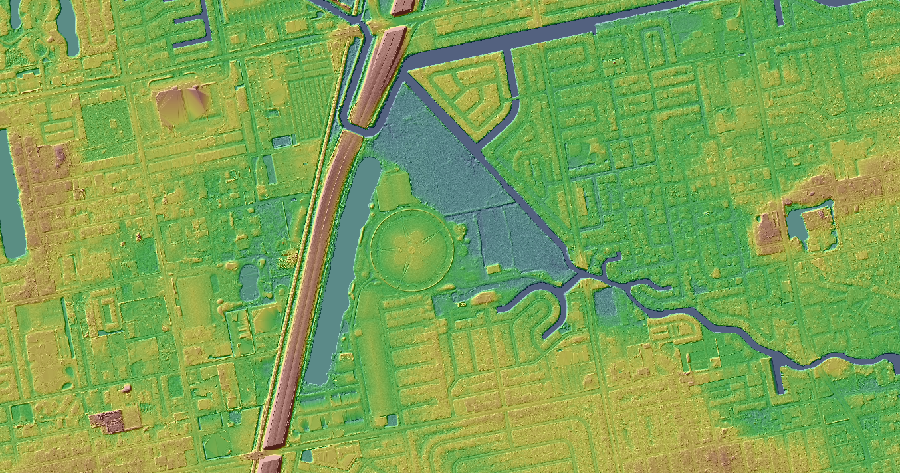
Emily Klipp
Project Manager
Dewberry
esklipp@dewberry.com
Ofc: 813 421 8651
Cell: 727 420 1467
Thank you.
Questions?

