Slide 1
RMP
Photogrammetric Calibration of the Phase One iXU-RS1900 Camera System
Ricardo Passini (CP, CMS, ASPRS) David Day (CP – ASPRS, GISP)
Wesley Weaver
Keystone Aerial Surveys
ILMF – ASPRS
Annual Conference. Denver, CO. January 27 – 31, 2019

Slide 2
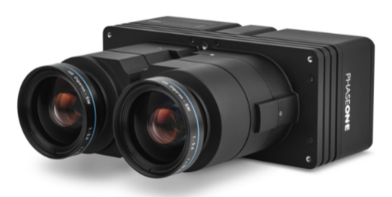
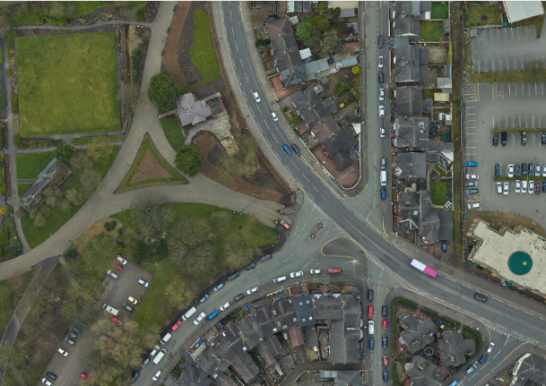
Photogrammetric Calibration of the Phase One iXU-RS1900 Camera System
RMP
The iXU-RS1900 dual lens aerial camera is a medium format advanced camera system, with technology designed specifically for the demands of aerial imaging projects. It is equipped with an Applanix POS AV system that enables direct geo-referencing of aerial images. The camera main characteristics are:
Lenses | Maximum Shutter | Opening Angle (long side) | Opening Angle (short side) | Lens Type | Weight | Dimensions
90 mm f/5.6 | 1/2000 | 33° | 25.1° | Rodenstock | 1150 g | 97.4 x 93 x 218 mm
Phase One iXU-RS1900
Like any other sensor needs to be calibrated. Two methods: (1) Lab Calibration; (2) Photogrammetric System Calibration
(1) Carried out under constant temperature, humidity, air pressure, etc.
(2) Carried out under working conditions.
 | Pressurized cabin, cover glass |  | Lens in free atmosphere |  | Lens in free atmosphere t like air
Flying Height | 6 Km | 14 Km | 6 Km | 14 Km | 6 Km | 14 Km
Wide Angle f=153 mm | -20 µm | -38µm | -36µm | -58µm | -47µm | -80µm
Normal Angle f=305 mm | +12µm | -17µm | -33µm | -28µm | -110µm | -172µm
A research carried out by Prof. Dr. H. Mayer (1987) demonstrates that there are differences in the shape of the camera cone when working under different environments. There are noticeable variations in the length of the calibrated focal length.
The change in the lab-calibrated focal length, used under working conditions, produces an affine distortion in height. For df~15μm with Photo Scale 1:6,500, and orientation using GCPs, height deformation (dh) will be about 10 cm. If GCPs are not used it can be proven that (dh) could be much bigger
The changes in the position of the principal point of the camera produce horizontal (π_{x}) and vertical (π_{y}) parallax. The first gives rise to erroneous height values of the reconstructed terrain, and the second can easily be bigger than the fixed stereoscopic vertical parallax for the purpose at hand. Hence, we can easily conclude that for direct sensor orientation laboratory calibration is not enough.

Slide 3
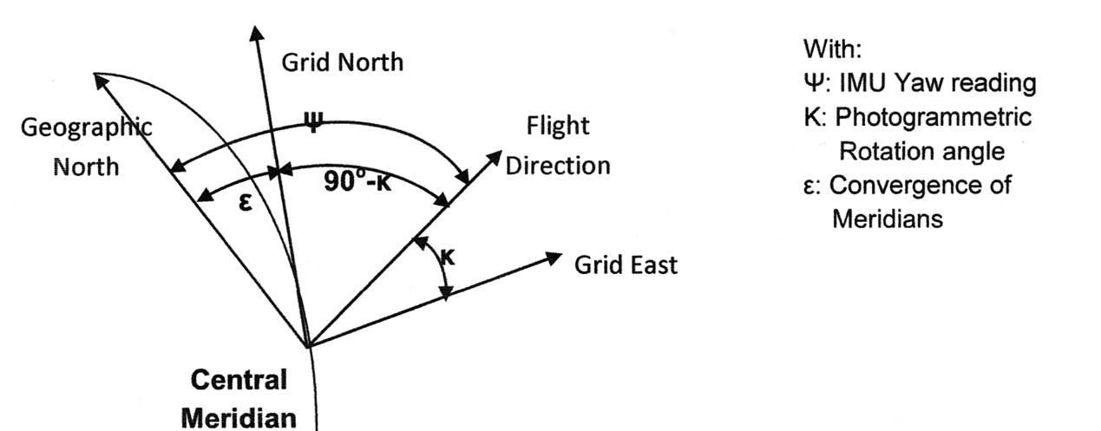
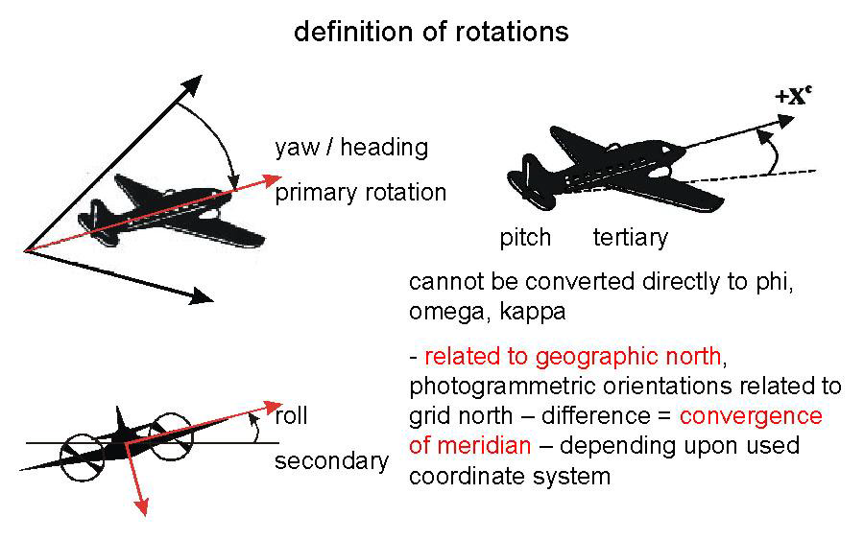
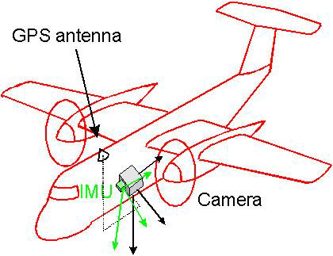
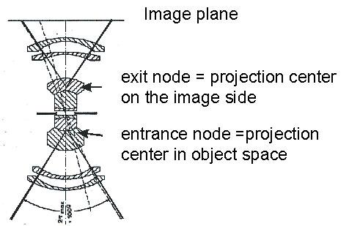
Photogrammetric Calibration of the Phase One iXU-RS1900 Camera System
RMP
Other calibration parameters are:
Misalignment angles between the camera axis and the IMU axis
GPS shifts that are introduced into lever arm corrections Distance between the center of the KF and the projection center of the camera
ε = Ψ – (90° – K)

Slide 4
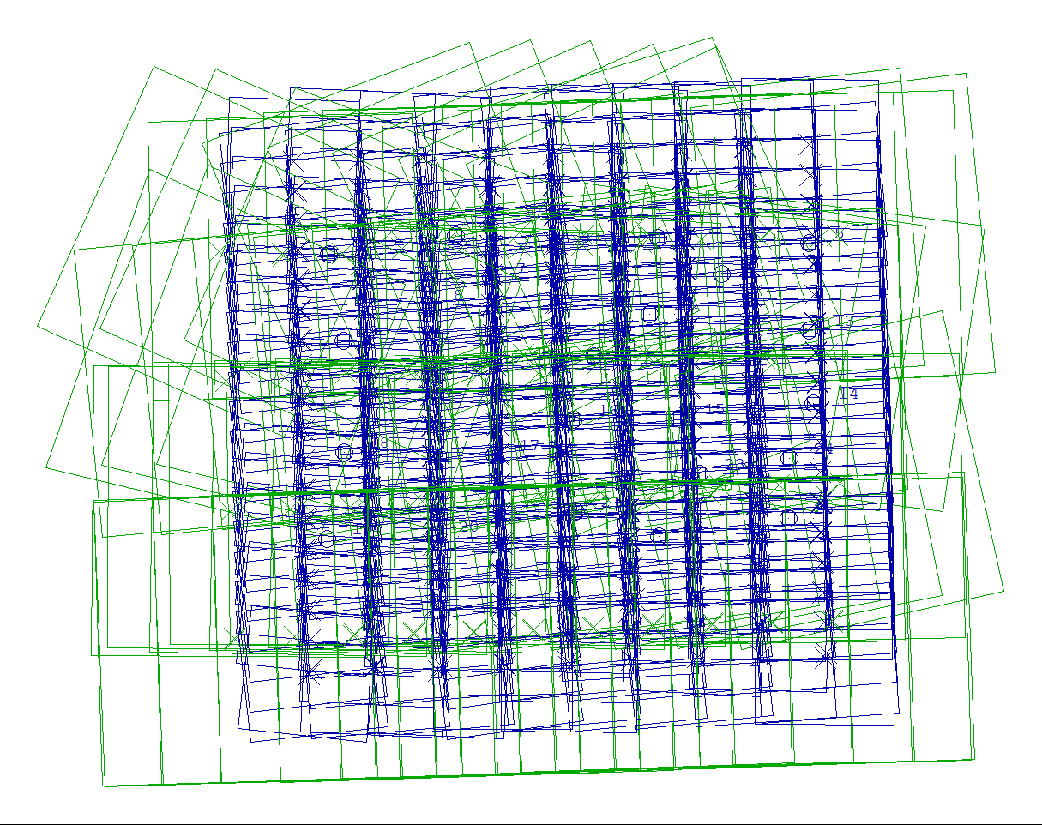
Photogrammetric Calibration of the Phase One iXU-RS1900 Camera System
RMP
THE CALIBRATION BLOCK
Approx. 7 sq. miles
60% Long and 40% Lat overlaps
25 GCPs ± 1 cm accuracy or better
Two GSD: 5 and 10 cm (Two flying altitudes) for a reliable determination of the focal length. To separate the computation of the calibrated focal length from the GPS Z-shift
Each strip flown in opposite direction. To eliminate the effects of the GPS shifts (X, Y) over the determination of the principal point. Further, the principal point in image x-direction is highly correlated to time errors of the recording of the instant of exposure.
High altitude 4 Lines 89 images. Low Altitude 9 Lines 405 images
Both flights transversal to each other to eliminate or minimize the cross-correlation between linear and angular orientation parameters
For the calibration, regarding stereo-pairs of the perimeter, only those with GCPs appearing in at least 3 consecutive images in the same strips were used. Meaning a great number of images in the periphery of the block were not used. This was done to obtain reliable boresight parameters

Slide 5
Photogrammetric Calibration of the Phase One iXU-RS1900 Camera System
RMP
1ST STEP IN THE CALIBRATION COMPUTATIONS: Bundle Block Adjustment with ABGPS and self-calibration (13 – 15) with only:
13 x’ = x + x *P13 y’ = y + y * P13 = focal length or GPS shift Z
14 x’ = x + P14 y’ = y = principal point x or GPS shift x’
15 x’ = x y’ = y + P15 = principal point y or GPS shift y’
Resulting in:
CHANGE OF FOCAL LENGTH -.020 = CORR. FOR F -> 89.980 mm
SHIFT OF PRINCIPAL POINT X: -.031 mm SHIFT OF PRINCIPAL POINT Y: -.002 mm
2nd STEP IN THE CALIBRATION COMPUTATIONS: Corrections of the observed image points due to the shifts of the calibrated principal point of the camera (Program BLPRE of BLUH package). With these, the new calibrated focal length (no ABGPS/IMU data), to carry out a simultaneous Bundle Block Adjustment. Results are shown below:
The systematic difference in Z (SYS-Z) is almost 20 times bigger than the combined planimetric [ $\sqrt{{(SYS−X)}^{2}+{(SYS−Y)}^{2}} ]$. Systematic errors
3RD STEP IN THE SYSTEM CALIBRATION: Computation of the misalignment and shifts using program GPSPL of BLUH package. Results:
These parameters can in turn be used to correct the orientations provided
by the ABGPS/IMU at each instant of exposure. Then, theoretically
speaking, operations like Direct Sensor Orientation can be carried out
with very good results. The next Table shows the results of such operation
Bundle Block Adjustment with Calibrated Camera Parameters (ft)
σ° | #GCPs | RMSX | RMSY | RMSZ | Max DX | Max DY | Max DZ
2.9 | 25 | 0.095 | 0.079 | .763 | .243 | -0.144 | 2.278
Syst. Differences and RMSE over GCPs without Syst. Differences (ft)
SYS-X | SYS-Y | SYS-Z | RMSX | RMSY | RMSZ
.0014 | .0034 | .0702 | 0.095 | 0.079 | 0.760
Misalignment and shifts computed by GPSPL
C-PITCH [GONS] | C-ROLL [GONS] | C-YAW [GONS] | CX [FEET] | CY [FEET] | CZ [FEET]
-0.00797 | -0.00119 | 0.00053 | 0.221 | -.150 | 0.241

Slide 6
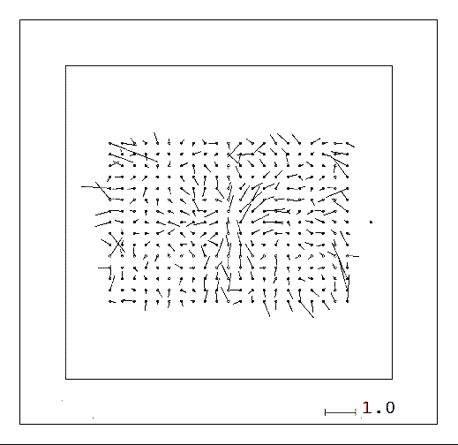
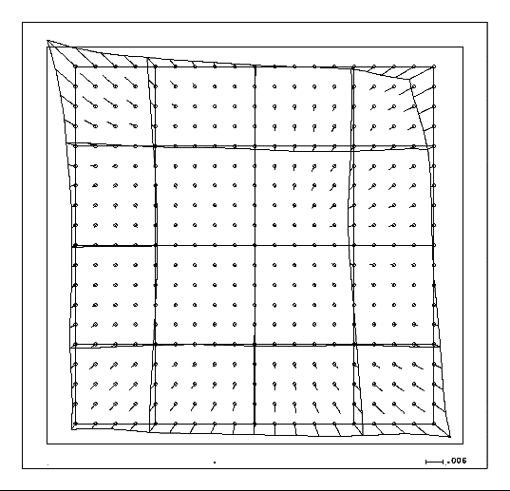
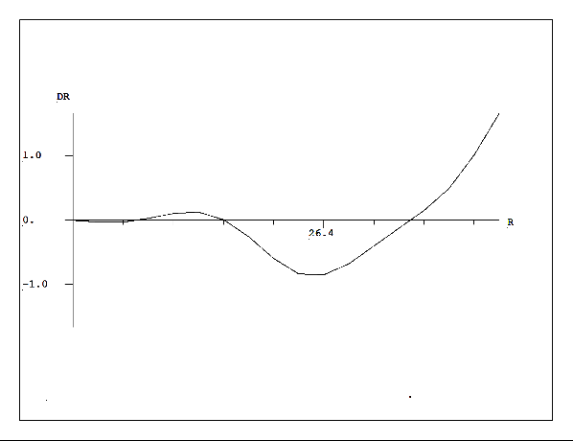
Photogrammetric Calibration of the Phase One iXU-RS1900 Camera System
RMP
σ° (μm) | #Chk Pts | RMSX | RMSY | RMSZ | Max-DX | Max-DY | Max-DZ
3.8 | 25 | 0.210 | 0.125 | 0.884 | 0.548 | -.379 | 2.798
The Table shows somewhat acceptable results for a Direct Sensor Orientation. Nevertheless, it shows large discrepancies at the RMSE-Z and Max-DZ that can be attributed to the remaining systematic image errors.
(Feet)
4th STEP. DETERMINATION OF THE SYSTEMATIC IMAGE ERRORS AND THEIR EFFECT. With this purpose SBB Adjustment using self-calibration with combination of Additional Parameters have been carried out. Results are shown in the next Table
No self-calibration |  |  |  | Self-calib.12. Add. Parameters |  |  |  | 12 Std. Add. Param. + 81 to 88
σ° | RMSX | RMSY | RMSZ | σ° | RMSX | RMSY | RMSZ | σ° | RMSX | RMSY | RMSZ
2.9 | 0.095 | 0.079 | 0.763 | 2.5 | 0.077 | 0.077 | 0.532 | 2.1 | 0.063 | 0.070 | 0.278
There are increases of accuracy in Z of about 30.3% and 63.6% when considering self-calibration with just the 12 St. Add. Param and with these plus 81 to 88 (See green values in table)
Overall mean residuals after Bundle Adjustment (No self-calibration)
Effect of the additional parameters by correcting the effect of the systematic errors (12 Std. + 81 to 88 add. Param.)
Radial Symmetric Lens Distortion out of self-calibration. Increase exponentially at the image corners
a
b
c

Slide 7
Photogrammetric Calibration of the Phase One iXU-RS1900 Camera System
RMP
CONCLUSIONS
For Photogrammetric Operations such as DSO or ISO, LABORATORY CALIBRATION IS NOT ENOUGH. Calibration Boresight operations have to be performed
Boresight must fulfill geometric conditions of high accuracy and coverage. Flights at 2 different GSD to eliminate the effect of the GPS-Z-shift over the calibrated focal length. Each strip be flown forward and reverse. This eliminate/minimize the GPS-(X,Y) shift in the determination of the principal point and the high correlation between the image x-coordinates and constant exposure time errors.
The calibrated camera parameters were done by a BBA using the ABGPS and the additional parameters 13 to 15 to all strips. Once the image observations were corrected another BBA was carried out with no self-calibration and no ABGPS data. The results show a strong effect of the remaining systematic errors over the Z-Components.
The relationship of the 3 systems (Camera, INS/IMU, AGPS) must have as reference the camera projection center in the object space (the entrance nodal point of the camera). The distance from the GPS central phase antenna and the projection center of the camera (entrance nodal point) is known with geodetic precision and is located on the vertical axis of the camera passing through the principal point, hence the offset of the IMU origin to the camera projection center has to be known before mixing the ABGPS data with the INS/IMU data by the Kalman Filter. Finally, the distance from the INS/IMU to the entrance nodal point of the camera is to be determined. The difference between the exterior orientations and the IMU-data leads to the boresight misalignment. Such a difference can only be done once the correction for convergence of meridians is applied and either the IMU readings are transformed to the adjusted EOs angles or vice versa. The exterior orientation from the bundle block adjustment is handled as an error free reference system, even if the accuracy cannot be neglected.

Slide 8
Photogrammetric Calibration of the Phase One iXU-RS1900 Camera System
RMP
All above mentioned computation were done by the use of the program GPSPL of the Program Package BLUH
Once all these parameters were computed and corrections applied (IMU readings + misalignment, components of the lever arms, etc.), using the calibrated camera parameters and the corrected image coordinates, a Direct Sensor Orientation (with multiple intersections on the GCPs/Check) was carried out. The RMSE, computed through the method detailed above, against the set of field measured GCPs/Check Points show large values on the RMSE-Z component that can be once again attributed to the remaining systematic errors in the camera image.
At this point it was decided to investigate the impact of the systematic image errors over the final accuracy. For that three BBA were carried out: one without self-calibration, another with self-calibration using only the 12 Standard Additional Parameters and lastly the 12 mentioned plus the 81 to 88 additional parameters that removes/minimize the effect of the image deformation at their corners (typical of small and medium size cameras) and the lack of flatness of the electronic chips over the focal plane of the camera. Improvements in the accuracy of the Z-Component of about 30.3 % and 63.6% was possible to be observed each time self-calibration was used.
The Radial Symmetric Lens Distortion was also computed out of the self-calibration parameters. Although this is small, a noticeable exponential increment of the values of the distortion by the corners of the camera can be seen. This also contributes to the effect of the above named residuals.

Slide 9
RMP
THANK YOU VERY MUCH FOR YOUR KIND ATTENTION
QUESTIONS…?
Dr. Ing. Ricardo Passini (CP, CMS-ASPRS),
David Day (CP-ASPRS,GISP),
Wesley Weaver

