Slide 1
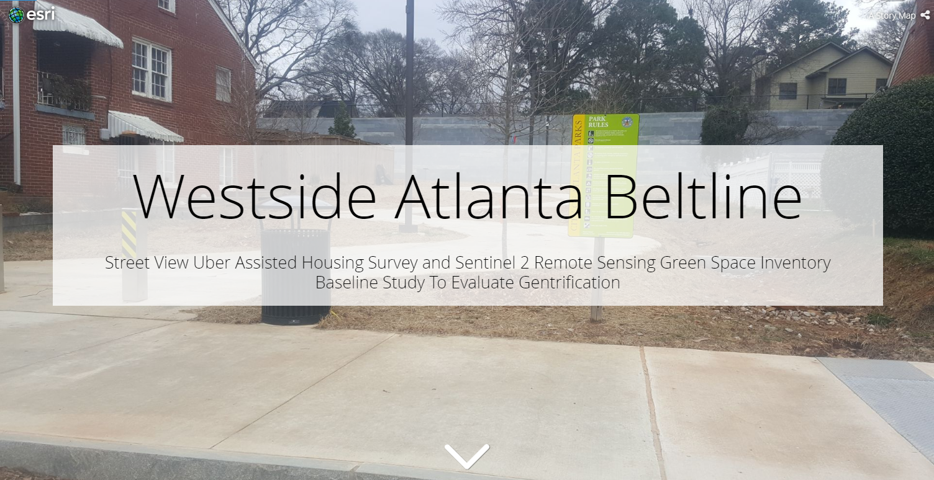
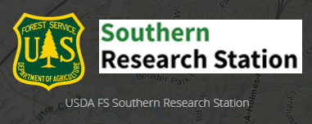
Amanda Aragón
Marguerite Madden
Cassandra Gaiter-Johnson
Center for Geospatial Research
University of Georgia
USDA Forest Service
Sothern Research Station

Slide 2
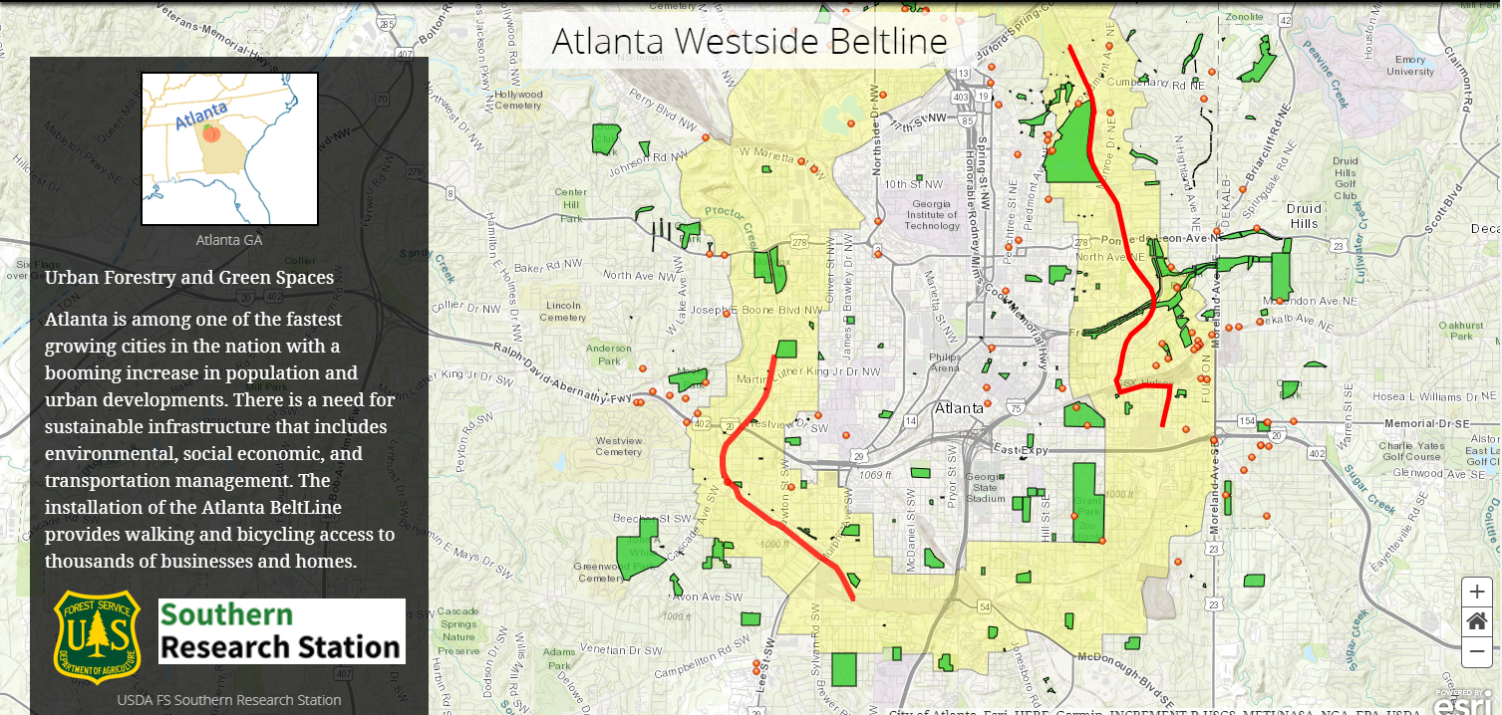

Slide 5
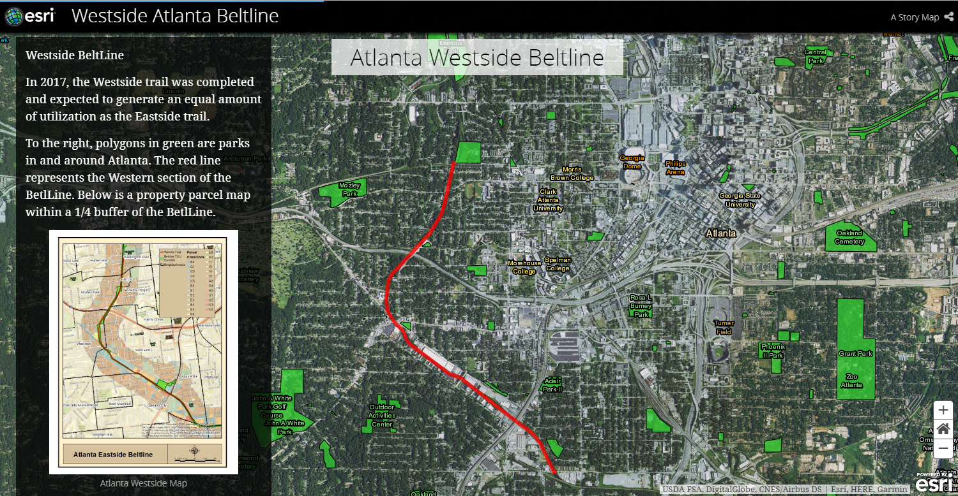

Slide 6
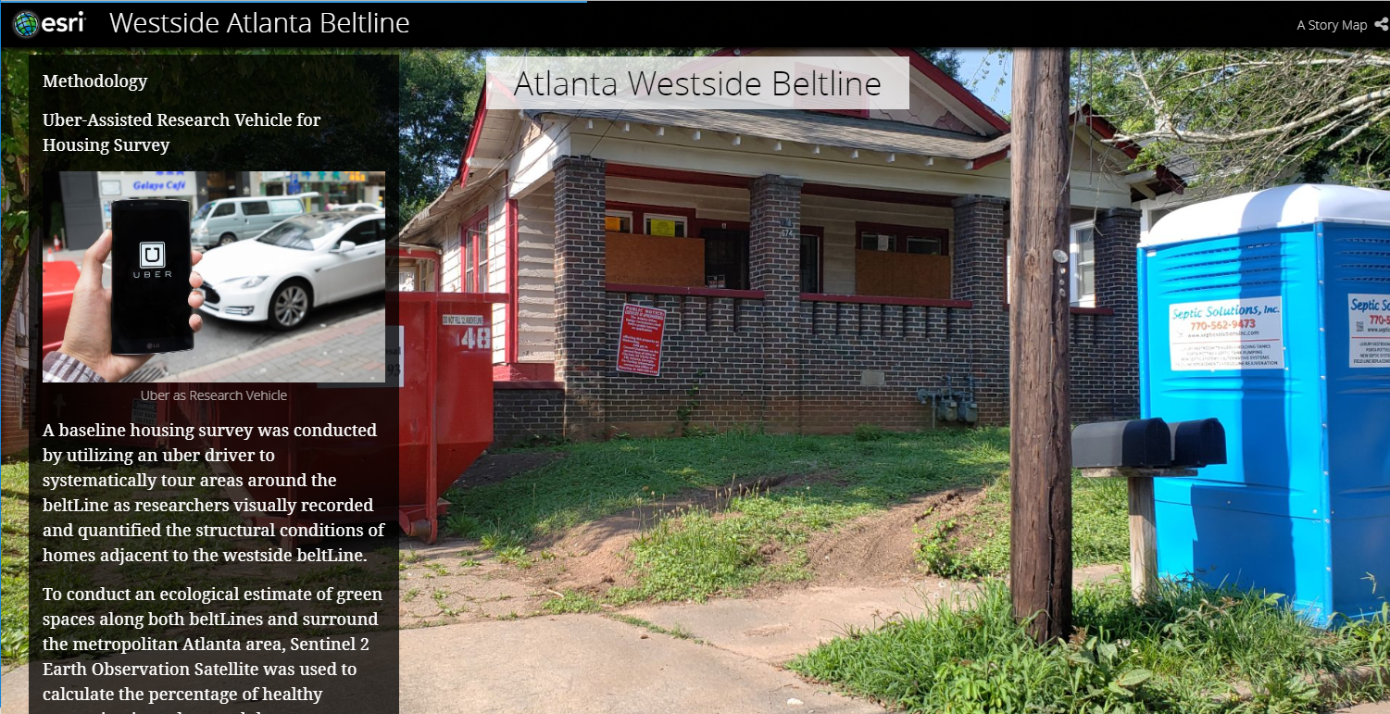

Slide 7
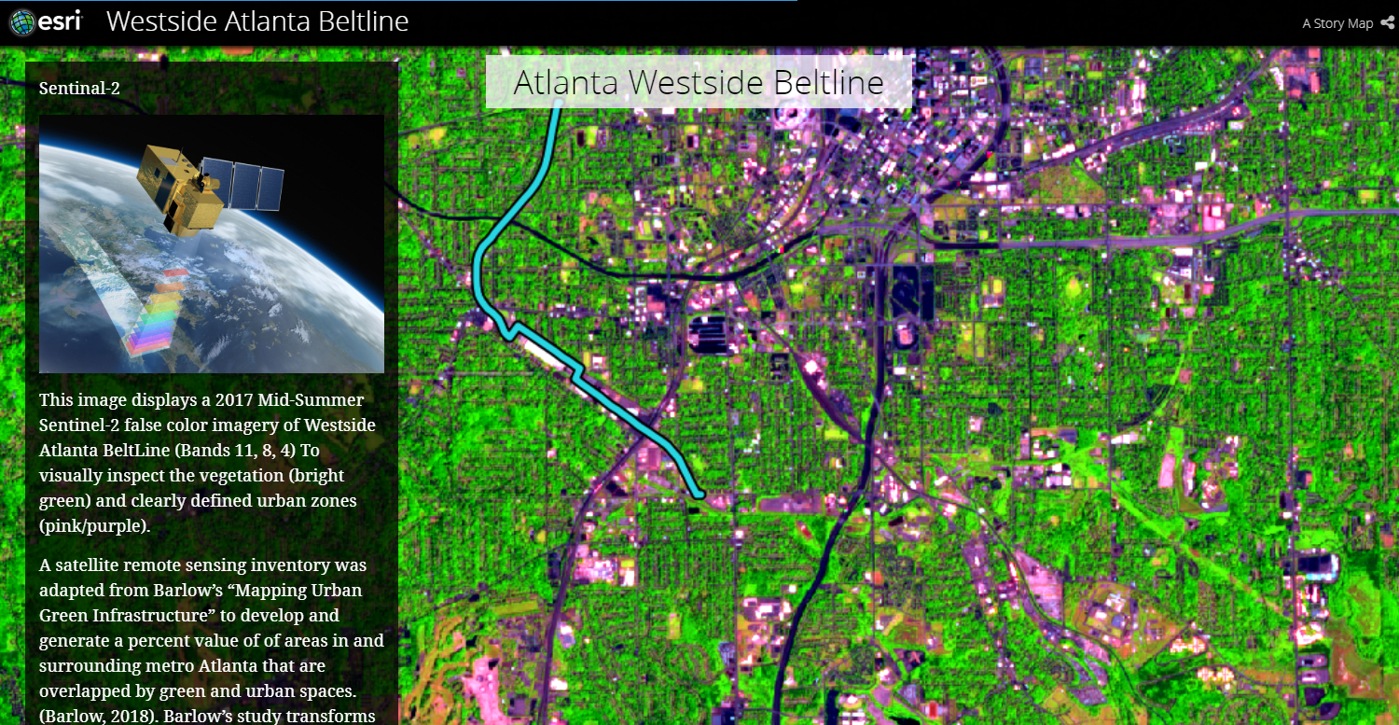

Slide 8
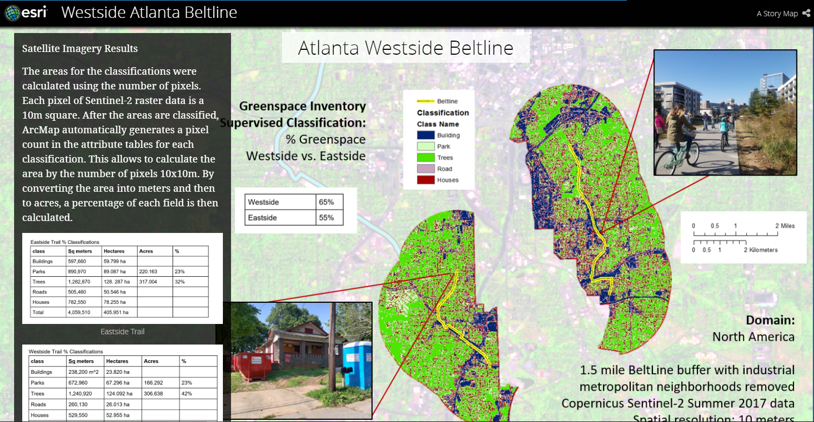

Slide 10
Contact
Amanda D. Aragón
Center for Geospatial Research (CGR)
The University of Georgia
Athens, GA 30602-2503
Story Map Link:
https://usg.maps.arcgis.com/apps/Cascade/index.html?appid=e6cd80bb91554431a1d14287fa8b1213

