Slide 1
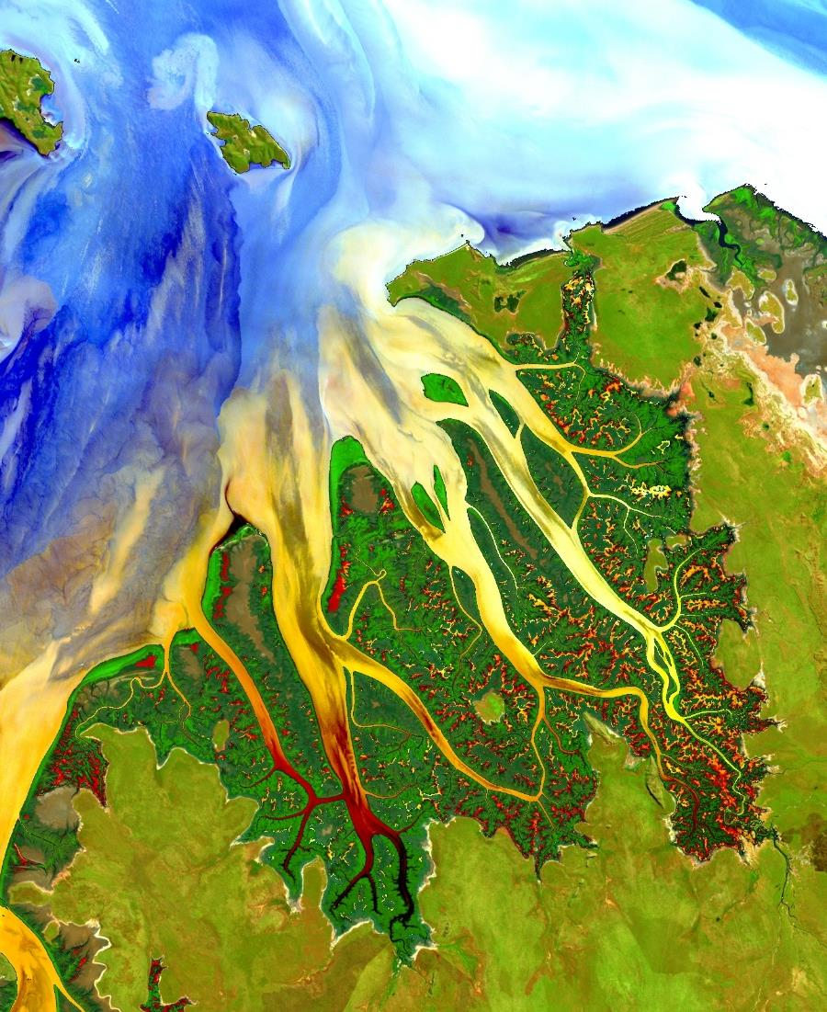
Science Advisors
Involved in NASA DEVELOP National Projects is Win-Win-Win
Marguerite Madden, Science Advisor
Georgia – Athens Node
Center for Geospatial Research
Department of Geography
University of Georgia

Slide 2
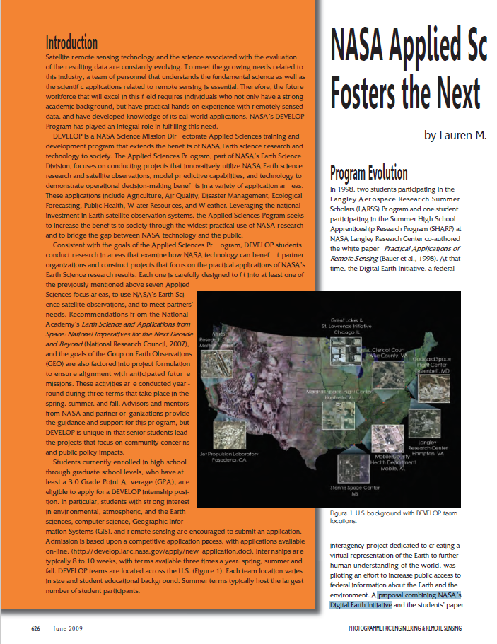
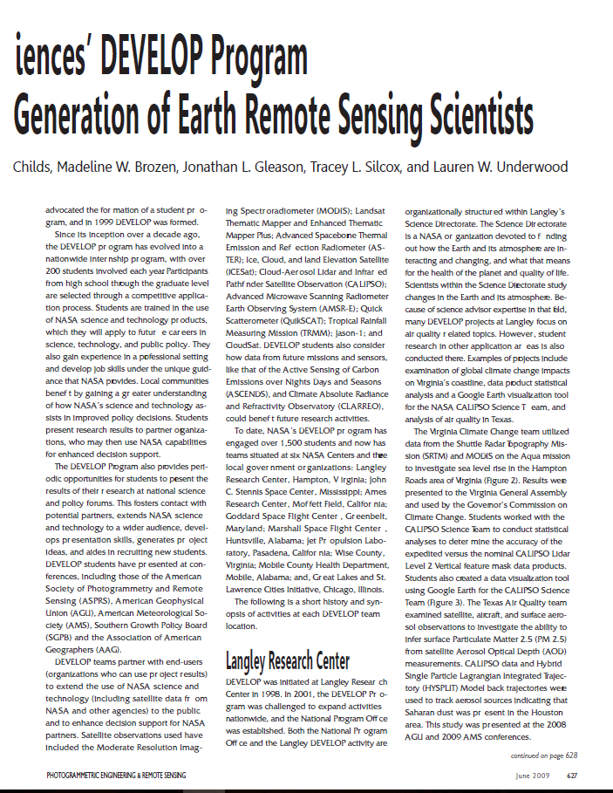
NASA Applied Sciences DEVELOP Program Fosters the Next Generation of Earth Remote Sensing Scientists
By L. Childs, M.W. Brozen, J.L. Gleason, T.L. Silcox and L. Underwood
Photogrammetric Engineering and Remote Sensing, June 2009, pages 626-632

Slide 3
NASA Earth Science
Advancing understanding of the Earth and developing technologies
to improve the quality of life on our home planet.
Earth is a complex, dynamic system we do not yet fully understand, and like the human body, is comprised of diverse components that interact in complex ways. The purpose of NASA's Earth science program is to develop a scientific understanding of Earth's system and its response to natural and human-induced changes, and to improve prediction of climate, weather, and natural hazards.

Slide 4
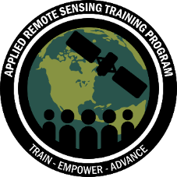
NASA Applied Sciences
Discovering Innovative & Practical Applications of NASA Earth Science
Thematic Application Areas
Capacity Building
Partner with public and private organizations
Discover innovative NASA Earth science applications
Support environmental decision-making activities
Demonstrate practical benefits of NASA Earth science
Help improve the quality of life and strengthen the economy
Agriculture &
Food Security
Water
Resources
Disasters
Eco Forecasting
Energy
Health & AQ
Urban Development
Transportation & Infrastructure

Slide 5
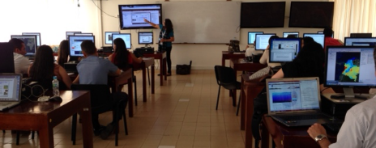
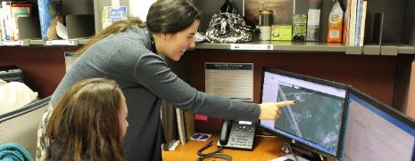
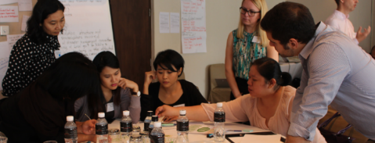
Capacity Building
The Applied Sciences’ Capacity Building Program (CBP) builds capacity within the United States and the developing world to expand use of Earth observations, and increase the awareness within non-traditional audiences of NASA Earth observations data and products.
ARSET
DEVELOP
SERVIR
Provides online and in-person trainings, empowering participants to use NASA Earth data, applications, and models in their research, decisions, and policy.
Addresses environmental and public policy issues by conducting interdisciplinary feasibility projects that apply the lens of NASA Earth observations to community concerns.
Helps developing countries use information provided by Earth observing satellites and geospatial technologies for managing climate risks and land use.

Slide 6
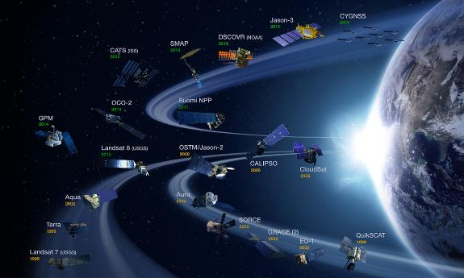
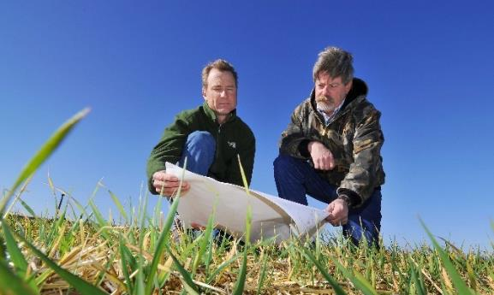
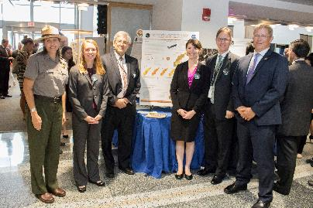
What is DEVELOP?
DEVELOP collaborates with decision makers to conduct feasibility projects that apply NASA Earth observations to address environmental issues. These projects engage young professionals (students and recent graduates) and decision makers in 10-week projects that identify opportunities to use NASA satellite data to create methodologies and tools for project partners. This directly supports both individuals and institutions, and increases the use of Earth observation data and enhances decision and policy making.
NASA DEVELOP
DEVELOP bridges the gap between NASA Earth Science and society,
building capacity in both its participants and end-user organizations to better prepare them to handle the environmental challenges that face society.

Slide 7
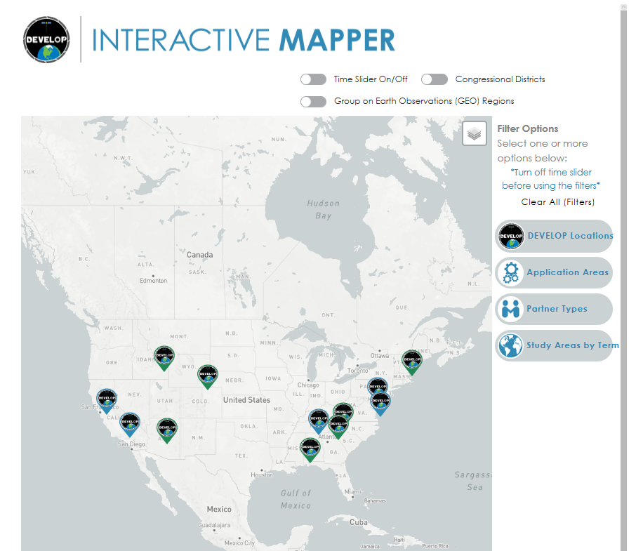
12 Nodes: develop.larc.nasa.gov/about.php
12 NASA DEVELOP Nodes
NASA Nodes
Maryland – Goddard
Virginia – Langley
California – JPL
California – Ames
Alabama – Marshall
NOAA Node
North Carolina – NCEI
Regional Nodes
(Accept International Applicants)
Massachusetts – Boston
Georgia – Athens
Alabama – Mobile
Colorado – Fort Collins
Idaho – Pocatello
Arizona - Tempe

Slide 8
Summer Term 2013 = First DEVELOP Project
Steve Padgett-Vasqauez
2010 MS Biological Sci.
Univ. Alabama-Birmingham
2010-2012 NASA DEVELOP Center Lead, Alabama - Marshall
2012 Univ. of Georgia ICON-Geography PhD
Helped establish the Georgia-Athens Node
2013-2014 Our first Center Lead

Slide 9
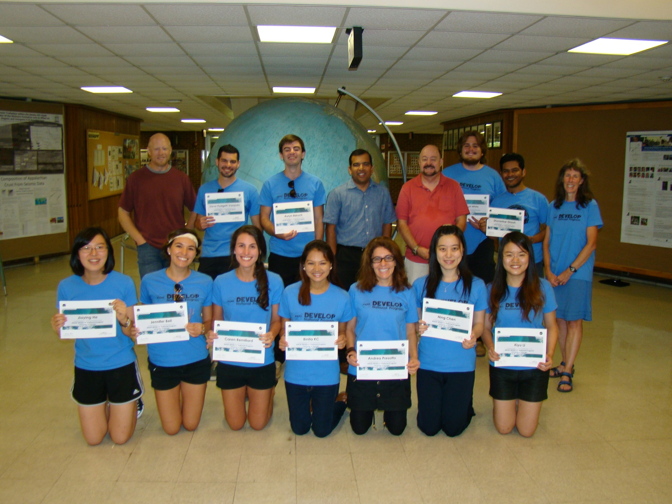
Summer Term 2013 = First DEVELOP Projects
Four Projects:
Brazil Ecological Forecasting
Southeast Air Quality
Georgia Ecological Forecasting
Tennessee Ecological Forecasting

Slide 10
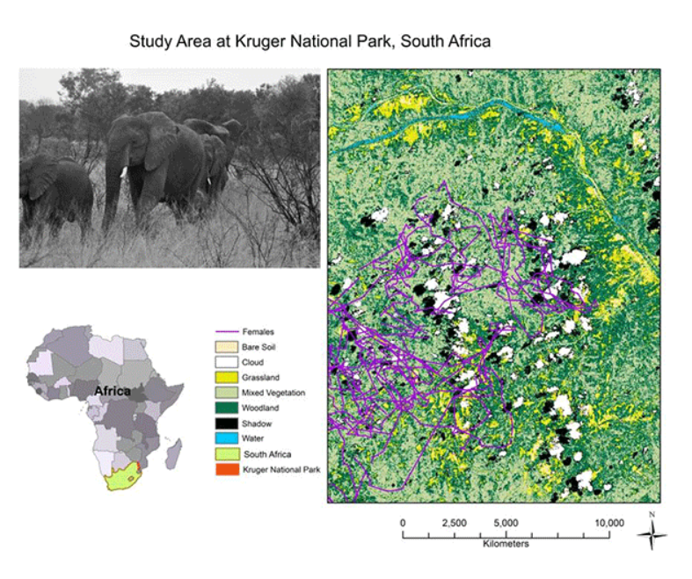
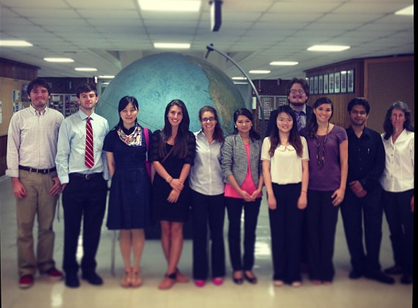
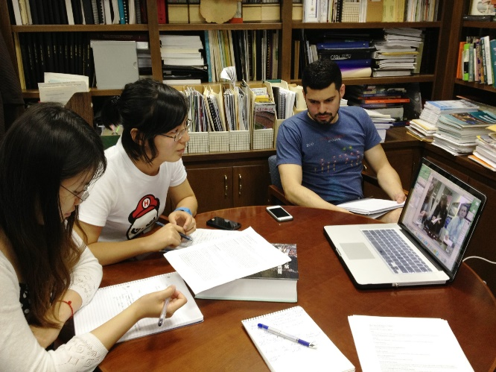
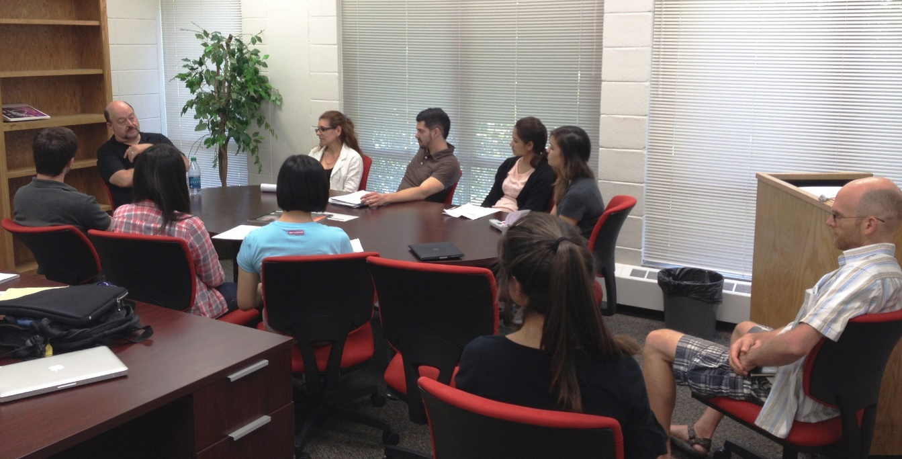
Spring Term 2014
Understanding Landscape Changes in Elephant Habitat within Krugar National Park through NASA Earth Observing Systems

Slide 11
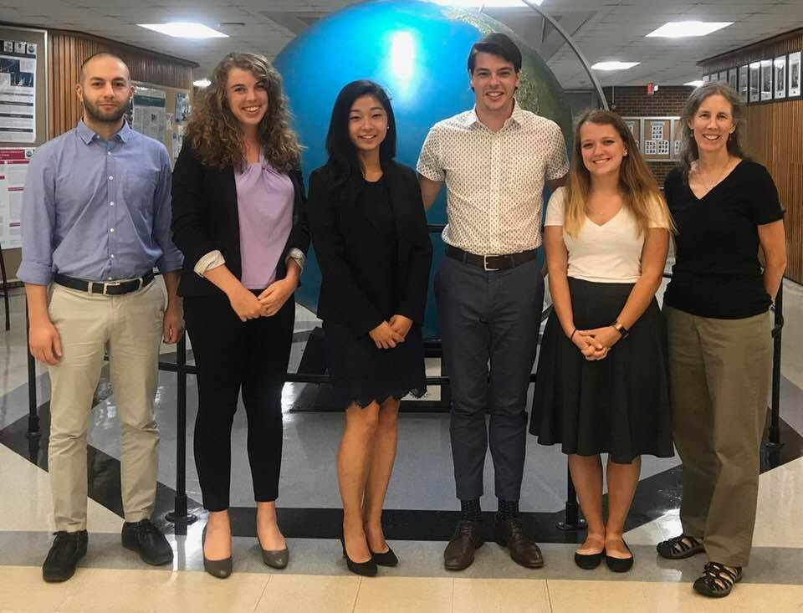
Fall Term 2018 = Many DEVELOP Projects!

Slide 12
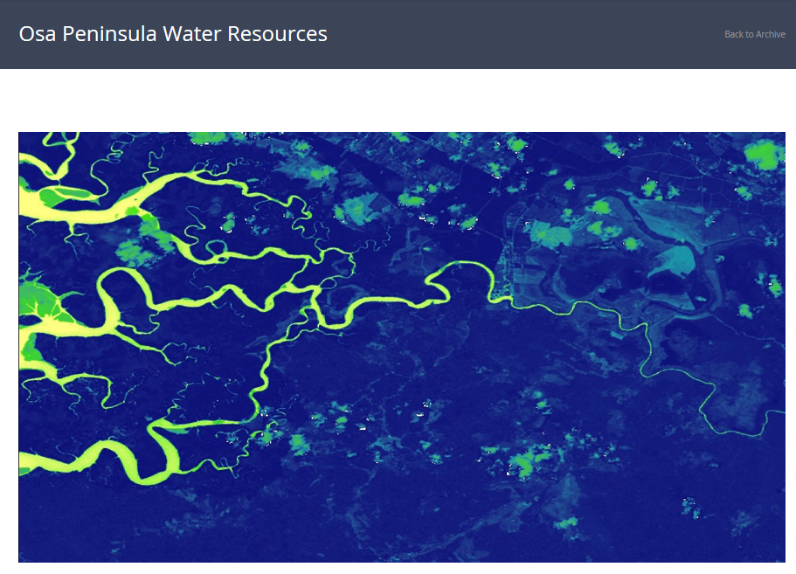
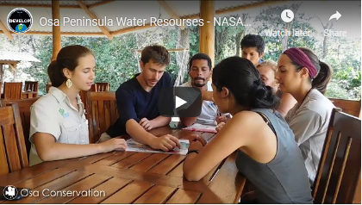
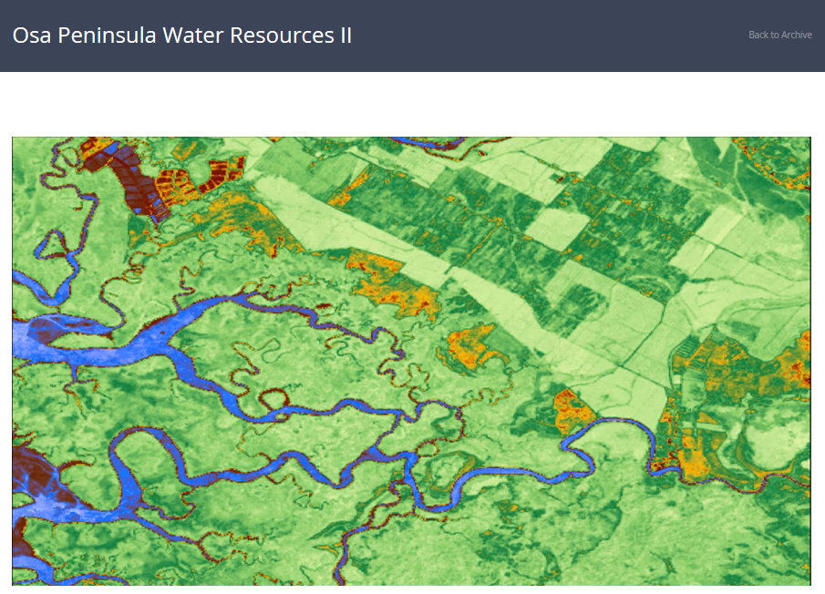
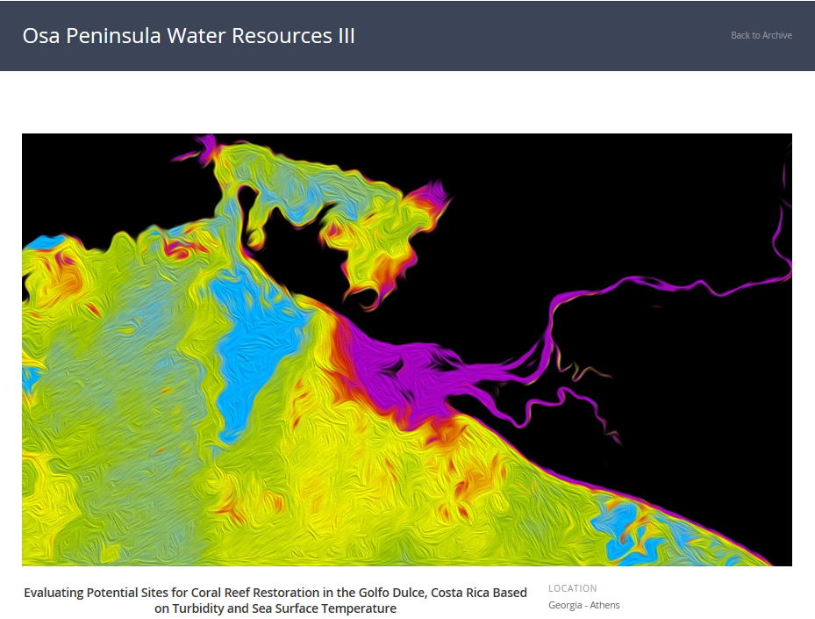
3 Term Project
Partner with Osa Conservation,
Costa Rica
2018 Spring
Osa Peninsula Water Resources I
Assessing Threats to River Water Quality and Mangrove Health based on Watershed Land Use on the Osa Peninsula, Costa Rica
2018 Summer
Osa Peninsula Water Resources II
Utilizing NASA Earth Observations to Evaluate Effects of Land Use Change on Watershed Health and Carbon Sequestration in the Osa Peninsula
2018 Fall
Osa Peninsula Water Resources III
Evaluating Potential Sites for Coral Reef Restoration in the Golfo Dulce, Costa Rica based on Turbidity and Sea Surface Temperature

Slide 13
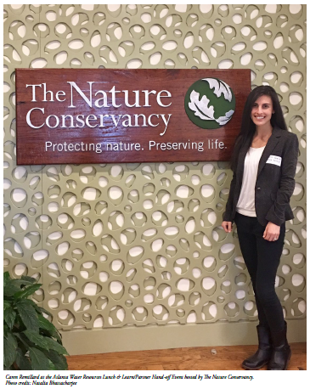
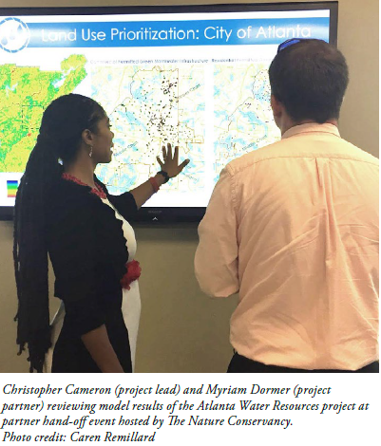
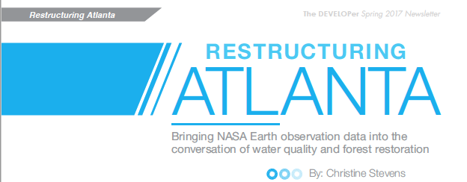
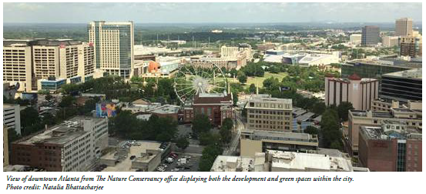
Connection with Partners

Slide 14
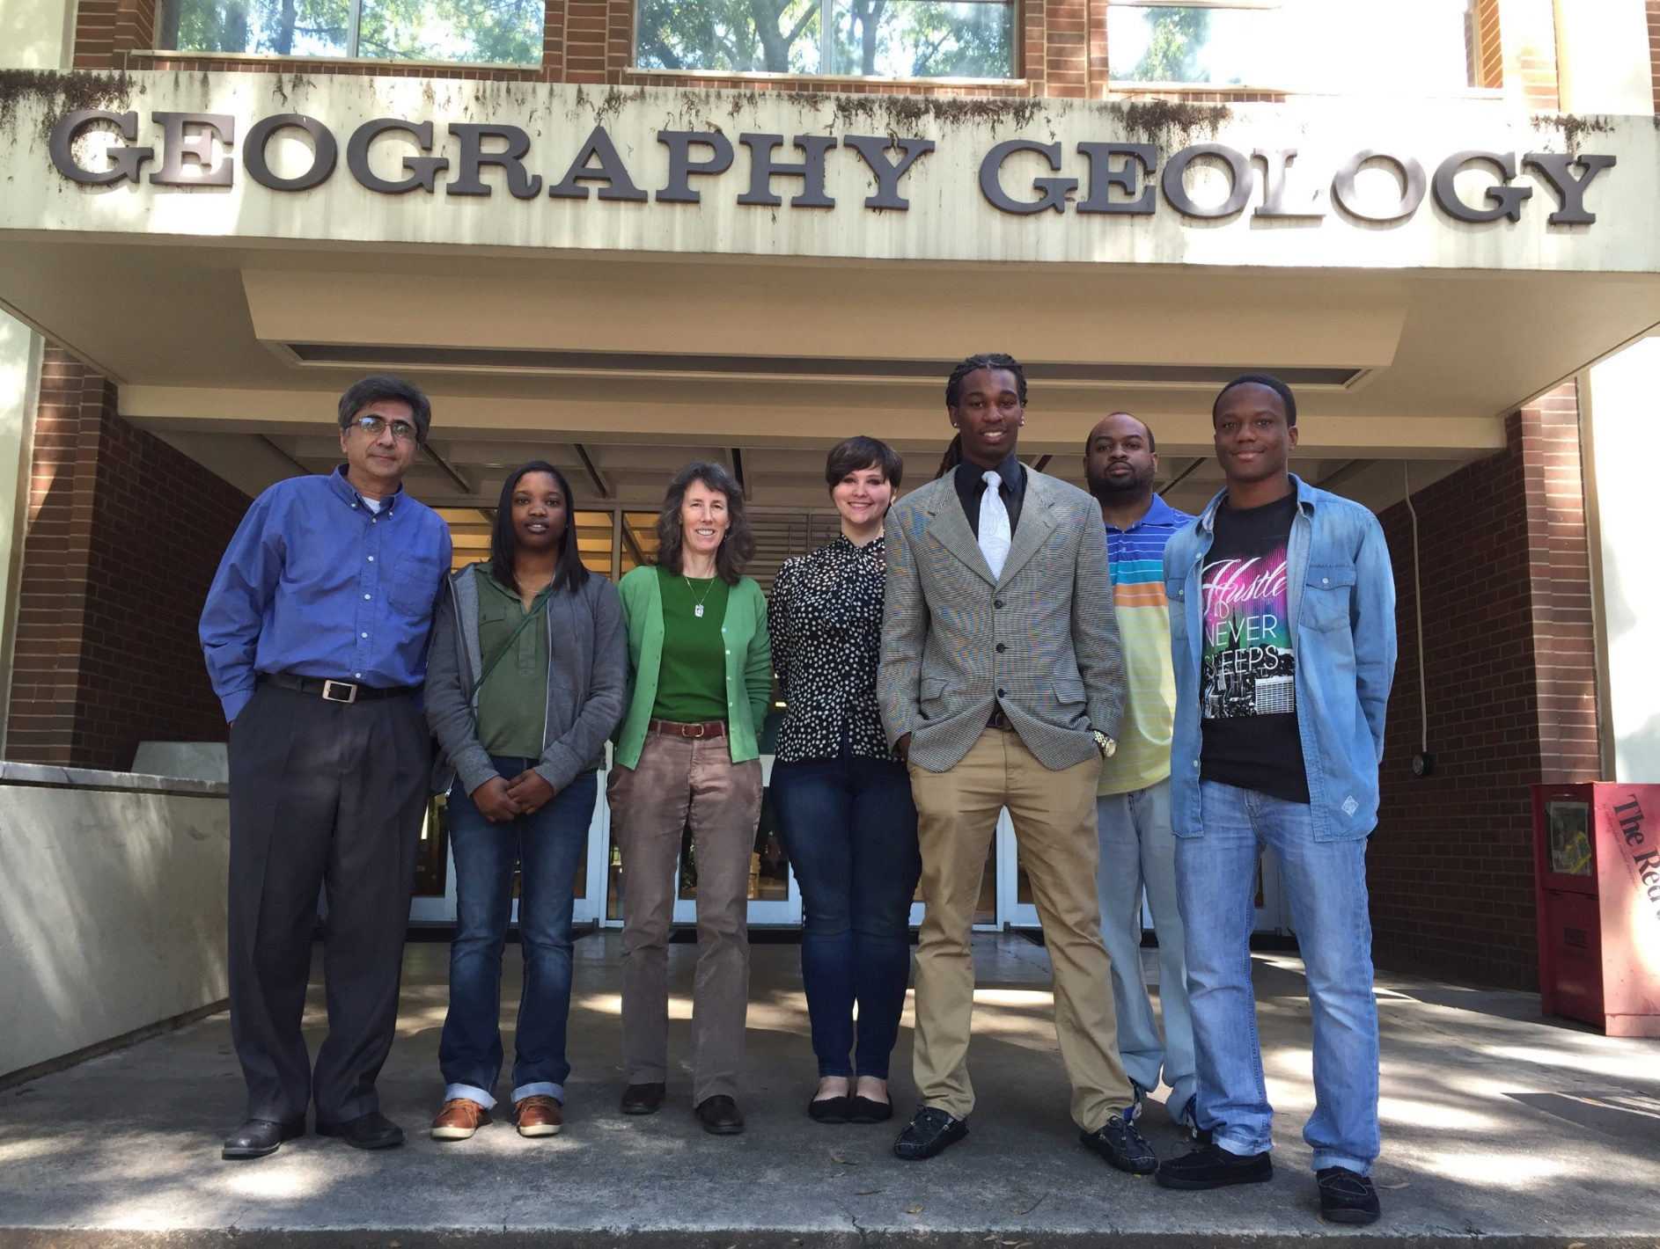
2016 Visit by North Carolina Fayetteville State University
Danielle Quick
2016 BS Biological Sci.
2017 NASA DEVELOP Team Lead, Langley Research Ctr., 2 terms
2017-2018 NASA DEVELOP Impact Analysis Fellow, Alabama – Mobile Node
2018-2019 NASA DEVELOP Impact Analysis Senior Fellow, Langley Research Ctr.
2020 – Graduate School??

Slide 15
ASPRS – NASA DEVELOP Special Sessions
ASPRS 2017, Baltimore, MD

Slide 16
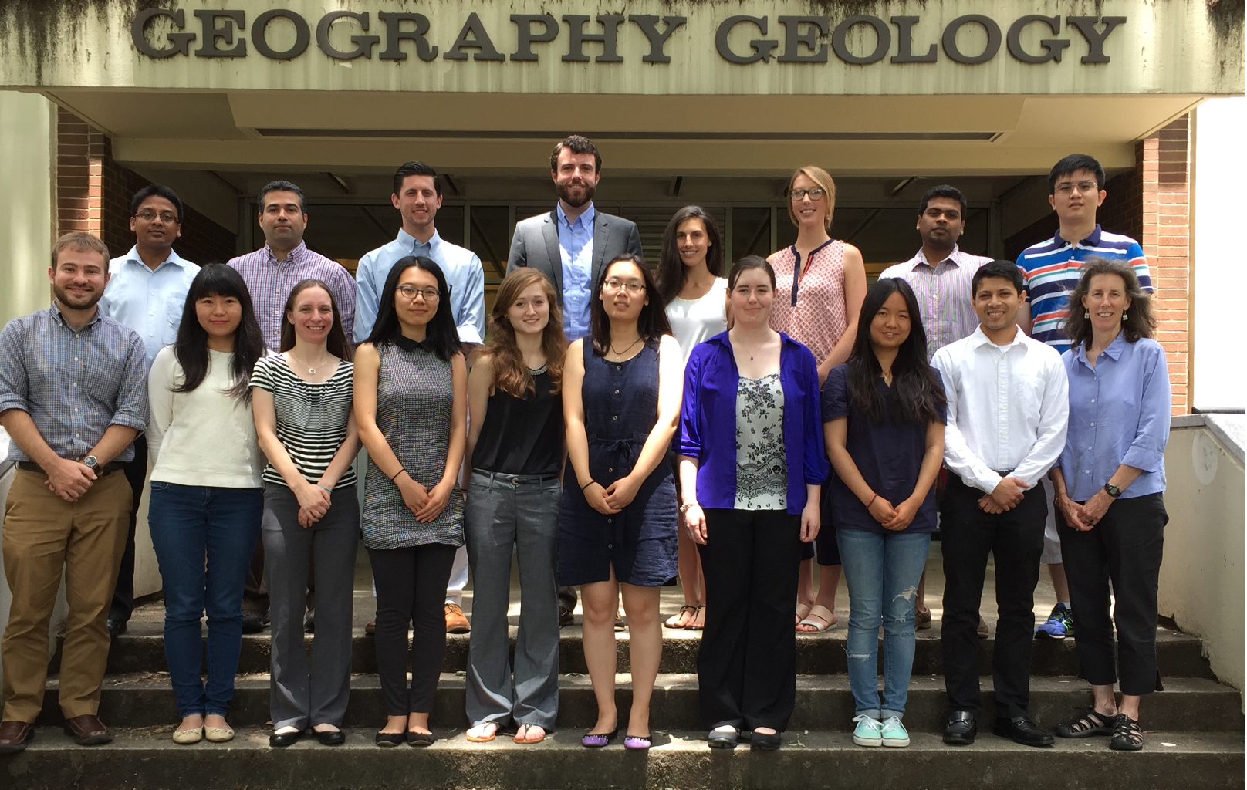
Hope you join us in NASA DEVELOP

Slide 17
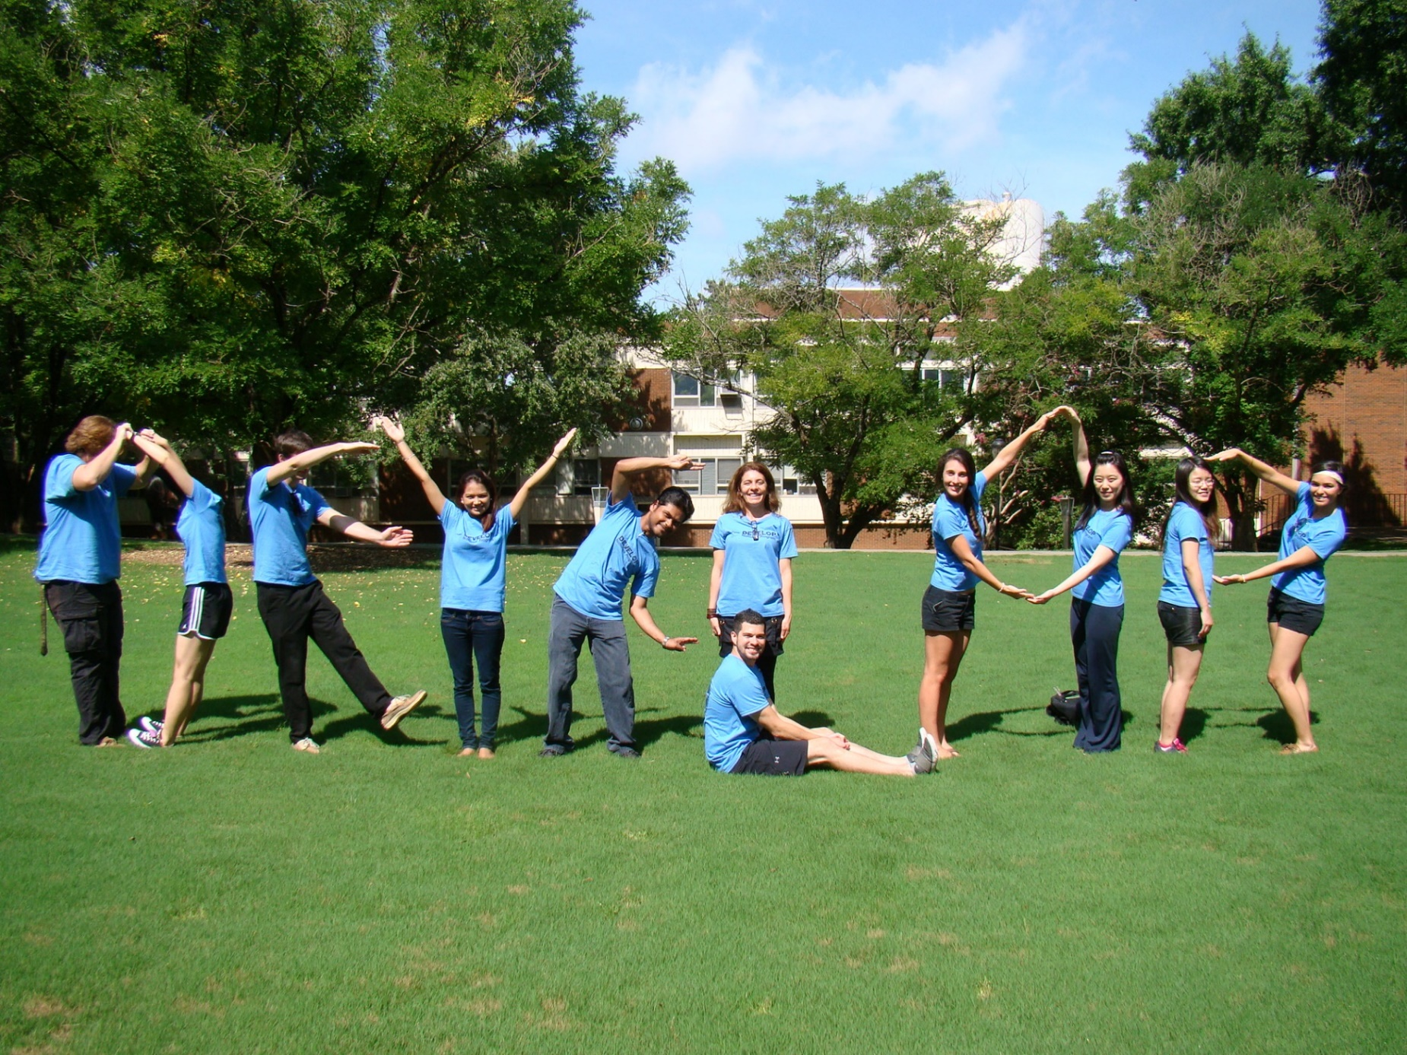
Summer Term 2019 Apply Jan. 21 - March 1

Slide 18
develop.larc.nasa.gov/apply.php
This material is based upon work supported by NASA through contract NNL16AA05C and cooperative agreement NNX14AB60A. Any mention of a commercial product, service, or activity in this material does not constitute NASA endorsement. Any opinions, findings, and conclusions or recommendations expressed in this material are those of the author(s) and do not necessarily reflect the views of the National Aeronautics and Space Administration and partner organizations.

