Slide 1

sUAS Payload Calibration for
Remote Sensing Applications
Mary Pagnutti
mpagnutti@i2rcorp.com
228-688-2452
ASPRS Annual Conference, Denver Colorado
January 30, 2019

Slide 2
Small UAS Camera Calibration
sUAS remote sensing
Radiometric calibration highlights
  MAPIR 3.2MP Kernel Modular Camera
Spatial assessment highlights
  Sony Nex-5T Digital Camera
A note about geometric calibration

Slide 3
sUAS Remote Sensing

Slide 4
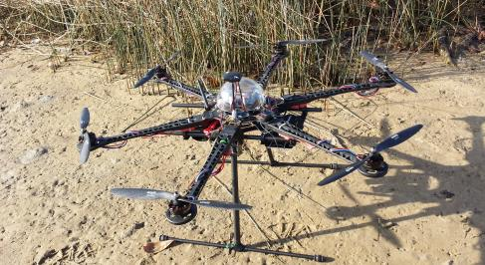
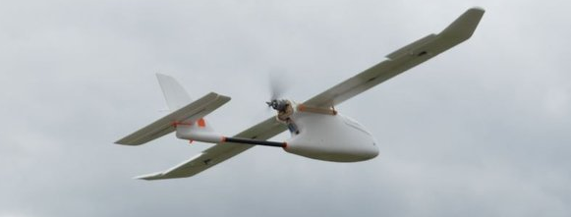
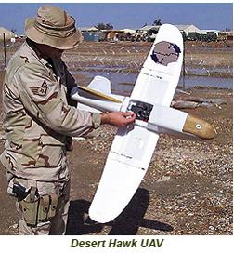
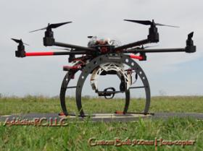
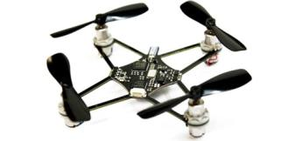
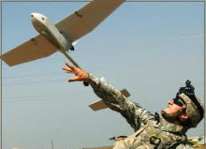
Small Unmanned Aerial Systems (sUAS)
Small lightweight portable UASs
  Typically <5 lbs with a 2-4 ft wing span (fixed wing)
  Carry a small sensor payload
  Battery powered
Fixed wing or rotary
DoD unmanned aircraft provide close-in reconnaissance and situational awareness
Commercial market is
  emerging

Slide 5
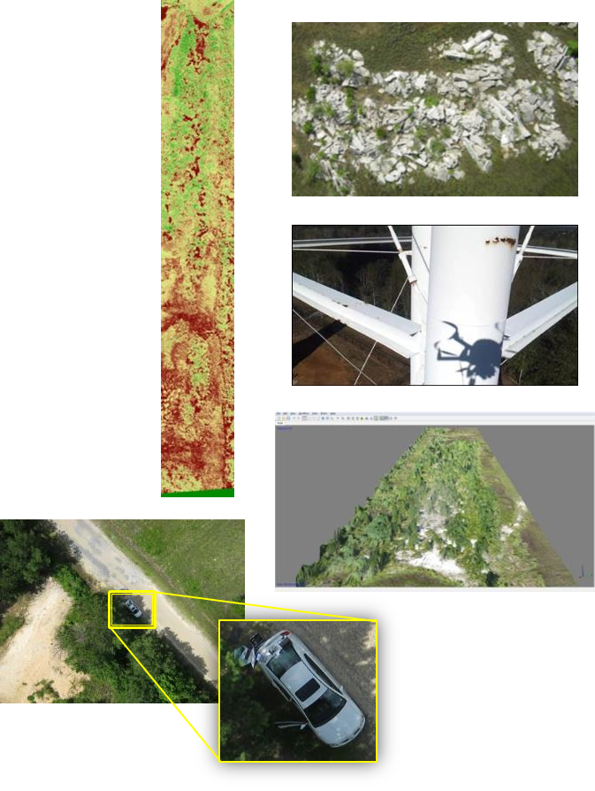
sUAS Applications
Small nimble UASs can monitor small areas with very high resolution imagery (< 2cm and a few mm if desired)
Different than traditional satellite and aerial mapping camera markets used for wide surveillance
Emergency response
  Initial assessment of damage
High resolution utilities assessment
Volumetric measurement of piles
Environmental baselines and monitoring
Facility management - critical infrastructure monitoring
Construction site monitoring

Slide 6
sUAS Remote Sensing
Differences
  Spatial resolution can be orders of magnitude higher than satellite imagers
  Low cost cameras are typically used
    Cameras not usually calibrated
Similarities
  Many applications require quantitative information from repeatable measurements
    Measurements should be independent of camera model and serial no.
    Measurements may need to be tied to National Standards

Slide 7
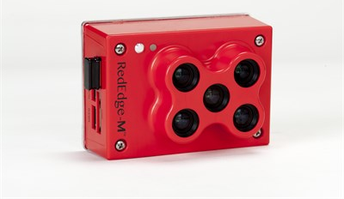
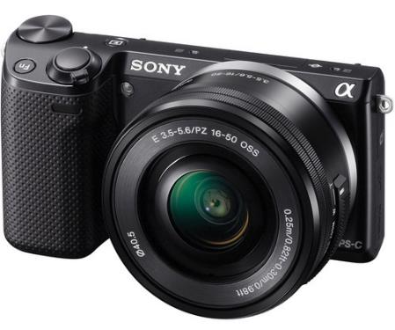

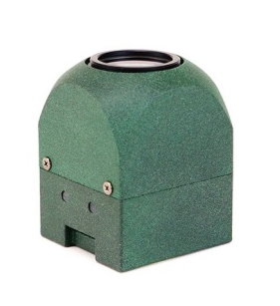
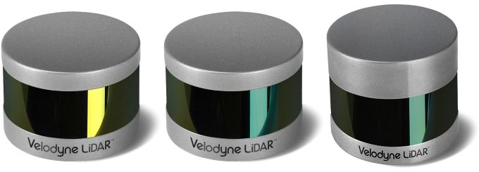
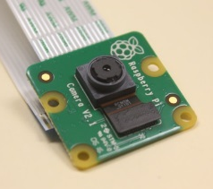
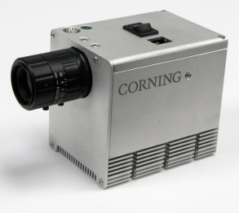
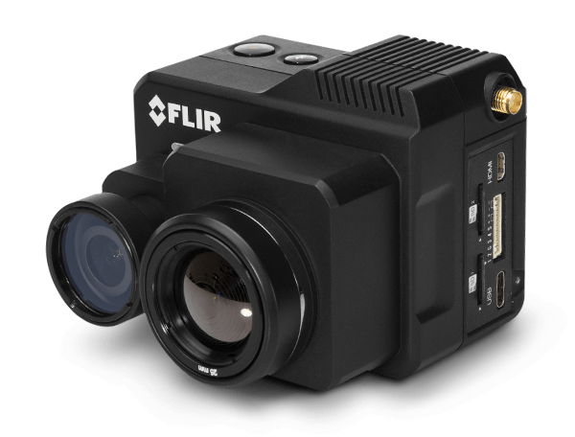
Example sUAS Sensors
Sensor payload types
  VNIR
    Panchromatic
    Multi-band (RGBN, red edge)
    Hyperspectral
  SWIR
  Thermal
  LiDAR
MicaSense Red Edge camera
Sony Nex-5T 16MP
Phase 1 iXM-50 50Mp
MAPIR Kernel
3.2 MP camera
Velodyne VLS-128 LiDAR
RPi 3 Camera
Module V2
Corning 410 Shark
HSI sensor
FLiR Duo Pro R

Slide 8
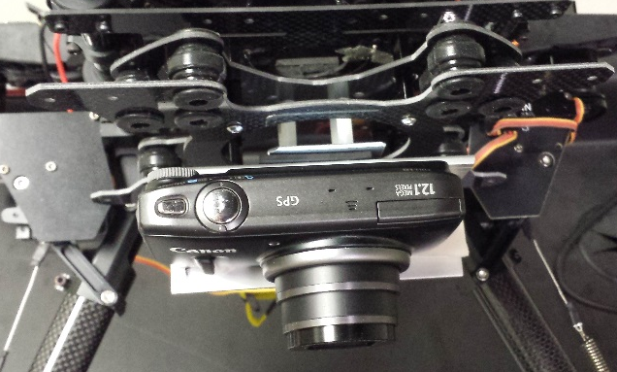
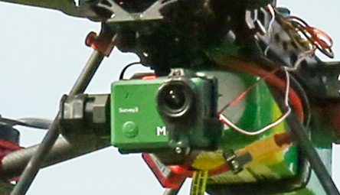
sUAS VNIR Imaging Sensors
Imaging cameras
  Most based on Silicon CMOS (~300-1000nm)
  Small detectors and small well capacities
  Low read noise
  Custom systems with direct georeferencing
Sony Nex-5T
MAPIR Survey 3

Slide 9



FAA sUAS Operating Rules
Aircraft Requirements
  Must be registered if over 0.55 lbs.
  Must perform pre-flight checks
Location Requirements
  Class G airspace (or waiver)
Operating Rules
  Must keep aircraft in sight
  Must fly under 400 ft (122 m)
  Must fly during the day
  Must fly at/below 100mph
  Must yield right of way to manned aircraft
  Must not fly over people
VLOS < ~1500 m
Z < 122 m
Flying for commercial use comes under Title 14 of the Code of Federal Regulations (14 CFR) Part 107

Slide 10
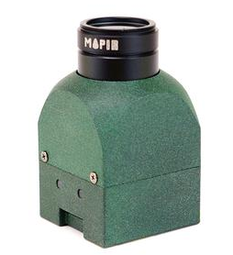

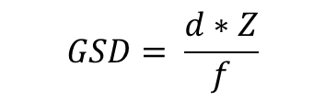
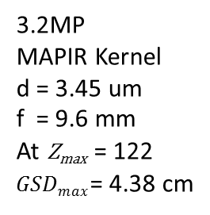
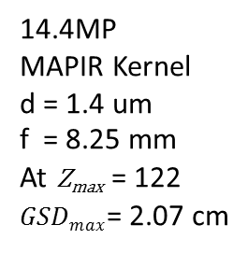

Relationship Between GSD and Altitude
Detector size, d
$$d$$
$$GSD= \frac{d∗Z}{f}$$
Focal Length, f
Lens
Altitude, Z
(limited by FAA)
14.4MP
MAPIR Kernel
d = 1.4 um
f = 8.25 mm
At Z_{max} = 122
$GSDmax$= 2.07 cm
3.2MP
MAPIR Kernel
d = 3.45 um
f = 9.6 mm
At Z_{max} = 122
$GSDmax$= 4.38 cm
$$GSD$$

Slide 11
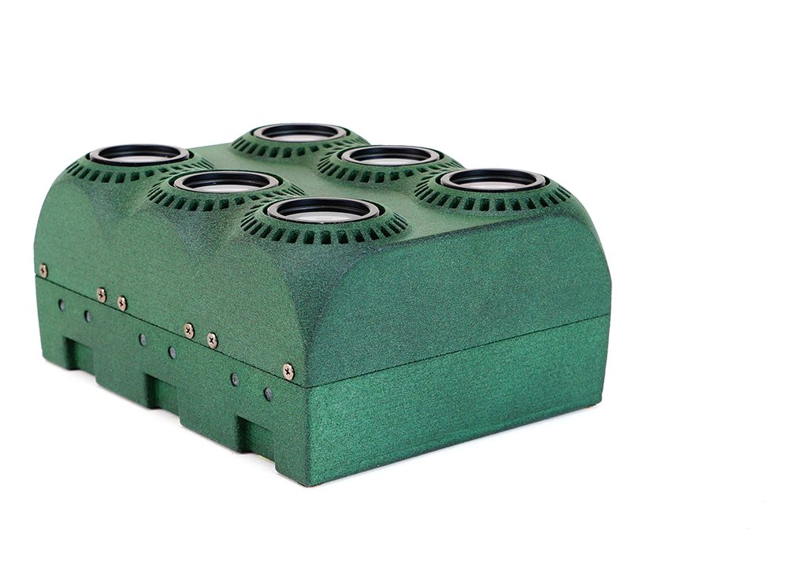
Radiometric Calibration Highlights
MAPIR Kernel Modular Camera
3.2MP

Slide 12
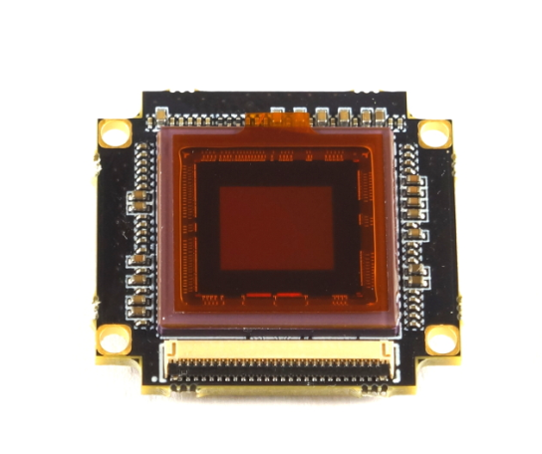
MAPIR Kernel 3.2MP Camera and Sensor Specifications
Sensor Parameter | Specification
Image Sensor Type | Back-illuminated CMOS (Mono)
Sensor | Sony
Number of Active Pixels | 2048 x 1536 ~ 3.2 MP
Sensor Size | 7.06 mm (H) x 5.30 mm (V)
Pixel Size | 3.45 μm (H) x 3.45 μm (V)
Bit Depth | 12-bit raw / 16-bit tiff
Max Full-Frame Frame Rate | 2 frames/sec
Shutter | Global
Camera Parameter | Specification
Lens Focal Length | 9.6 mm
F-Number | 3.0
Instantaneous Field of View (IFOV) | 0.360 mrad
Full-Frame Field of View (FOV) | 40.8 deg (H) x 30.6 deg (V)
Hyperfocal Distance | 5.13 m
Filter Options (17) | 405nm, 450nm, 490nm, 518nm, 550nm, 590nm, 615nm, 632nm, 650nm, 685nm, 725nm, 780nm, 808nm, 850nm, 880nm, 940nm, 945nm

Slide 13

MAPIR Kernel 3.2MP Camera Radiometric Calibration
Radiometric Calibrations
  Dark frame assessment
  Linearity evaluation
    Linearity with ISO setting
    Linearity with exposure time
  Flat fielding
  Absolute radiometric calibration
    Spectral response measurement

Slide 14
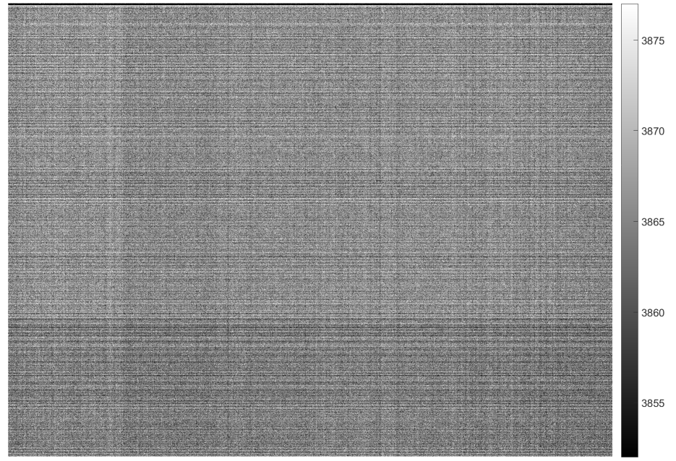
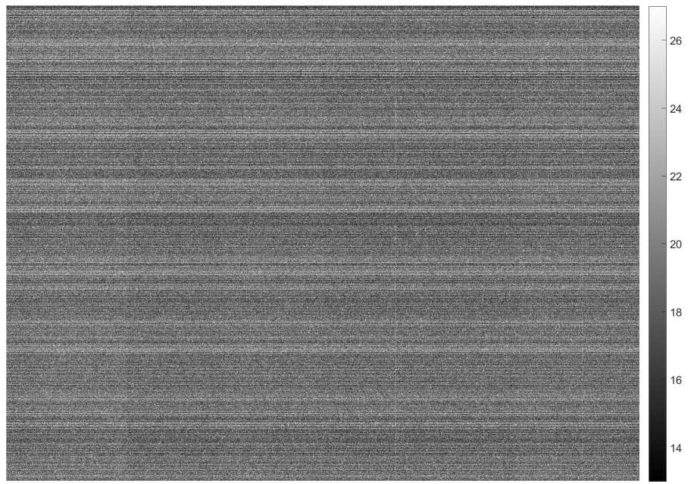
MAPIR Kernel 3.2MP Dark Frame Assessment
Dark frame assessment quantifies and corrects for the camera’s fixed-pattern noise bias
Acquired 30 frames of dark data (after warm-up)
Statistical assessment
  Min, max, mean, median, temporal (frame-to-frame) standard deviation
Dark frame mean
Dark frame standard deviation
ISO 100 / Exposure 28 (“1/12”, 83.3ms)

Slide 15
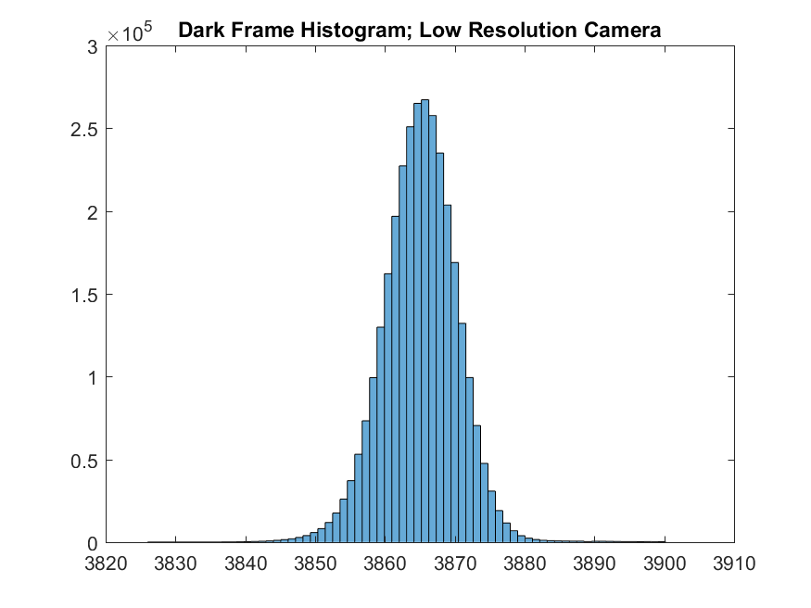
MAPIR Kernel 3.2MP Dark Frame Assessment
 | Dark Frame Values
Min | 3826
Max | 18071
Mean | 3846
Median | 3865
STD | 22.28
ISO 100 / Exposure 28 (“1/12”, 83.3ms)

Slide 16
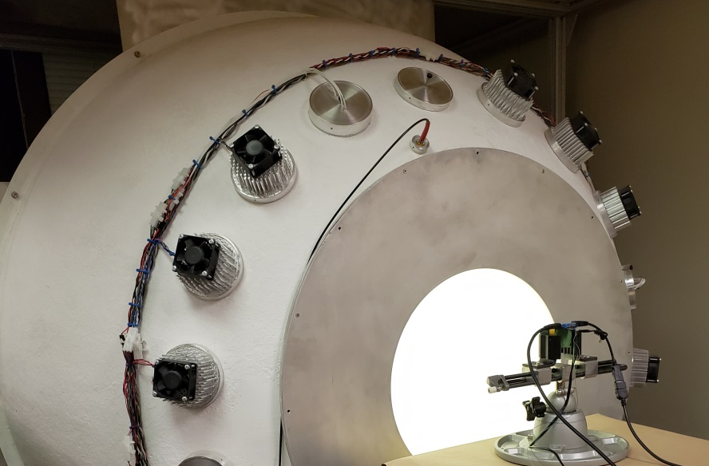
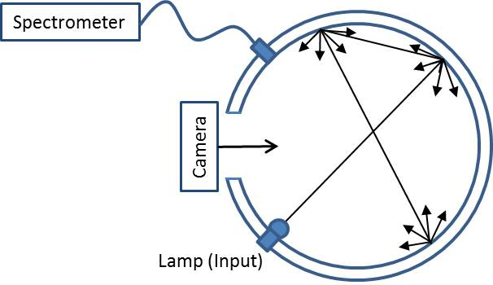
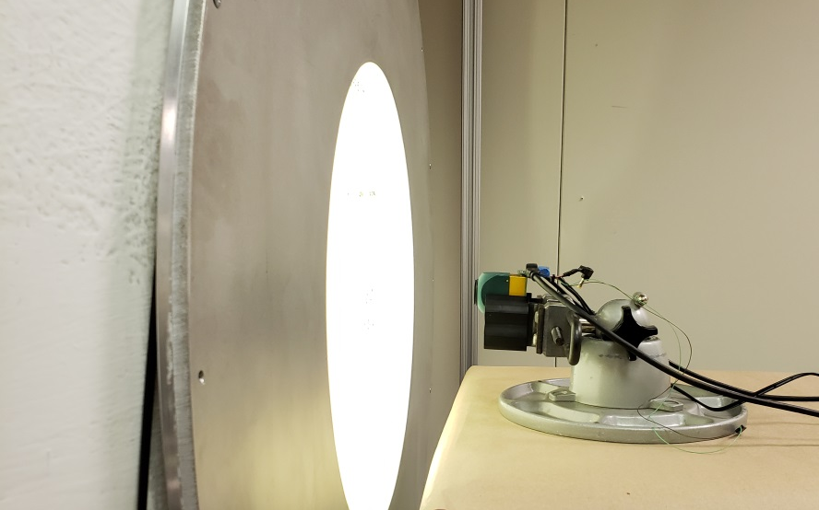
Uniform Illumination using Laboratory Integrating Spheres
NIST-traceable
Highly reflective
Lambertian surface
I2R 1.5m diameter integrating sphere
Lamped with QTH lamps, white LEDs and RGBN LEDs

Slide 17
MAPIR Kernel 3.2MP Linearity Evaluation Method
Linearity evaluation performed by exposure time and by ISO
  By Exposure at ISO 200
  By ISO at Exposure 17 (“1/160”, 6.25ms)
Linearity evaluation used median of 6 bright uniform frames acquired at each exposure or ISO
  Mean of a subset of center pixels calculated for each exposure or ISO and plotted
  Mean values were fit to a line, and residuals were reviewed to evaluate linearity

Slide 18
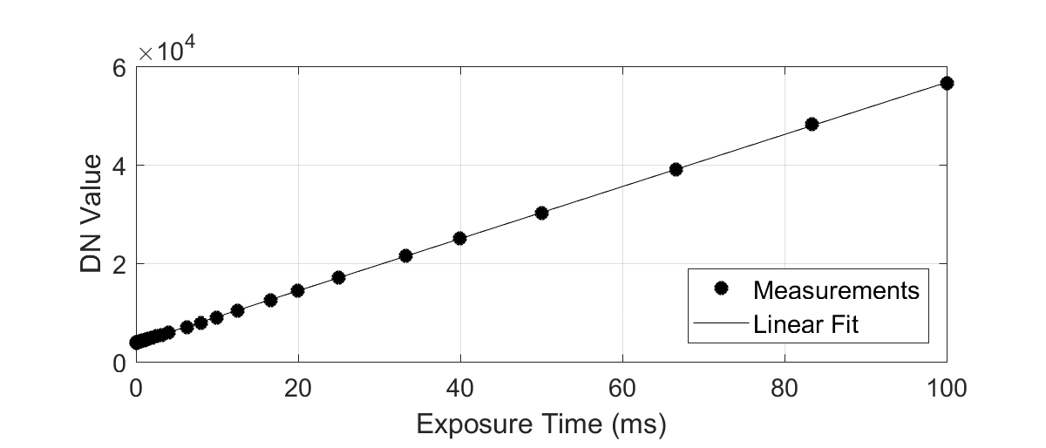
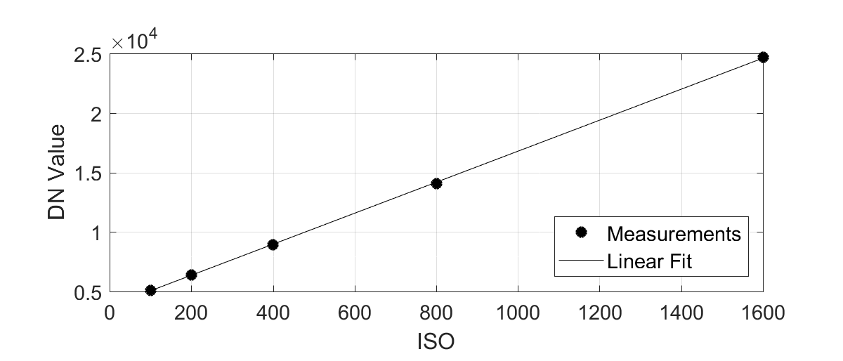
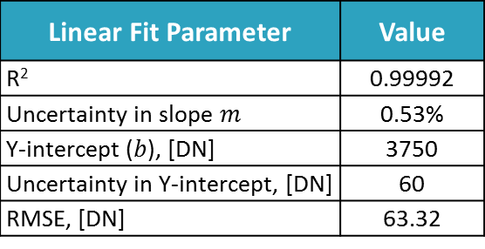
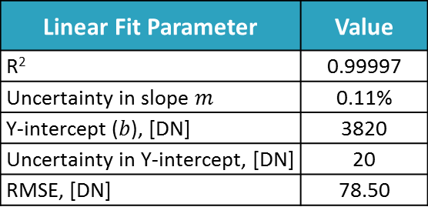
MAPIR Kernel 3.2MP Linearity with Exposure Time and ISO
Linear Fit Parameter | Value
R² | 0.99997
Uncertainty in slope $m$ | 0.11%
Y-intercept ($b$), [DN] | 3820
Uncertainty in Y-intercept, [DN] | 20
RMSE, [DN] | 78.50
Linear Fit Parameter | Value
R² | 0.99992
Uncertainty in slope $m$ | 0.53%
Y-intercept ($b$), [DN] | 3750
Uncertainty in Y-intercept, [DN] | 60
RMSE, [DN] | 63.32

Slide 19
MAPIR Kernel 3.2MP Flat Fielding Method
Flat fielding corrects for lens roll-off and other artifacts
Images acquired of bright uniform calibration sphere
  120 frames of data collected at different viewing geometries to remove any minor sphere defect effects
  Exposure 28 (“1/12”, 83.3ms)
  ISO 100
Median of all bright images produced the flat field image
  Flat field surface normalized to unity using the mean of a subset of pixels from the center of the image
  Different cross sections extracted and reviewed

Slide 20
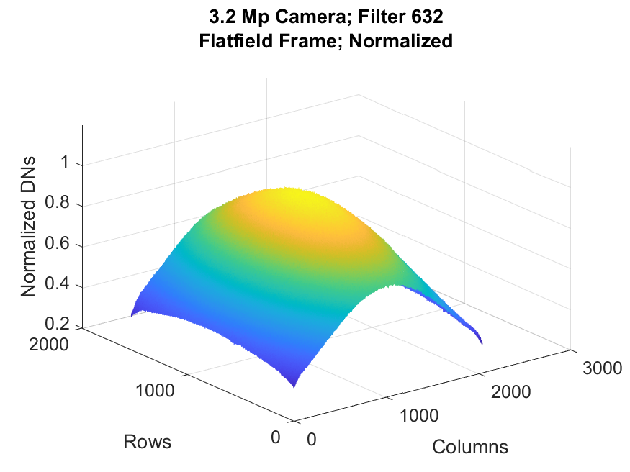
MAPIR Kernel 3.2MP Flat Fielding
Exposure setting = 83.3 ms
ISO = 100
632 nm filter

Slide 21
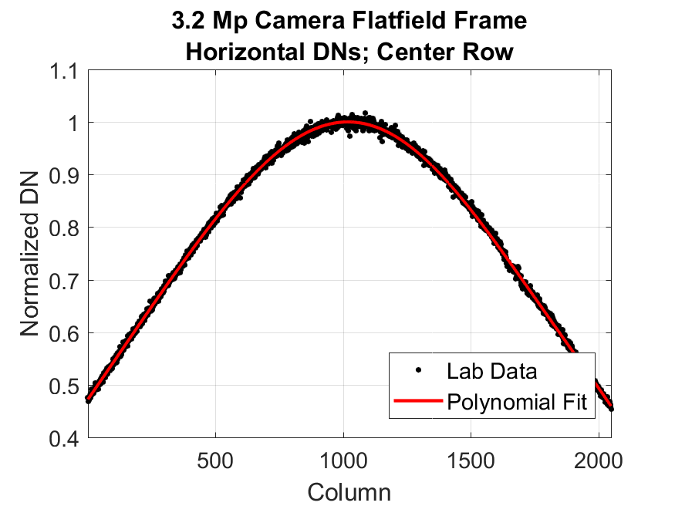
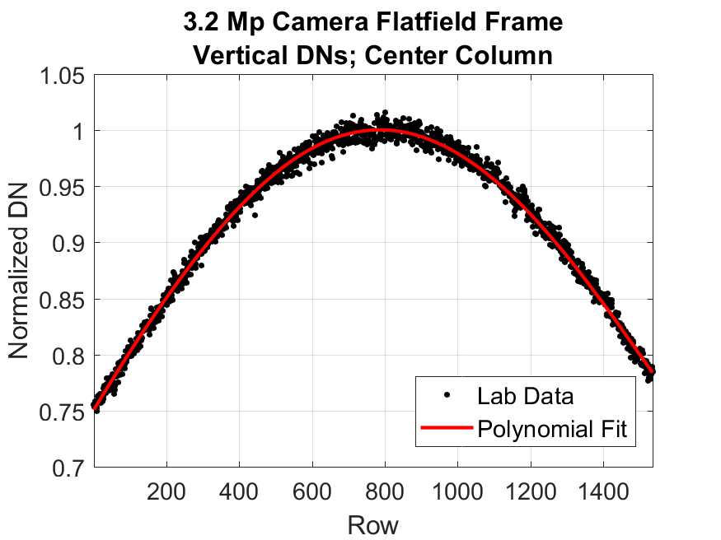
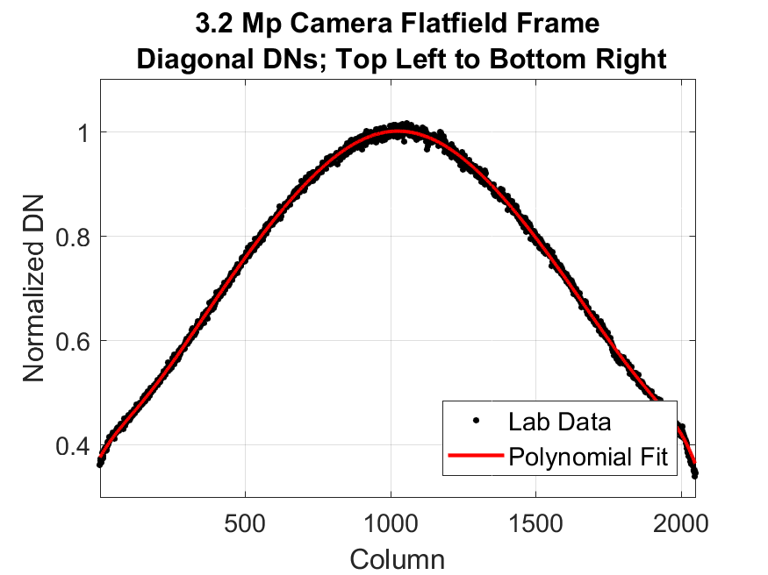
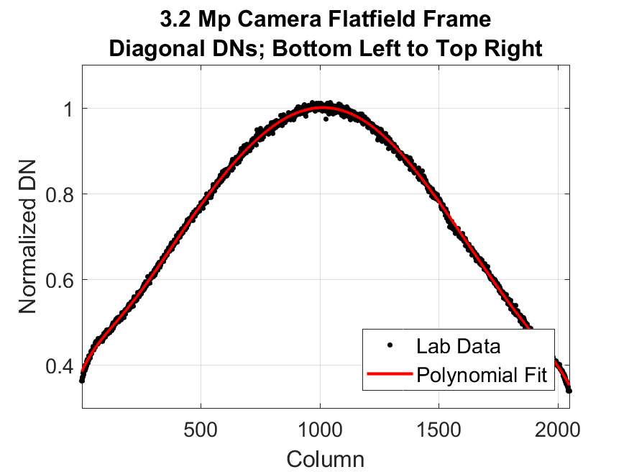
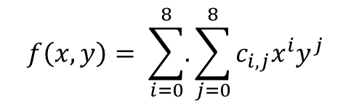
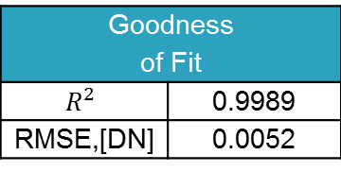
MAPIR Kernel 3.2MP Flat Fielding
Transects fit to a polynomial in the form:
$$f\left(x,y\right)= \sum_{i=0}^{8}{.}\sum_{j=0}^{8}{c_{i,j}x^{i}y^{j}}$$
Goodness of Fit
$$R^{2}$$ | 0.9989
RMSE,[DN] | 0.0052

Slide 22
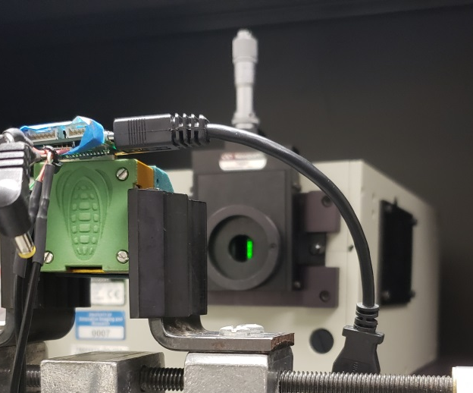
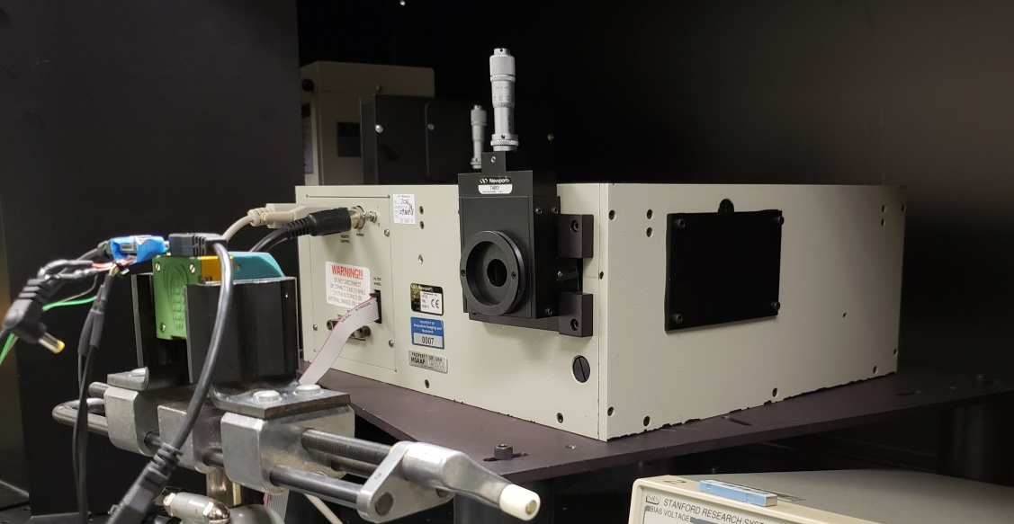
MAPIR Kernel 3.2MP Spectral Response Measurements
Spectral response is a measure of how each detector responds to a given input illumination as a function of wavelength
Multiple filters evaluated
  450, 490, 518, 550, 615, 650, 685, 725, 780, 808, 850 nm

Slide 23
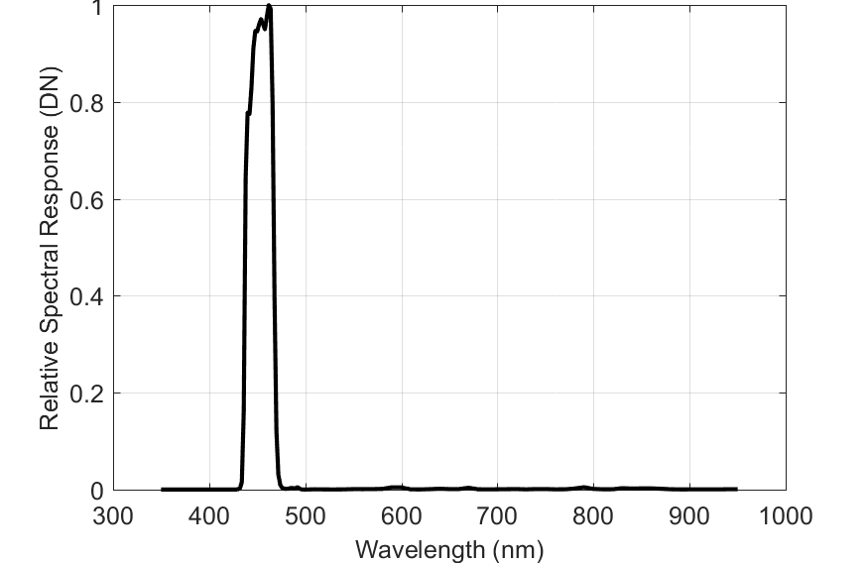
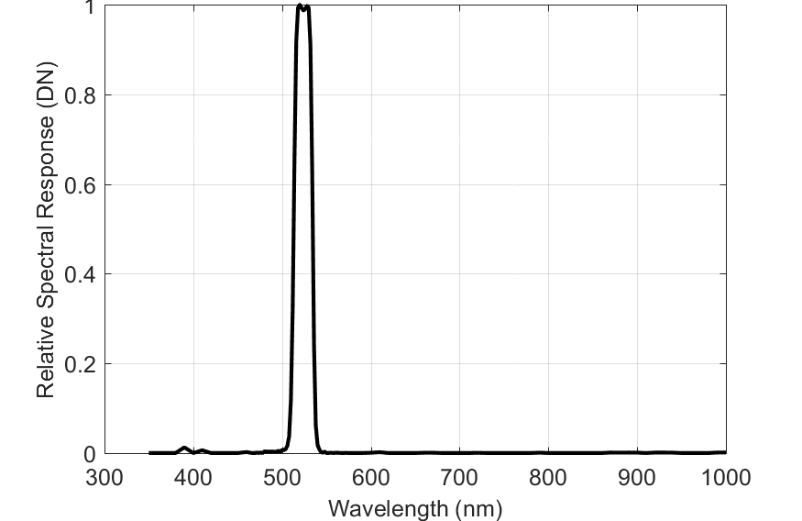
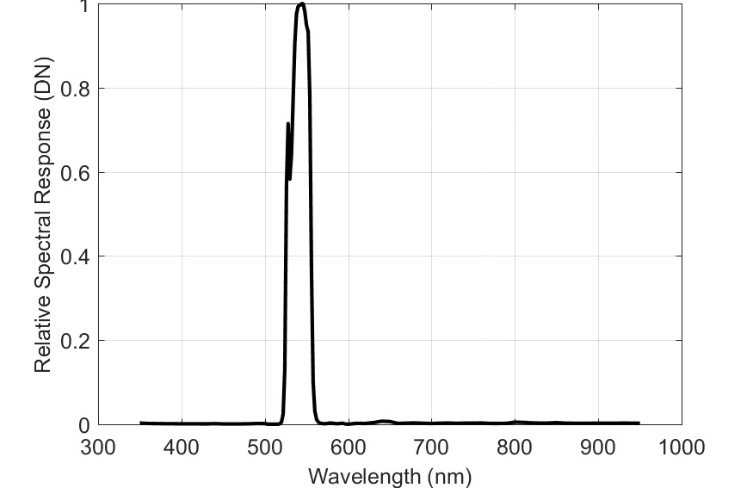
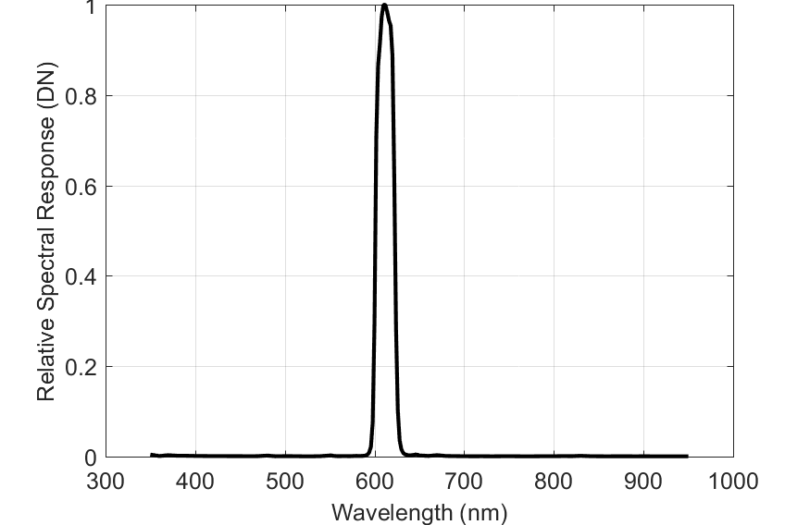
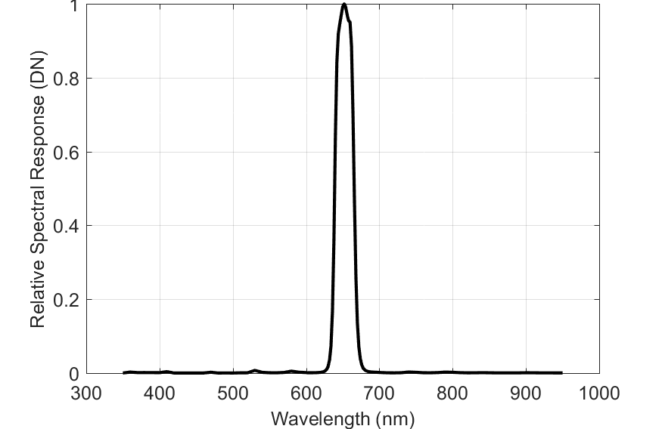
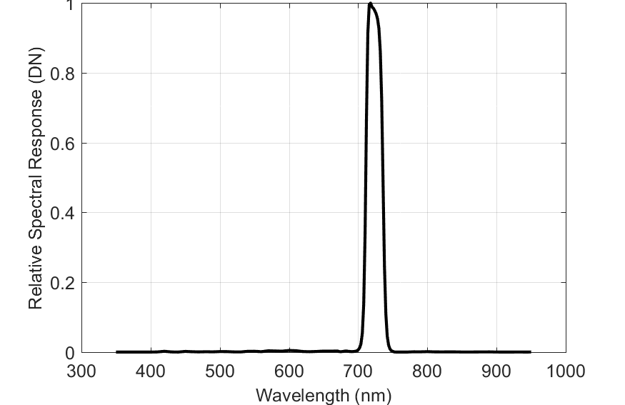
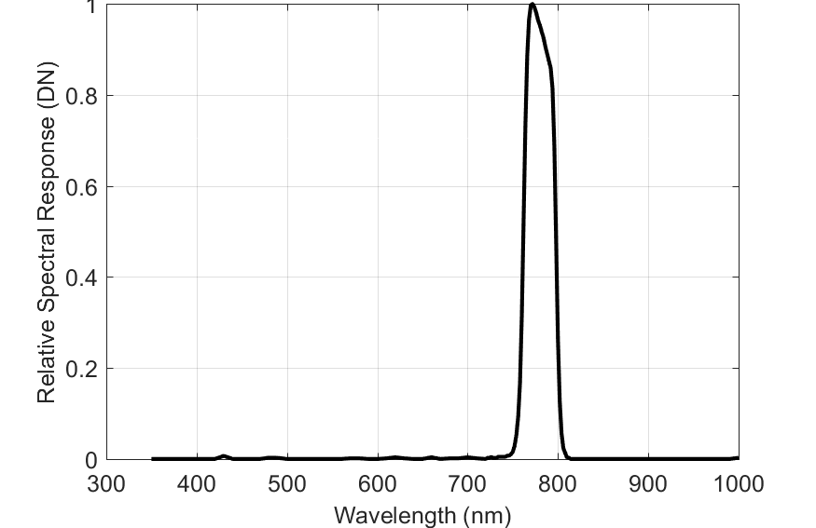
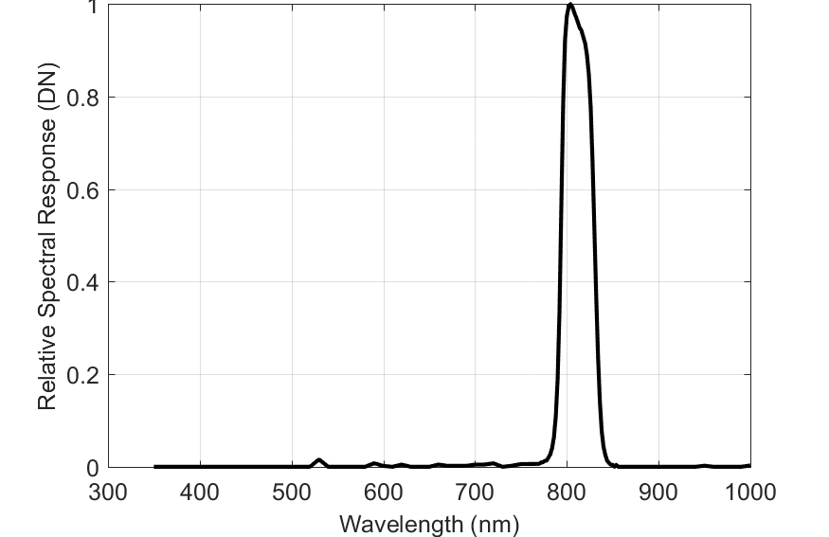
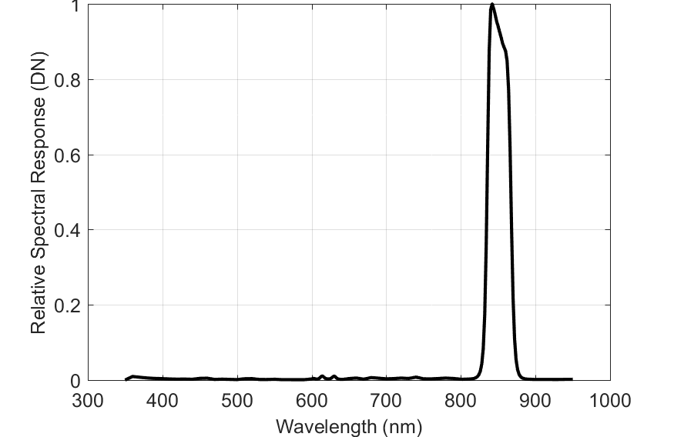
MAPIR Kernel 3.2MP Spectral Response Measurements
Filters (nm): 450, 518, 550, 615, 650, 725, 780, 808, 850

Slide 24



Absolute Radiometric Calibration
$$DN=\frac{N_{e}}{QSE}≈\frac{πτA_{d}}{4{(f\#)}^{2} QSE hc} \int_{0}^{∞}{L_{i}\left(λ\right)S\left(λ\right)dλ}$$
DN = Digital Number
N_{e} = Number of Signal Electrons
QSE = Detector Quantum Scale Equivalence
= N_{well} / N_{DR}
N_{DR} = 2 ^{number of bits}
$τ$ = Integration Time (Exposure Time)
A_{d} = Detector Area
f # = f-number
h = Planck’s Constant
c = Speed of Light
$λ$ = Wavelength
$Li\left(λ\right)$= Spectral Radiance (image)
$Lo\left(λ\right)$= Spectral Radiance (scene)
S(λ) = Camera Spectral Response
= $λ$ η($λ$) T($λ$)
η($λ$) = Quantum Efficiency
T($λ$) = Optical Transmission
f #
$Lo\left(λ\right)$
A_{d}
Lens

Slide 25


MAPIR Kernel 3.2MP Camera Absolute Radiometric Calibration Results
Simplifying the equation we can say
  Where:
  g = gain coefficient = ISO/100
  τ = exposure setting [ms]
A NIST-traceable spectrometer measured sphere illumination (L ) as the camera acquired imagery
To keep the MAPIR camera radiometrically calibrated, this type of assessment would have to be performed periodically.
  The frequency would depend on the radiometric accuracy required, camera operation and operating conditions.
$L=\frac{C}{gτ}$ DN
Filter nm | Calibration Coefficient C $$\frac{ms mW}{m^{2} sr μm DN }$$
450 | 5.450
550 | 3.762
615 | 4.796
650 | 3.990
725 | 5.333
808 | 7.268
850 | 8.572

Slide 26
Spatial assessment highlights
Sony Nex-5T Digital Camera

Slide 27
Spatial Resolution
Spatial resolution/image sharpness depends on:
  Ground Sample Distance (GSD)
    Depends on pixel pitch, focal length, and height above target
  Point spread Function (PSF)
      The response that at an electro-optical system has to a point source
      Includes motion, optics, detector electronics, …
High spatial resolution allows information extraction using texture and shape

Slide 28

Image Sharpness Parameters

Slide 29

Edge Analysis Overview
Image sharpness is found by measuring how quickly an image transitions from dark to bright across an edge
Image of an Edge
Normalized Edge Response

Slide 30

Tilted Edges
Tilted edges allow for finer than single pixel resolution, which gives a better estimate of the normalized edge response
We use the normalized edge response to calculate the image sharpness parameters
Image of an Edge
Normalized Edge Response

Slide 31
sUAS Spatial Resolution
Can vary across the Field of View
Very different than high end satellite or aerial imaging sensors
Correctable ???

Slide 32

Camera and Lens Specifications
Sony Nex-5T Digital Camera
Sensor Type/Size | CMOS Bayer Array, 23.5 x 15.6 mm
Pixel Size | 4.76 μm
Maximum Resolution | 16MP: 4912 x 3264
Camera Format | APS-C (1.5x Crop Factor)
Opteka 50mm Manual Lens operated at F8
Focal Length | 50 mm
Aperture | Minimum: f/22, Maximum: f/2
Camera Mount | Sony E
Angle of View | 30°
Minimum Focus Distance | 2.13’ / 64.8 cm

Slide 33
sUAS Data Acquisition
Ultra-high resolution data (<1 cm GSD) was acquired using a Sony Nex-5T camera flown on an I2R Endurance Quad over Long Beach, MS
  240 images acquired over an 80m x 80m area
  52 m altitude, 3 m/s velocity
  Ground Sample Distance (GSD) of acquired data 0.5 cm
Edge targets deployed in acquired images
  Measure spatial quality of the in-flight data
Laboratory measurements of spatial resolution and flat fielding performed prior to data acquisition

Slide 34


Spatial Resolution Measurement
Edge target placed at the end of a hall
52 m from camera

Slide 35


Spatial Resolution Sample Edge

Slide 36

I2R Endurance Quad
I2R Endurance Quad in flight with installed Sony Nex-5T payload

Slide 37

Sample Image with Edge Targets

Slide 38


Sample Measured MTF Curve
In-track Edge
Cross track Edge
In-track Edge
In-track Edge
Green Band
RER = 0.36
Green Band
RER = 0.36

Slide 39
Low Altitude UAS Data
Data was acquired at a range of lower altitudes over a target
  52m, 40m, 30m, 20m
  GSDs ranged from 0.5 cm down to 0.19 cm
Targets were imaged repeatedly and compared
52m data shows pavement and vegetation details
Ultra-high resolution data also reveals leaf structure (individual blades of grass visible), that can be used in place of a quadrat for vegetation species identification

Slide 40
Relationship Between GSD and Altitude
Maximum Height set by FAA

Slide 41


UAV Image Sharpness Comparison
Two UAV images acquired at the same GSD (0.5 cm) showing the effect of image sharpness. The image on the left is much blurrier than the image on the right. However, the painted text is legible in both examples.

Slide 42


Next Generation Spatial Resolution Targets

Slide 43

Eye Chart Image – 52 m Altitude

Slide 44

Eye Chart Image – 40 m Altitude

Slide 45

Eye Chart Image – 30 m Altitude

Slide 46

Eye Chart Image – 20 m Altitude

Slide 47
A Note on Geometric Calibration

Slide 48



Geometric Calibration
Geometric Calibration
  Orients camera and image with respect to world coordinates, and corrects distortion introduced by the camera and lens
    Enables measurements in world units directly from imagery
    Enables removal of lens distortion and provides scale
Pin Cushion
Distortion
Barrel
Distortion

Slide 49



Geometric Calibrations
Can be performed in the lab for both visible and thermal imaging cameras
Checkerboard target used to geometrically calibrate sUAS cameras
Target has low contrast in the TIR
Contrast significantly improves and pattern reverses when illuminated with a QTH lamp

Slide 50
Acknowledgements
Robert Ryan
Richard Brown
Kara Burch
Daniel Cuervo
Jed Leggett
David Sitton

