Slide 1
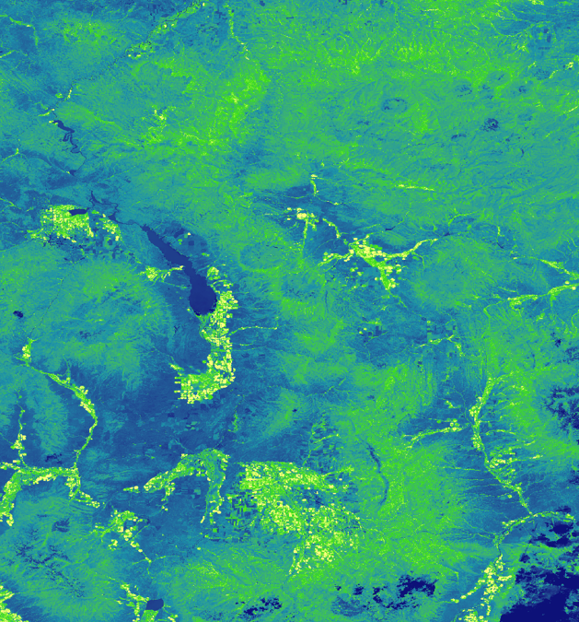
Mapping Lodgepole Pine Mortality Across the Intermountain West
Jillian LaRoe
Julia Sullivan
Jennifer Mehren
Timothy Mayer
Gary Olds

Slide 2
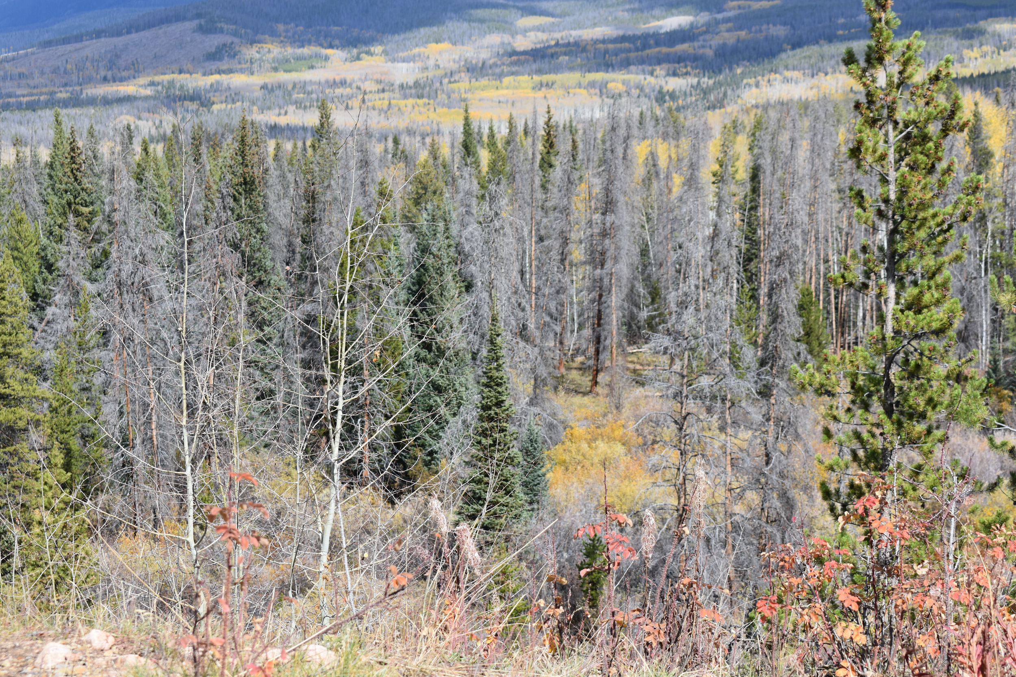
Community Concern
Millions of acres of conifer mortality throughout the Intermountain West
Impacts water quality, wildlife habitat, and recreation
Bark beetle outbreaks are cyclical by nature, and there will be another
Lack of comprehensive information on mountain beetle, current data is geographically limited
Image Credit: Jenny Mehren
Notes:
Forest ecosystems provide critical habitat for wildlife, filter and store water, and serve as a backdrop for recreation. In the past decade (2000-2013), millions of acres of coniferous forest have been impacted by the mountain pine beetle (MPB) across the Intermountain West. Current information of the MPB’s impacts across the region is not comprehensive and is geographically limited.
Image Credit: Jenny Mehren, team member

Slide 3
Mountain Pine Beetle & Forest Susceptibility
Three factors crucial to identifying forests potentially at risk:
Climate Conditions
Altering climatic environments
Drought
Beetle Pressure
Life History
Presence
Forest Structure
Composite
Age
Image Credit: bstad
Notes:
Image credit: bstad, Pixabay, https://pixabay.com/en/wood-bark-beetle-paths-2009067/
These are three factors that affect whether or not forests are at risk to MPB outbreaks. It is difficult to assess what the exact climate is going to be like, and it isn’t possible to track MPB. It is possible to assess forest structure using remote sensing and NASA Earth observations.

Slide 4
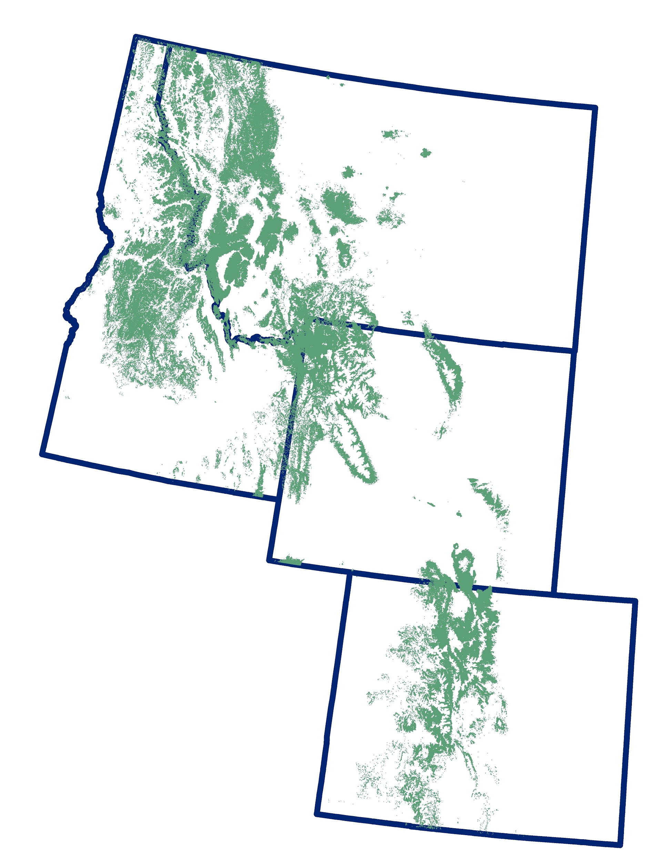
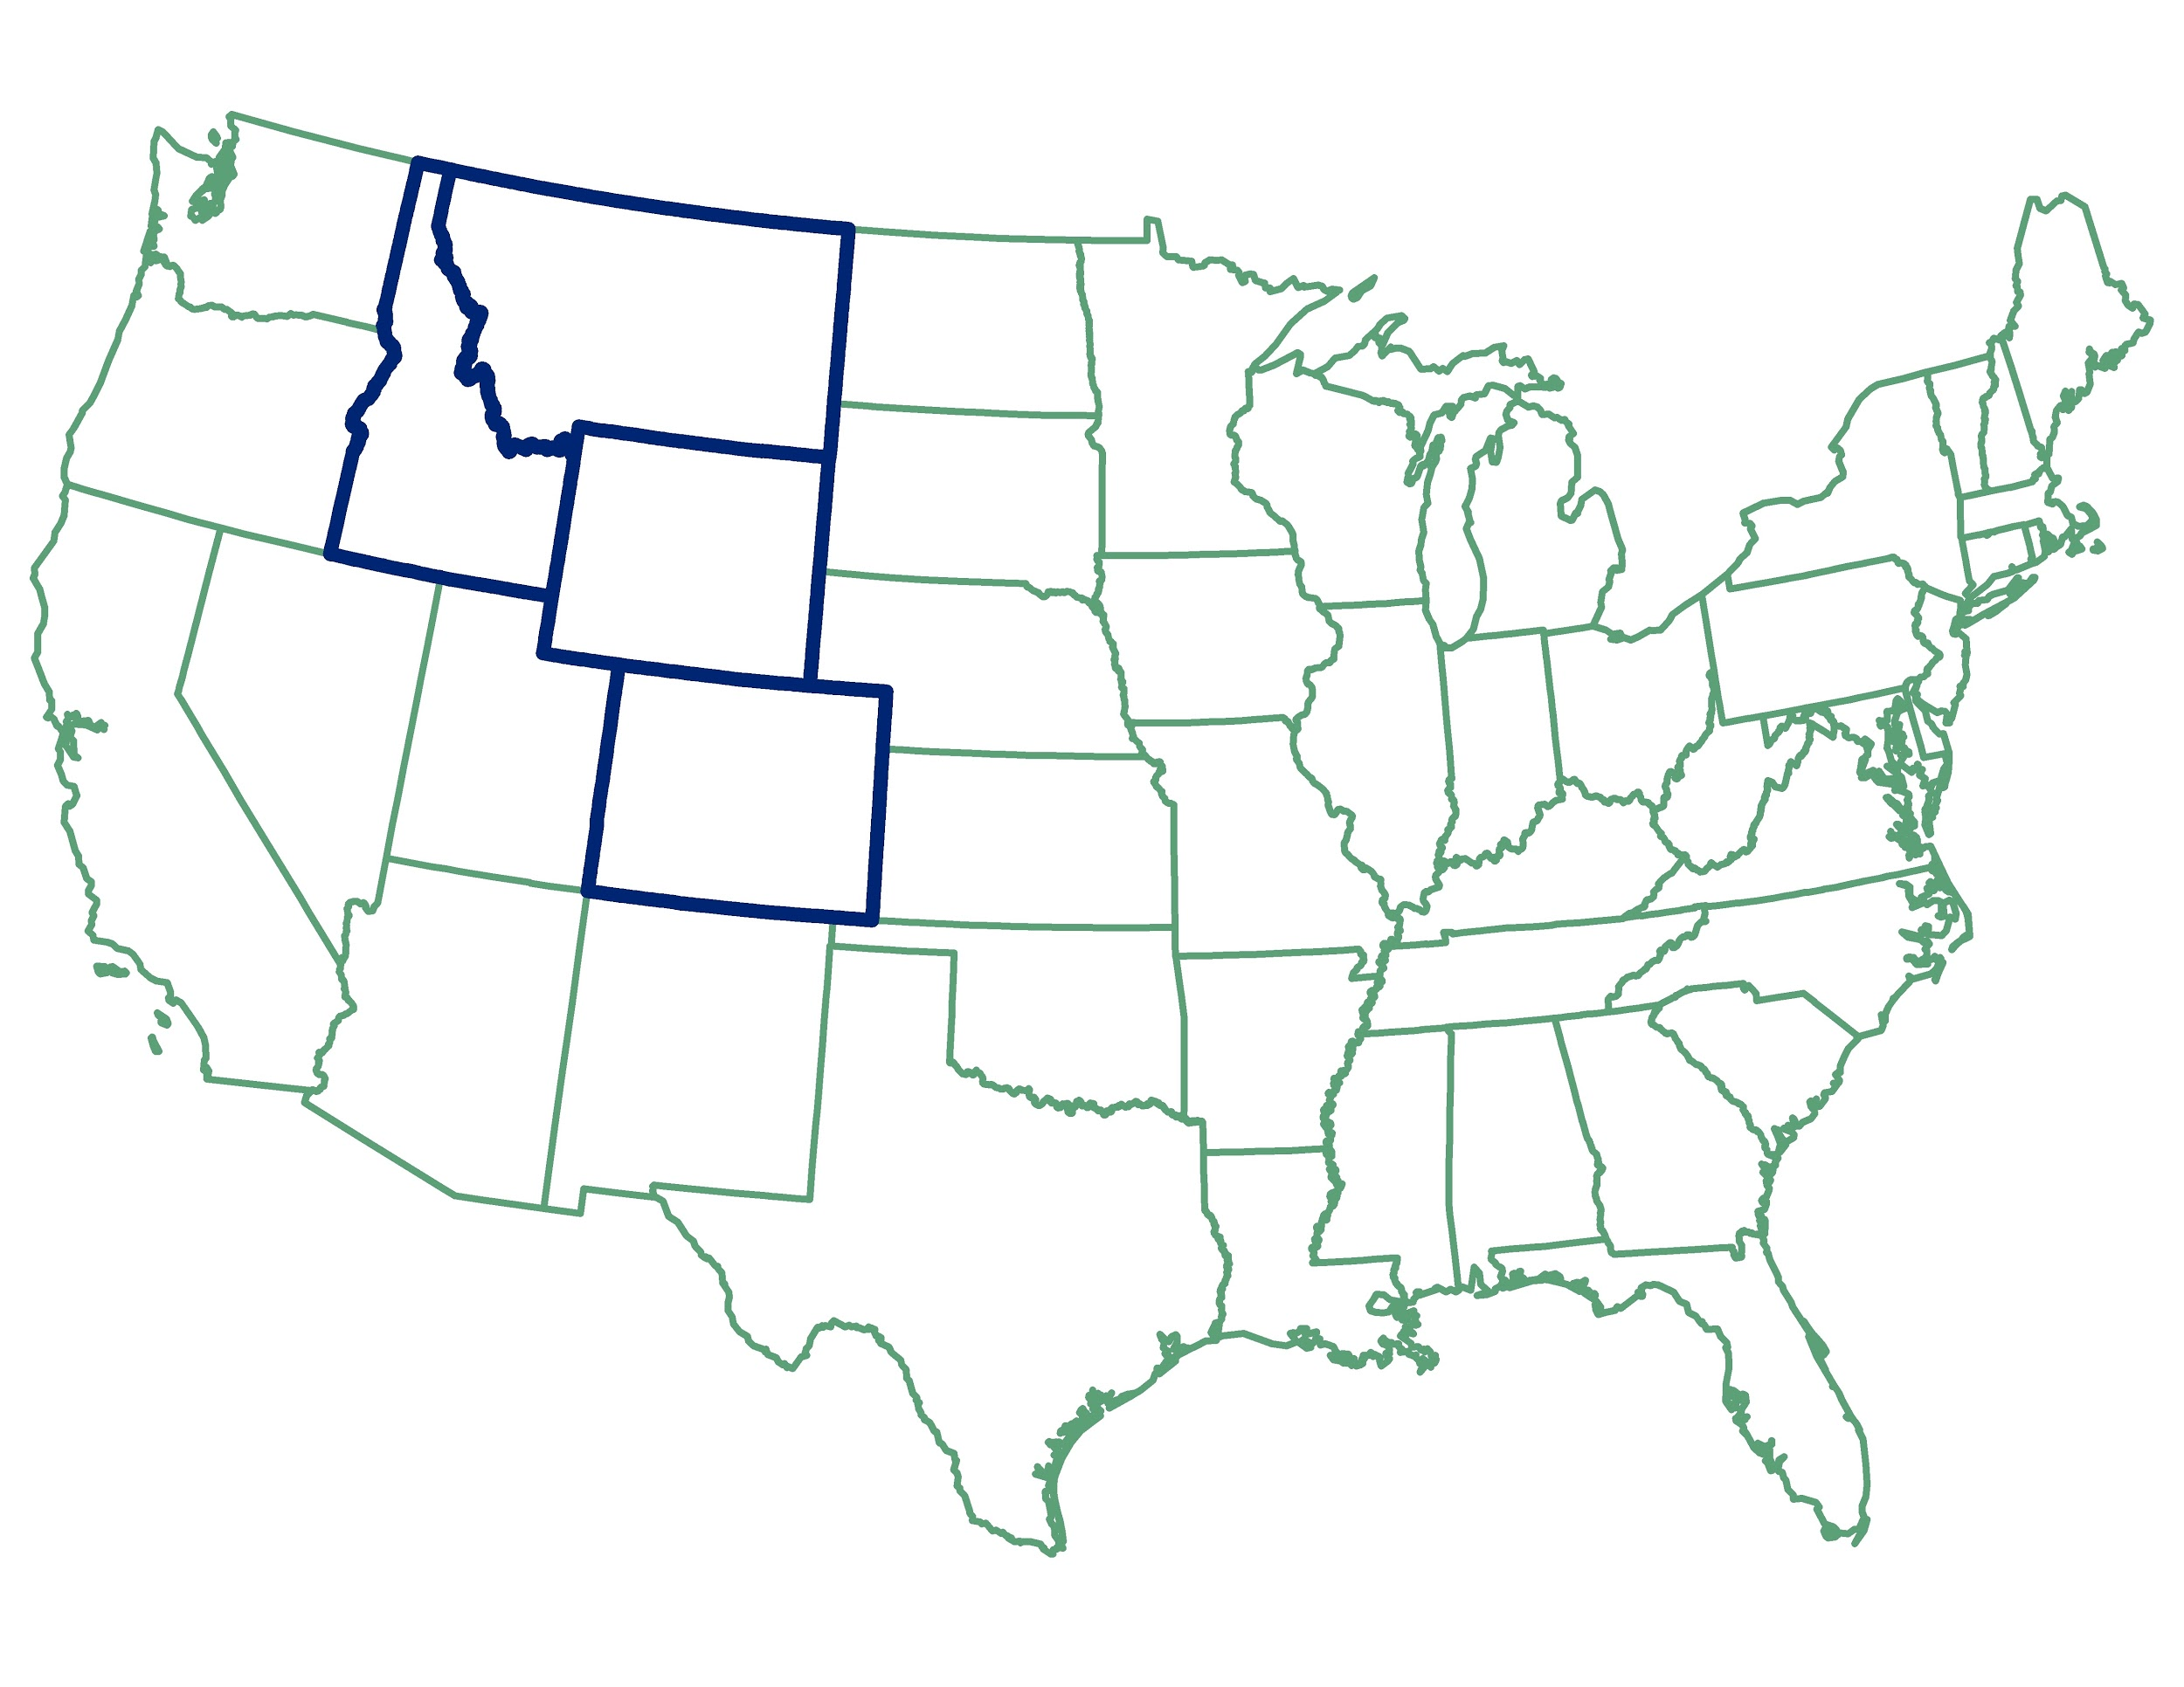
Study Area
Intermountain West
Colorado
Idaho
Montana
Wyoming
Lodgepole pine forests
Study period: 2013
Intermountain West
Lodgepole Pine
Source: LANDFIRE, ESRI
Notes:
Our study area covers Colorado, Idaho, Montana, and Wyoming, also known as the Intermountain West. We examined areas covered by lodgepole pine forest during the study period of 2000 to 2013.

Slide 5
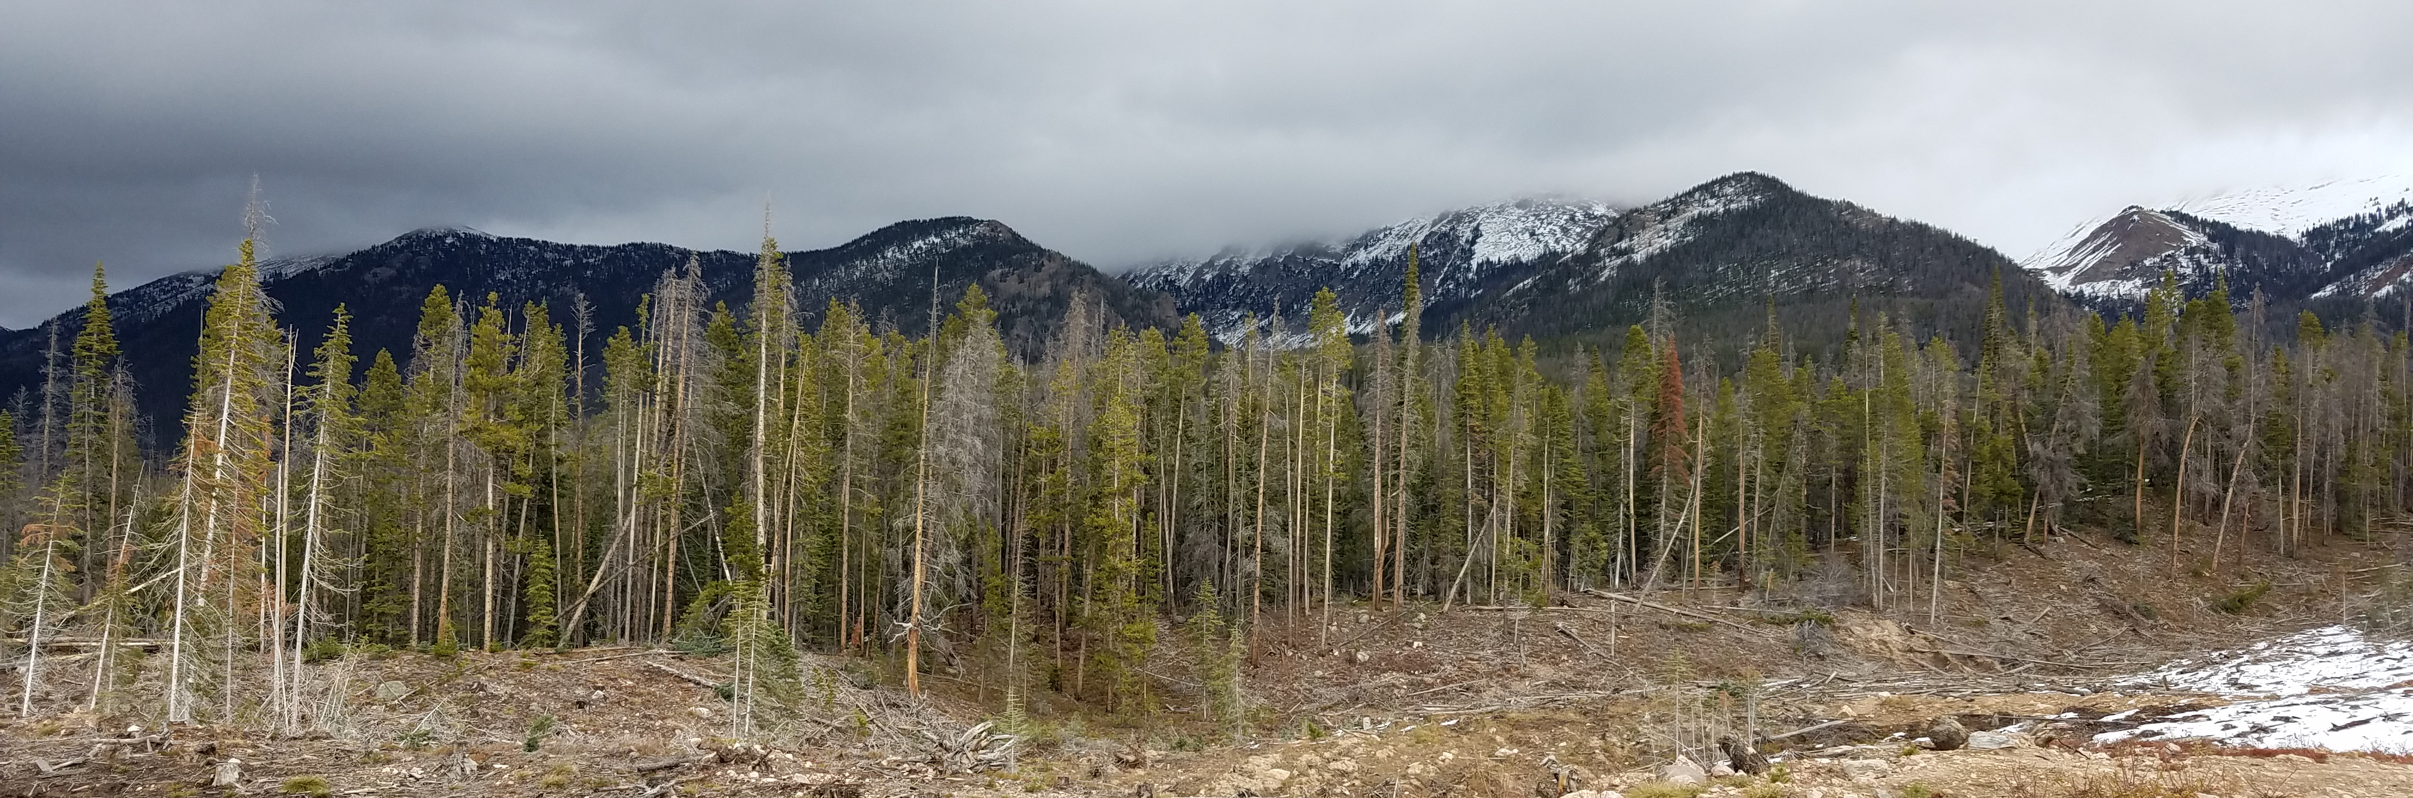
Partner
In partnership with the Bioenergy Alliance Network of the Rockies
Image Credit: Gary Olds
Notes:
This project partnered with the Bioenergy Alliance Network of the Rockies to address these concerns.
Image Credit: Gary Olds, team member

Slide 6
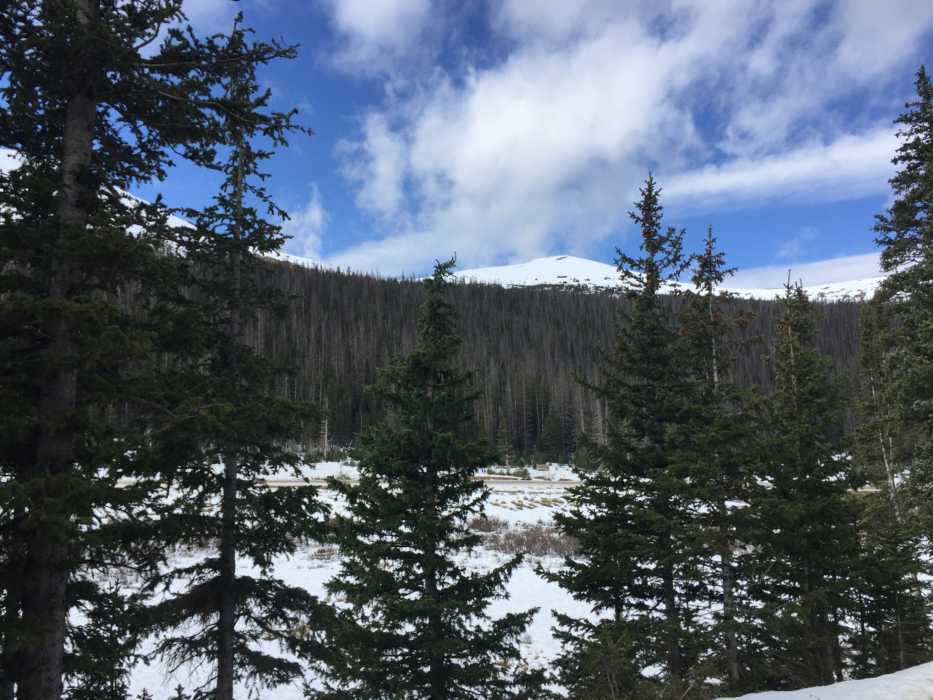
Objectives
Identify and analyze current lodgepole pine stands in Colorado, Idaho, Montana, and Wyoming
Generate maps depicting current live and dead lodgepole pine
Image Credit: Julia Sullivan
Notes:
The objectives of this project were to map live and dead lodgepole pine after the recent severe mountain pine beetle outbreak (2013) across Colorado, Idaho, Montana, and Wyoming
Image Credit: Julia Sullivan team member

Slide 7
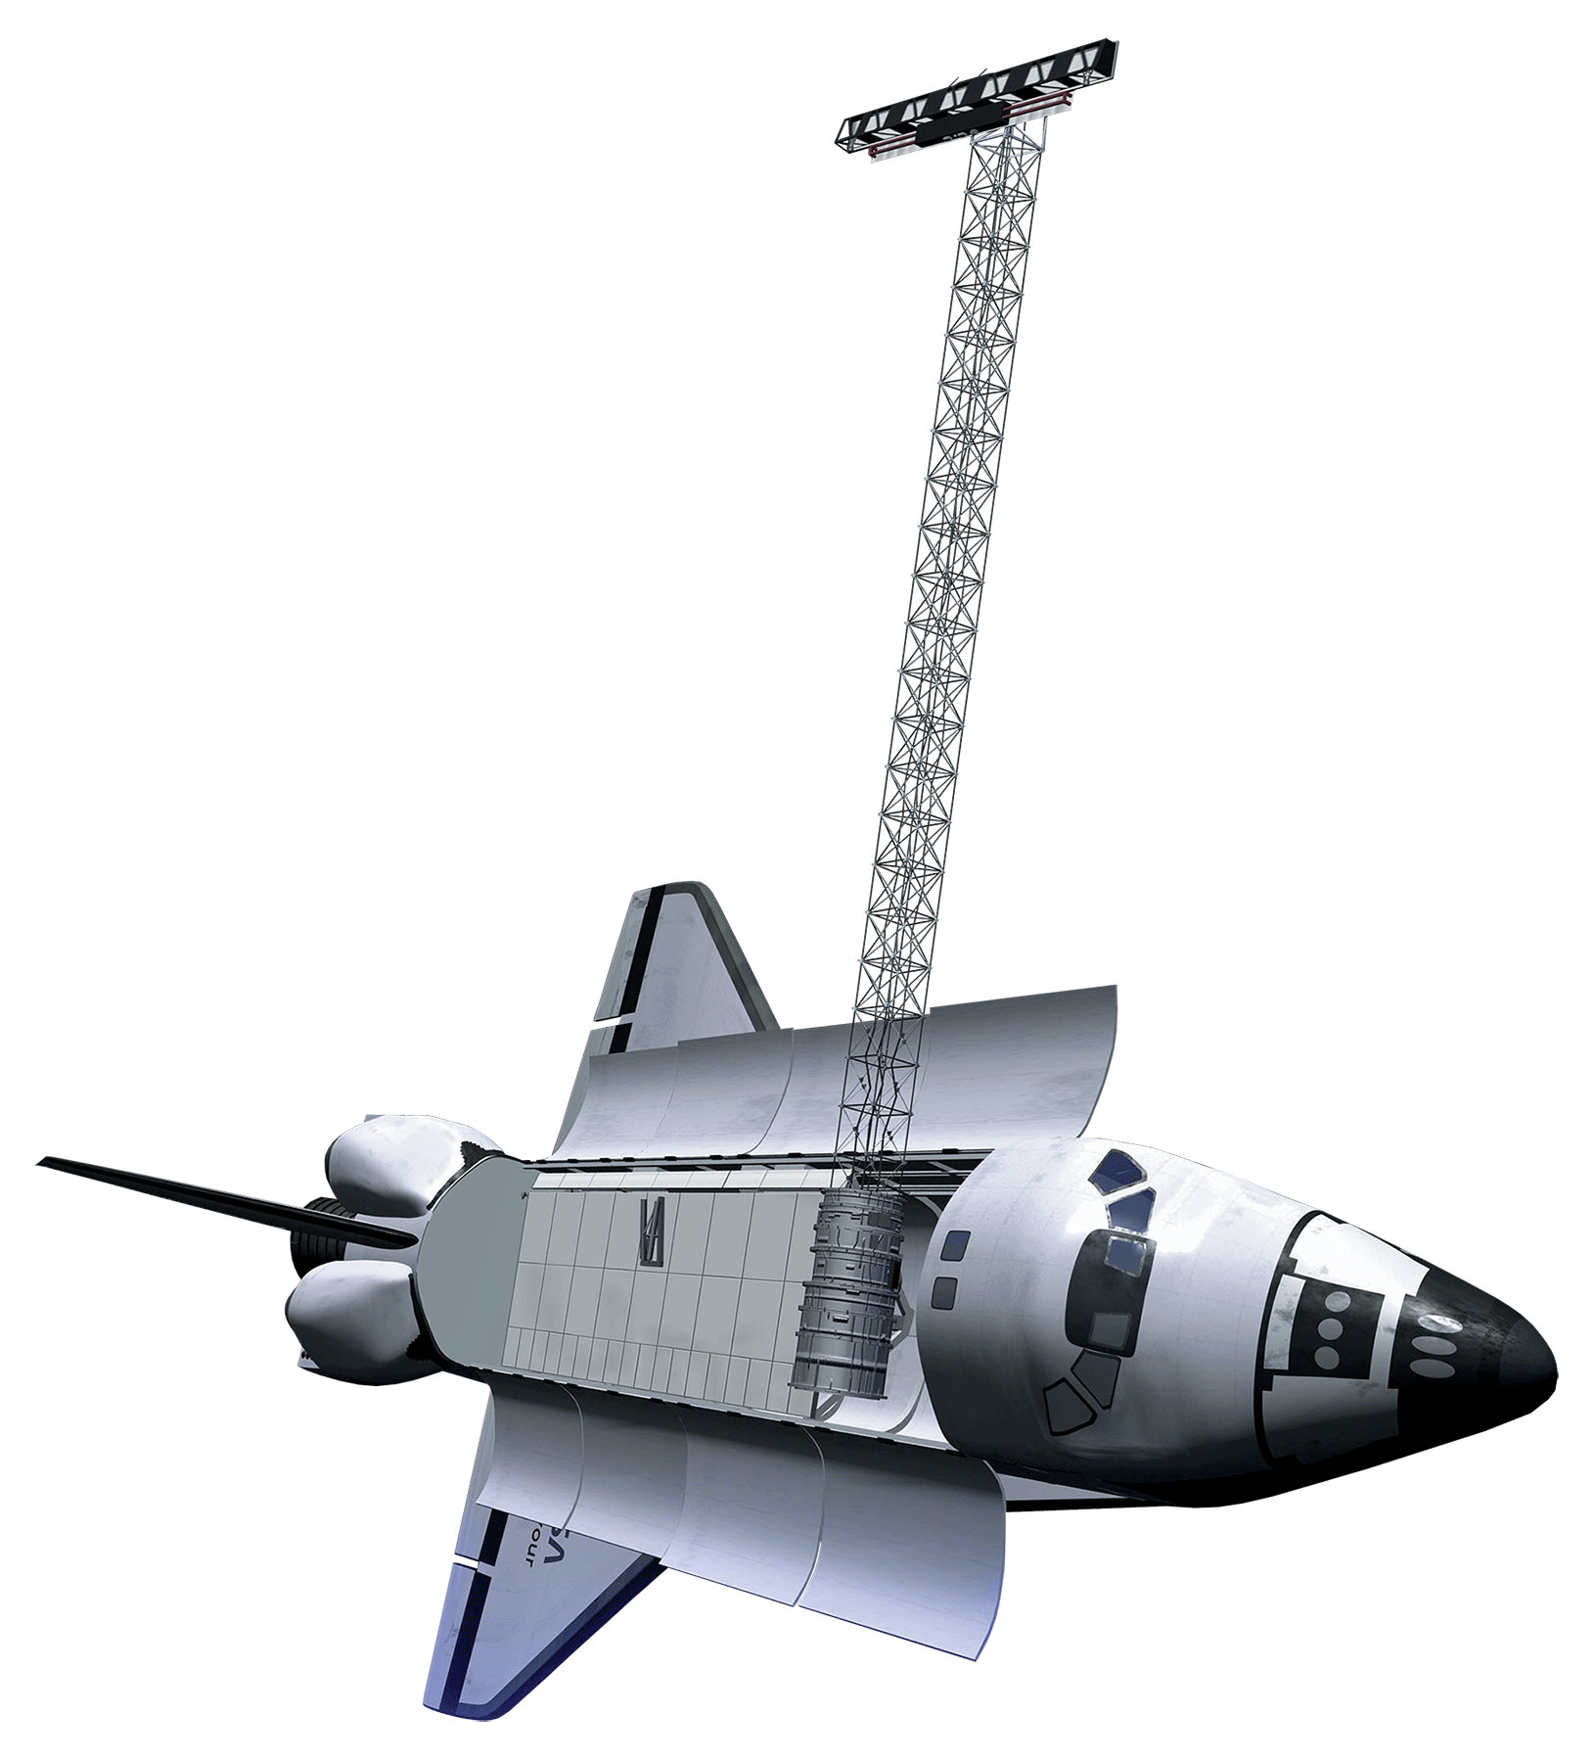
Satellites and Data Acquisition
Landsat 8 OLI & TIRS
Landsat 5 TM
SRTM
Image Credit: qimono
Notes:
Through the Google Earth Engine API, we acquired 30m satellite imagery from Landsat 5 TM and Landsat 8 OLI & TIRS. We used these images to derive information about the tree canopy cover. We also obtained a 30m digital elevation model from NASA’s Shuttle Radar Topography Mission to create topographic indices. High resolution aerial imagery (1m) was acquired from the National Agriculture Imagery Program (NAIP) to conduct sampling.
Image Credit: qimono, Pixabay, https://pixabay.com/en/sunrise-space-outer-globe-world-1756274/

Slide 8
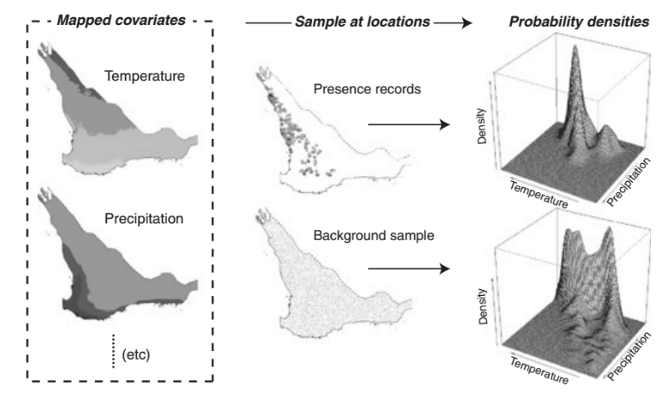
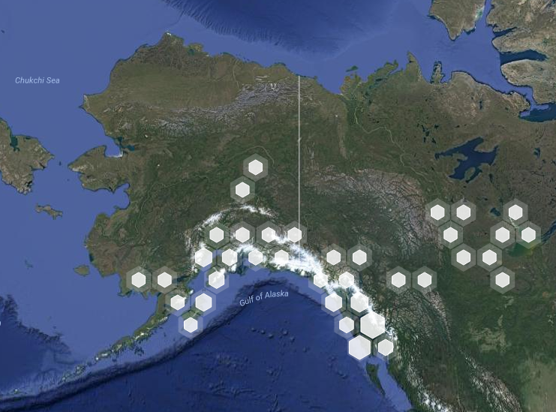
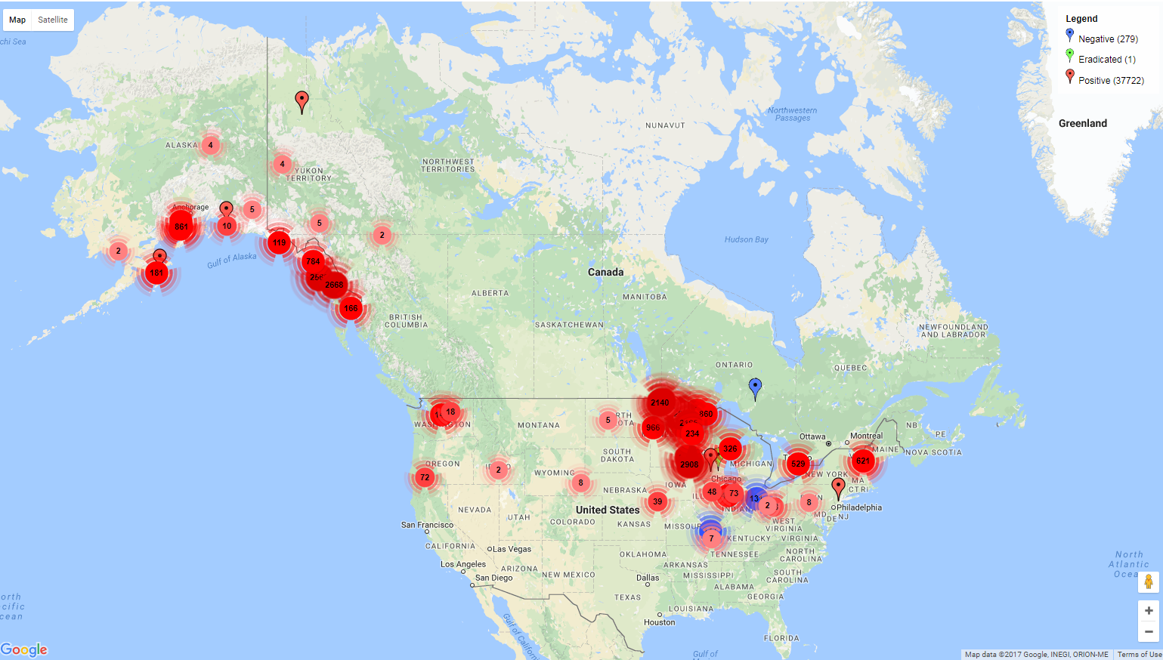
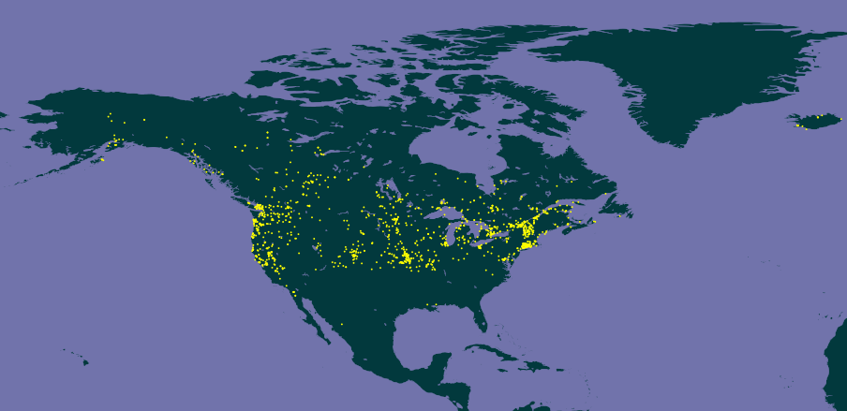
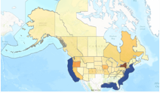
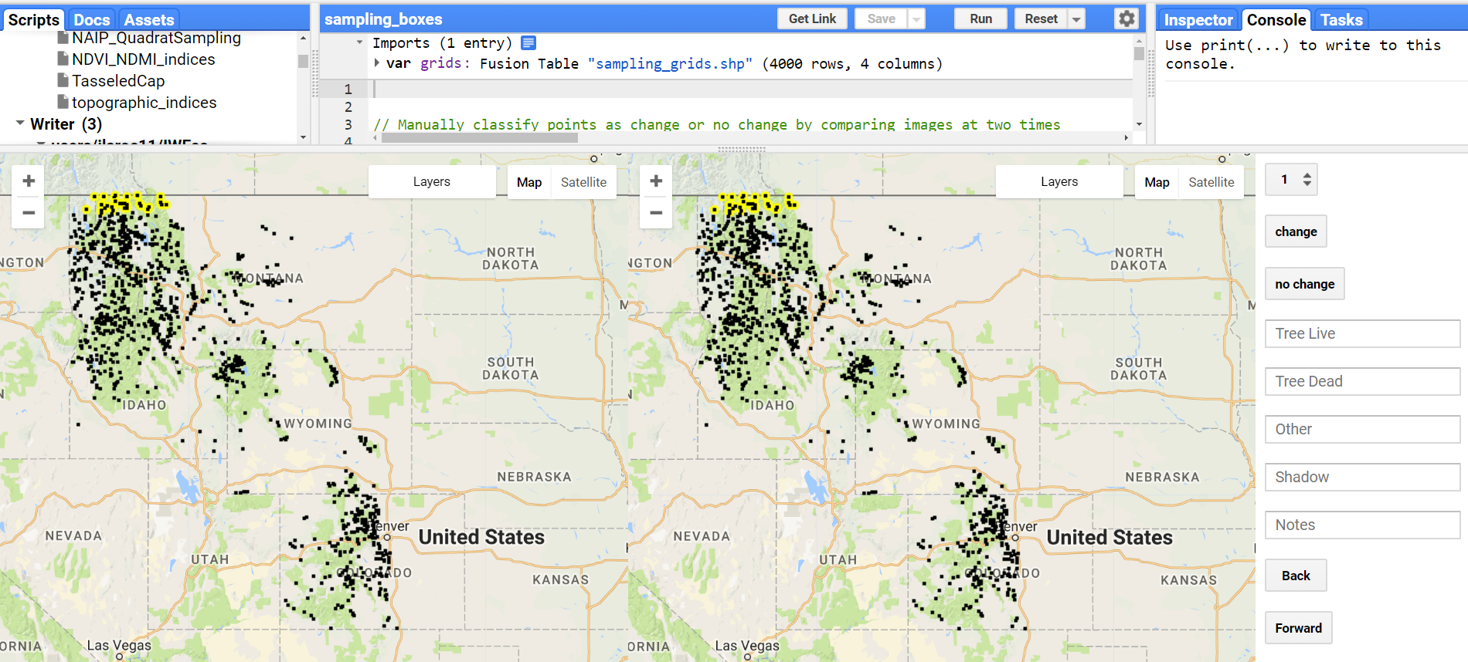
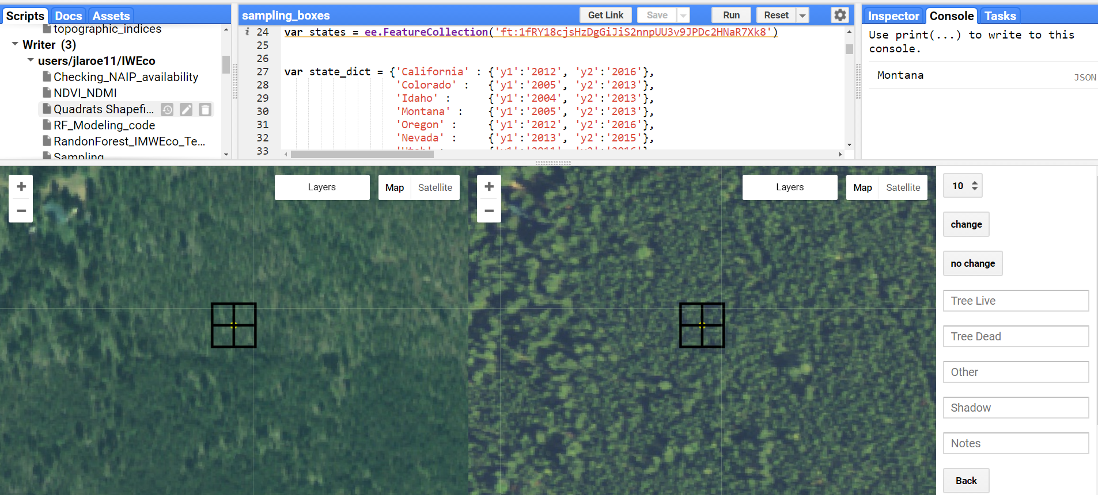
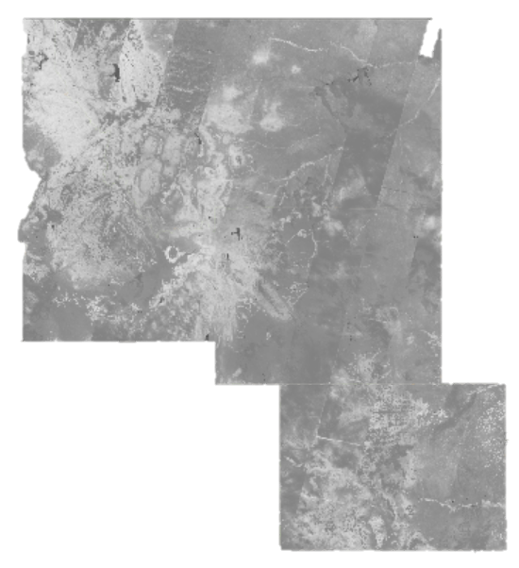
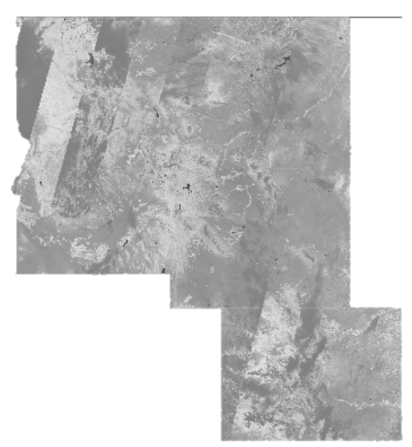
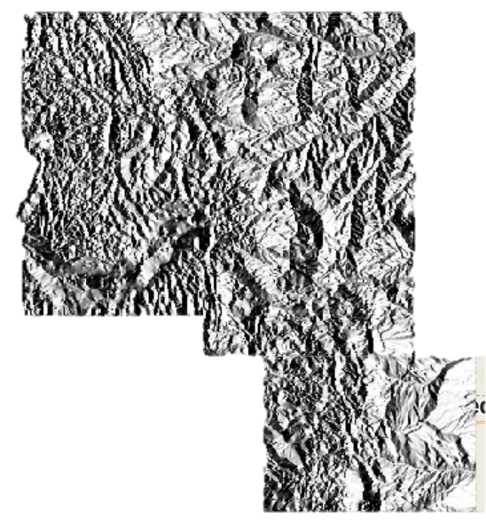
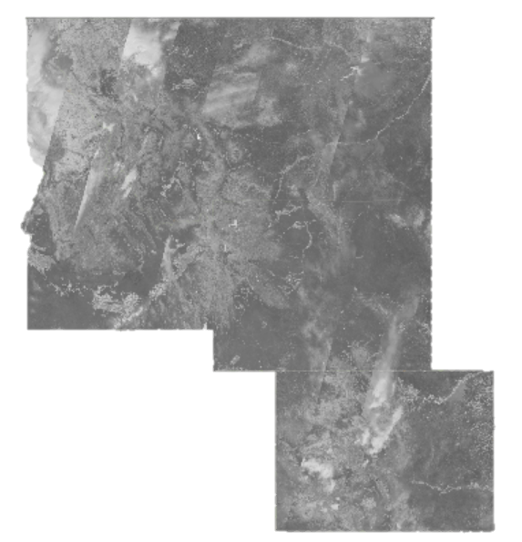
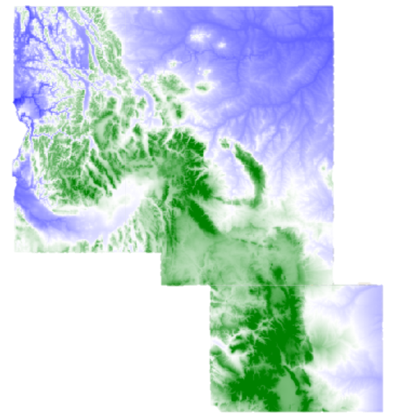
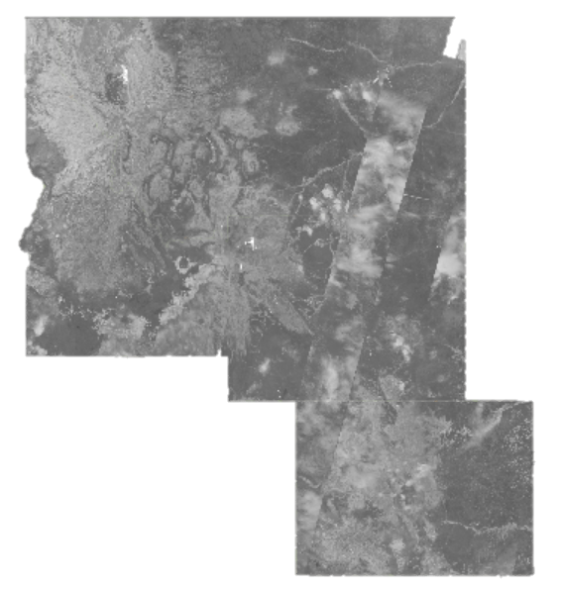
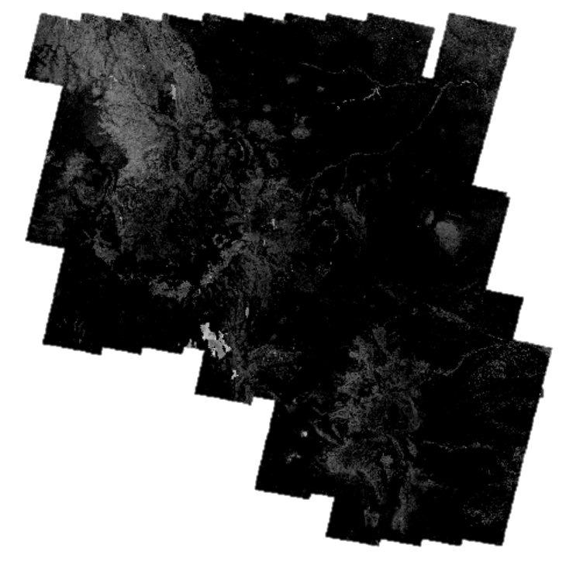
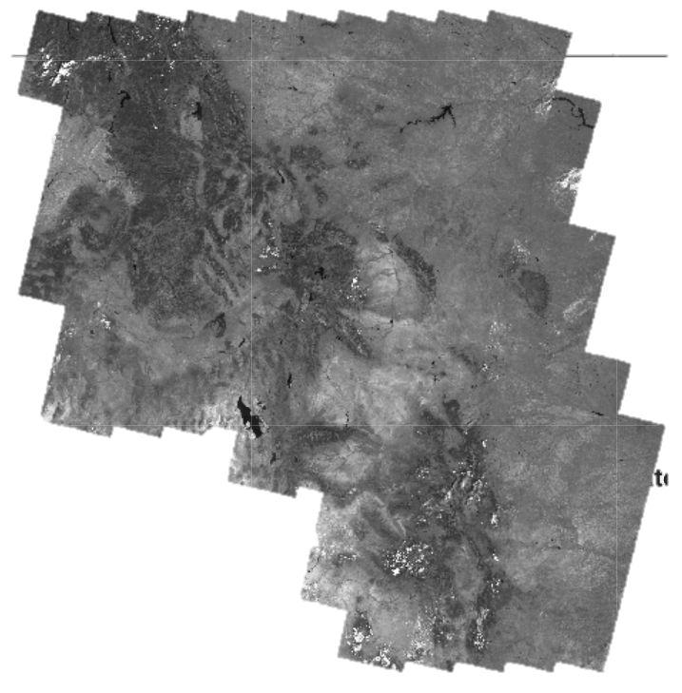
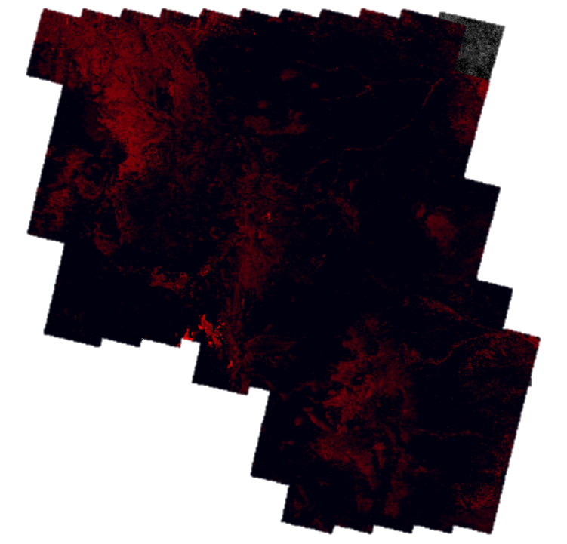
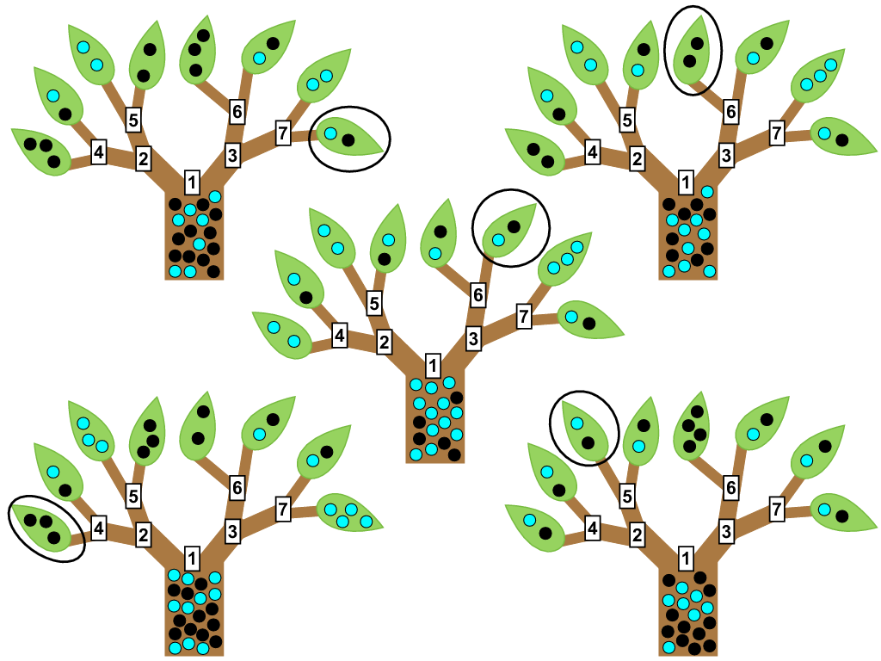
Methods
Overview
1) Conducted NAIP Imagery Ocular Sampling Via Google Earth Engine
Percent live/dead lodgepole pine forest
2) Utilized Google Earth Engine to generate variables from 2000-2013
Output of environmental predictor variables
3) Random Forest
Model Evaluation:
Output predictive maps of
Notes:
Using the Google Earth Engine API, our team sampled 1000 plots via ocular image interpretation using 2012 & 2013 NAIP true and false color imagery over coniferous forest (specifically lodgepole pine) within our study area. We then generated environmental predictor variables from the Landsat 5 & 8 imagery and the SRTM digital elevation model. We ran variable selection and preliminary Random Forest models using R, and finalized our models in Earth Engine to create our maps. Models were evaluated using a variety of metrics including out of bag error (OOB), root mean square error (RMSE), and predicted vs. observed.

Slide 9
Sampling
1,000 random points
Quadrats aligned with Landsat pixels
Percent Live
Percent Dead
Sampled using NAIP Imagery (National Agricultural Imagery Program)
Montana, Colorado, Idaho 2013
Wyoming 2012
Notes:
We sampled 1000 points using NAIP imagery by aligning 30m Landsat pixels.
In addition to recording the percent live and percent dead, additional categories accounted for
percent cover of shadow and other (includes non-tree vegetation, bare ground, and water).

Slide 10
Environmental Predictor Variables
Variables
Topographic
Vegetation Indices
Moisture Indices
Notes:
We derived vegetation and moisture indices paired with topographic data at a 30m resolution as predictors of live and dead live lodgepole pine.

Slide 11
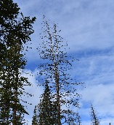
Modeling
Random Forest classification
2. Model Evaluation
3. Predictive maps of live and dead lodgepole pine cover
LIVE
DEAD
Notes:
We used a Random Forest machine learning algorithm to classify percent cover of live and dead trees (both binary & presence/absence and

Slide 12
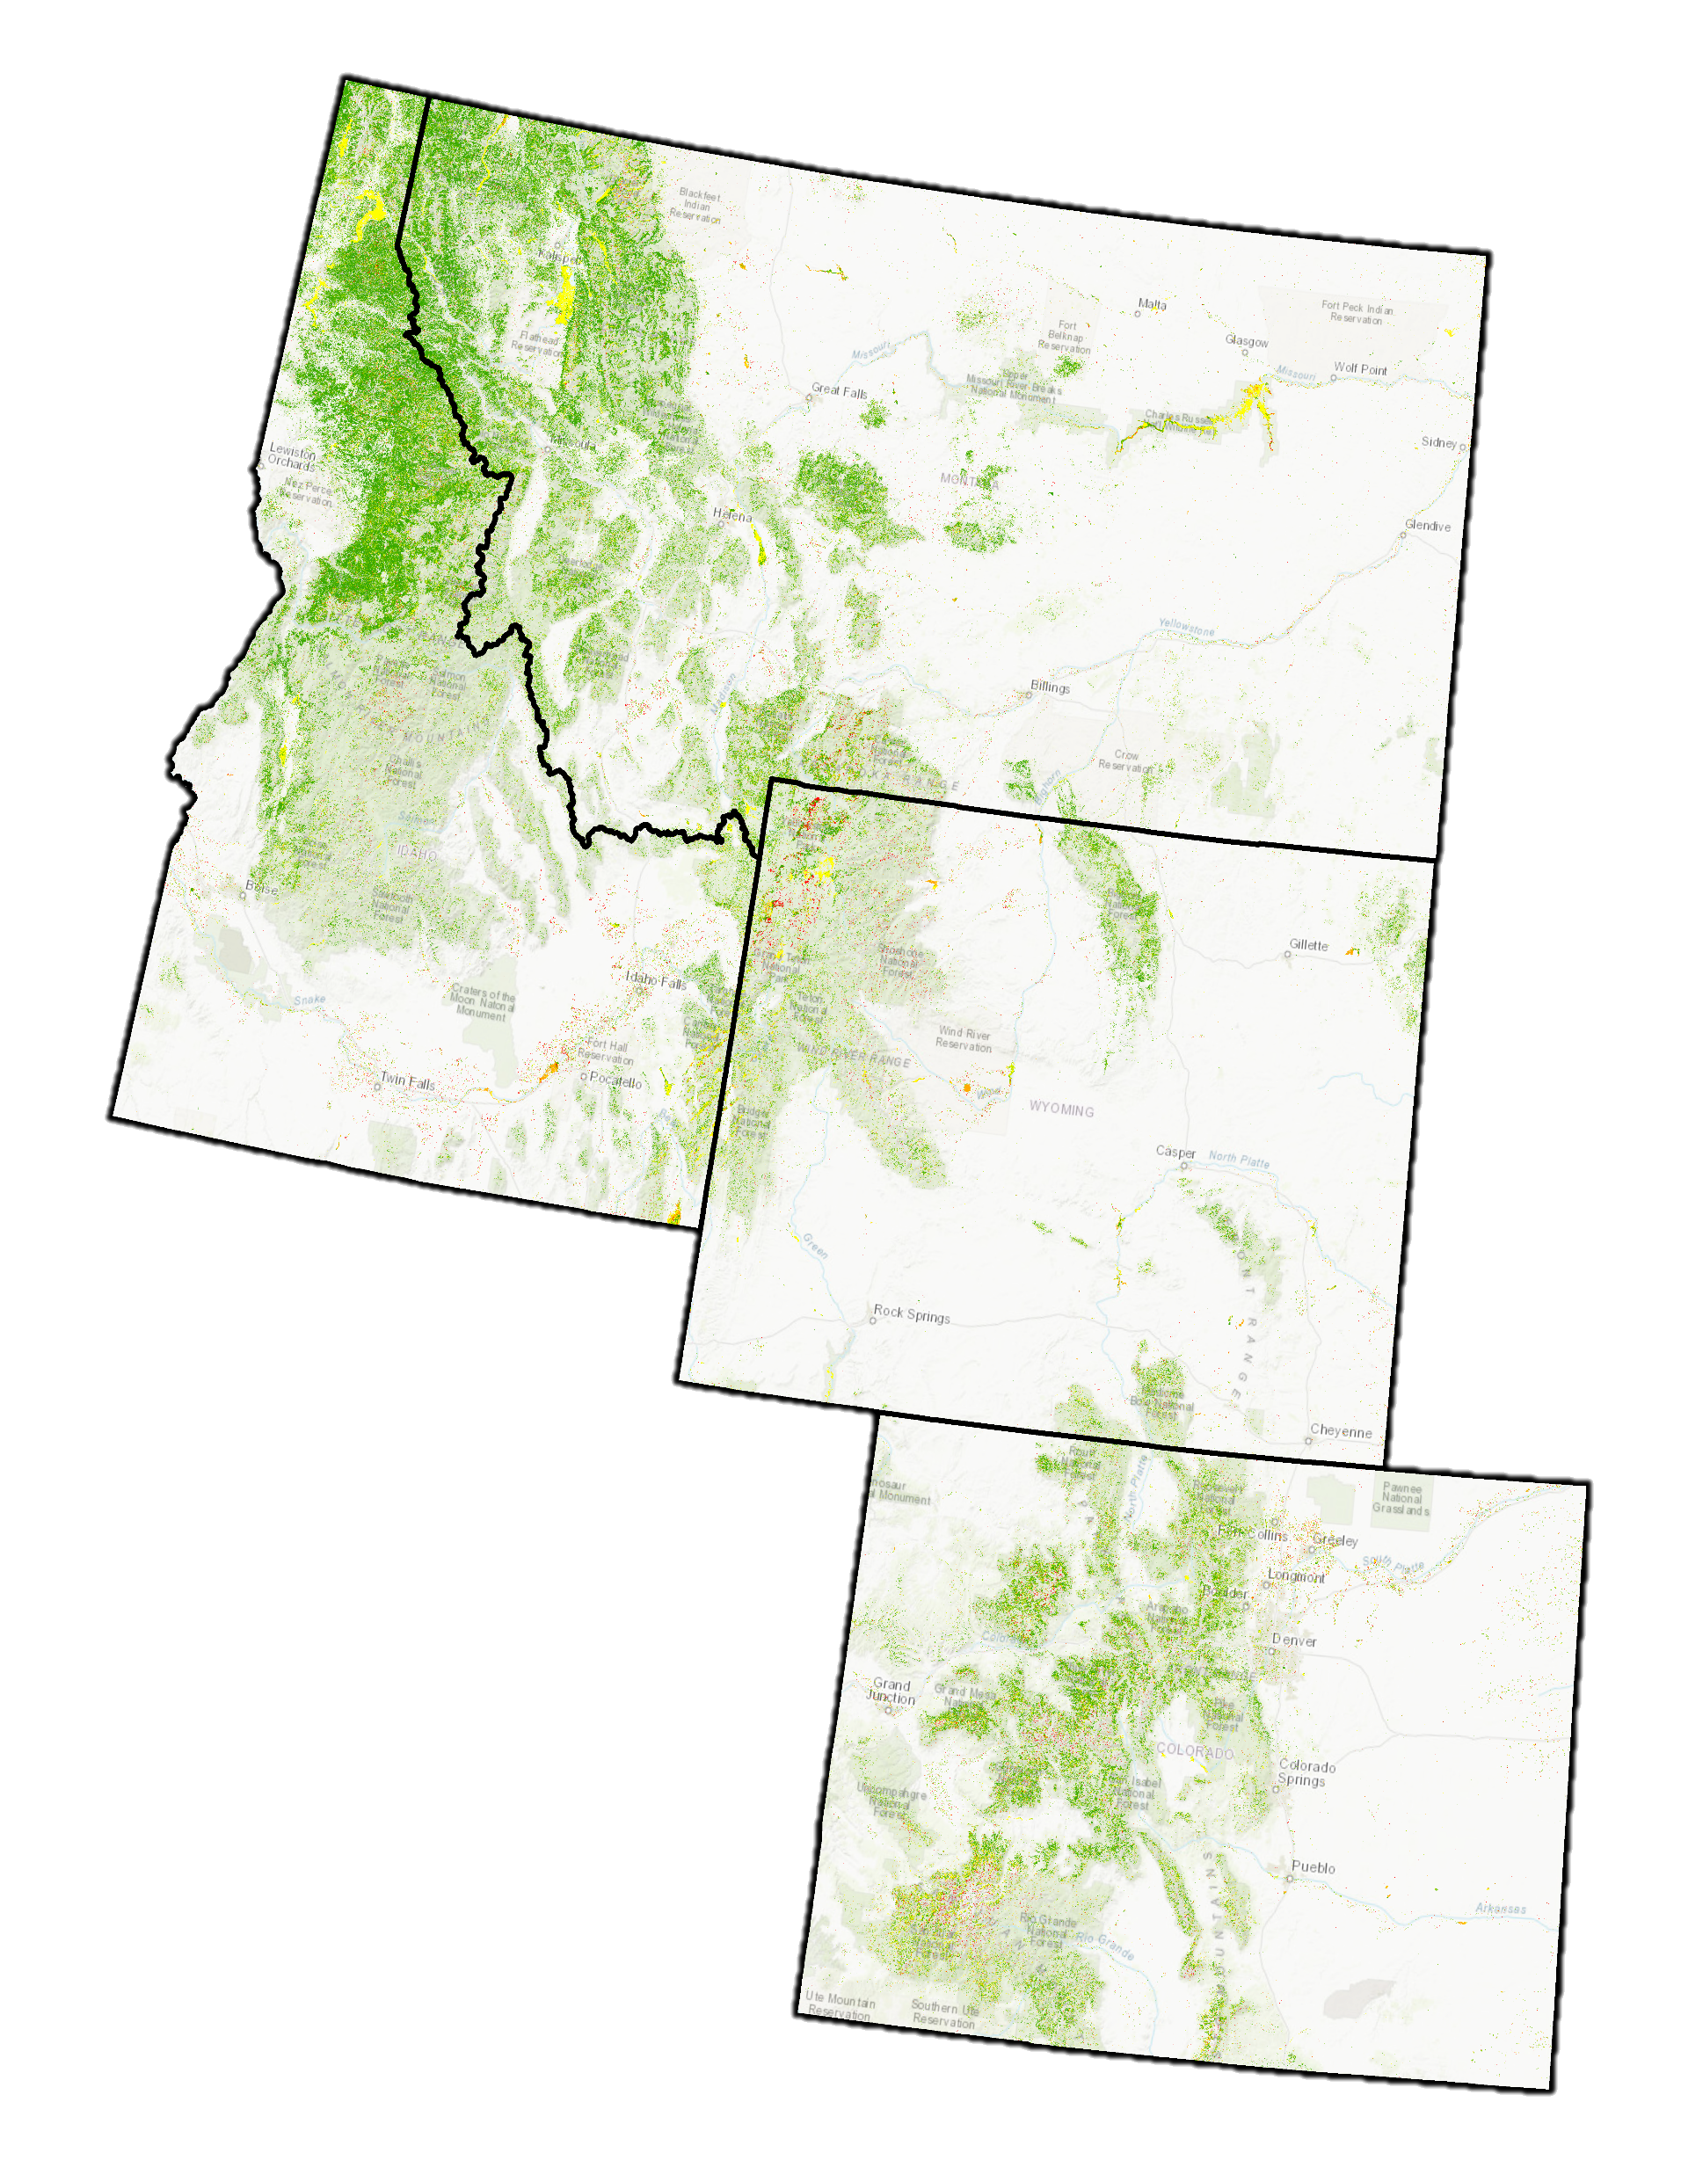
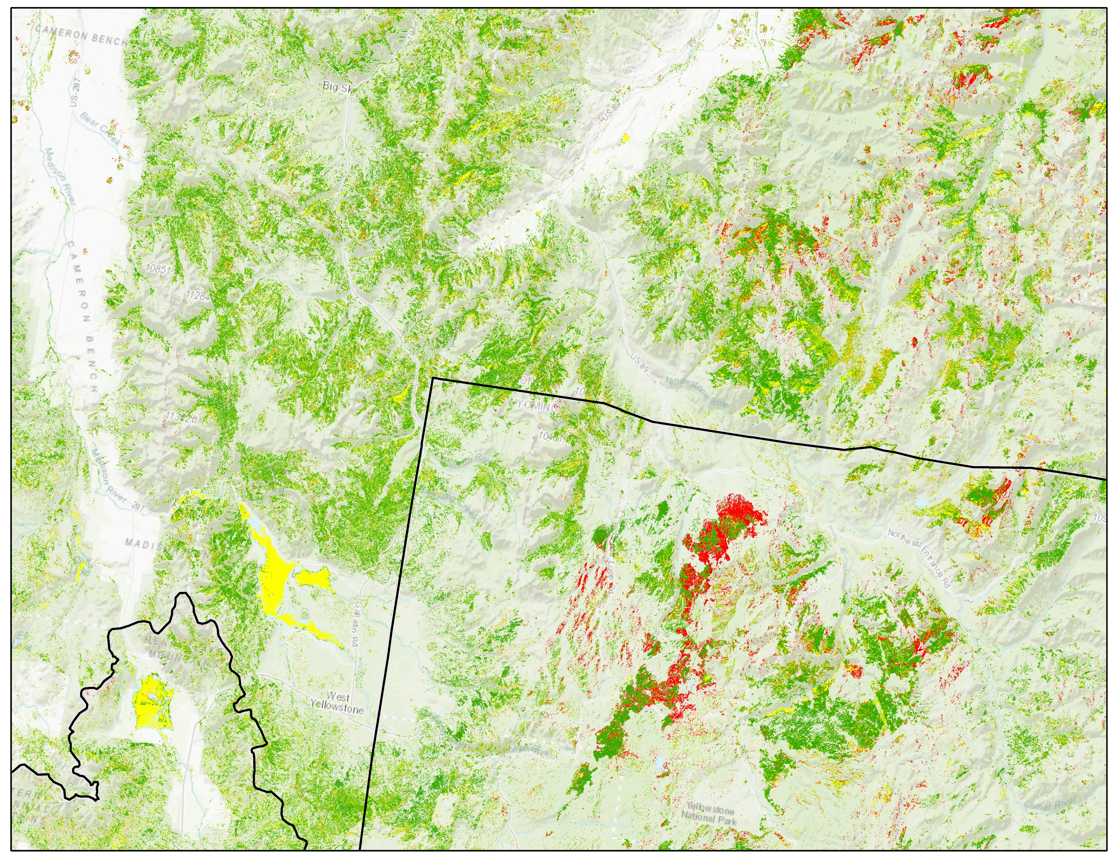
Results - Live
Percent cover
< 20
20 - 30
30 - 40
40 - 50
50 - 60
60 - 70
> 70
Notes:
Our team used a 2-step classification system to generate this continuous map of live lodgepole pine coverage across the study area.

Slide 13
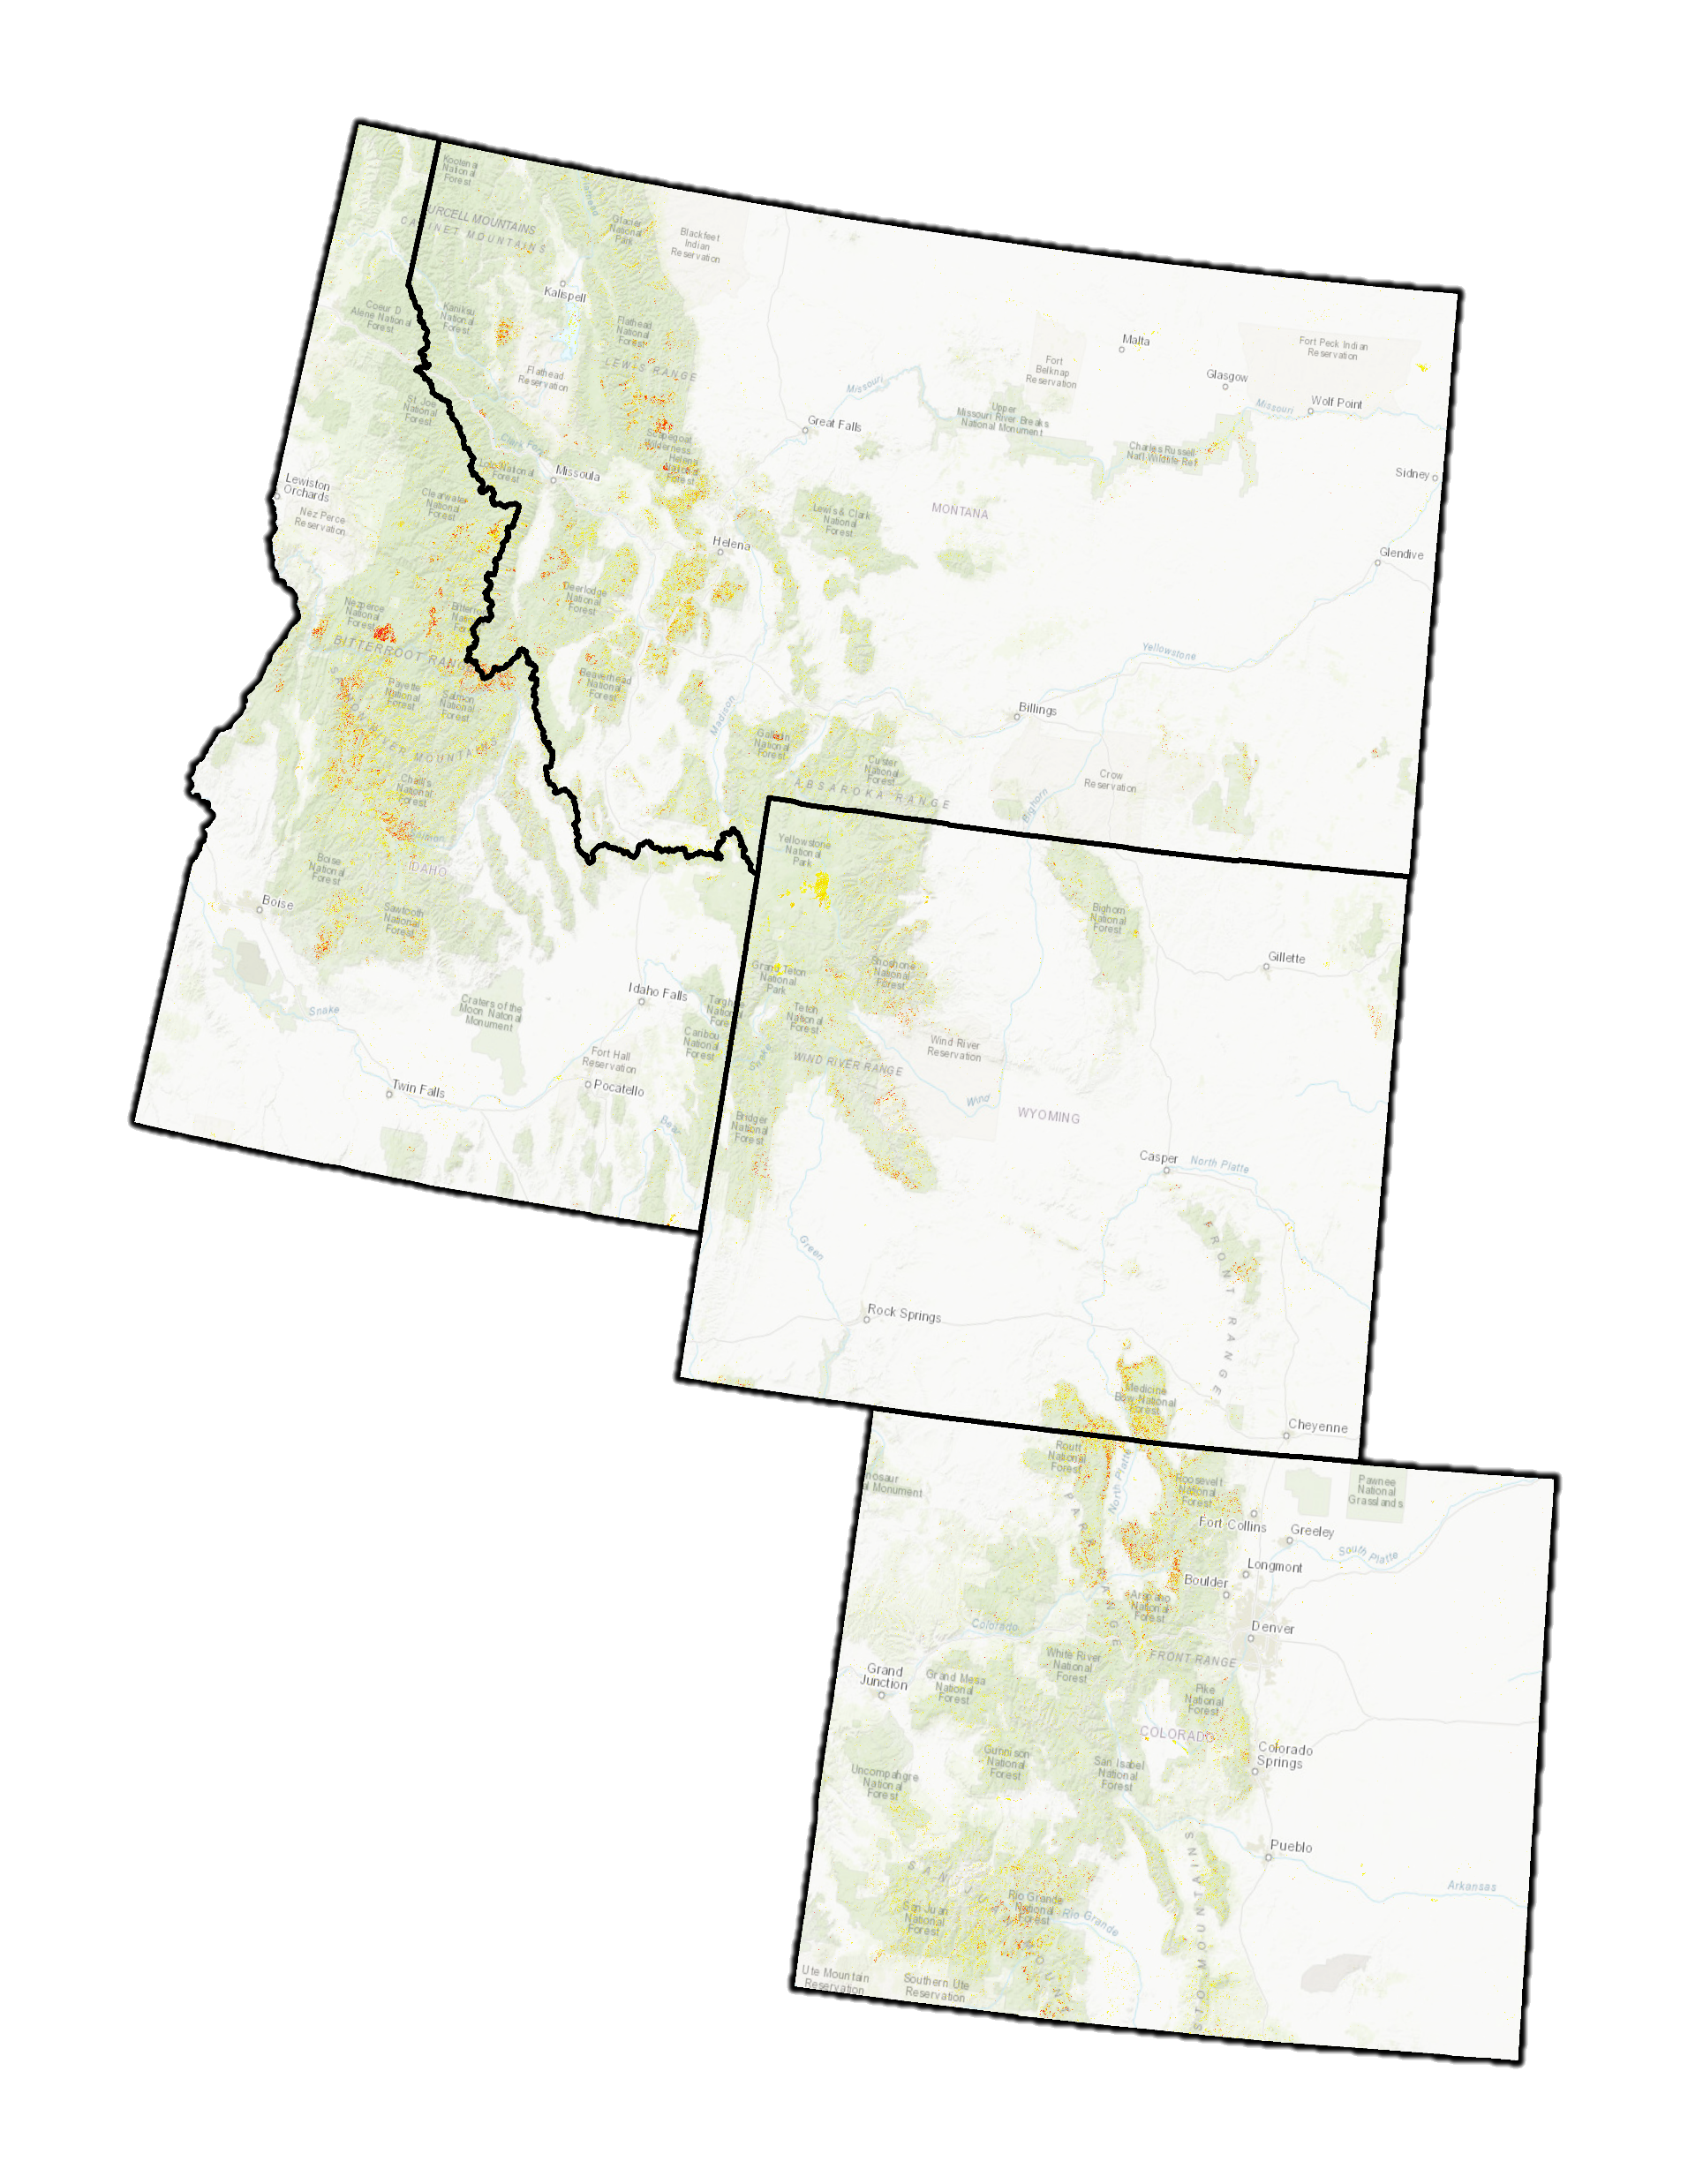
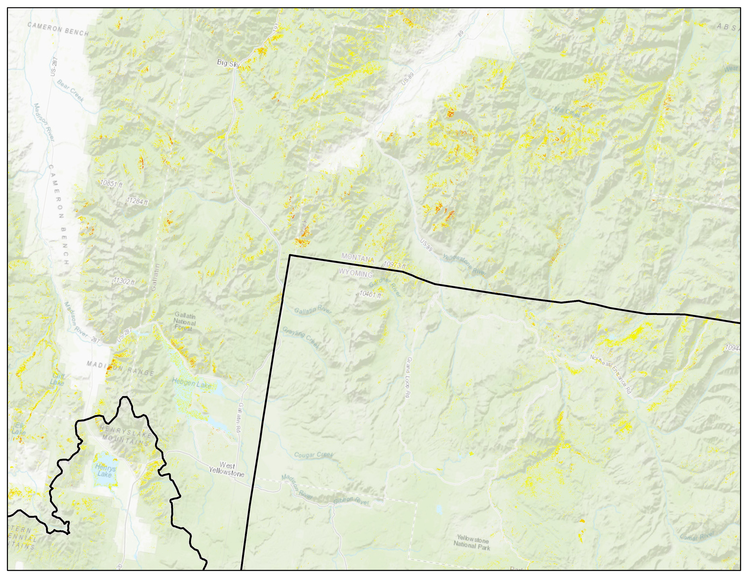
Results - Dead
Percent cover
< 20
20 - 30
30 - 40
40 - 50
50 - 60
60 - 70
> 70
Notes:
Our team used a 2-step classification system to generate this continuous map of dead lodgepole pine coverage across the study area.

Slide 14
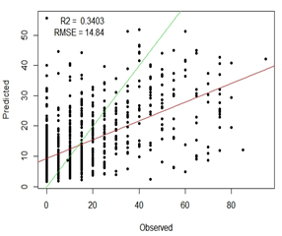
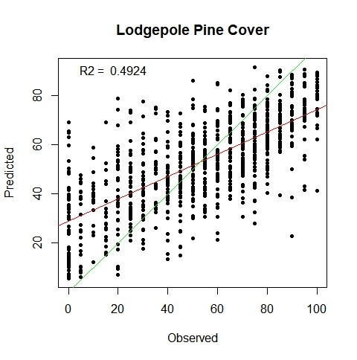
Model Evaluation
Notes:
We used several standard statistical methods to evaluate our models. Here on the left we see a confusion matrix for the binary classification model. Green areas indicate correctly classified plots whereas red areas indicate plots that were not correctly classified.
On the right, we see a predicted vs observed graph for our regression (continuous) model. The points represent training observations, and the red line is the line of best fit of the model.
Figures threshold result sec. tech paper

Slide 15
Errors and Uncertainties
Modeling
Limited Sampling
Threshold values for binary maps
Data limitations to species mapping
Live trees are not necessarily susceptible
Scope
Climate predictions
Bark Beetle predictions
Canopy structure and cover as the variable of interest
Large area with regional variability
Mountain Pine Beetle Epidemic
Beetle Population
Climate
Forest Structure
Notes:
Within our methodology, there are accuracy limitations to only using 1,000 sampling points over four large states to train our model. The thresholds set for the live and dead lodgepole pine binary maps may have introduced bias in our results. Multispectral imagery can be used to identify and monitor vegetation health; however, is limited in its capability to identify individual species. Live lodgepole pines were mapped but this does not necessarily mean that all will be at risk.
The three major components effecting mountain pine beetle outbreaks are climate, forest structure, and beetle populations. It is difficult to accurately predict future climate and genetic variability within beetle populations, so this leaves forest structure and cover as the primary focus in this project.

Slide 16
Conclusions
The percent live maps of lodgepole pine will provide insight towards identifying the locations of possible future bark beetle
Maps produced will allow BANR to further explore the severity of Bark Beetle outbreak effects within the IMW
Improved upon previous regional mapping efforts of bark beetle mortality by using finer resolution and accounting for severity
Notes:
Our work can inform future management and assessment of beetle-killed wood as a biofuel.

Slide 17
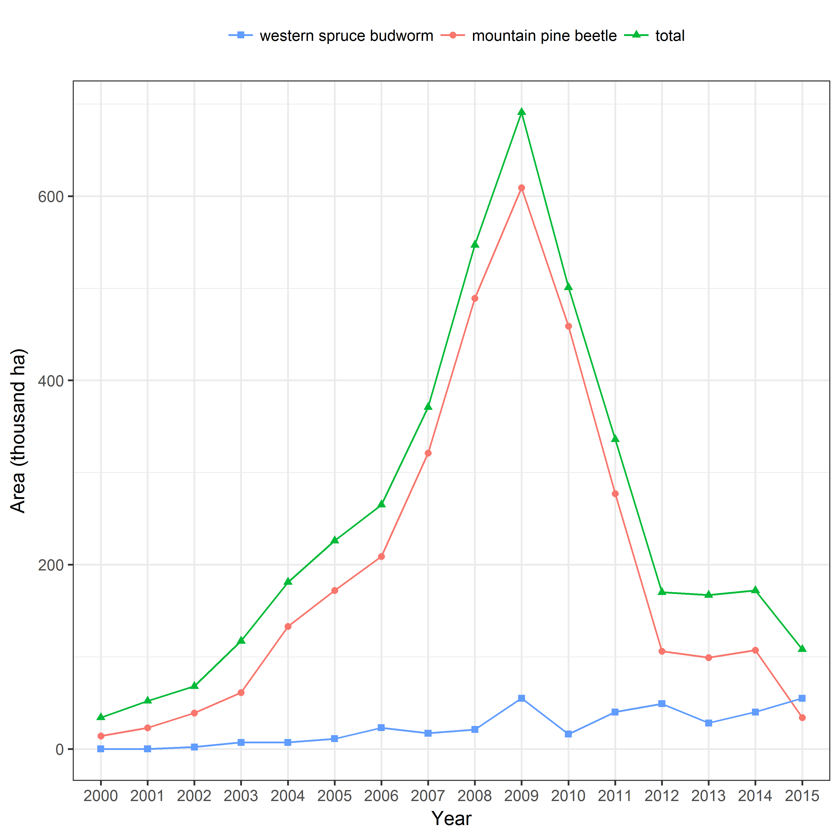
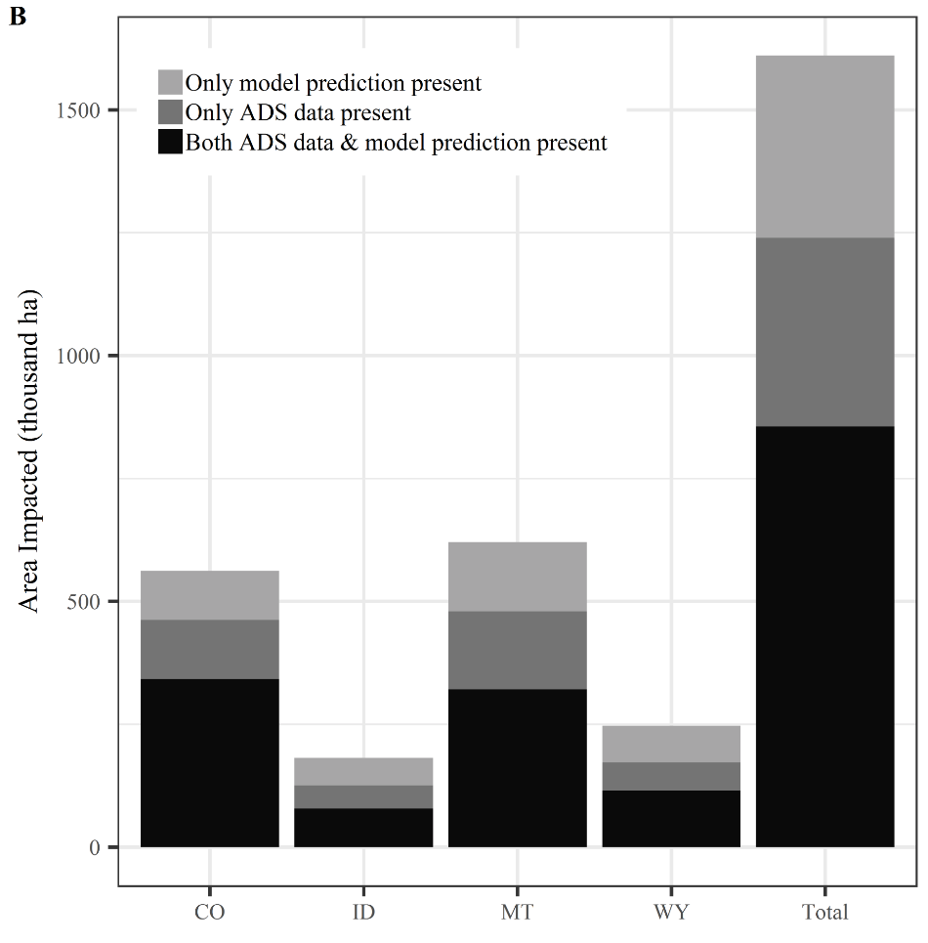
BANR Research
Aerial Detection Survey (ADS) - mortality, cause, and year
Model refinement and comparison
Colorado had severe impacts at greater geographic extents
Notes:
Our work can serve as a foundation to expand on this research.
Other aspects that can be explored include a higher number of predictor variables, expanding the area to be analyzed, and determining the economic value of beetle-kill wood as a biofuel.

Slide 18
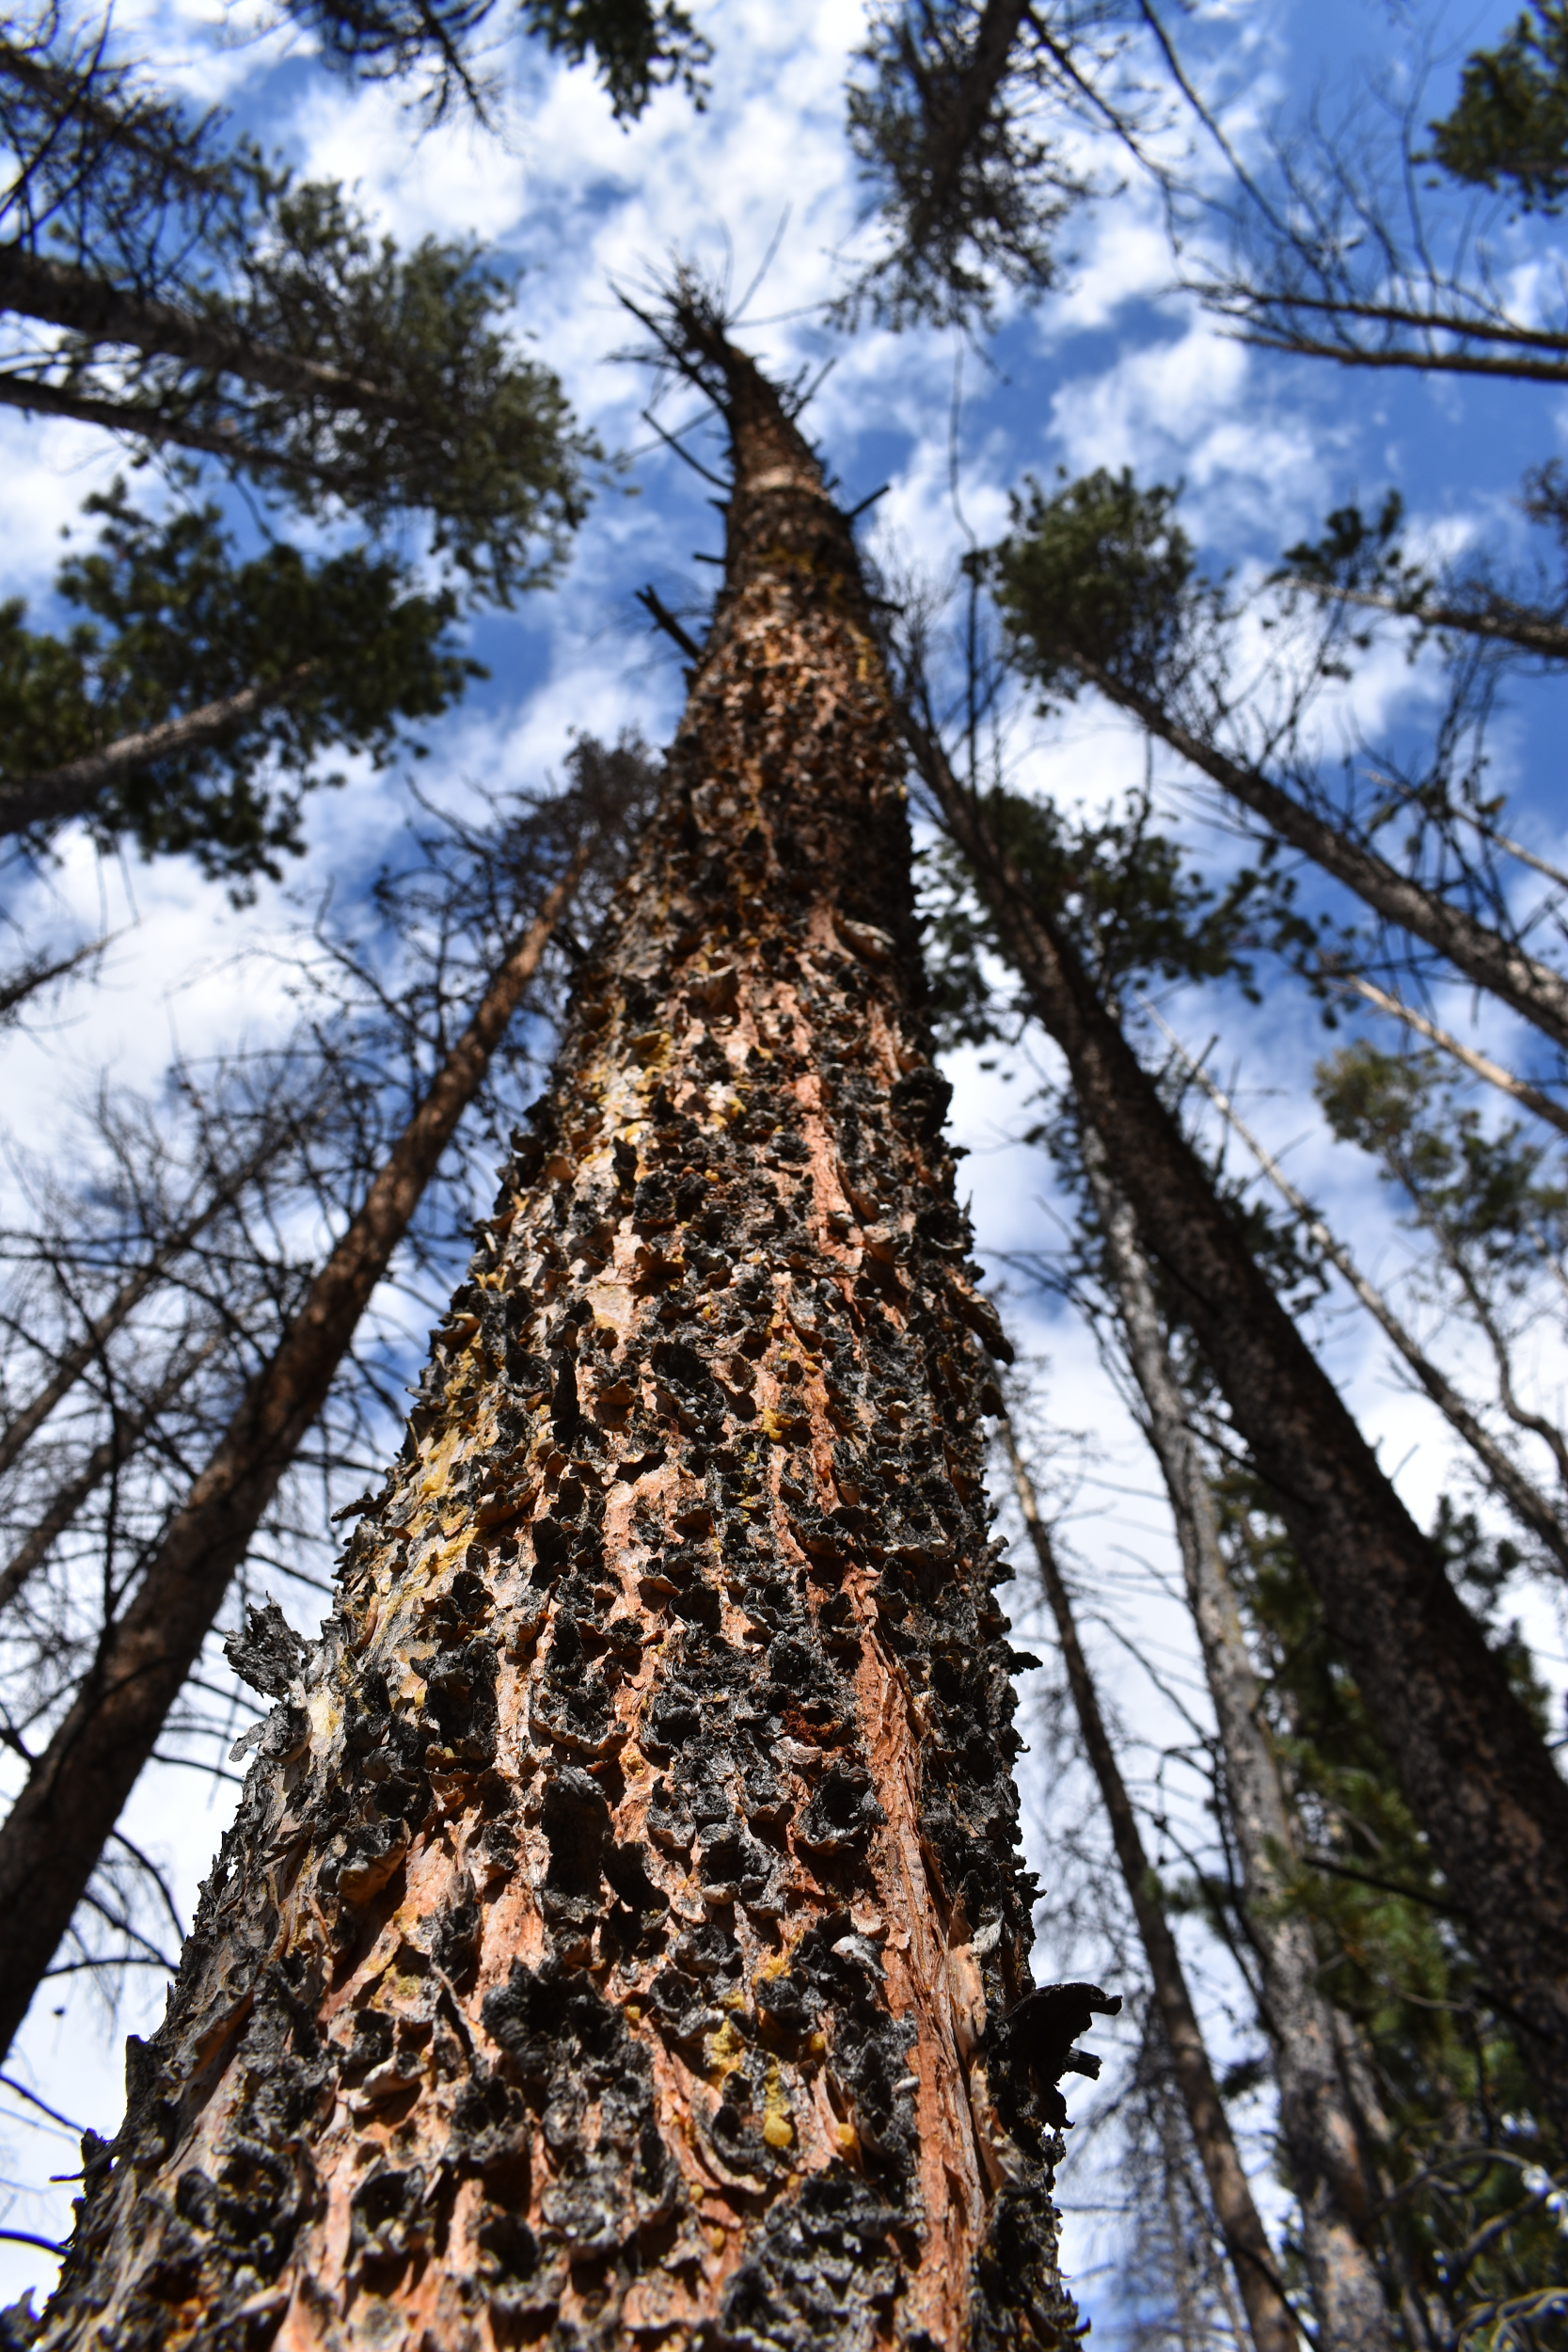
Acknowledgements
Partner
Bioenergy Alliance Network of the Rockies
Advisors and Mentors
Dr. Paul Evangelista (Colorado State University, Natural Resource Ecology Lab)
Tony Vorster (Colorado State University, Natural Resource Ecology Lab)
Brian Woodward (Colorado State University, Natural Resource Ecology Lab)
Stephen Leisz (Colorado State University)
Steven Filippelli (Colorado State University, Natural Resource Ecology Lab)
Peder Engelstad (Colorado State University, Natural Resource Ecology Lab)
Dr. Amanda West (Colorado State University, Natural Resource Ecology Lab)
Emma Zink Hatcher (Colorado State University, Natural Resource Ecology Lab)
Robert Sturtevant (Colorado State University, former State Forest Manager)
Image Credit: Jenny Mehren
Notes:
This project would not be possible without the support and mentorship from scientists in the Natural Resource Ecology Lab at CSU.

Slide 19
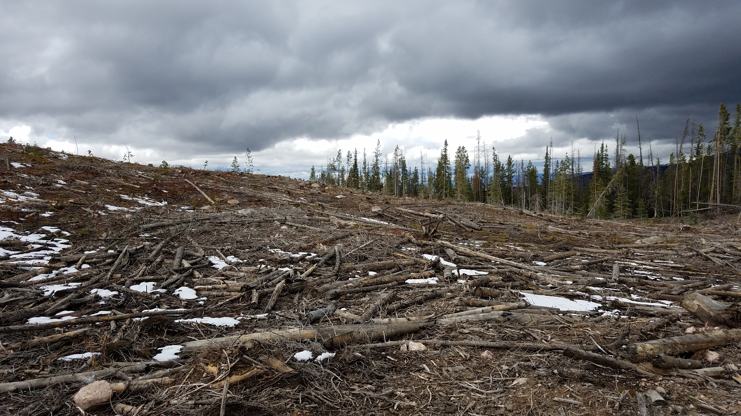
Questions?
Image Credit: Gary Olds
Notes:
Our work can serve as a foundation to expand on this research.
Other aspects that can be explored include a higher number of predictor variables, expanding the area to be analyzed, and determining the economic value of beetle-kill wood as a biofuel.
Image Credit: Gary Olds, team member

