Slide 1

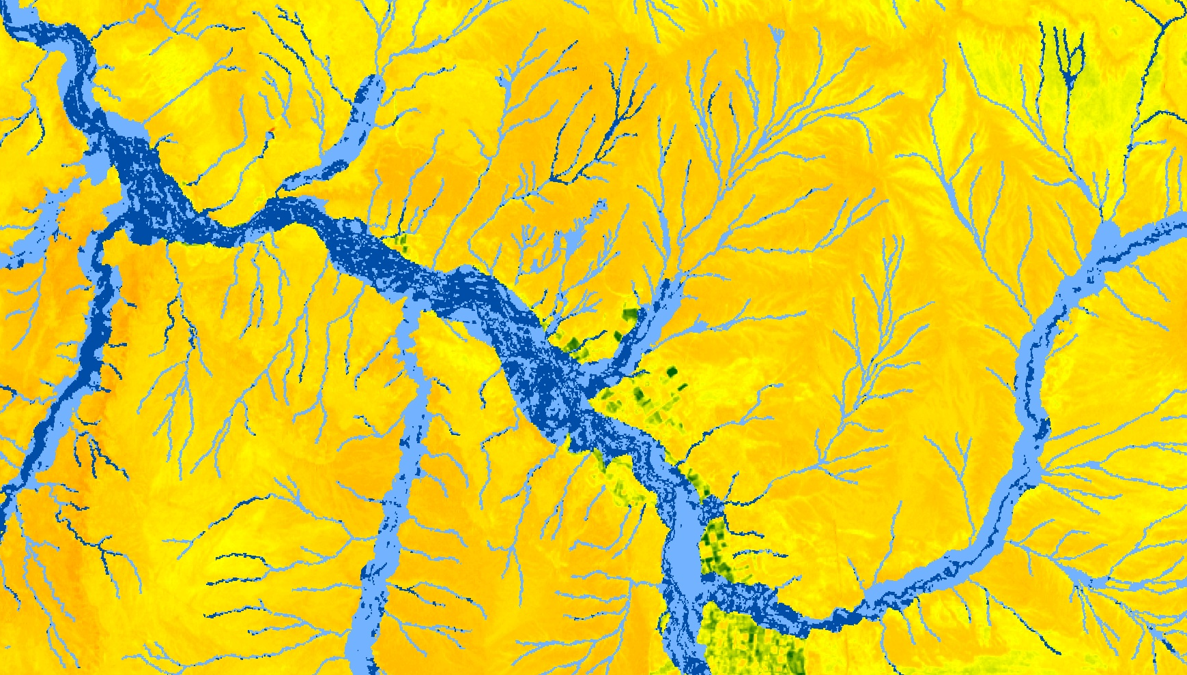

Utilizing NASA Earth Observations to Evaluate the Presence of Russian Olive in the Colorado River Basin
Kristin Davis
Katie Walker
Kevin Gallagher
Dan Carver
Caroline Martin
Notes:
Hello all, thank you for being here this afternoon. As … mentioned, I’ll be talking with you all today about another NASA DEVELOP project that I was a part of for 10 weeks in the fall of 2017 where we used remotely sensed imagery to evaluate Russian olive distribution in the Colorado River Basin.

Slide 2
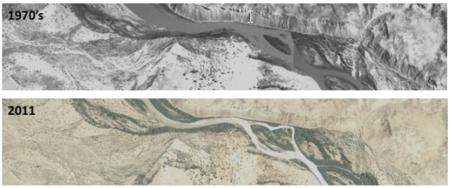
Community Concerns
Image Credit: Monet
Image Credit: Steve Bassett
Upper Colorado River Basin (UCRB) supplies water to over 40 million people
Function and structure of riparian zones are threatened by invasive species
Russian olive presence in the UCRB needs further study
Notes:
The upper Colorado River Basin supplies water to over 40 million people in 7 western US states. Not only is this river basin incredibly important for people, but its waters also sustain native riparian ecosystems.
Riparian ecosystems represent a unique transition zone between aquatic and terrestrial environments that are highly biodiverse and provide important ecosystem services, such as erosion control.
However, the function and structure of riparian zones are threatened by the spread of invasive species.
One such invasive species is Russian olive, which is native to Eurasia and has spread quickly in the West since its introduction into the US in the early 1900s. While it can be found in upland areas and was originally advertised as a great tree for windbreaks, it has become problematic in riparian areas in western rivers.
Currently, Russian olive presence in the UCRB is poorly understood, which limits managers’ abilities to address the impacts of this species in the basin.
Image Source: Steve Bassett. 2015. San Juan River Historical Ecology Assessment. San Juan Recovery Implementation Program Biology Committee Meeting. The Nature Conservancy.

Slide 3
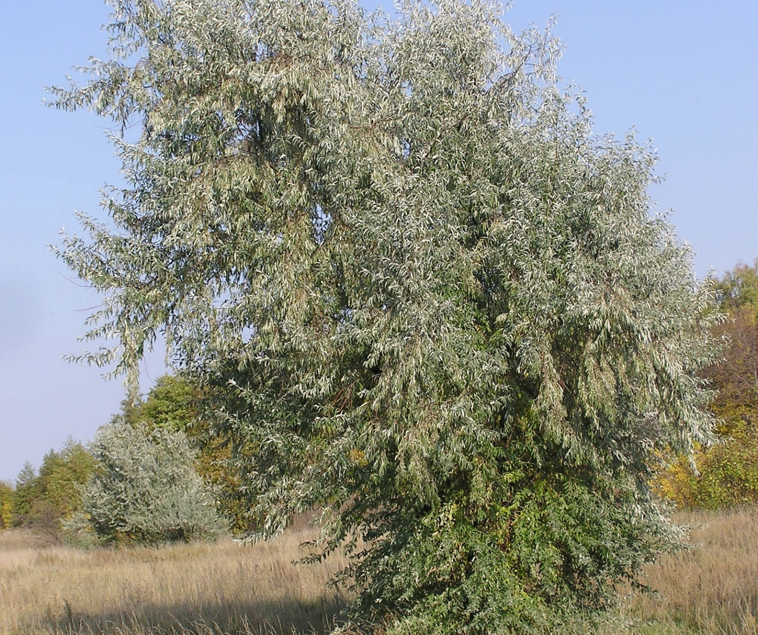
Objectives
Map current Russian olive distribution on the San Juan River
Compare change in Russian olive presence between 2006 and 2016
Compare Russian olive distribution between sensors and data types
Image Credit: Le.Loup.Gris
Notes:
To determine Russian olive presence and impacts on one portion of the Upper Colorado River Basin, the San Juan River, we developed four primary objectives.
First we wanted to map the current Russian olive distribution along the San Juan River.
We then wanted to examine whether Russian olive distribution had changed over time, so we determined the change in Russian olive presence over a 10 year period, between 2006 and 2016.
3. We also wanted to compare Russian olive distribution between different sensors and data types. We were curious whether imagery with finer spatial resolution would produce better distribution maps, and I’ll explain why we wanted to compare data types in a few minutes.
Image Source: By Le.Loup.Gris - Own work, CC BY-SA 3.0, https://commons.wikimedia.org/w/index.php?curid=17191769

Slide 4
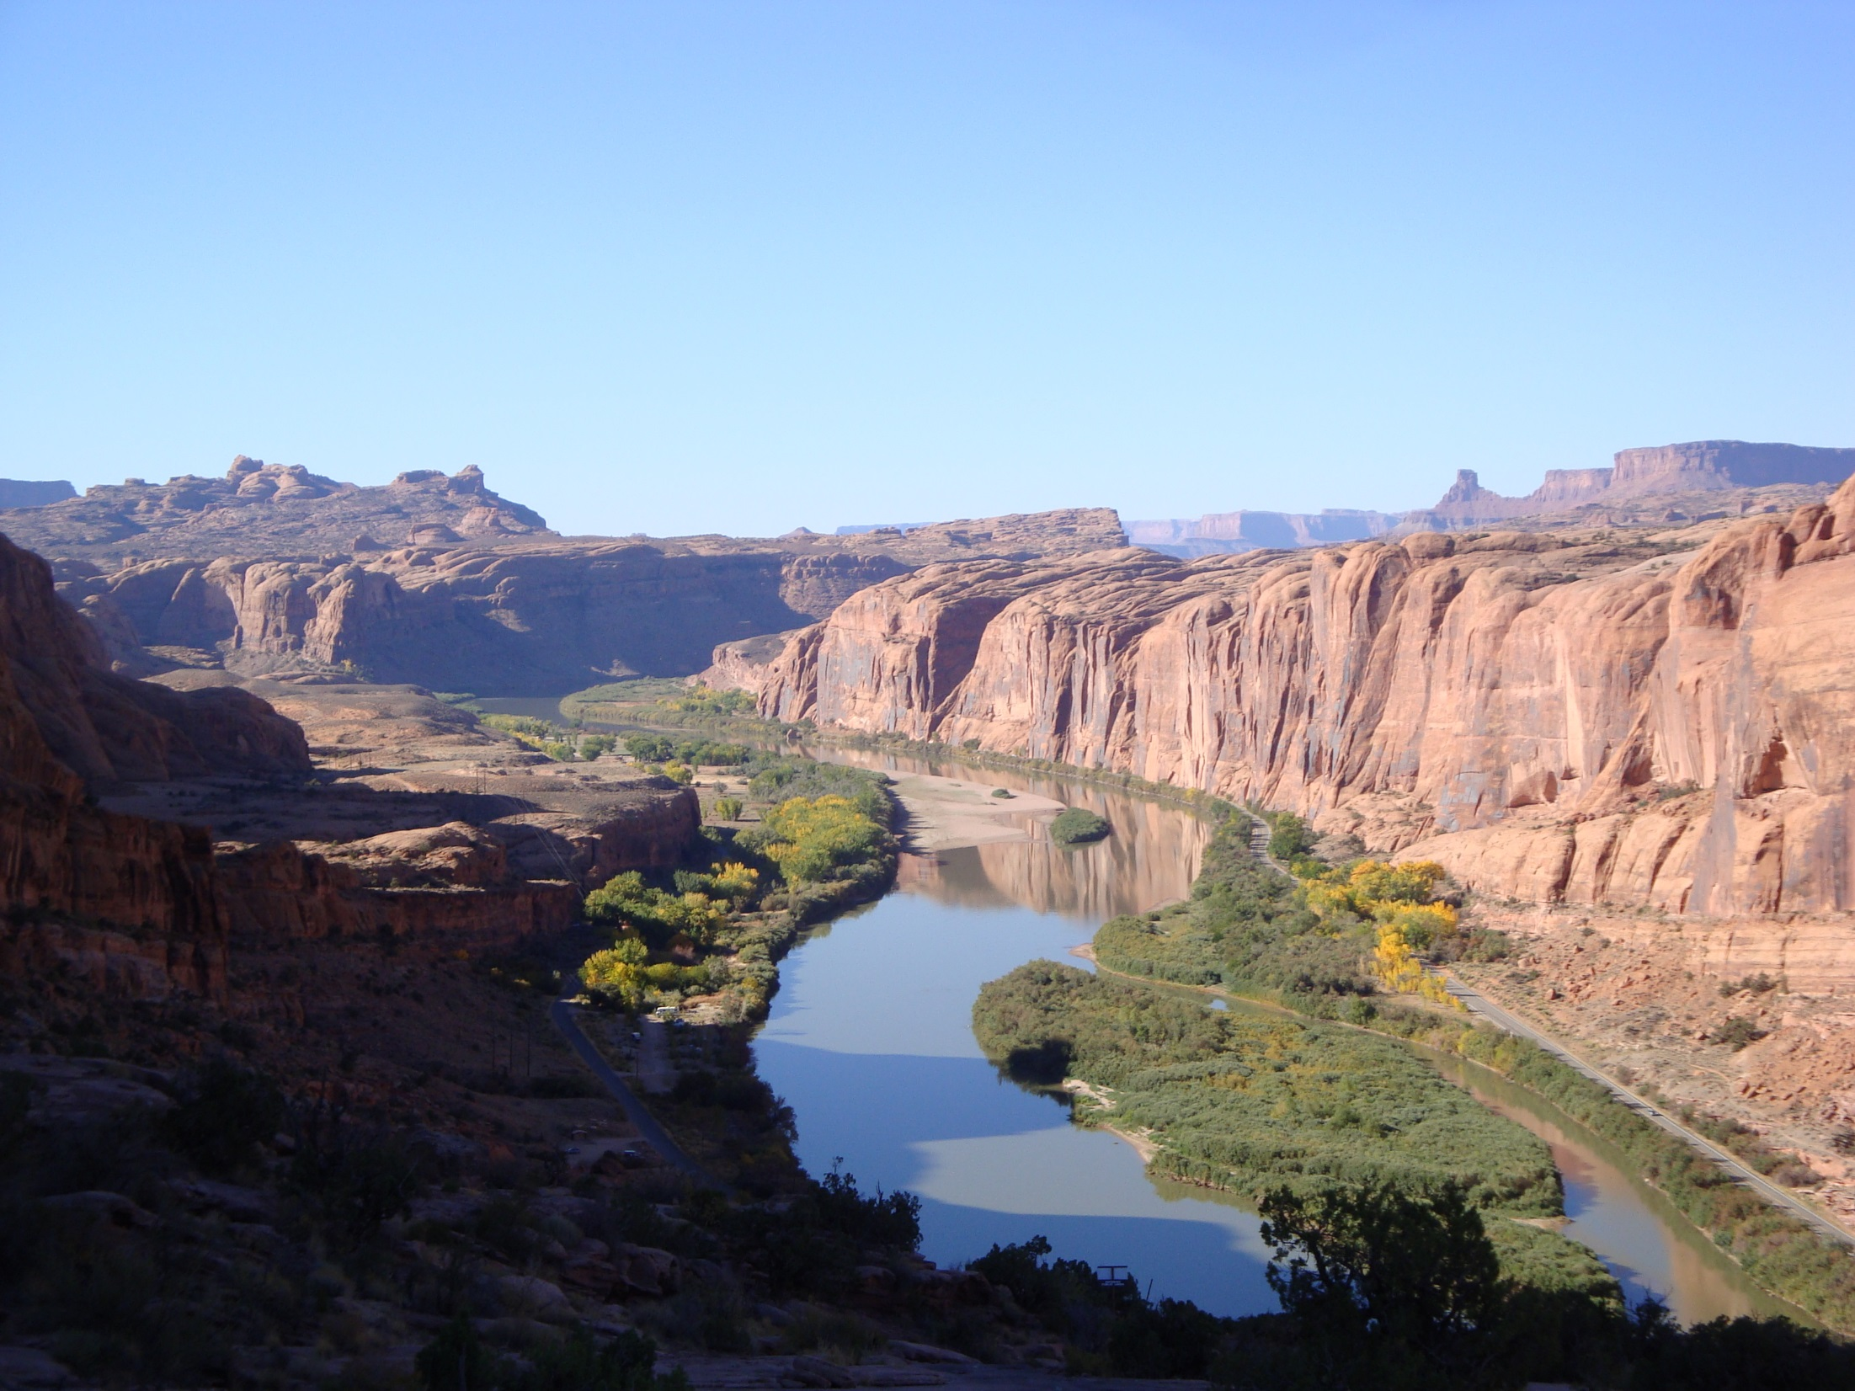

Project Partners
Walton Family Foundation
Natural Resource Ecology Laboratory
Image Credit: USGS
Notes:
To conduct this project, we partnered with the Walton Family Foundation, which supports the sustainable management of invasive species in the Colorado River Basin, and the USGS, in collaboration with the Natural Resource Ecology Laboratory at Colorado State University.
Image Source: https://www.flickr.com/photos/usgeologicalsurvey/26837176242/; public domain

Slide 5
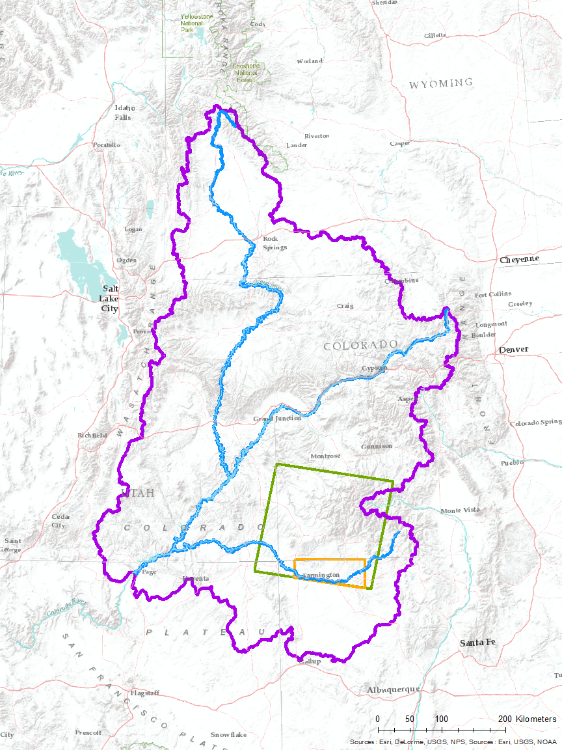
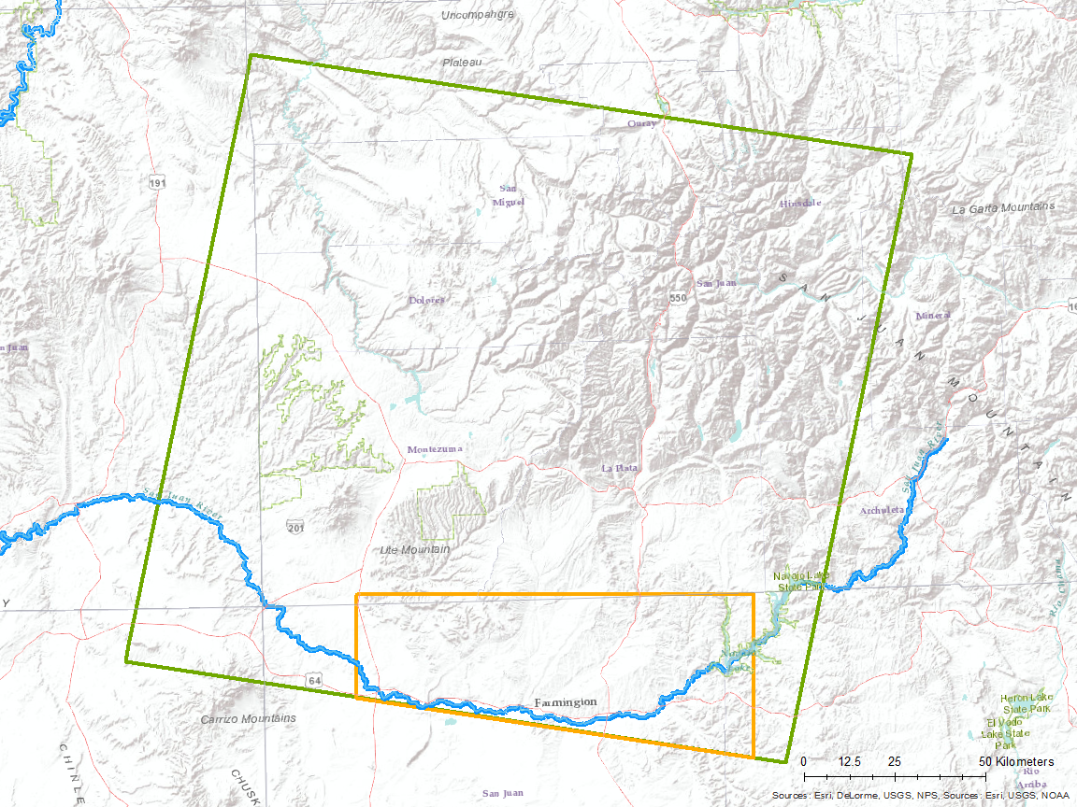
Study area
Upper CRB
Rivers
Landsat
study area
Sentinel-2
study area
Landsat P35-R34
Green
River
Colorado River
San Juan River
Portion of Sentinel-2
Tile 12SYF
San Juan River
Notes:
The Upper Colorado River Basin covers portions of Colorado, Utah, New Mexico and Arizona, but we focused on riparian areas in Landsat path 35, row 34, shown on these maps in green, which contains the San Juan River. We focused on riparian areas only in our study area because our partners were primarily interested in Russian olive impacts in riparian zones.
For our objective comparing how satellites with different spatial resolutions detected Russian olive presence, we focused on the area of overlap between our Landsat scene and Sentinel-2 tile 12SYF, since this overlap covers a large portion of the San Juan River
Image Source: Esri, Delorme, USGS, NPS, NOAA; ArcMap 10.3.1

Slide 6


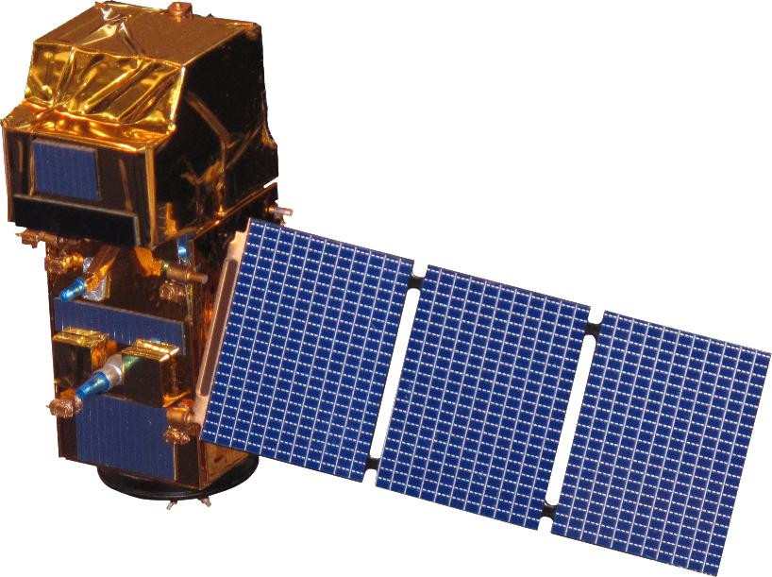

NASA Satellites/Sensors Used
Landsat 5 TM
Landsat 8 OLI & TIRS
Sentinel-2 MSI
10 m
30 m
30 m
Image Credit: NASA
Notes:
We used imagery from three satellites in this project – Landsat 5, Landsat 8 and Sentinel 2. We pre-processed imagery to account for the resolution differences between Sentinel-2 and Landsat 8.
Earth Background Image Source: https://www.nasa.gov/sites/default/files/bwhi1apicaaamlo.jpg_large.jpg
Satellite Image Source: http://www.devpedia.developexchange.com/dp/index.php?title=List_of_Satellite_Pictures, NASA DEVELOP

Slide 7
Methodology – Mapping Russian Olive
Field & Digital
Data
2016 - 17
Landsat 5 & 8, Sentinel-2
Field Collected Data: Information collected by user on the ground
Field & Digital Data
2005 - 06
Digitally Collected Data: ocular estimation using
NAIP imagery
Riparian Zone
Image Credit: Monet
Data
Software
Algorithm
Output
1
2
3
4
Notes:
Here I will briefly describe the workflow we used to map Russian olive in our study area. We used imagery from Landsat 5, 8 and Sentinel-2 and a delineated riparian zone to define our study area. This riparian zone was created by a previous DEVELOP project and we used that layer to restrict our study area because our partners were primarily interested on Russian olive impacts in riparian zones.
Our Russian olive presence/absence data are comprised of two types – field collected data and digitally sampled data. Our field data consisted of presence locations of Russian olive from citizen science and federal databases. We originally planned to just use field data in this project, but we noticed some discrepancies in these data that were concerning in terms of our remote sensing approach, so we ocularly sampled for presence and absence of Russian olive from 1m NAIP imagery to obtain digitally collected data.
Image Source: Colorado River Basin Water Resources I, NASA DEVELOP

Slide 8
Methodology – Mapping Russian Olive
Field & Digital
Data
2016 - 17
NASA Earth observations:
Landsat 5 & 8, Sentinel-2
Field Collected Data: Information collected by user on the ground
SAHM
Field & Digital Data
2005 - 06
Digitally Collected Data: ocular estimation using
NAIP imagery
Riparian Zone
Image Credit: Monet
R
SAHM: Software Assisted Habitat Modeling
Data
Software
Algorithm
Output
1
2
3
4
Notes:
We used two softwares to model Russian olive presence –the USGS’s Software for Assisted Habitat Modeling, or SAHM, and program R.
Image Source: Colorado River Basin Water Resources I, NASA DEVELOP

Slide 9
Methodology – Mapping Russian Olive
Field & Digital
Data
2016 - 17
RF
NASA Earth observations:
Landsat 5 & 8, Sentinel-2
Field Collected Data: Information collected by user on the ground
SAHM
MARS
Field & Digital Data
2005 - 06
GLM
Digitally Collected Data: ocular estimation using
NAIP imagery
BRT
Riparian Zone
Image Credit: Monet
R
SAHM: Software Assisted Habitat Modeling
Data
Software
Algorithm
Output
1
2
3
4
Notes:
SAHM is great because it fits multiple types of models to create distribution maps, including random forest models, generalized linear models, multivariate adaptive regression splines and boosted regression trees, and then provides metrics indicating which model performed best. However, there’s a learning curve to become comfortable with the software.
In R, one has to fit each of those models separately, but if you have code to do so it can be faster than working through SAM.
Image Source: Colorado River Basin Water Resources I, NASA DEVELOP

Slide 10
Methodology – Mapping Russian Olive
Field & Digital
Data
2016 - 17
RF
NASA Earth observations:
Landsat 5 & 8, Sentinel-2
Field Collected Data: Information collected by user on the ground
SAHM
MARS
Field & Digital Data
2005 - 06
GLM
Digitally Collected Data: ocular estimation using
NAIP imagery
BRT
Riparian Zone
RF
Image Credit: Monet
R
SAHM: Software Assisted Habitat Modeling
Data
Software
Algorithm
Output
1
2
3
4
Notes:
For the sake of time and resources, with only fit random forest models in R.
Image Source: Colorado River Basin Water Resources I, NASA DEVELOP

Slide 11
Methodology – Mapping Russian Olive
Field & Digital
Data
2016 - 17
RF
NASA Earth observations:
Landsat 5 & 8, Sentinel-2
Field Collected Data: Information collected by user on the ground
SAHM
MARS
Field & Digital Data
2005 - 06
GLM
Presence/ Absence
Binary
Maps
Digitally Collected Data: ocular estimation using
NAIP imagery
BRT
Riparian Zone
RF
Image Credit: Monet
R
Presence/ Absence
Binary
Maps
SAHM: Software Assisted Habitat Modeling
Data
Software
Algorithm
Output
1
2
3
4
Notes:
The outputs of both approaches were binary maps showing Russian olive presence and absence in our study area.
Image Source: Colorado River Basin Water Resources I, NASA DEVELOP

Slide 12
Results – Mapping Russian Olive
Presence Area and Statistics
Data Set | Percentage of Valley Bottom Detected as RO |  | Out of Bag Error (%) |  | AUC (Area Under ROC Curve)
 | Digital | Field | Digital | Field | Digital | Field
LS5 | 3.30 | 63.75 | 2.44 | 15.36 | 0.69 | 0.60
LS8 | 1.06 | 1.46 | 2.94 | 6.01 | 0.68 | 0.62
LS8 subset | 1.42 | N/A | 2.11 | N/A | 0.68 | N/A
Sentinel | 1.26 | N/A | 2.09 | N/A | 0.77 | N/A
Notes:
From our models, we evaluated the percentage of the valley bottoms in our study area where Russian olive was present based on data type, time period and sensor, and these percentages will be shown in this first main column – Percentage of Valley Bottom Detected as Russian Olive. We used two model evaluation statistics, Out of Bag Error and AUC, to evaluate our models, which will be in shown in these outer two columns.

Slide 13
Results – Mapping Russian Olive
Presence Area and Statistics
Data Set | Percentage of Valley Bottom Detected as RO |  | Out of Bag Error (%) |  | AUC (Area Under ROC Curve)
 | Digital | Field | Digital | Field | Digital | Field
2006 | 3.30 | 63.75 | 2.44 | 15.36 | 0.69 | 0.60
2016 | 1.06 | 1.46 | 2.94 | 6.01 | 0.68 | 0.62
Landsat 8 | 1.42 | N/A | 2.11 | N/A | 0.68 | N/A
Sentinel 2 | 1.26 | N/A | 2.09 | N/A | 0.77 | N/A
Notes:
So here are our results for each model we fit. One of the first things we can see on this table is how differently the digital data and the field data predicted Russian olive presence.
Models trained on field data and imagery from 2006 severely overpredicted Russian olive presence and had a high out of bag error. This was not nearly as extreme in 2016, but models trained using field data and imagery from that year still predicted…

Slide 14
Results – Mapping Russian Olive
Presence Area and Statistics
Data Set | Percentage of Valley Bottom Detected as RO |  | Out of Bag Error (%) |  | AUC (Area Under ROC Curve)
 | Digital | Field | Digital | Field | Digital | Field
2006 | 3.30 | 63.75 | 2.44 | 15.36 | 0.69 | 0.60
2016 | 1.06 | 1.46 | 2.94 | 6.01 | 0.68 | 0.62
Landsat 8 | 1.42 | N/A | 2.11 | N/A | 0.68 | N/A
Sentinel 2 | 1.26 | N/A | 2.09 | N/A | 0.77 | N/A
Notes:
…more Russian olive and had a higher out of bag error.

Slide 15
Results – Mapping Russian Olive
Presence Area and Statistics
Data Set | Percentage of Valley Bottom Detected as RO |  | Out of Bag Error (%) |  | AUC (Area Under ROC Curve)
 | Digital | Field | Digital | Field | Digital | Field
2006 | 3.30 | 63.75 | 2.44 | 15.36 | 0.69 | 0.60
2016 | 1.06 | 1.46 | 2.94 | 6.01 | 0.68 | 0.62
Landsat 8 | 1.42 | N/A | 2.11 | N/A | 0.68 | N/A
Sentinel 2 | 1.26 | N/A | 2.09 | N/A | 0.77 | N/A
Notes:
So ultimately we found that models trained on digitally collected data performed better than models fit to field data.

Slide 16
Results – Mapping Russian Olive
Presence Area and Statistics
Data Set | Percentage of Valley Bottom Detected as RO |  | Out of Bag Error (%) |  | AUC (Area Under ROC Curve)
 | Digital | Field | Digital | Field | Digital | Field
2006 | 3.30 | 63.75 | 2.44 | 15.36 | 0.69 | 0.60
2016 | 1.06 | 1.46 | 2.94 | 6.01 | 0.68 | 0.62
Landsat 8 | 1.42 | N/A | 2.11 | N/A | 0.68 | N/A
Sentinel 2 | 1.26 | N/A | 2.09 | N/A | 0.77 | N/A
Notes:
If we focus then on the digitally collected data, we found our models predicted a small decrease in Russian olive presence in our study area from 2006 to 2016.

Slide 17
Results – Mapping Russian Olive
Presence Area and Statistics
Data Set | Percentage of Valley Bottom Detected as RO |  | Out of Bag Error (%) |  | AUC (Area Under ROC Curve)
 | Digital | Field | Digital | Field | Digital | Field
2006 | 3.30 | 63.75 | 2.44 | 15.36 | 0.69 | 0.60
2016 | 1.06 | 1.46 | 2.94 | 6.01 | 0.68 | 0.62
Landsat 8 | 1.42 | N/A | 2.11 | N/A | 0.68 | N/A
Sentinel 2 | 1.26 | N/A | 2.09 | N/A | 0.77 | N/A
Notes:
We also found that models fit using imagery from Sentinel 2 and the corresponding portion of Landsat 8 in our study area predicted pretty similar amounts of Russian olive and had similar out of bag errors, but the model fit using Sentinel imagery had a higher AUC, potentially suggesting a better model.

Slide 18
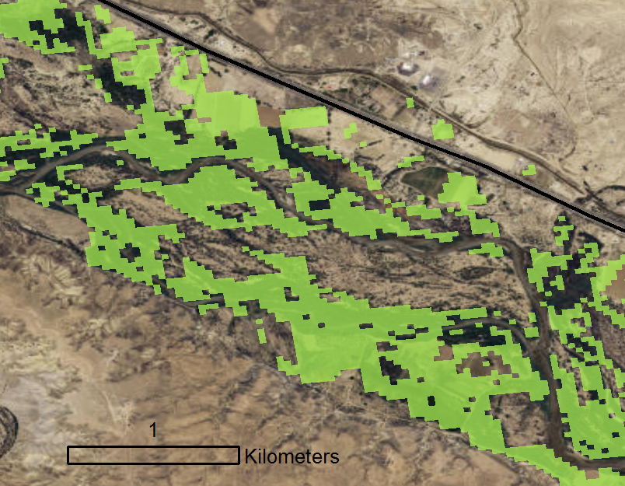
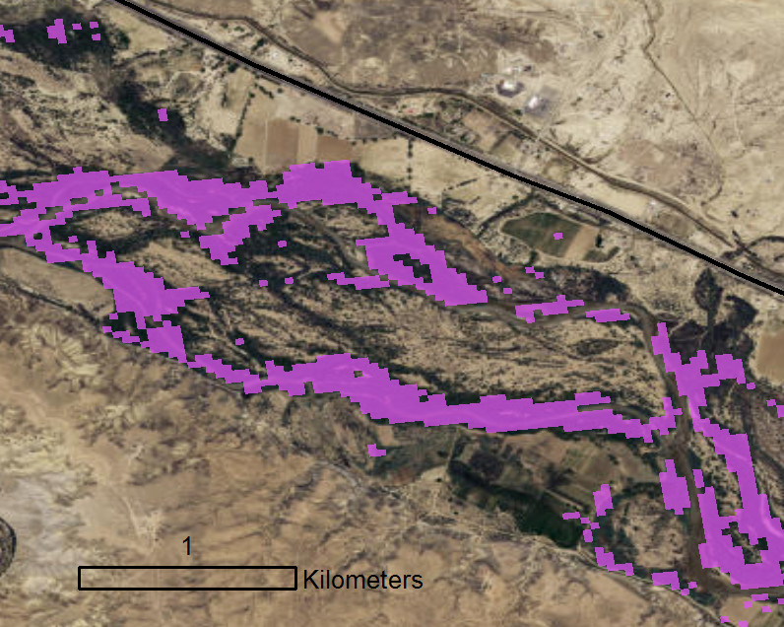
Results – 2006 to 2016
2006
2016
Presence: 3.30% of Valley Bottom
Presence: 1.06% of Valley Bottom
Notes:
Now to visually demonstrate some of the comparisons we examined, I’ll show a few maps we produced from the random forest modeling we performed in program in R using our digitally sampled data.
As I mentioned, our models showed…

Slide 19
Results – 2006 to 2016
2006
2016
Presence: 3.30% of Valley Bottom
Presence: 1.06% of Valley Bottom
Notes:
reduced Russian olive presence in 2016 than in 2006.

Slide 20
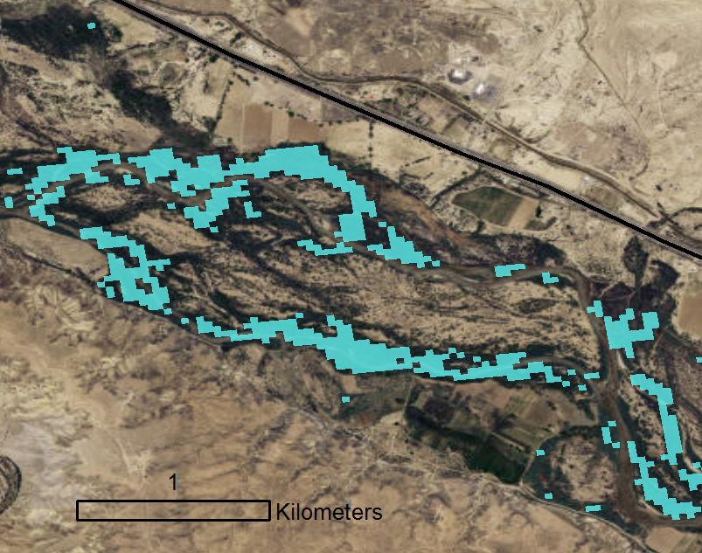
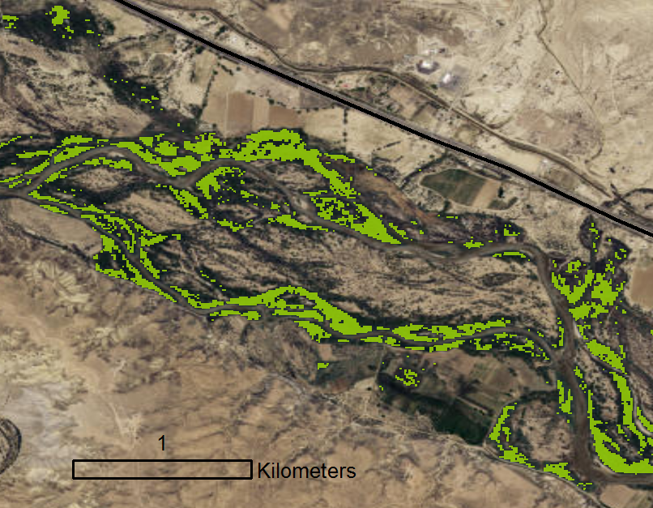
Results – Landsat 8 to Sentinel-2 (2016)
Landsat 8 (Subset)
Sentinel-2
Presence: 1.42% of Valley Bottom
Presence: 1.26% of Valley Bottom
Notes:
For our spatial resolution comparison, we found our Sentinel-2 model predicted slightly…

Slide 21
Results – Landsat 8 to Sentinel-2 (2016)
Landsat 8 (Subset)
Sentinel-2
Presence: 1.42% of Valley Bottom
Presence: 1.26% of Valley Bottom
Notes:
…less Russian olive presence than the Landsat 8 model. and had a lower Out of Bag Error and a higher AUC. This suggests Sentinel-2 could be suitable for detecting Russian olive in our study area.

Slide 22
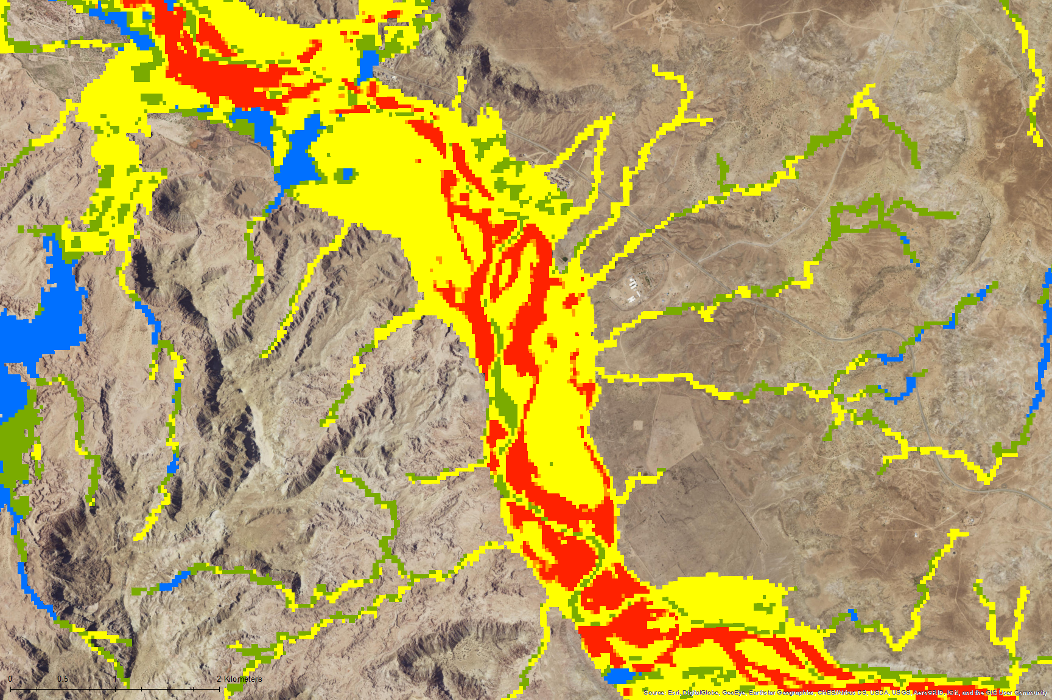
Results – Mapping Russian Olive using SAHM
Landsat 8 (2016)
Four Models Compared:
Number of models detecting presence
0
3
Generalized Linear Models
1
4
Random Forest
2
Boosted Regression Trees
Multivariate Adaptive Regression Splines
Notes:
Here, I want to highlight one of the outputs of the USGS’ Software for Assisted Habitat Modelling, or SAHM. As I mentioned before, SAHM fits multiple models to develop distribution maps – these include generalized linear models, random forest models, boosted regression trees and multivariate adaptive regression splits. The map shown here is one of the outputs SAHM produces and this map is showing where these four models fit to the same data and imagery agree on presence. Cooler colors represent areas where fewer models agree on presence, and warmer colors represent areas where more models agree on presence.
We see that a couple of models are predicted Russian olive presence in a larger portion of the study area compared to other models – shown by the yellow color that dominates the map - which suggests one needs to be thoughtful about choosing a model to create distributions and that using multiple models to map distributions could potentially ensure a more reliable or accurate product.
Image Source: ESRI, DigitalGlobe, GeoEye, Earthstar Geographics, CNES/Airbus DS, USDA, USGS, AeroGRID, IGN, and the GIS User Community

Slide 23
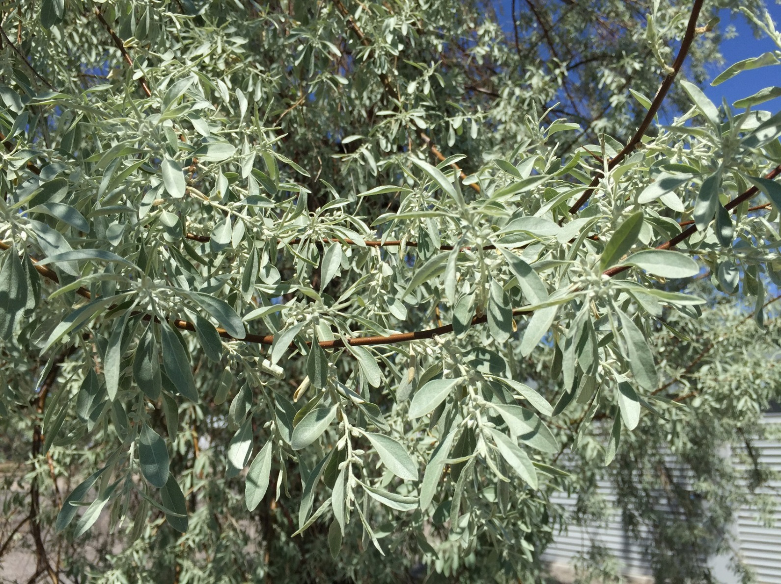
Errors and Uncertainties
Importance of field data collected for remote sensing purposes
Image Credit: Famartin, Wikimedia Commons
Notes:
We learned a lot from our project, not least of which being that not all data are equally useful for remote sensing analyses.
For example, field data of a location of an individual tree does not scale well to a 30m x 30m pixel. That was often the case in our field data – they consisted of a presence location at an individual tree, or there were points where it looks like an individual was standing on one side of the river bank looking across it and saw Russian olive, so they took a point where they were standing rather than at the trees themselves.
We suspect this contributed to why our models trained on field data, especially using older imagery, severely overpredicted Russian olive presence in our study area, and this emphasized to us the importance of having field data that were collected specifically for remote sensing purposes.
Image Source: https://commons.wikimedia.org/wiki/File:2015-04-29_14_31_02_Russian_Olive_foliage_along_Nevada_State_Route_723_(Soda_Lake_Road)_in_Churchill_County,_Nevada.jpg

Slide 24
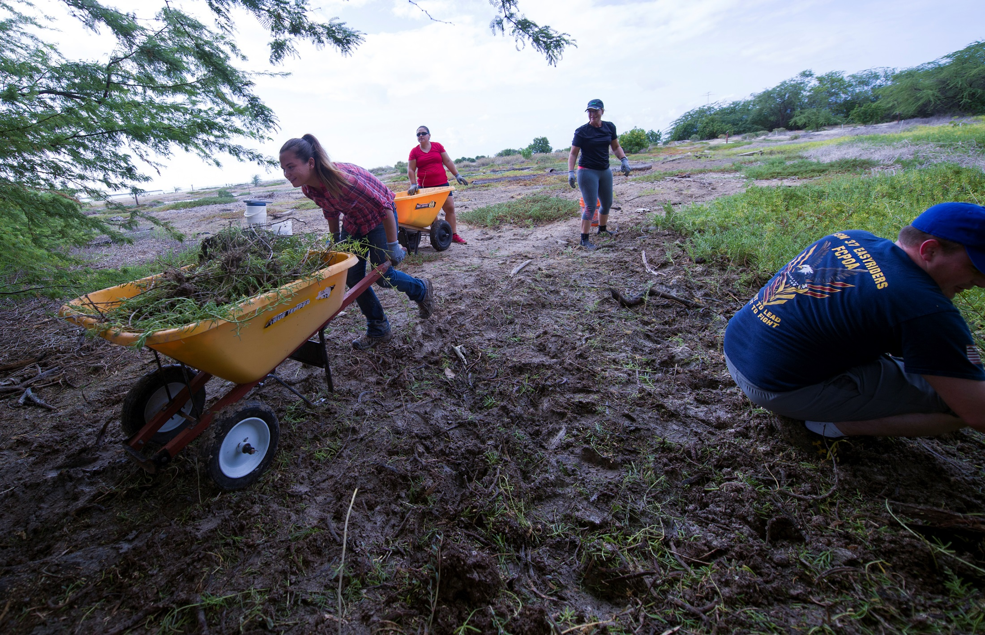
Conclusions
Russian olive is relatively easy to detect in aerial imagery
Digital data performed better than field data, but field data is important for validation
Maps can help inform monitoring, management and restoration
Image Credit: Petty Officer Gabrielle Joyner, Wikimedia Commons
Notes:
Overall, though, we found that the unique gray-green leaves of Russian olive were relatively easy to see on imagery, which we think makes it a species suitable for studying using remote sensing.
While we found our models fit to our digital data performed better than models fit to our field data, collecting field data is still very important for model validation and ground-trothing.
Finally, we have confidence in some of our final distribution maps and believe they can help assist the Walton Family Foundation’s efforts to manage for Russian olive on the San Juan River.
Image Source: Petty Officer 2nd Class Gabrielle Joyner, Wikimedia Commons, 161028-N-WC566-040, https://www.dvidshub.net/image/2953305/navfac-hawaii-continues-ahua-reef-restoration

Slide 25
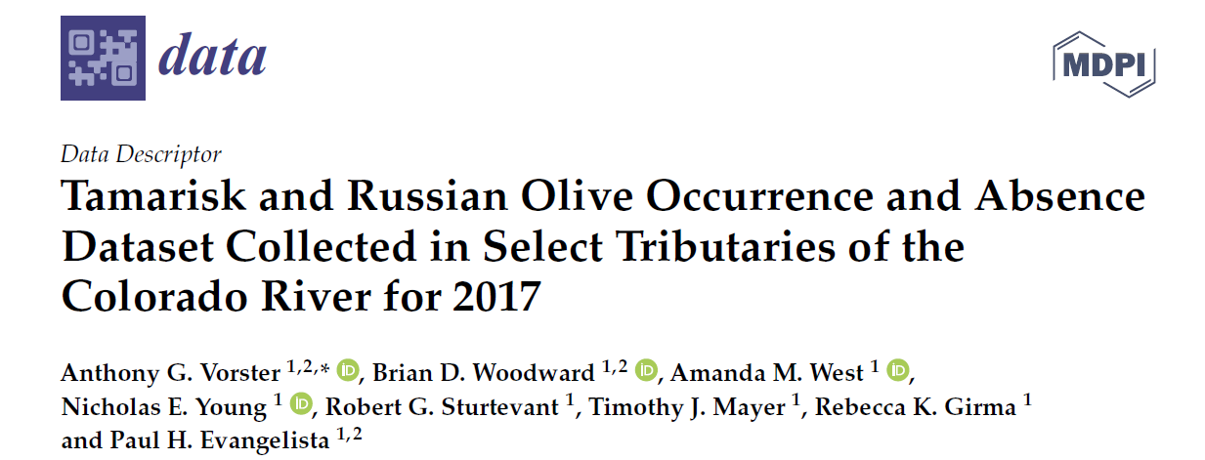
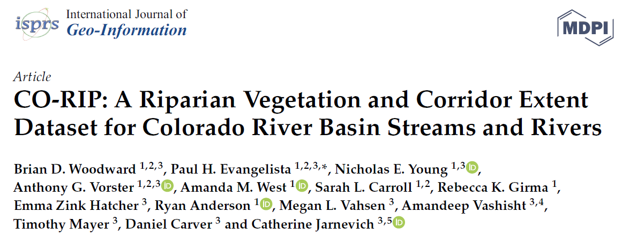
Future work
Image Credits: Kristin Davis
Notes:
Just briefly back to my point about field data collected for remote sensing analyses, our collaborators actually went out into the field and collected some data upon realizing the paucity of good field data for remote sensing for these invasive species. This dataset for tamarisk and Russian olive is publically available from the journal Data and is titled (read title).
Our collaborators also published the tool for delineating the riparian zone that produced our valley bottom layer, and that can be found through this article in the International Journal of Geo-Information and is titled (read). Both are open source and we hope can assist others who are exploring invasive species impacts or riparian ecosystems in the Colorado River Basin.
Image Source: Screenshots taken by Kristin Davis of the publications shown in the slide – top: Woodward et al. 2018. CO-RIP: A riparian vegetation and corridor extent dataset for Colorado River Basin streams and rivers. ISPRS International Journal of Geo-Information 7:397. doi:10.3390/ijgi7100397; bottom: Vorster et al. 2018. Tamarisk and Russian olive occurrence and absence dataset collected in select tributaries of the Colorado River for 2017. Data 3:42. doi:10.3390/data3040042.

Slide 26
Acknowledgements
Science Advisors and Mentors at Colorado State University:
Dr. Paul Evangelista (Advisor) Anthony Vorster (Mentor)
Dr. Amanda West (Advisor) Brian Woodward (Mentor)
Science Mentors at the USGS:
Dr. Gabriel Senay
Dr. Catherine Jarnevich
Previous Contributors:
Megan Vahsen
Emily Campbell
Julia Sullivan
Chanin Tilakamonkul
Brian Woodward
Leana Schwartz
Sarah Carroll
Amandeep Vashisht
Partners:
US Geological Survey
Walton Family Foundation
Notes:
I want to acknowledge all of the advisors, mentors and contributors to this project. Their help was invaluable.

Slide 27
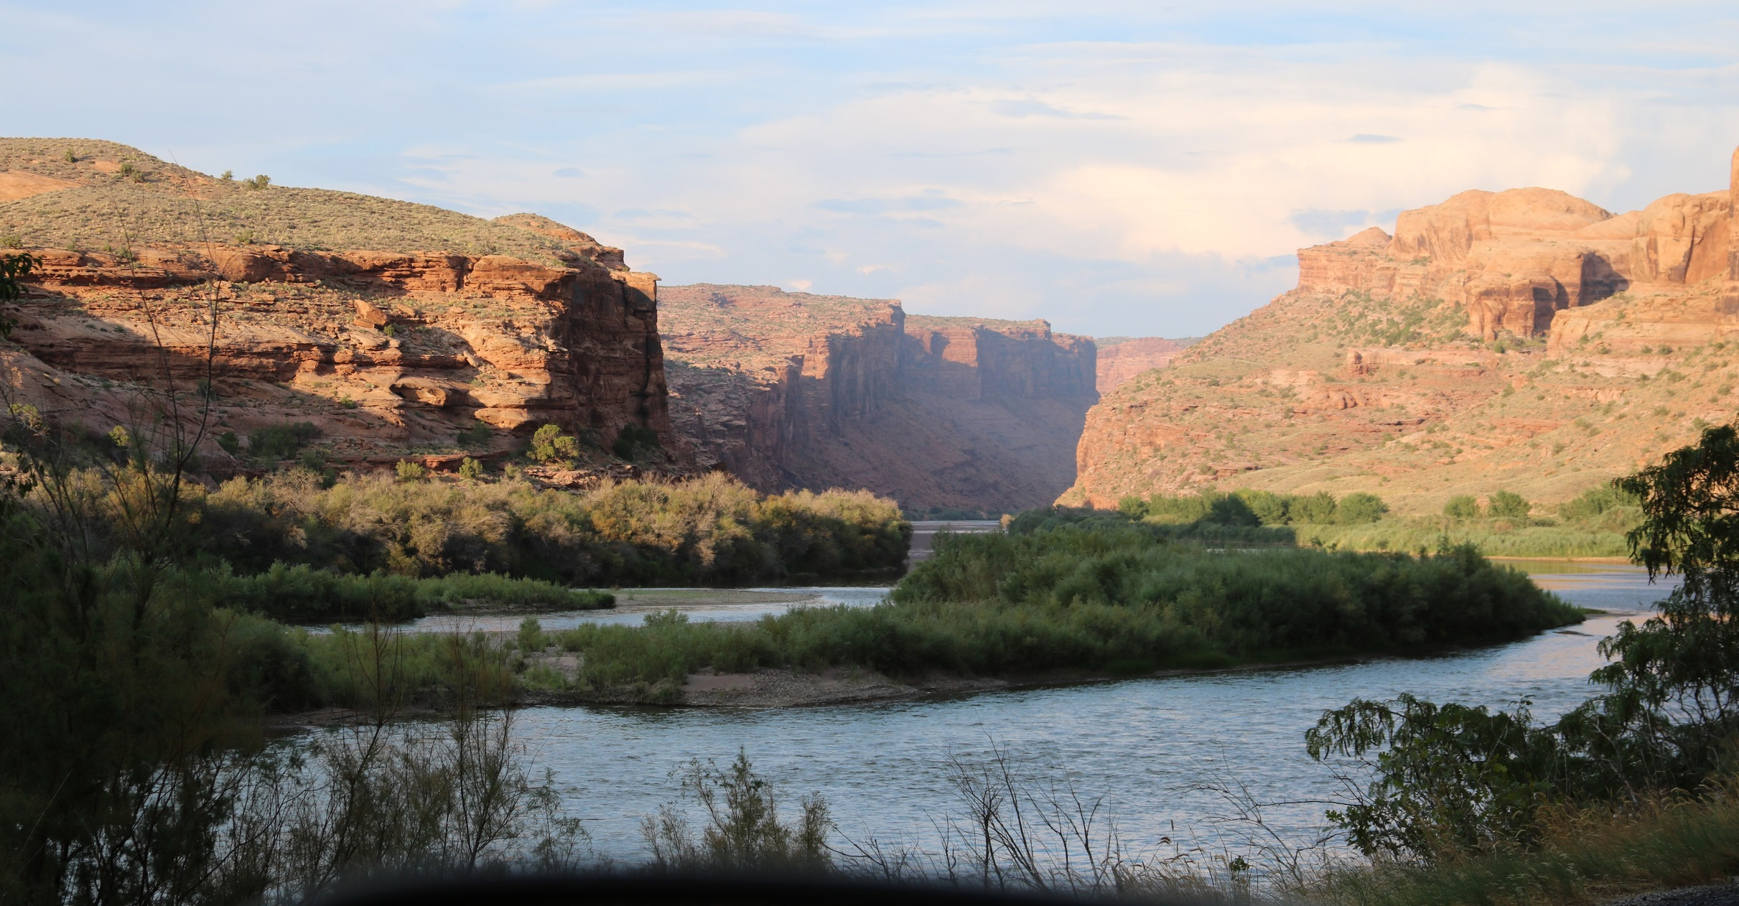
Questions?
Image Credit: diveofficer
Notes:
Thank you for your time and attention and I’m happy to take questions.
Image Source: https://www.flickr.com/photos/diveofficer/36478654913/; diveoffier, Flickr

