Slide 1
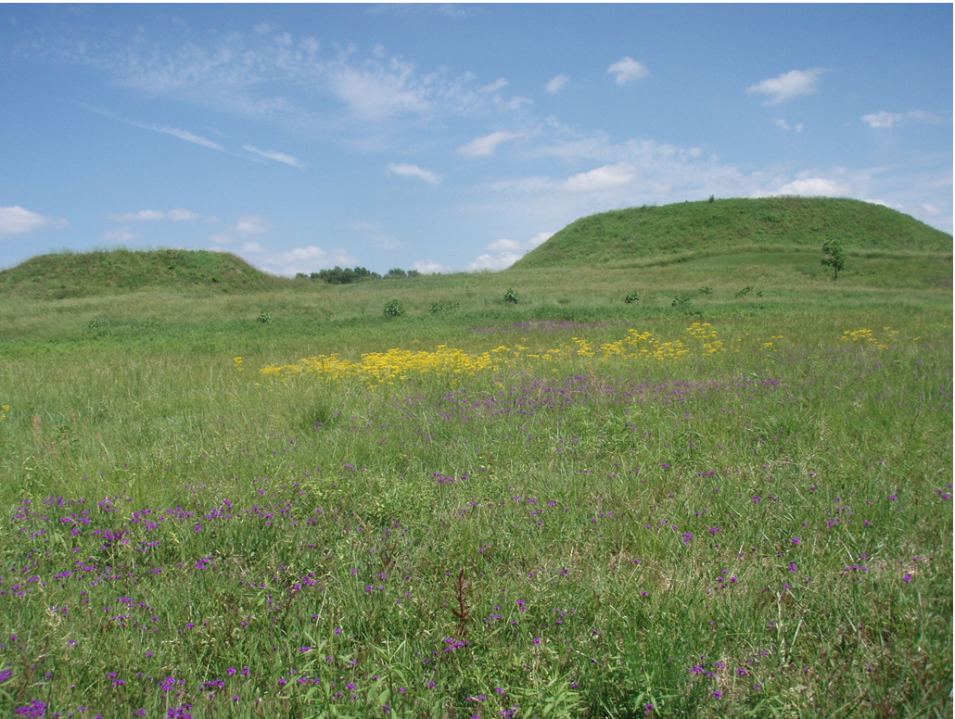


Maintaining National Park Service Vegetation Databases
in the Southeastern United States
using Emerging Geospatial Techniques
Marguerite Madden, Thomas Jordan, David Cotten,
Nancy O’Hare and Brandon Adams
Center for Geospatial Research (CGR)
Department of Geography , University of Georgia
mmadden@uga.edu / cgr.uga.edu
ILMF-ASPRS Annual Conference
Denver, Colorado, 28-30 January 2019
CGR
Center for Geospatial Research

Slide 2
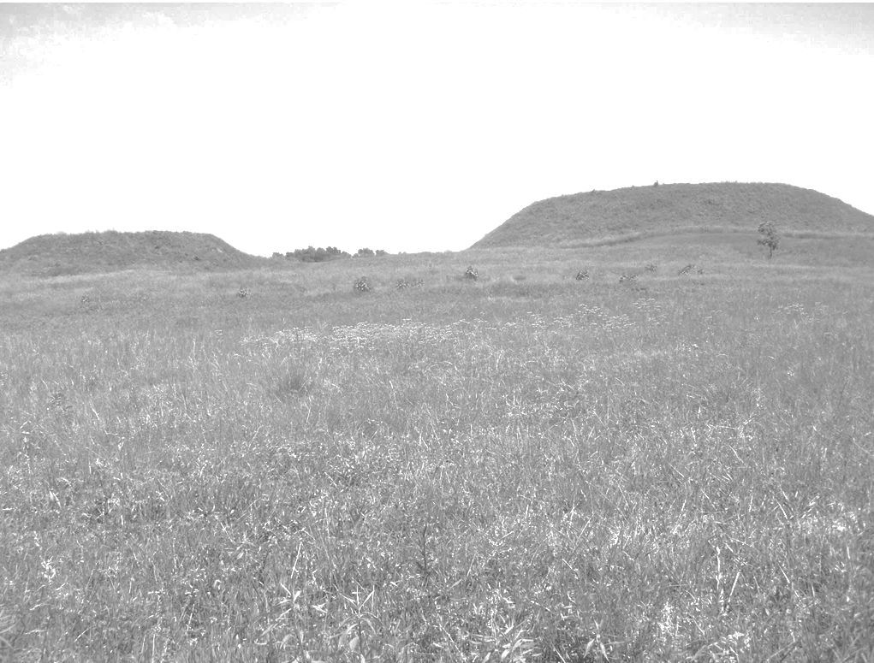
Motivation:
Researchers at UGA-CGR have created detailed vegetation databases for 28 National Park Service (NPS) units in the Southeastern U.S. as part of the Vegetation Inventory Program conducted jointly by the USGS Center for Biological Informatics and the NPS.
Beginning with Everglades NP and Big Cypress National Preserve (1995) to six Parks in the Southeast Coast Network (2019), mapping methods have evolved from manual interpretation of analog aerial photographs to hybrid manual-automated techniques using digital imagery, field data collection with mobile devices and UAS.
New methods are now required to update and maintain the over 300 National Park vegetation resource databases in the upcoming Inventory 2.0 Program.

Slide 3
Objectives:
Explore use of emerging geospatial technologies (e.g., GEOBIA, mobile mapping, UAS, structure from motion, VR/AR, machine learning, deep learning) to assess vegetation changes over time.
Find best methods and practices for integrating advanced geographic techniques for effective/efficient updating of NPS vegetation databases using case studies of vegetation recovery following disturbances.

Slide 4
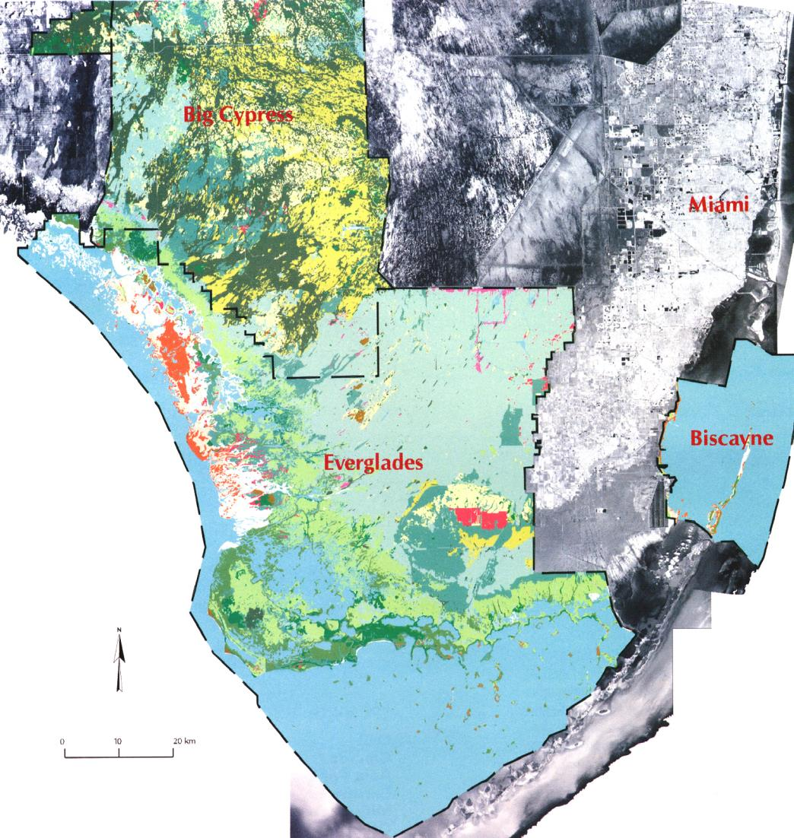
NPS Vegetation Inventory
1995 - 1999
Everglades National Park
Big Cypress National Preserve
Biscayne National Park
Welch, R., M. Remillard and R. Doren, 1995. GIS database development for South Florida’s National Parks and Preserves, Photogrammetric Engineering and Remote Sensing, 61(11): 1371-1381.
Welch, R., M. Madden and R. Doren, 1999. Mapping the Everglades, Photogrammetric Engineering and Remote Sensing, 65(2): 163-170.
Madden, M., D. Jones and L. Vilchek, 1999. Photointerpretation key for the Everglades Vegetation Classification System, Photogrammetric Engineering and Remote Sensing, 65(2): 171-177.

Slide 5
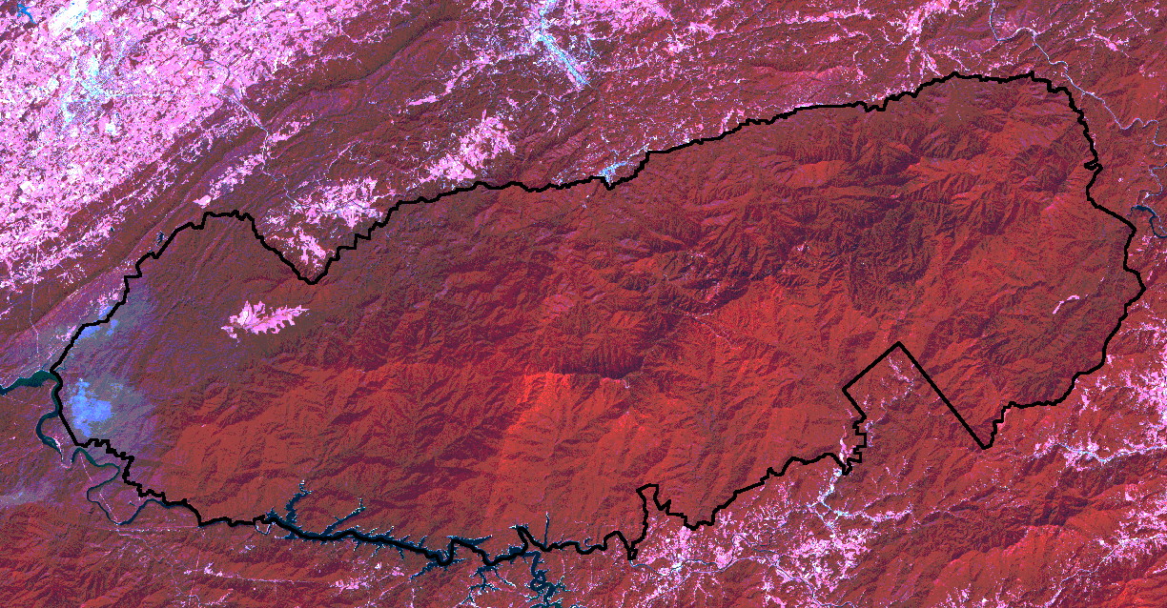
Great Smoky Mountains National Park
Gatlinburg
250 m
2025 m
Cherokee
10 km
Largest wilderness area east of the Mississippi River--covers over 202,000 ha (500,000 acres) of continuous eastern deciduous forest with high diversity, old growth forest and 9 million visitors each year.
Welch, R., T. Jordan and M. Madden, 2000. GPS surveys, DEMs and scanned aerial photographs for GIS database construction and thematic mapping of Great Smoky Mountains National Park, Int. Archives of Photogrammetry and Remote Sensing, Vol. 33, Part B4/3: 1181-1183.
Welch, R., M. Madden and T. Jordan, 2002. Photogrammetric and GIS techniques for the development of vegetation databases of mountainous areas: Great Smoky Mountains National Park, ISPRS Journal of Photogrammetry and Remote Sensing, 57(1-2): 53-68.

Slide 6
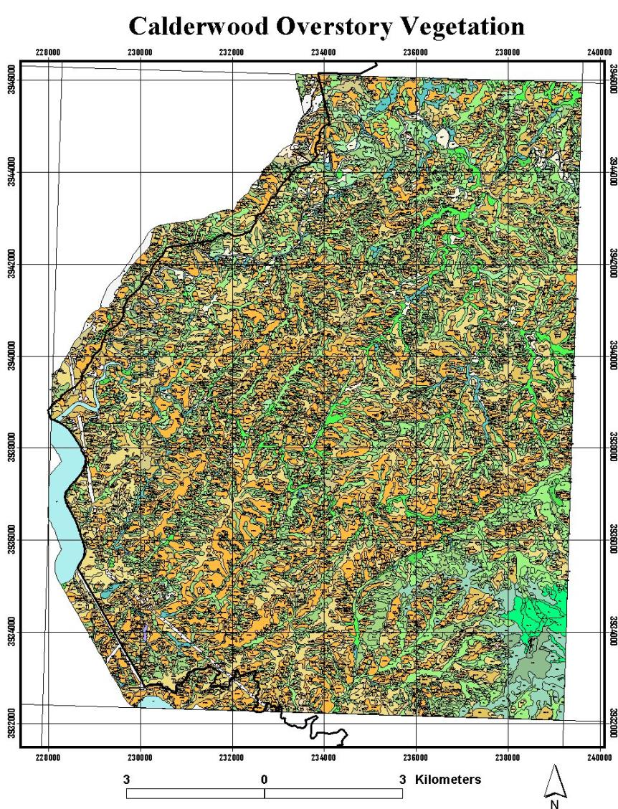
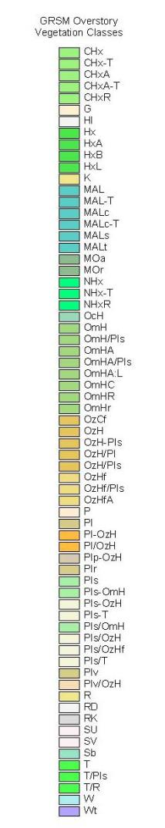
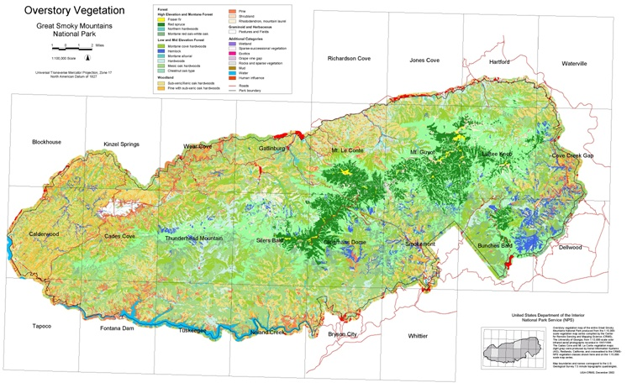
USGS/NPS National Vegetation Mapping Program
Manual photo interpretation needed to discriminate over 100 vegetation classes to 80% overall accuracy.

Slide 7
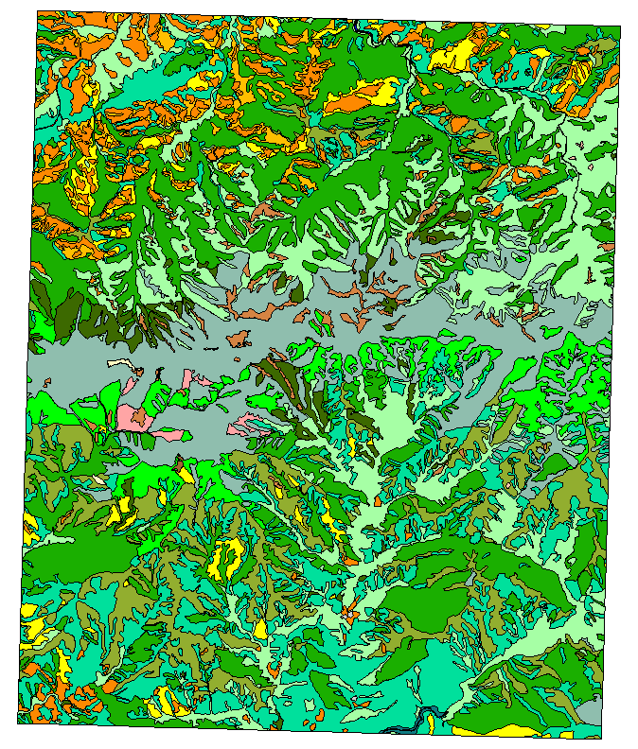
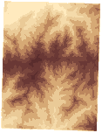
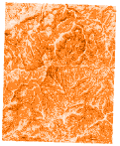
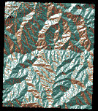
Elevation
Range
+
Slope
+
+
Aspect
P(CHx) = .29 (North aspects 0 to 23º or 338 to 360º)
+ .19 (Northeast aspects 23 to 68º)
+ .31 (Northwest aspects 293 to 338º).
Empirically-Based Rule Sets for GEOBIA

Slide 8
Aggregated Forest Type/Community Classification Schema
5-Class | 7-Class | 9-Class | 15-Class | Association Description
Coniferous | T | T | T/NHxA T/HxA | Eastern Hemlock (T) and Mixed Northern Hardwood-Acid Type (NHxA) or Successional Mixed, Acidic (HxA)
Deciduous | NHx MOr Hx | NHx NHxA NHxR MOr Hx | NHxBe NHxA NHxR MOr/R-K MOr/Hth MOr/G HxA HxA/T | Northern Hardwoods Yellow Birch Type (NHxB) Beech Gap (NHxBe) Acid Type (NHxA) Rich Type (NHxR) Montane Northern Red Oak (MOr) with Rhododendron-Kalmia (R-K), Heath Bald (Hth) or graminoid Mixed Hardwoods Acid Type (HxA) with Eastern Hemlock (T)
Mixed | CHx | CHxR | CHxR CHxR/T | Cove Hardwoods (CHx) Rich Type (CHxR) with Hemlock (T)
Shrub | Hth | Hth | Hth/NHx Hth/Sb | Heath Bald/Northern Hardwoods Heath Bald /Shrub (Sb)
Grass | P | P | P | Graminoid Pasture

Slide 9
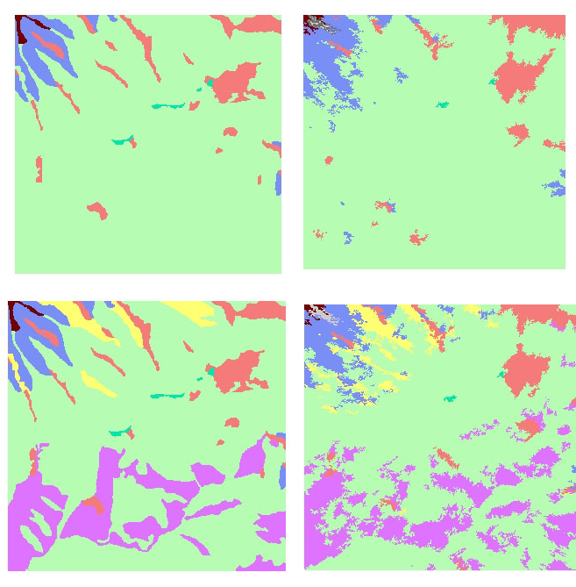
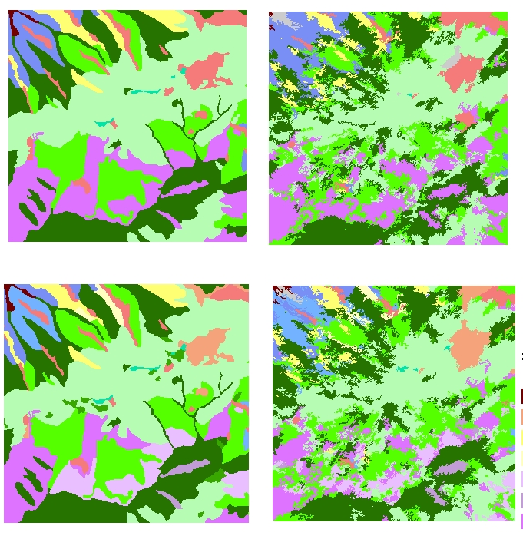
High Resolution Satellite Imagery and GEOBIA!
5 Class
9 Class
Definiens Professional 5.0
7 Class
15 Class
Definiens 5.0
Kim, M., M. Madden and T. Warner, 2008. Object-based forest stand mapping using multispectral IKONOS Imagery: Estimation of optimal image object size, In., T. Blashcke, S. Lang and G. Hay (Eds), Object-Based Image Analysis: Spatial Concepts for Knowledge-Driven Remote Sensing Applications, Springer-Verlag, New York, 291-307.
Madden, M., T. Jordan, M. Kim, H. Allen and B. Xu, 2009. Integrating remote sensing and GIS: From overlays to GEOBIA and geovisualization, In, M. Madden (Ed.), The Manual of Geographic Information Systems, American Society for Photogrammetry and Remote Sensing, Bethesda, Maryland, 701-720.

Slide 10
Classification Accuracy:
Aggregated Forest Classes and Scale Parameter
5 Classes
7 Classes
9 Classes
15 Classes
Classification Accuracy
Scale Parameter
Kim, M., M. Madden and B. Xu, 2010. GEOBIA forest mapping in Great Smoky Mountains National Park, Photogrammetric Engineering and Remote Sensing, 76(2): 137-149.

Slide 11
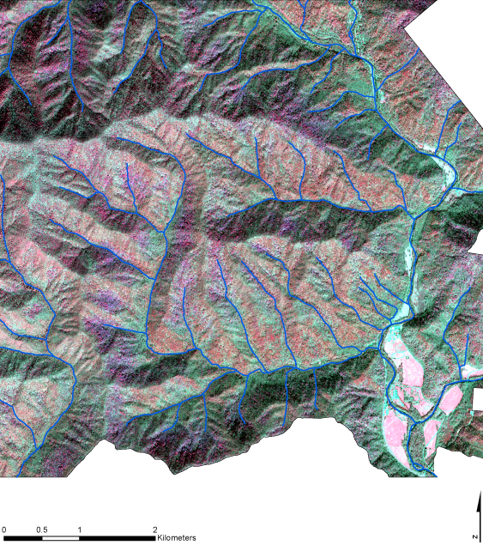
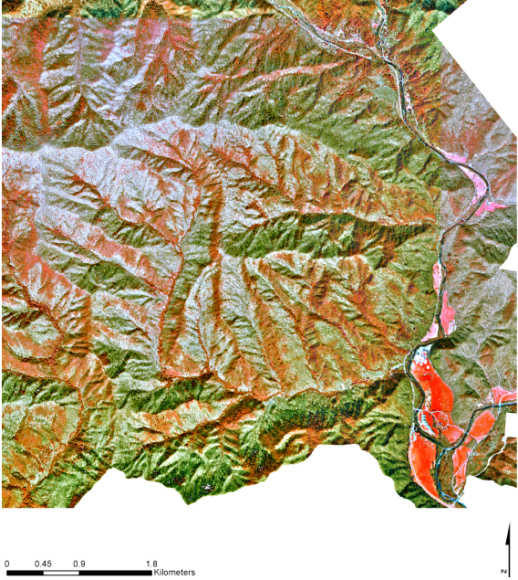
Methodology
Definiens Developer 7.0
IKONOS Image
October 30, 2003
CIR Orthophoto Reference
October 27, 1997 (1:12,000)
(a)
(b)
Kim, M., M. Madden and T. Warner, 2009. Object-based forest type mapping with grey-level co-occurrence matrix texture and multispectral IKONOS imagery, Photogrammetric Engineering and Remote Sensing, 75(7): 819-829,

Slide 12
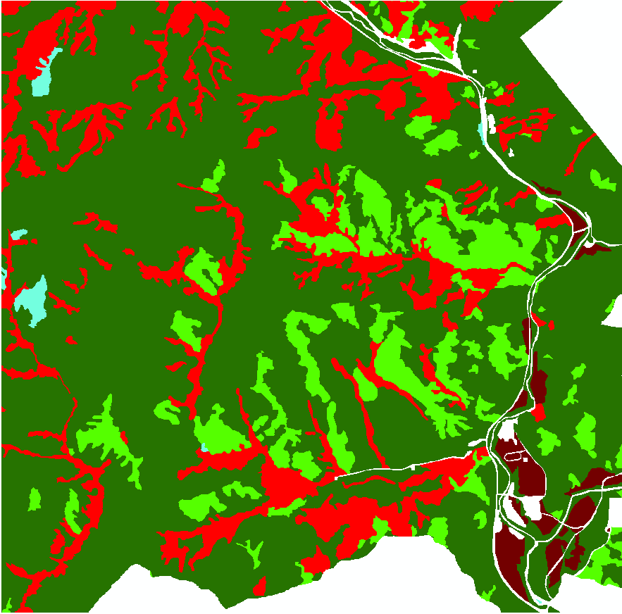
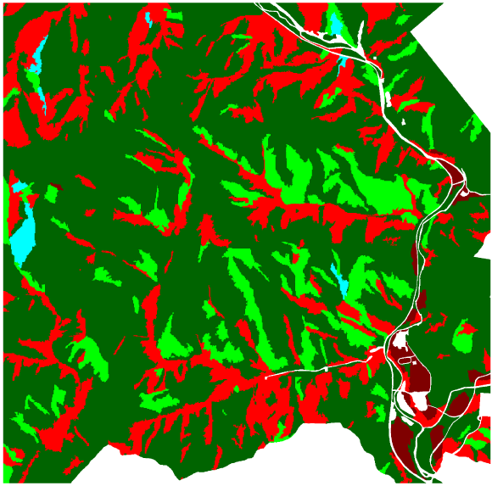
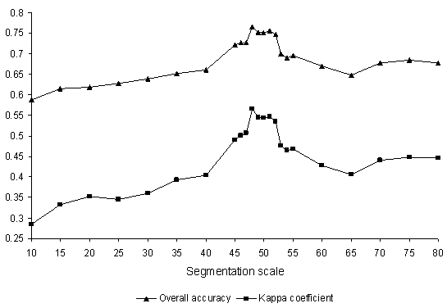
GEOBIA using Spectral Mean, Topography and Stream Channels
Spectral
Topo
Streams
Manual
Classification Accuracy
Segmentation Scale
% Accuracy
Kappa Coefficient
Scale 48: 76.6/0.57
Kim, M., T. Warner, M. Madden D. Atkinson, 2011. Multi-scale. GEOBIA with very high spatial resolution digital aerial imagery: scale, texture and image objects, International Journal of Remote Sensing, 32(10: 2825-2850

Slide 13
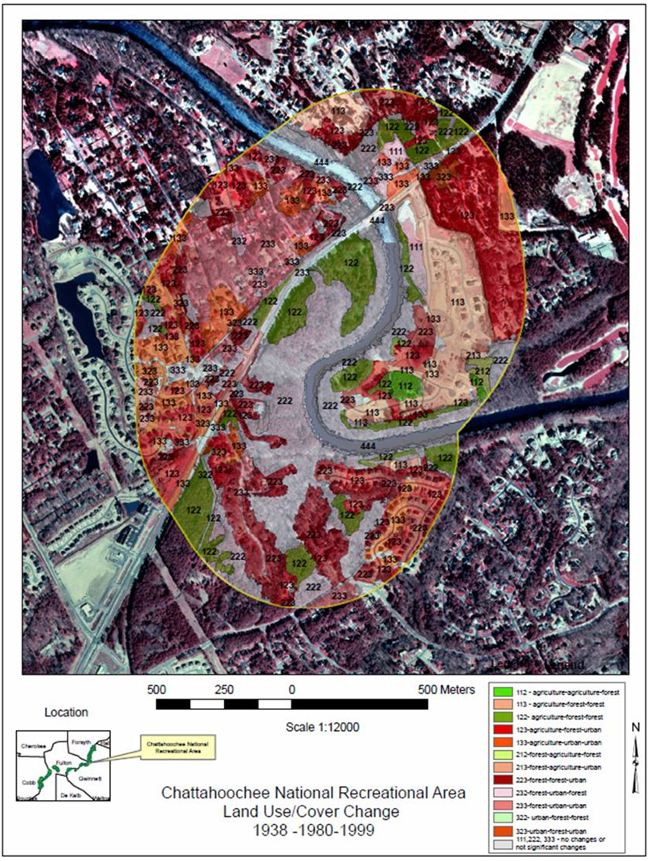
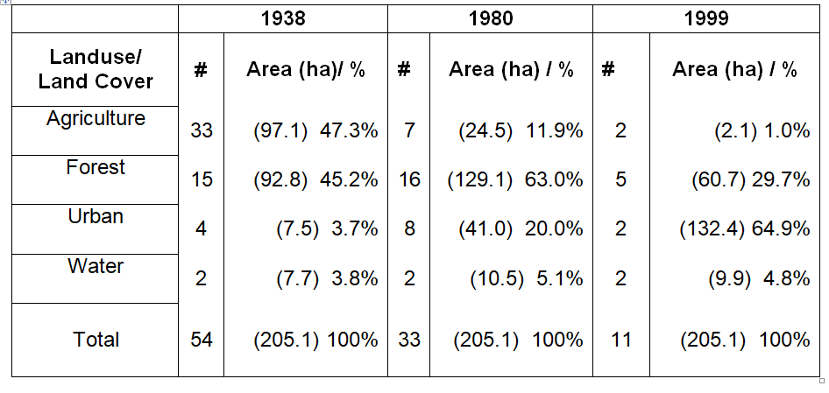
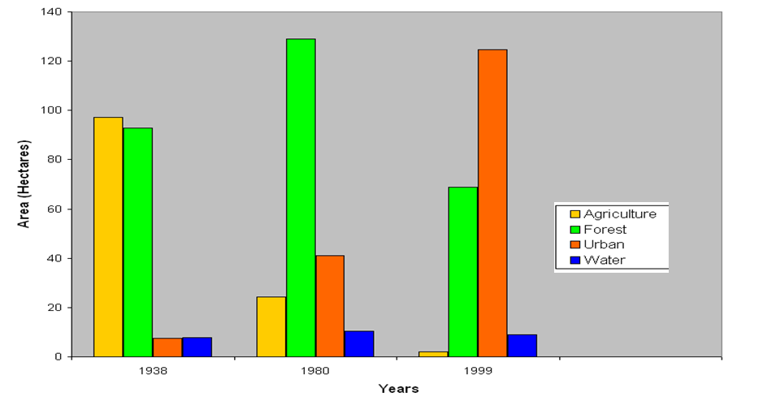
GEOBIA for Change Analysis – 1938-1980
Orthoimages and Forest-Agriculture-Urban
Conversion for the Chattahoochee River National Recreation Area
Madden, M., T. Jordan and J. Masour, 2009. Orthoimages and Forest-Agriculture-Urban Conversion 1938-1980 for the Chattahoochee River National Recreation Area, Final Report to the U.S. Department of Interior, National Park Service, Public Service Cooperative Agreement Number P534007A185, Center for Remote Sensing and Mapping Science, The University of Georgia, Athens, GA, 46 p.

Slide 14
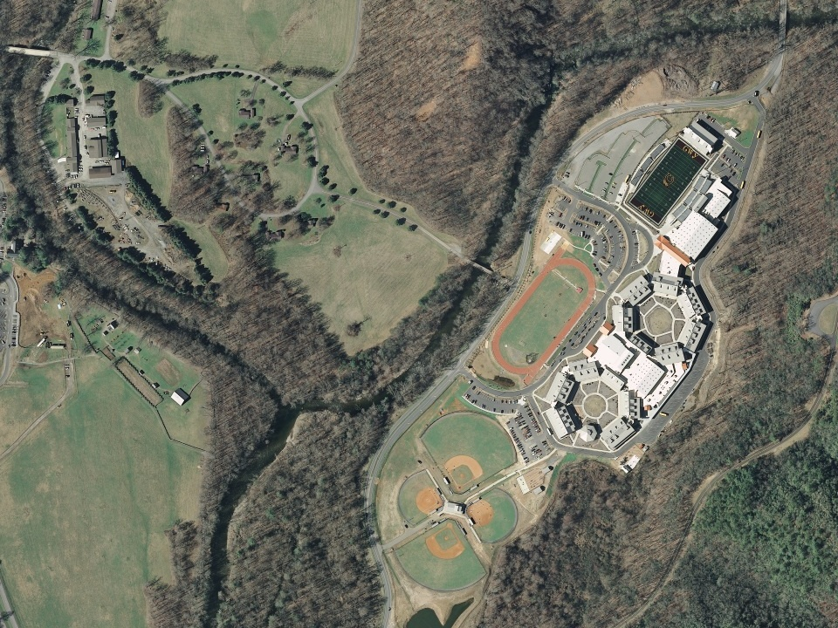
2010-2011 Acquisition of Airborne Lidar and Orthoimagery for National Parks, Forests and Parkways in the Southern Appalachian Mountains
University of North Georgia + University of Georgia
Funded by U.S. Geological Survey (USGS) under the American Recovery and Reinvestment Act (ARRA) 2010-2011:
Improve LiDAR/orthoimagery of the National Map; and
Create/save jobs and train students for high skill positions in geospatial technology.

Slide 15
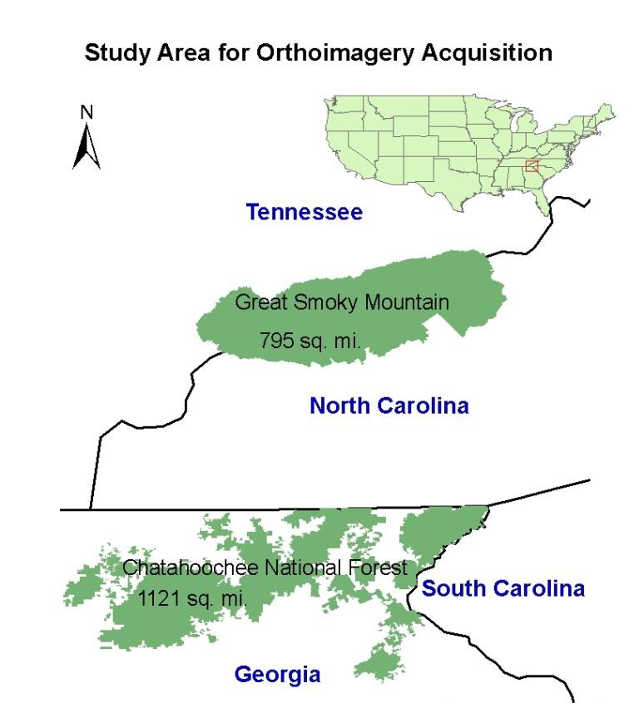
2059 km² (795 mi²)
Study Area for LiDAR/Orthoimagery
Orthoimagery for Great Smoky Mountain National Park (GRSM) and adjacent Foothills Parkway, managed by the National Park Service (NPS)
LiDAR for Tennessee portion of GRSM and Foothills Parkway
Foothills Parkway
GRSM
1399 km² (540 mi²)
CNF
2903 km² (1121 mi²)
LiDAR and Orthos of Chattahoochee National Forest (CNF) in north Georgia managed by the USDA Forest Service

Slide 16
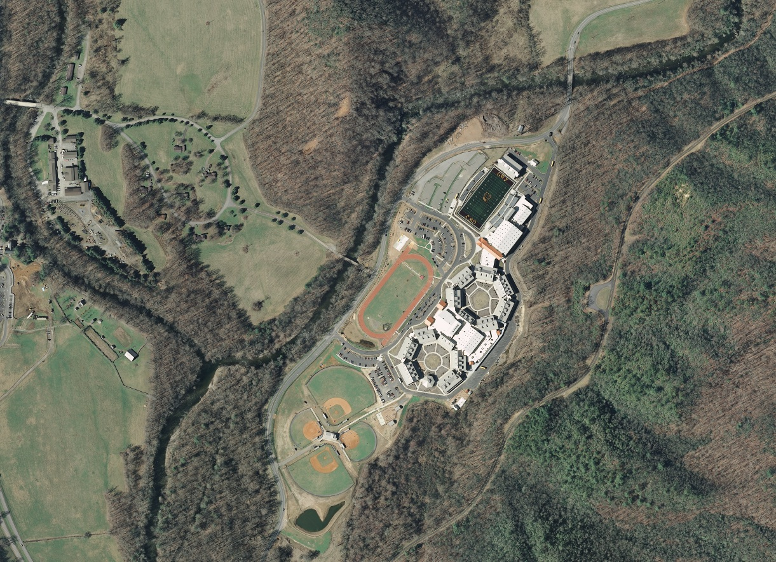
Image data were collected by Photo Science, Norcross, Georgia using a Zeiss/Intergraph Digital Mapping Camera
4 bands @ 30-cm resolution (6096 x 6500 pixel frame)
Leaf-off and snow-free conditions:
GRSM – April 2010 (2963 frames or 1034 tiles of 1500 x 1500 m)
CNF – March/April 2010 (5448 frames or 1946 tiles)

Slide 17
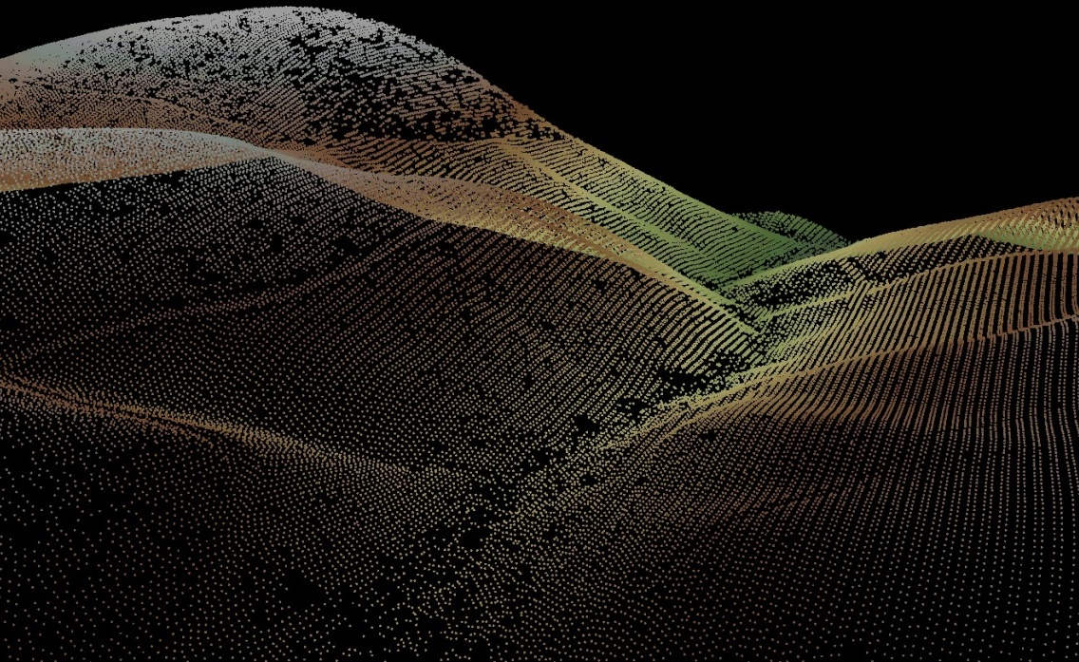
LiDAR data were collected by Photo Science, Lexington, Kentucky using an Optech Gemini ALTM LiDAR sensor.
Leaf-off and snow free conditions:
Tennessee portion of GRSM and Foothills Parkway
February, March and April 2011

Slide 18
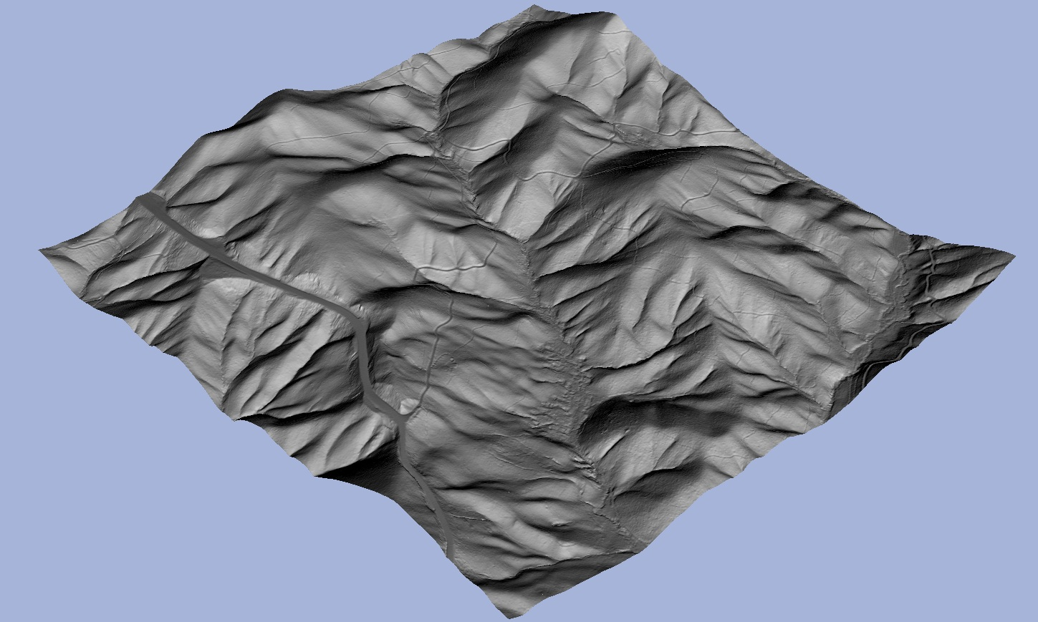
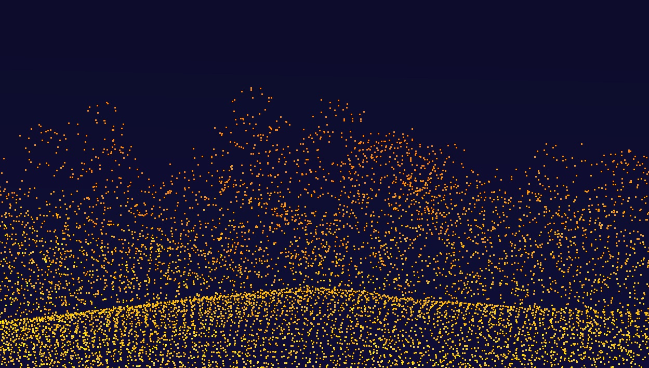
LiDAR Deliverables
1.5-m DEM
Classified Point Cloud

Slide 19
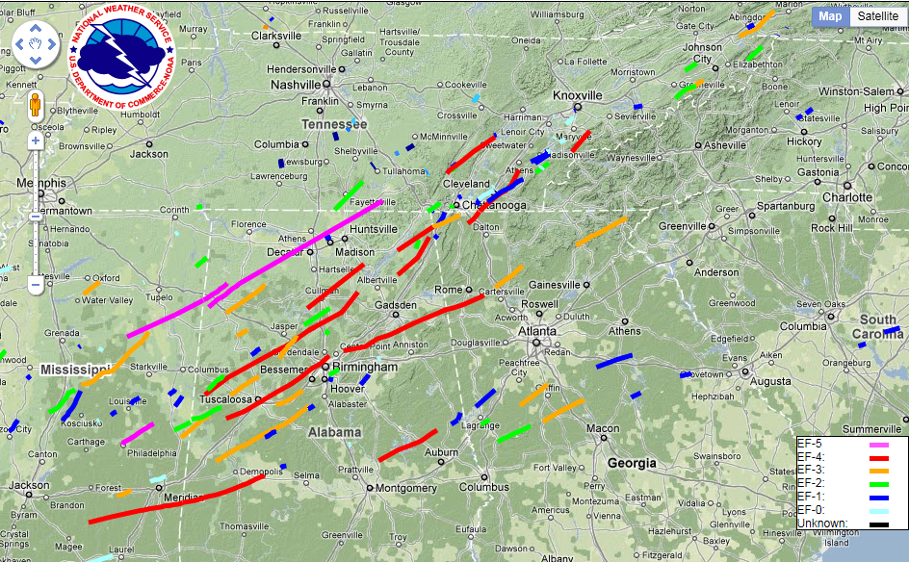
National Weather Service Tornado Tracks 24-29 April, 2011
EF4
EF4
EF4
EF3
http://www.srh.noaa.gov/srh/ssd/mapping/

Slide 20
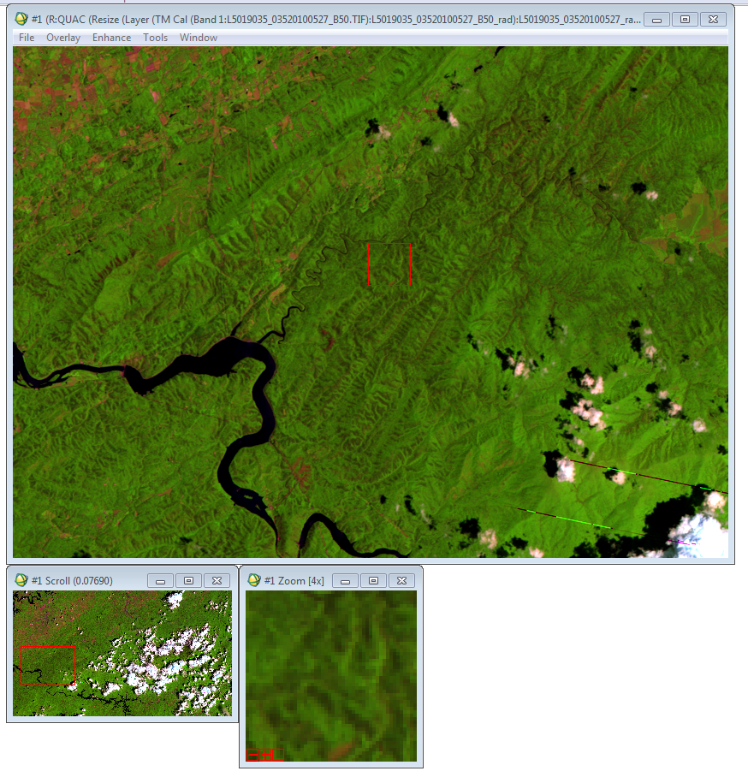
Before
Landsat 5 TM
Image acquisition:
May 27, 2010

Slide 21
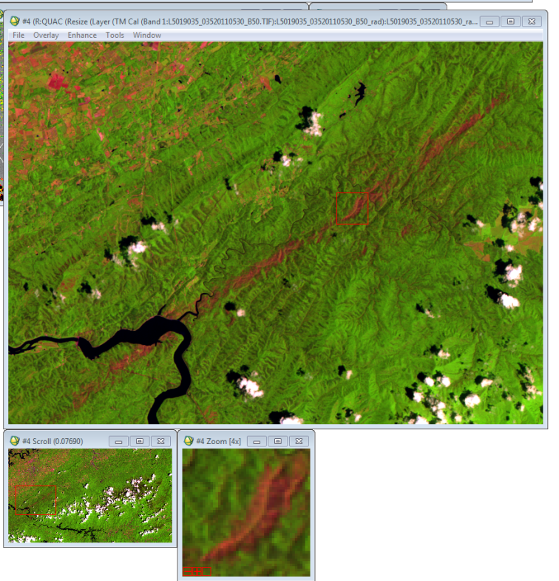
After
Landsat 5 TM
Image acquisition:
May 30, 2011

Slide 22
Vegetation Indices Calculation
  Evaluate the performance of NDVI and EVI to characterize vegetation damage
  We used EVI considering:
    Improved sensitivity of EVI under high biomass
    Correction for residual aerosol
    Adjusted for canopy background signal
Landsat TM
Geocover
Geometric rectification
Atmospheric correction
VI calculation
GDEM
Topography normalization
Spectral Mixing Analysis
Segmentation
Notes:
Optimized' index designed to enhance the vegetation signal with improved sensitivity in high biomass regions and improved vegetation monitoring through a de-coupling of the canopy background signal and a reduction in atmosphere influences
NIR/red/blue are atmospherically-corrected or partially atmosphere corrected (Rayleigh and ozone absorption) surface reflectances, L is the canopy background adjustment that addresses non-linear, differential NIR and red radiant transfer through a canopy, and C1, C2 are the coefficients of the aerosol resistance term, which uses the blue band to correct for aerosol influences in the red band. The coefficients adopted in the MODIS-EVI algorithm are; L=1, C1 = 6, C2 = 7.5, and G (gain factor) = 2.5.
Whereas the Normalized Difference Vegetation Index (NDVI) is chlorophyll sensitive, the EVI is more responsive to canopy structural variations, including leaf area index (LAI), canopy type, plant physiognomy, and canopy architecture. The two VIs complement each other in global vegetation studies and improve upon the detection of vegetation changes and extraction of canopy biophysical parameters. [1].

Slide 23
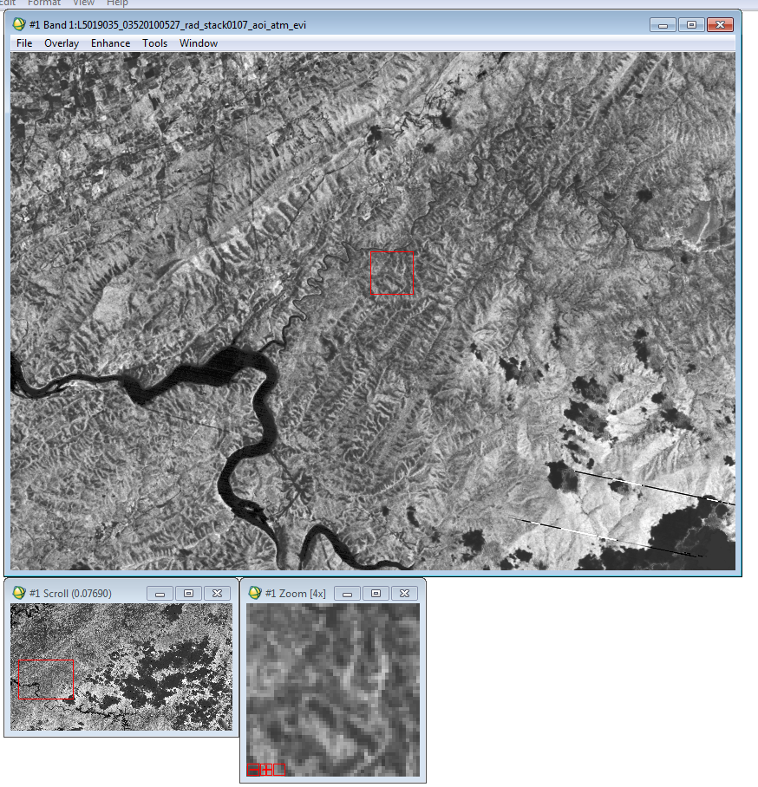
Before
EVI

Slide 24
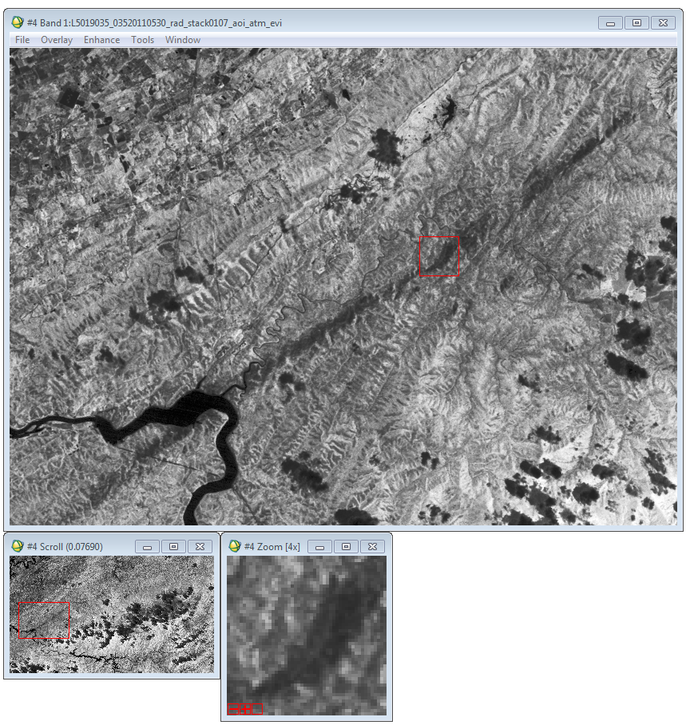
After
EVI

Slide 25
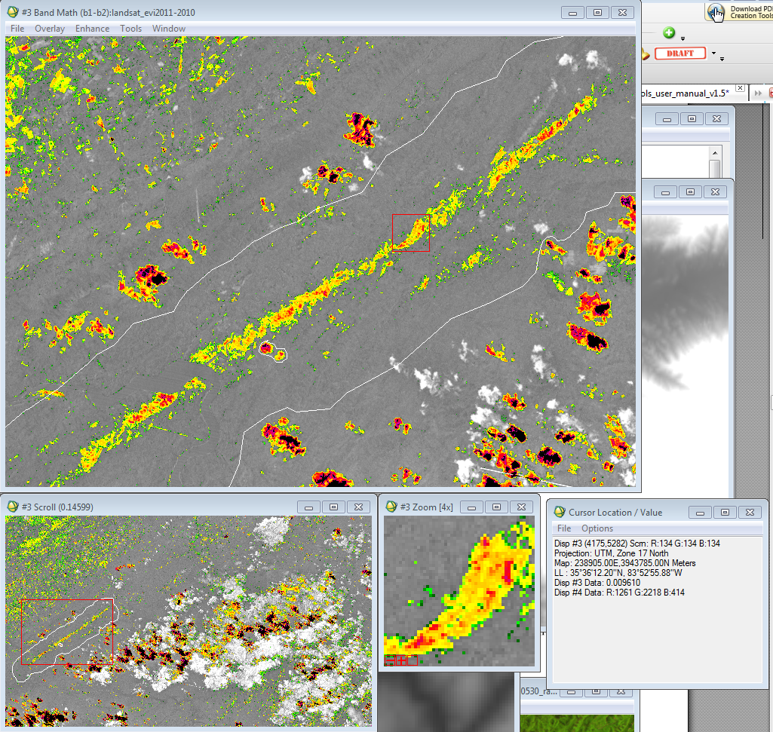
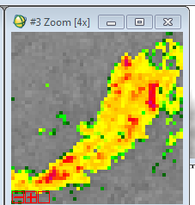
Delta
EVI
Landsat TM
EVI2011-
EVI2010
-0.40
-0.34
-0.28
-0.22
-0.16
-0.10

Slide 26
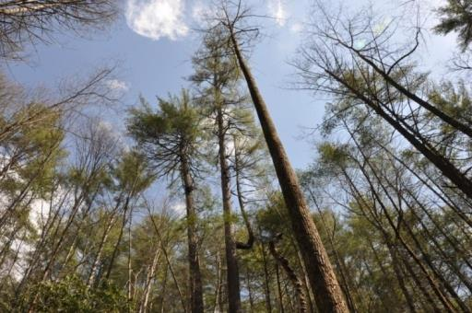
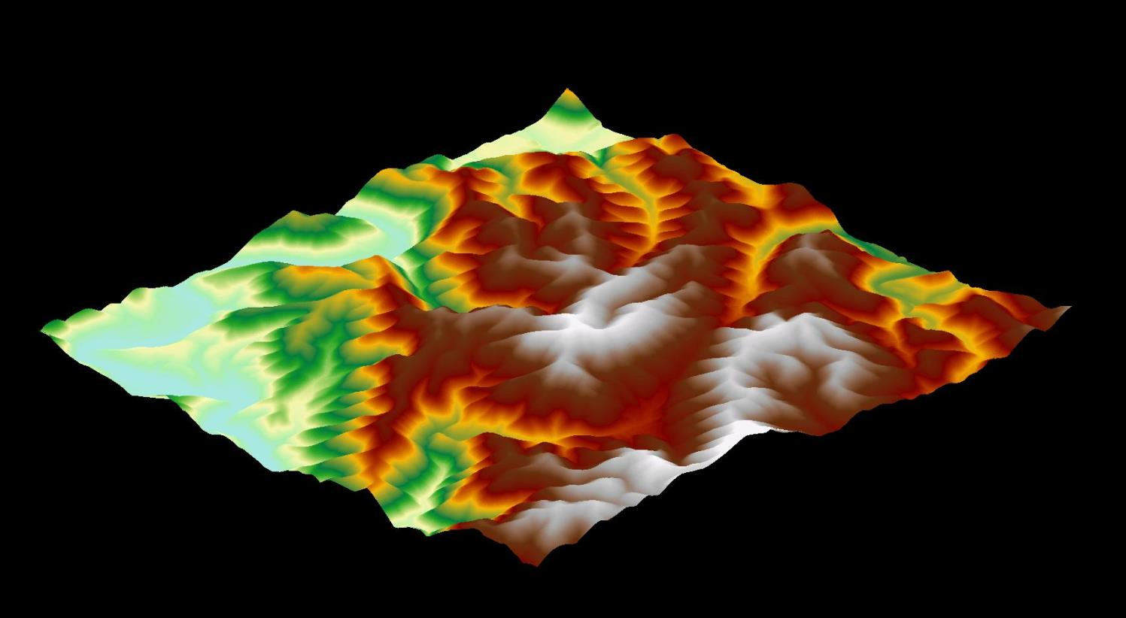
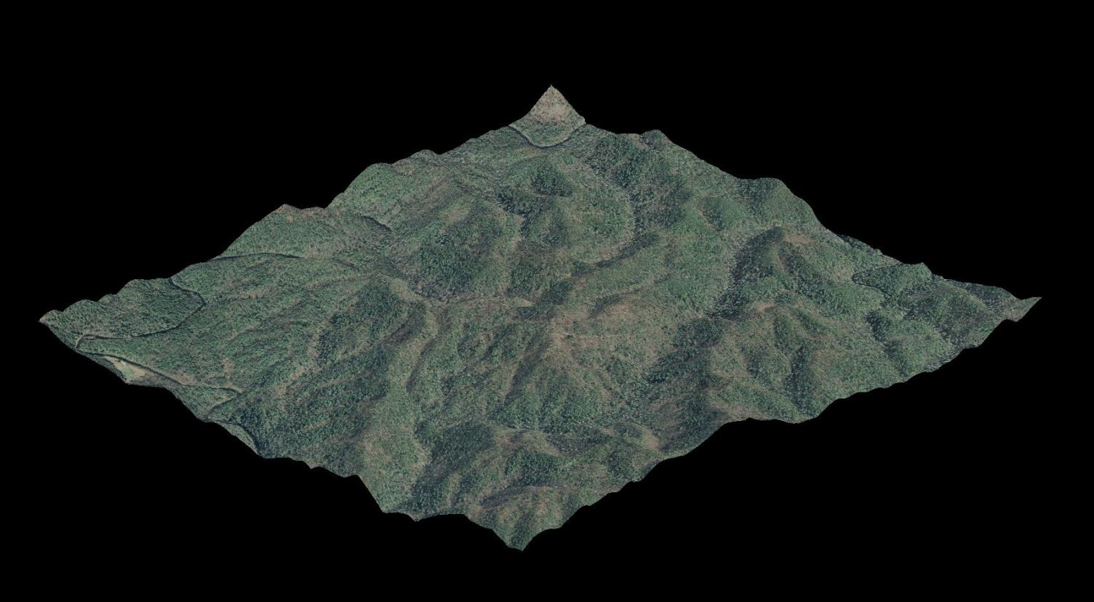
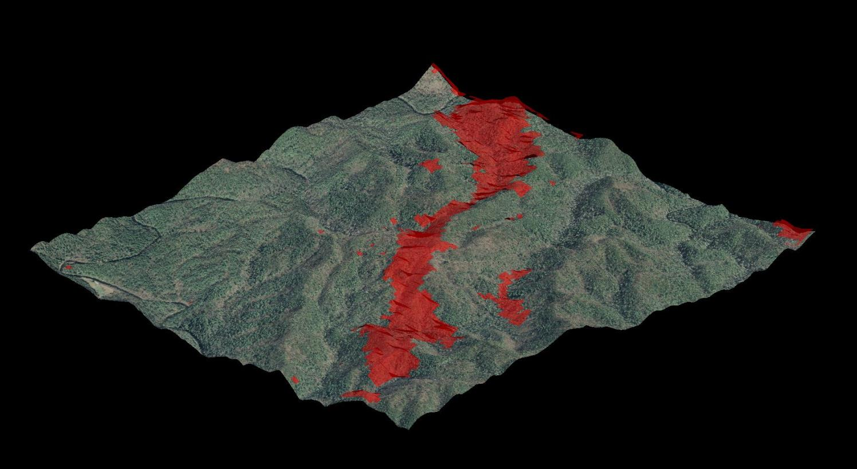
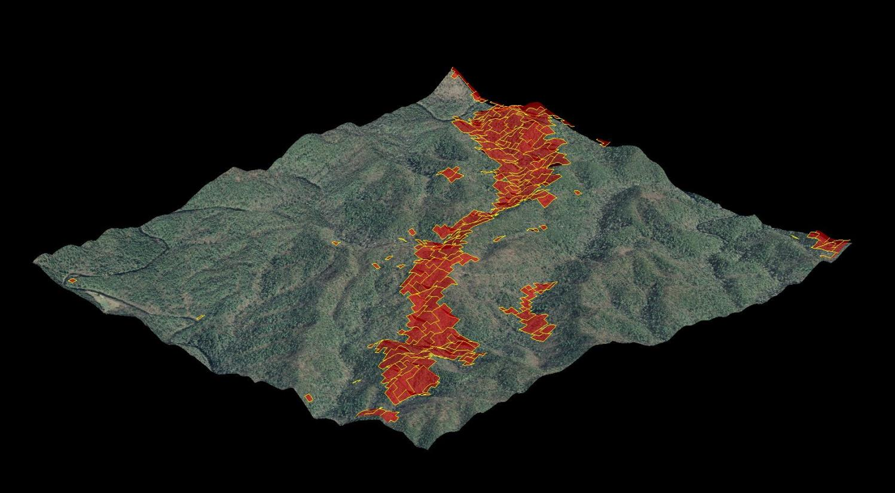
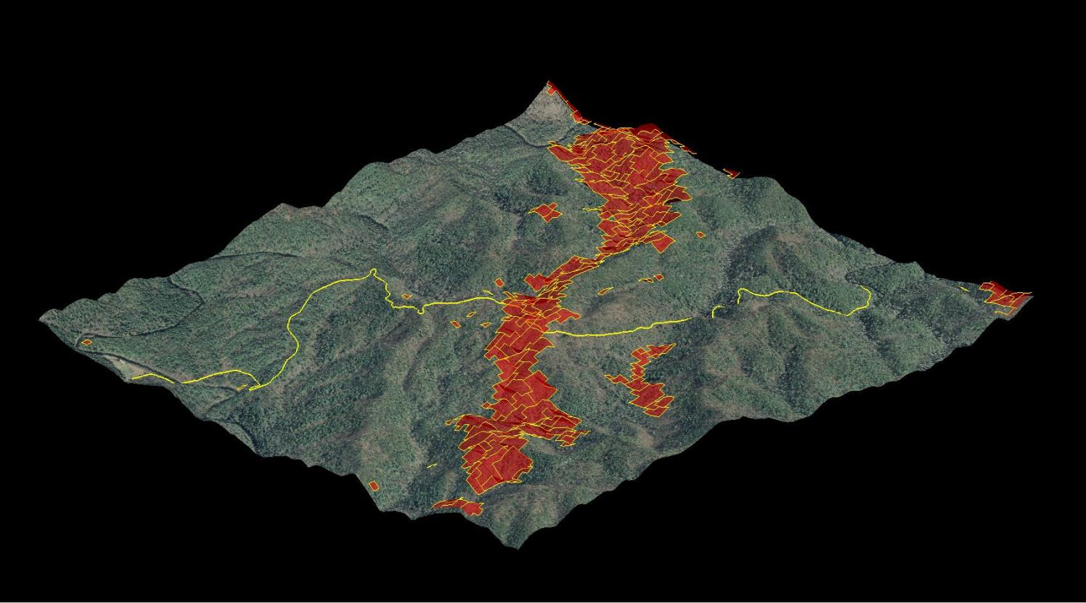
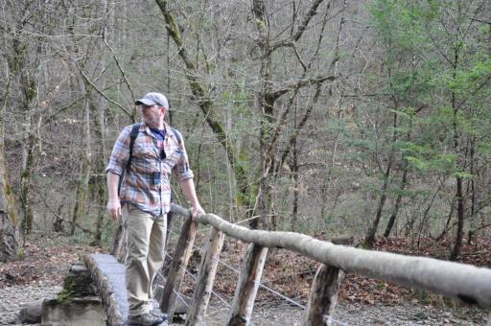

Slide 27
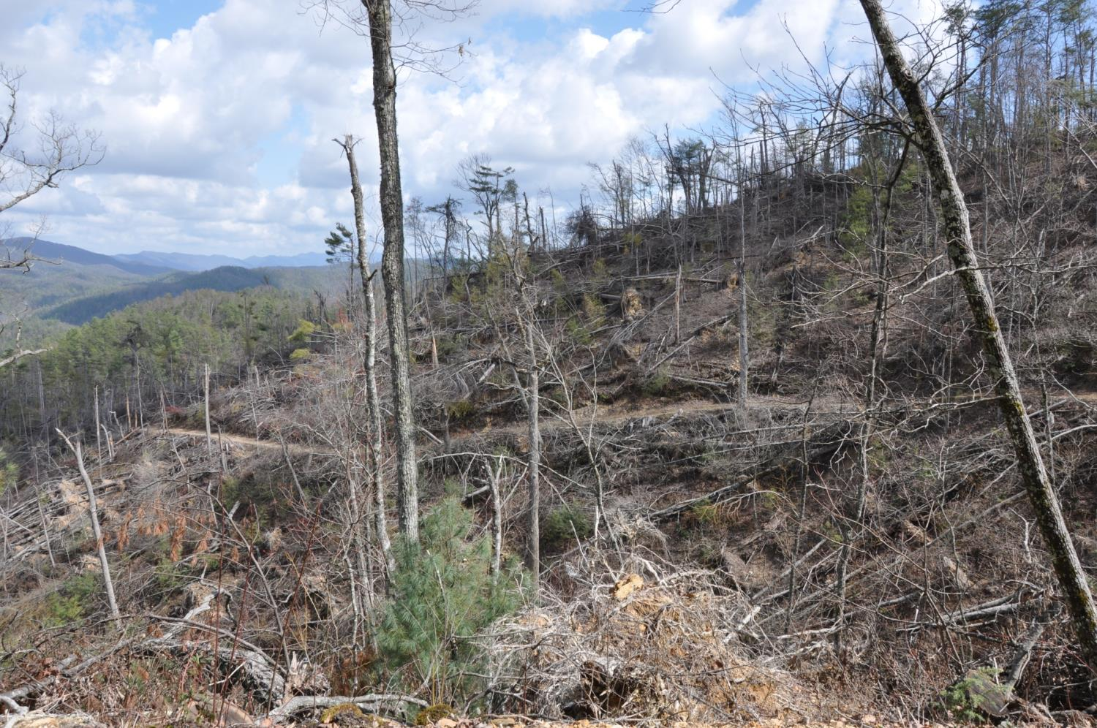

Slide 28
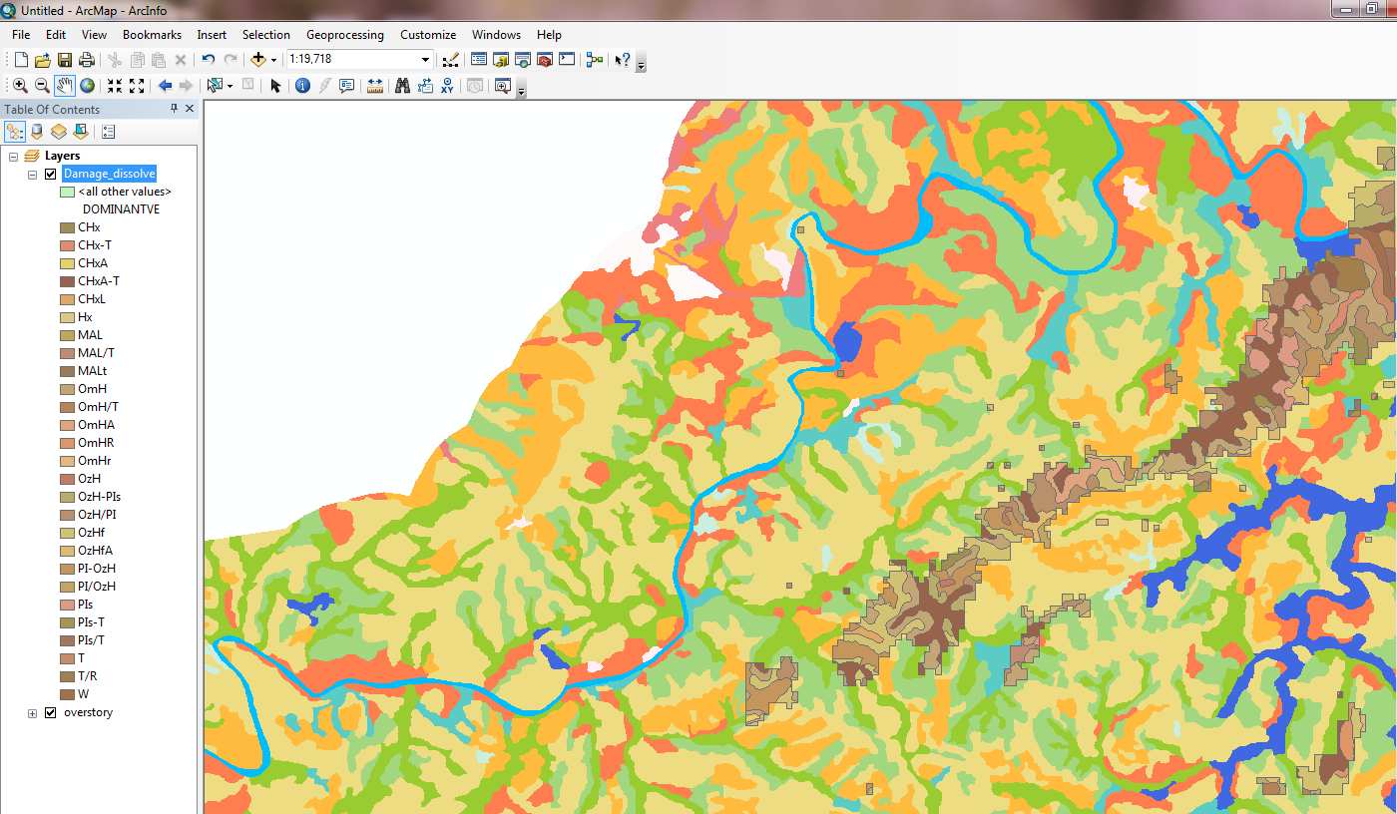
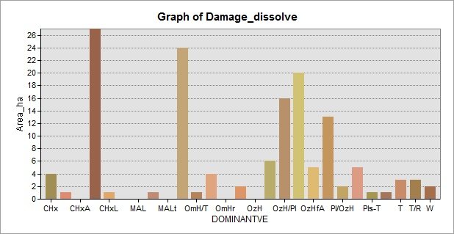
Total Damage by Forest Vegetation Class
Meisic Oak
Hardwoods
Cove
Hardwoods
Xeric Oak
Hardwood with Pines
Area (ha)
Dominant Forest Class

Slide 29
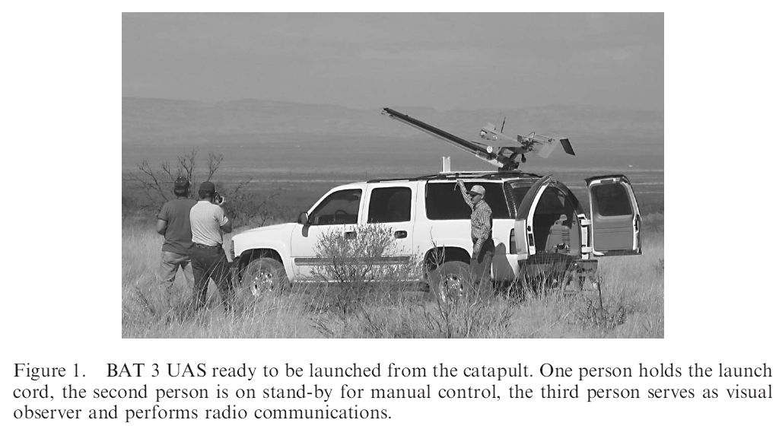
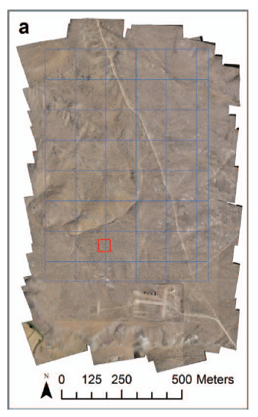
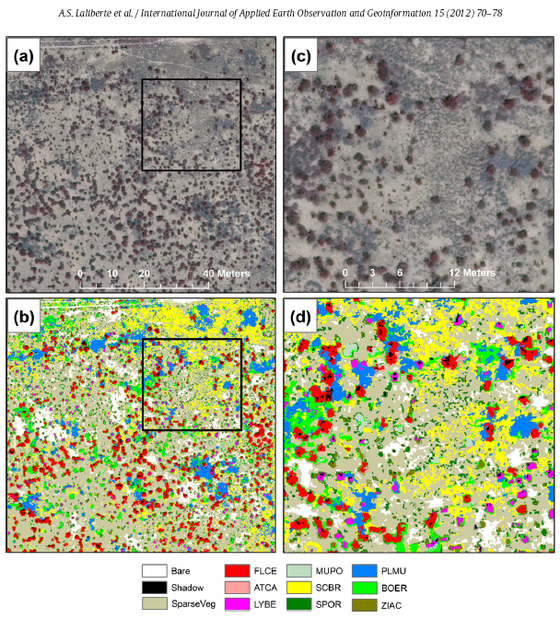
GEOBIA integration in operational data collection by Unmanned Aerial Systems (UAS)
Laliberte, A.S., D.M. Browning and A. Rango, 2012. A comparison of three feature selection methods for object-based classification of sub-decimeter resolution UltraCam-L imagery, International Journal of Applied Earth Observation and Geoinformation 15:70-78.
Laliberte, A.S., C. Winters and Al. Rango, 2011. UAS remote sensing missions for rangeland applications, Geocarto International, 26:2, 141-156

Slide 30
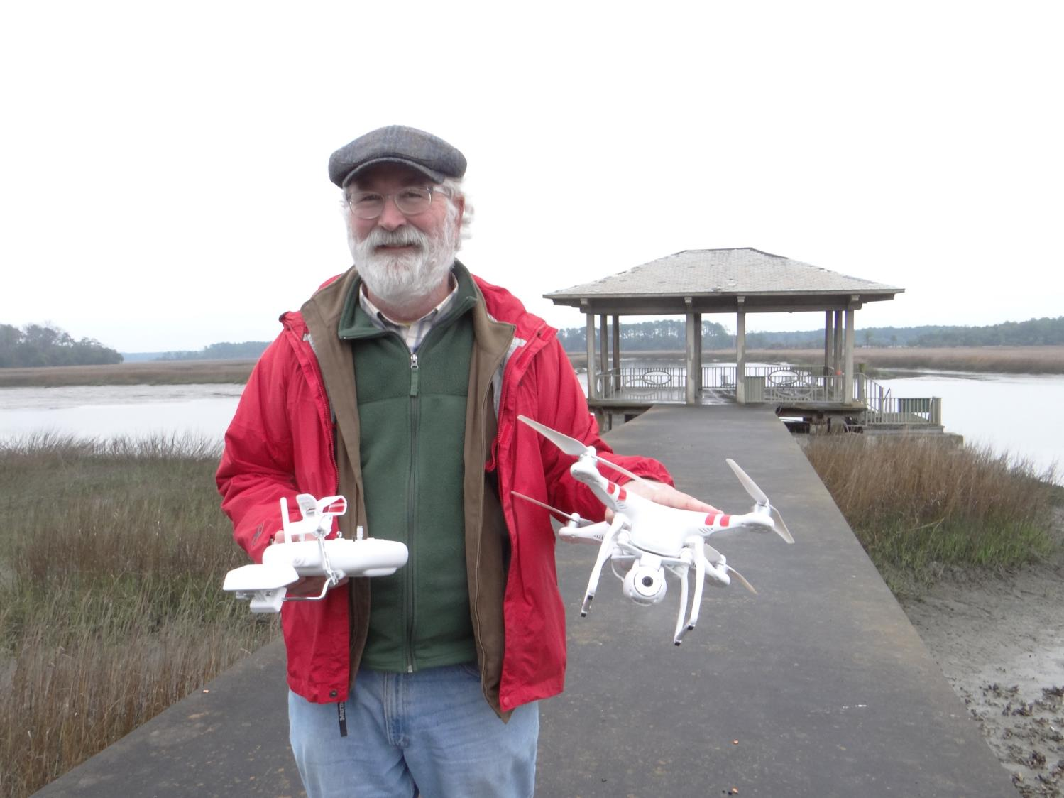

We Drones
Small Unmanned Aerial Systems (sUAS)
DJI Phantom Quadcopters

Slide 31
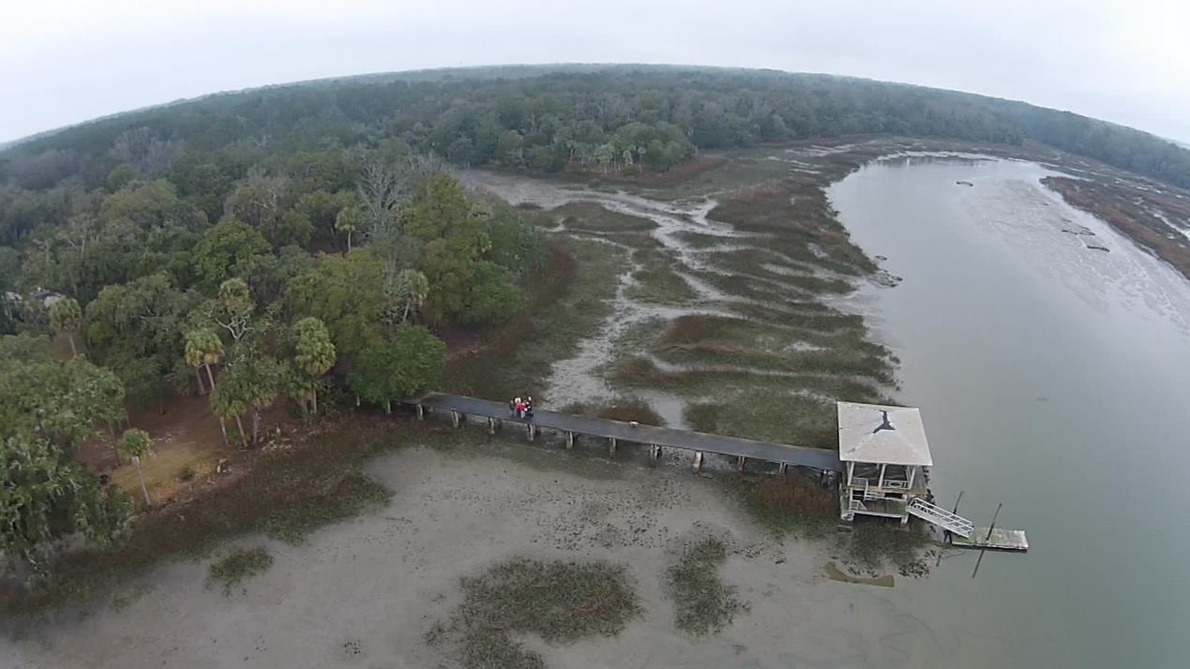
Marsh Monitoring and Habitat Mapping
Wormsloe State Historic Site, Isle of Hope, Georgia
Madden, M., T. Jordan, S. Bernardes, D. Cotten, N. O’Hare and A. Pasqua, 2015. Unmanned Aerial Systems (UAS) and Structure from Motion (SfM) Revolutionize Wetlands Mapping, Invited Chapter , In, R. Tiner, M. Lang and V. Klemas (Eds), Remote Sensing of Wetlands: Applications and Advances, CRC Press Taylor & Francis Group, Boca Raton, Florida, 10: 195-222.

Slide 32
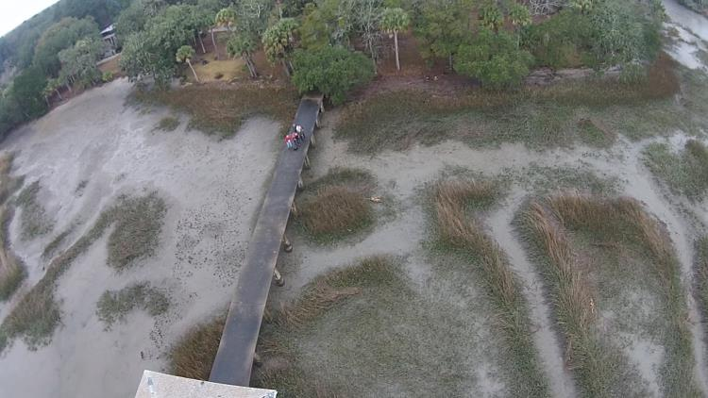


Extract frames from video clip
Oblique photos at 60 degree angle,
Flight line parallel to shoreline
Madden, M., T. Jordan, S. Bernardes, D. Cotten, N. O’Hare and A. Pasqua, 2015. The Future of Unmanned Aerial Systems (UAS) for Natural and Cultural Resource Monitoring, Invited Paper In, Fritsch, D. (Ed), Photogrammetric Week ‘15, Institute of Photogrammetry, University of Stuttgart, Germany, pp. 369-385.

Slide 33

Color, 3D Point Cloud from PhotoScan

Slide 34

2D Marsh Art by Tommy Jordan

Slide 35

3D Marsh Art by Tommy Jordan

Slide 36




Hurricane Irma damage - Sapelo Island

Slide 37







UAS + MicaSense RedEdge Sensor
MicaSense RedEdge
RGB
Near Infrared
Red Edge
Vegetation and Soil Moisture Indicies
Notes:
The following slides “remind” people of what 3DIG is.

Slide 38



Vegetation Mapping of Sapelo Island
Notes:
CGR is involved in mapping vegetation at multiple locations, including Sapelo.

Slide 39






Field Campaign on Sapelo Island
(26-29 September 2017)
September 26-29, 2017
Notes:
Checking AA points for vegetation mapping and observed browning
Choose either this slide or the following one (non animated)

Slide 40


Very High Resolution Analysis (UAS) and Structure from Motion: 3D model
3D point cloud
Orthomosaic
Orthomosaics and 3D models show extensive browning following Irma.
Notes:
So, we have an RGB camera and a multispectral sensor. What can we do with those and how can they be used for linking local observations to more regional ones?
Drones images show widespread browning on the eastern side and close to the southern tip of Sapelo.

Slide 41

Visually see browning: detection & extent in before/after satellite imagery
Sep 01, 2017
Oct 11, 2017
Notes:
Before and after type of analysis.
No significant browning for 2016.
Is this phenology? We don’t see significant browning in end of October 2016.
How long does it take for leaves to get brown? First Sentinel detection was ~10 days after hurricane (no images available before that)

Slide 42





Quantify Damage - Fraction of Green Vegetation Cover and % Change
Anomaly of fraction of green vegetation cover (% change)
100%
100%
Sep 01, 2017
Anomaly
-100%
0%
Anomaly
Oct 11, 2017
Notes:
These images are similar to fractions produced by spectral unmixing (but these result from neural net)
Numbers represent percentage of the pixel covered by green vegetation
Negative anomalies (reduction in green cover) can be seen along the easternside coastine.

Slide 43


Goal is to quantify structure and spectral responses to stress
https://youtu.be/99zr8aPce-M

Slide 44

Augmented Reality to visualize vegetation stress responses
Gaming Software:
Unity

Slide 45


AR brings field visualization to the lab = aid to verification
Microsoft HoloLens to “see” the in situ collards in the lab

Slide 46

Deep Learning
https://www.deeplearningbook.org/
Goodfellow, I., Y. Bengio and A. Courville, 2016. Deep Learning, MIT Press
Artificial Intelligence
Machine Learning
Representation Learning
Deep
Learning

Slide 47






Deep Learning
OR
Output is in the visible layer
Object Identity
Object Parts
Corners and Contours
Edges
Pixels
Series of hidden layers extracts increasingly abstract features from the image.
Called hidden because their values are not given in the data, the model must determine which concepts are useful for explaining the relationships in the observed data.
Input is in the visible layer
Goodfellow et al. (2016)

Slide 48


Slide 49

Seeing is Believing…and understanding both imagery and products of image analysis.
Conclusion:
We bring our life experiences/perceptions/values to our computer screens.
Understand the image features before we process.
Image interpretation is critical to assessment of classification, segmentation, image object quality, machine learning, deep learning, etc..
Keep in mind as we explore new techniques.

Slide 50






Acknowledgements
National Park Service
Southeast Coastal Network
Chopper and Annie
Many, Many UGA-CGR Graduate Students:
Amanda Aragon, Shannon Healy, Drew Knight

