Slide 1

ON-ORBIT GEOMETRIC CALIBRATION OF A SKYSAT
Methods and Results
Dr. Byron Smiley • 30 Jan 2019

Slide 2
Outline
SkySat constellation update/review
On-orbit geometric calibration techniques:
  boresight definition, using Landsat 8 PAN as reference
  interior orientation, using Pléiades-1A/B as reference
Featuring real SkySat-14 data!

Slide 3
SKYSAT CONSTELLATION UPDATE

Slide 4
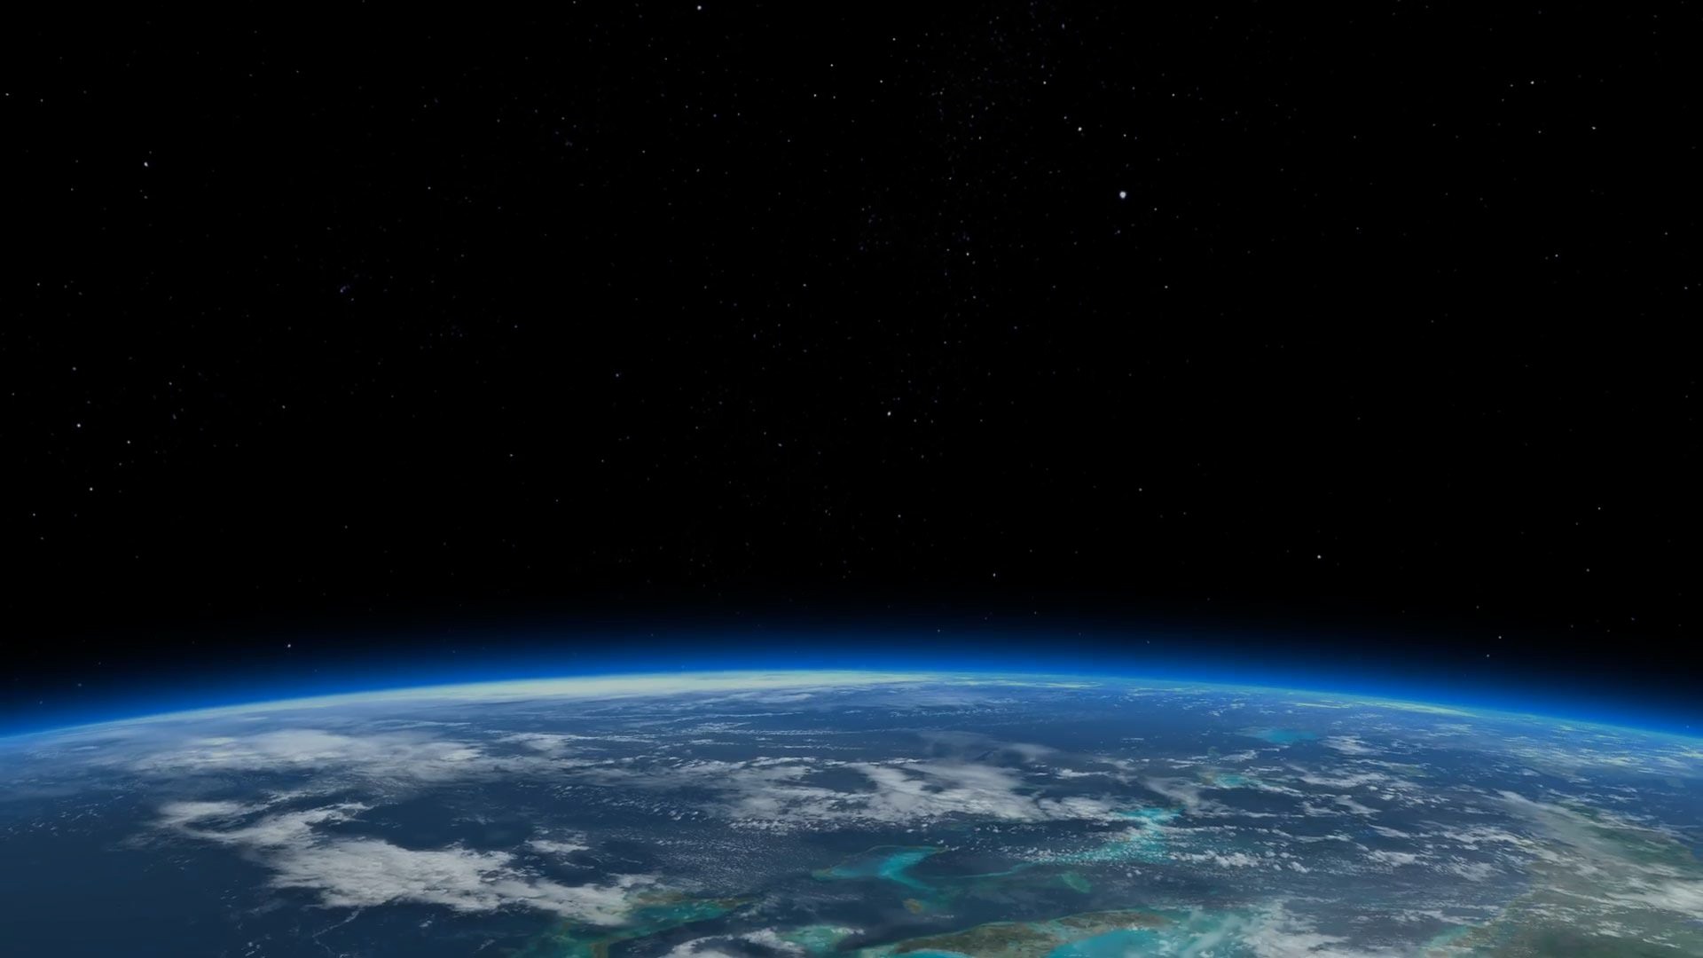
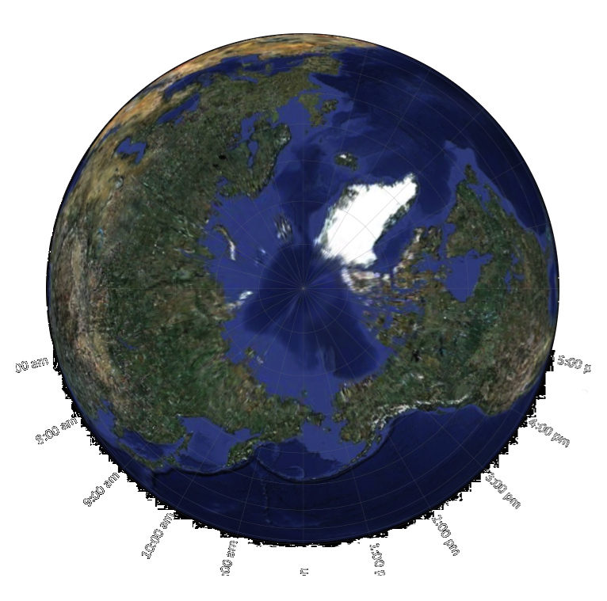
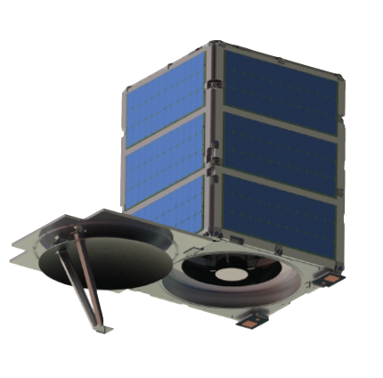
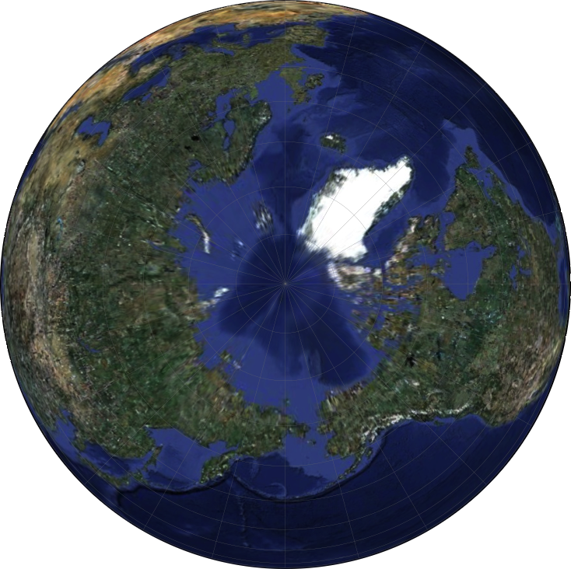
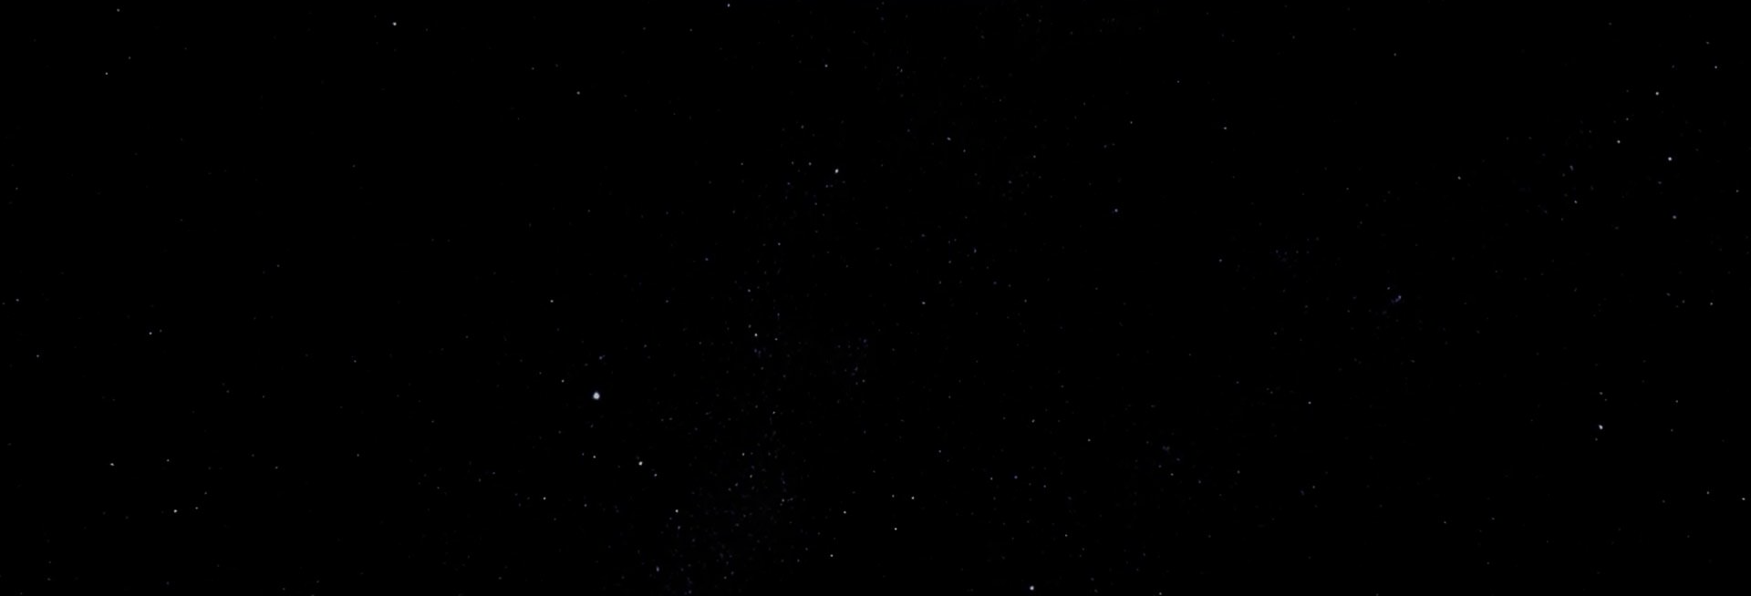
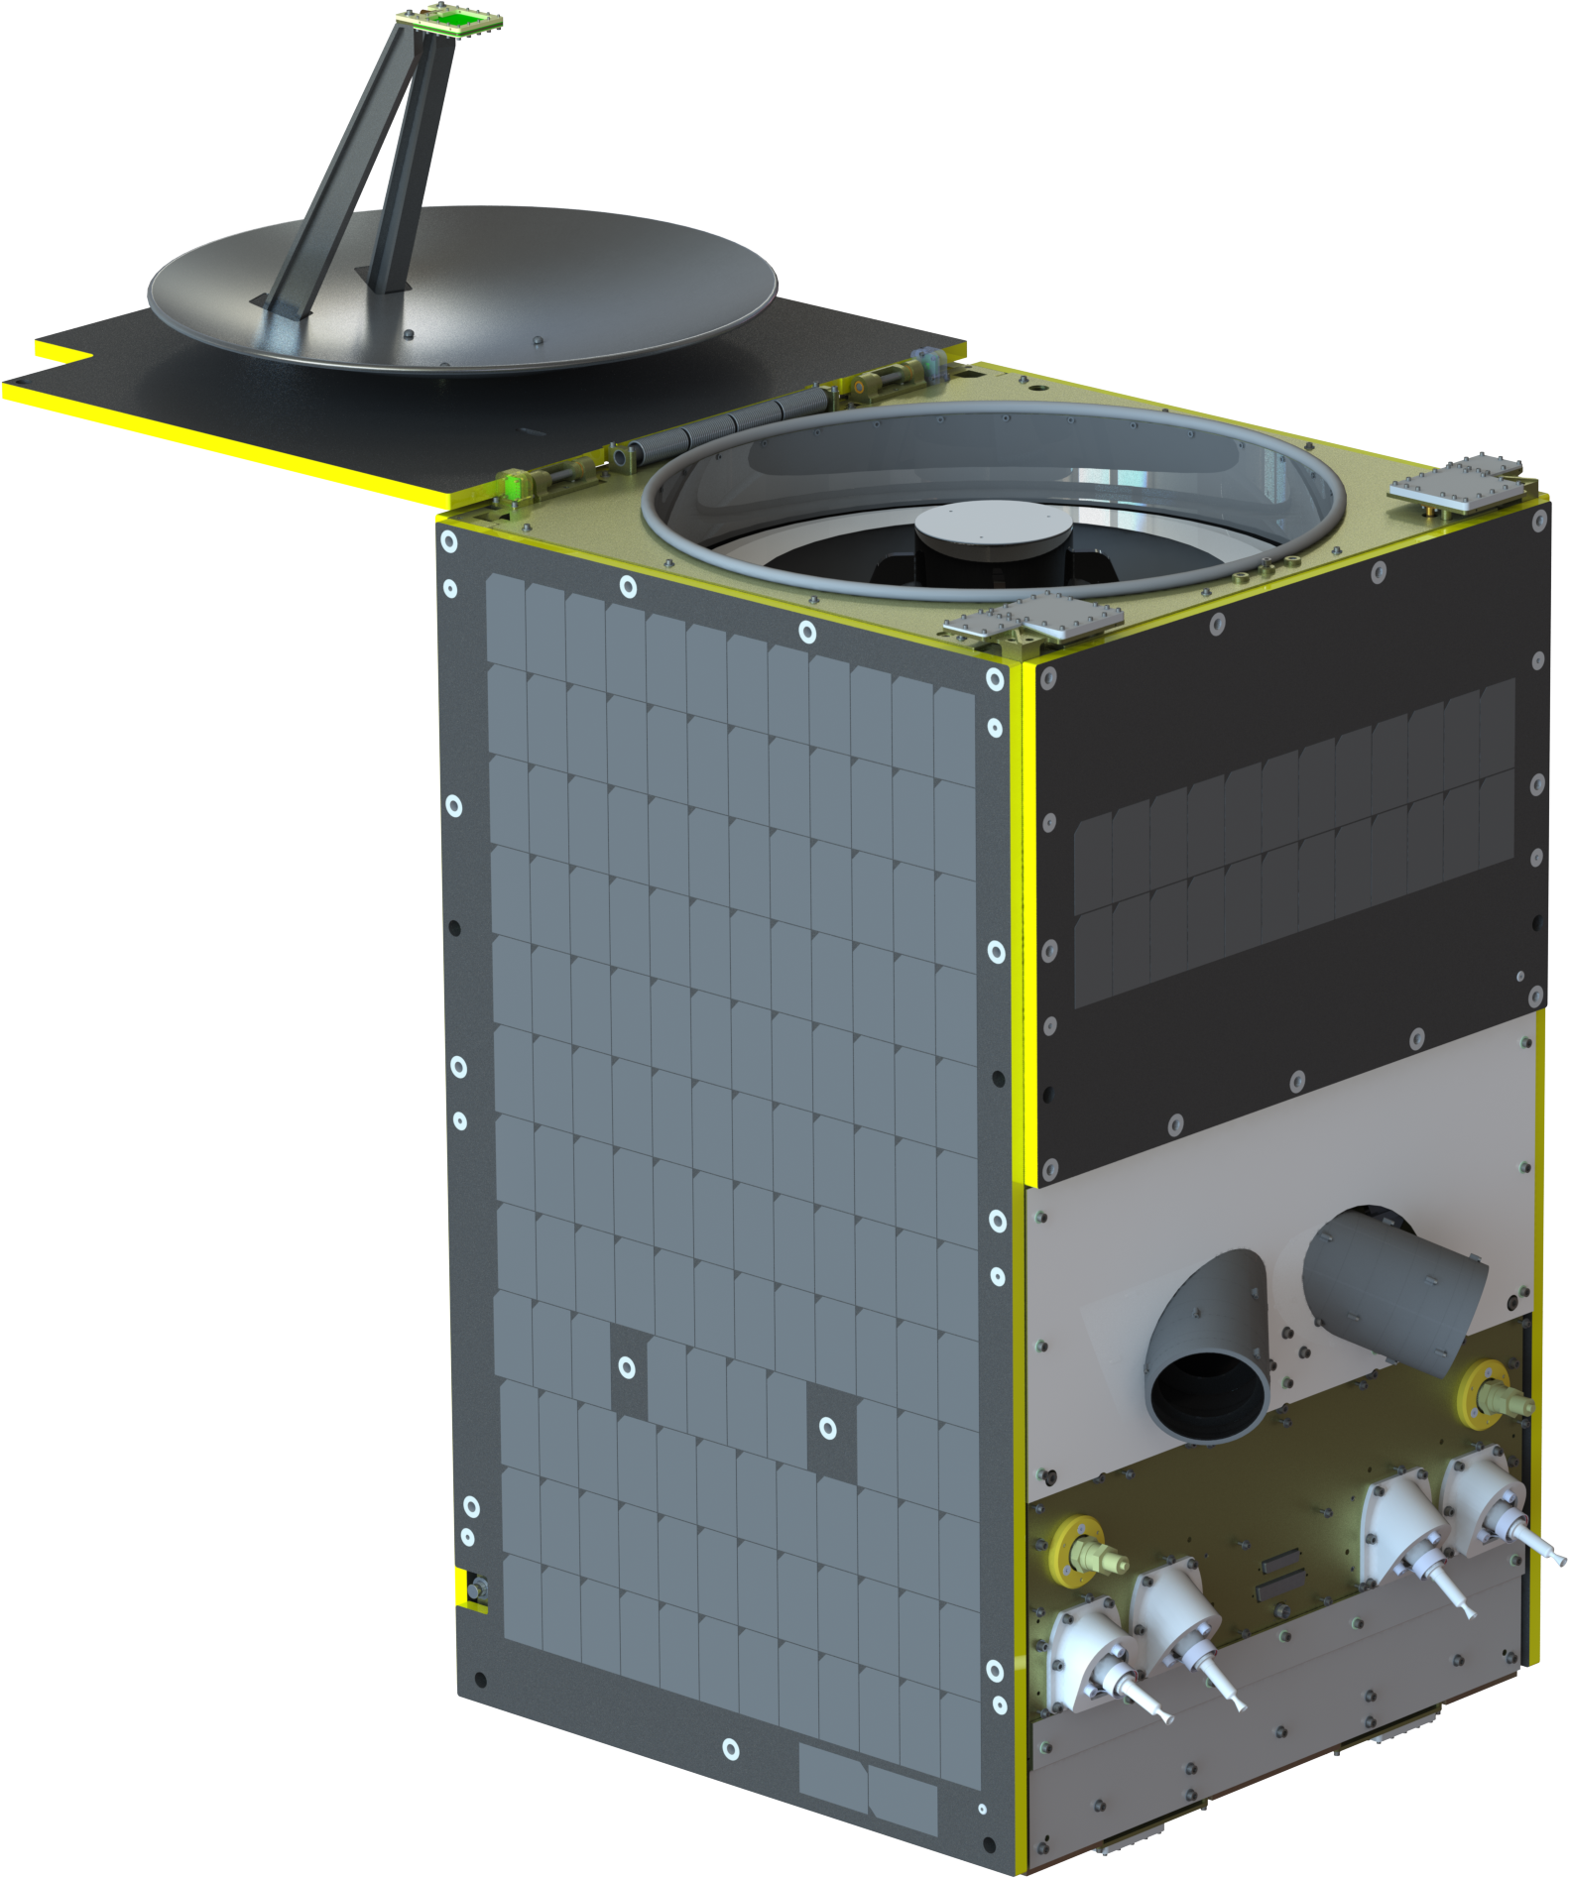

Planet currently has 15 SkySats in orbit
SkySat-1
launched on Dnepr, 21 Nov 2013
~570 km, 11:02am (as of Jan 2019)
SkySat-2
launched on Soyuz, 8 Jul 2014
~620 km, 3:09pm (as of Jan 2019)
SkySat-3
launched on PSLV, 22 Jun 2016
~495 km, 10:45am (as of Jan 2019)
SkySat-4 5 6 7 (Block 1)
launched on Vega, 16 Sep 2016
~495 km, 10:15am (as of Jan 2019)
SkySat-8 9 10 11 12 13 (Block 2)
launched on Minotaur, 31 Oct 2017
~500 km, 1:07pm (as of Jan 2019)
SkySat-14 15 (remaining Block 2)
launched on SpaceX Falcon 9 SSO-A, 3 Dec 2018
~575 km, 10:20am (as of Jan 2019)
“generation A”
“generation C”
Notes:
Slide for compositions – download guide from here:
https://www.dropbox.com/sh/cwlero9tqxyzsws/AADkcxEn29D0cH6QCMesLWwJa?dl=0

Slide 5
These are the SkySat focal planes
OLD
CURRENT
From SkySat-1 to SkySat-4
From SkySat-5 to SkySat-15
Detector 2
Detector 2
PAN
PAN
blue
NIR
Detector 3
green
Detector 1
Detector 3
red
Detector 1
red
green
PAN
NIR
PAN
PAN
blue
PAN
blue
blue
NIR
NIR
green
green
red
red
red
red
green
green
NIR
NIR
blue
blue
focal planes shown as projected to the ground

Slide 6
BORESIGHT CALIBRATION TECHNIQUES

Slide 7

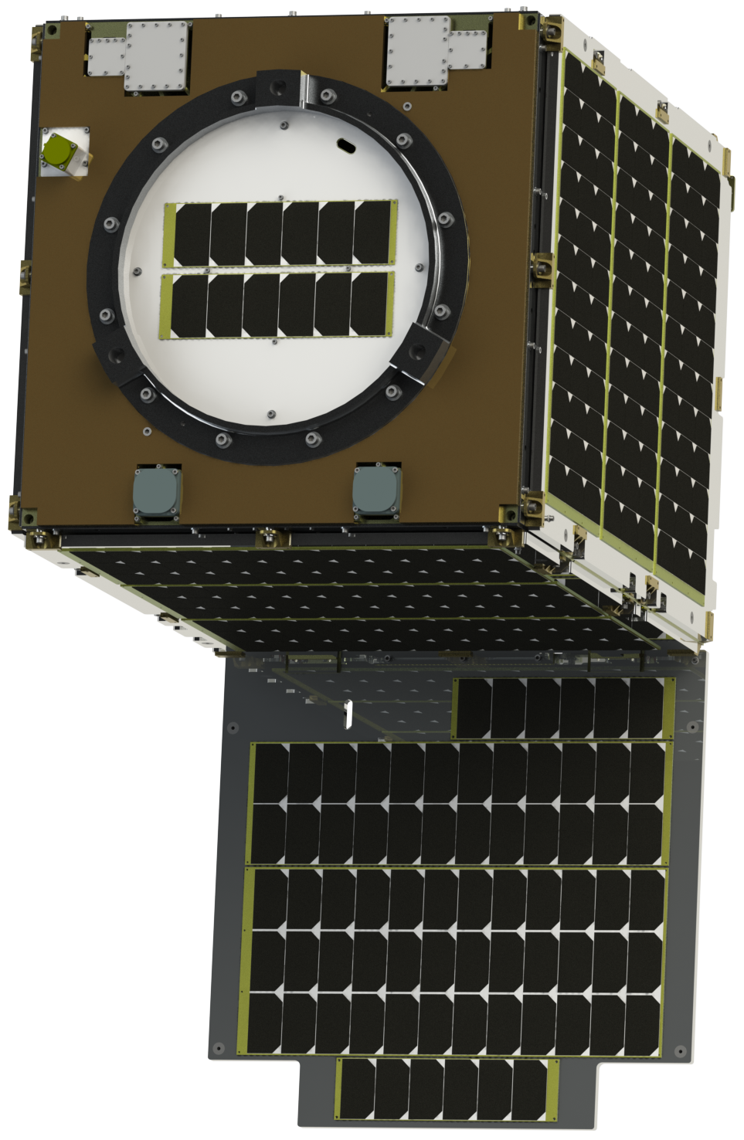
The telescope z axis is the boresight
“Telescope boresight definition”
It’s how the interior orientation couples/connects to the exterior orientation.
SPOILER ALERT: IT’S A ROTATION.
y
+z points down to Earth
(boresight)
Z
X
+x points along the open door
2
3
1

Slide 8
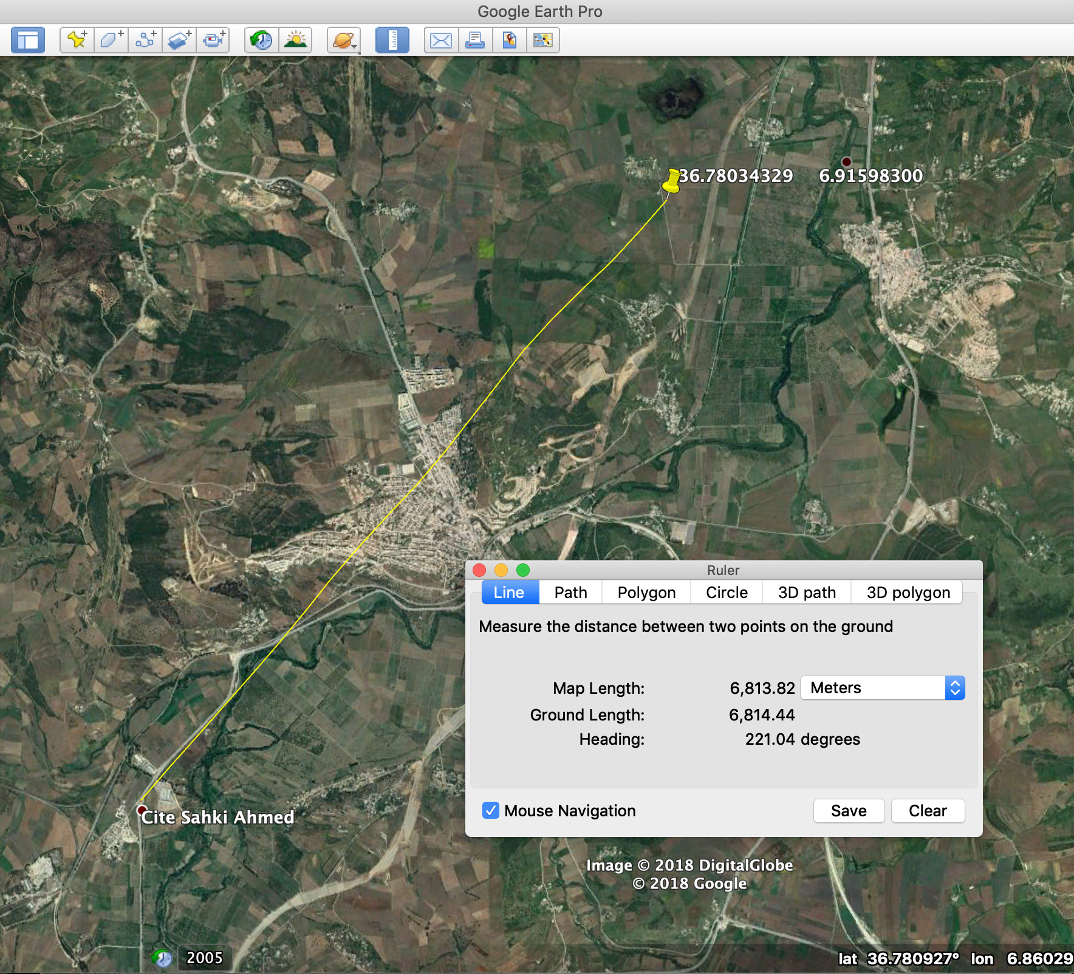
In the beginning, there’s always a big bias
pre-launch guess for the boresight is only within 5-10 milliradians
altitude of 575 km (for SkySat-14, 15) magnifies the error to a few kms
first images reveal the magnitude and direction of the bias
By comparing a feature to its projected
coordinates, initially SkySat-14 had a
6.8 km offset
actual Google Earth screenshot from SkySat-14 calibration work

Slide 9

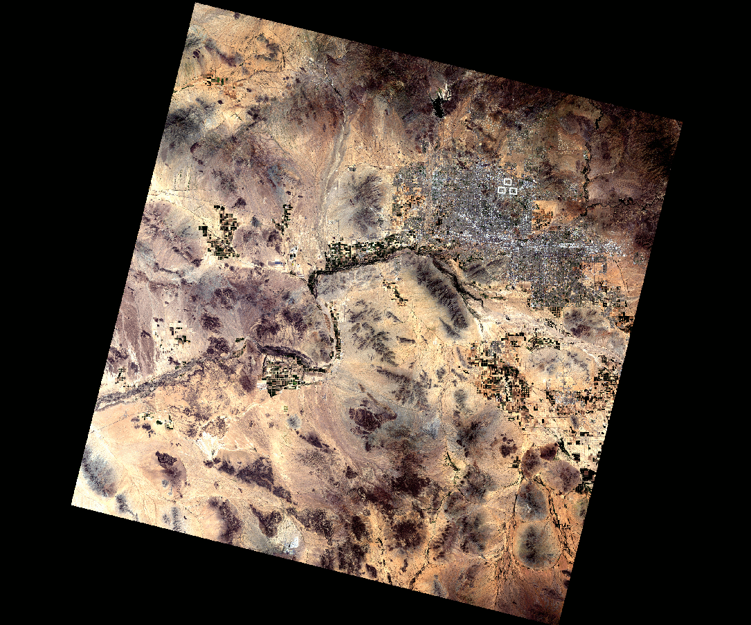
Landsat-8 has a wider swath than SkySats
Phoenix, AZ
C gen SkySat footprint, 6.7 km wide at nadir
185 km
Landsat 8 tile
bands 4, 3, and 2
initial bias is tiny compared to Landsat extent
⇒ mistargeted SkySat imagery will be present
in the Landsat tile*†
* unless you’re near an edge… then use two tiles!
† unless you’re near a corner… then use four tiles!

Slide 10
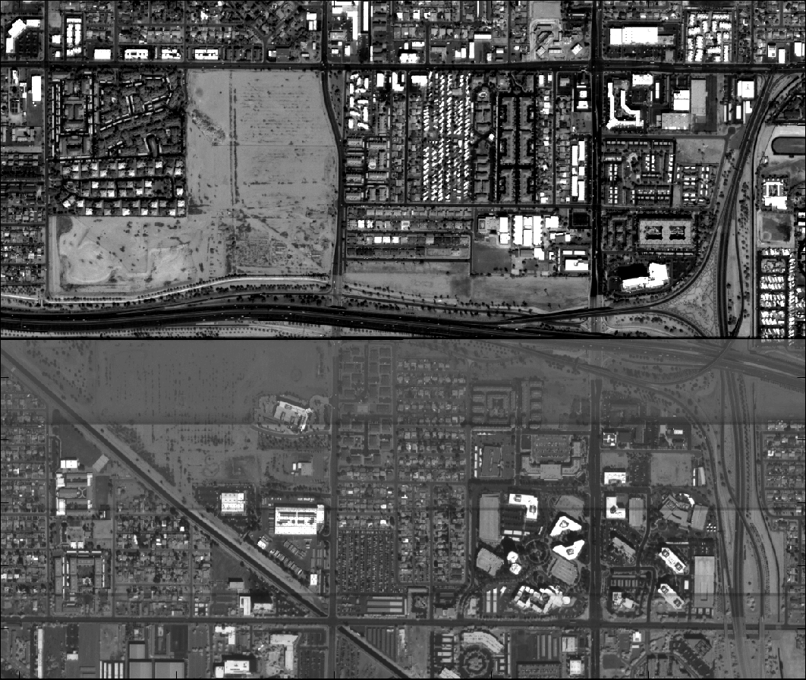
Registering SkySat to Landsat is tricky
Byron developed “mock orthorectification” to register raw SkySat frames to Landsat-8 PAN tiles
PAN
B
G
R
N
full, raw detector image is the
PAN j2k on top
MS j2k on bottom
full resolution SkySat-4 image of Phoenix

Slide 11

Registering SkySat to Landsat is tricky
Byron developed “mock orthorectification” to register raw SkySat frames to Landsat-8 PAN tiles
full resolution SkySat-4 image of Phoenix
downsampled SkySat-4 image of Phoenix
downsample factor =
15 meters (ortho pixel size)
0.903 meters at nadir (SkySat-4 raw pixel size)

Slide 12
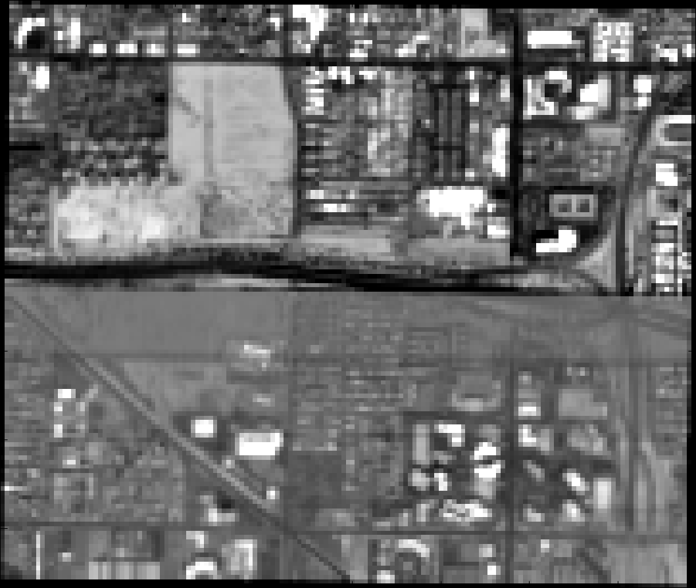
Registering SkySat to Landsat is tricky
Byron developed “mock orthorectification” to register raw SkySat frames to Landsat-8 PAN tiles
full resolution SkySat-4 image of Phoenix
downsampled SkySat-4 image of Phoenix
“mock orthorectified” SkySat-4 image of Phoenix
orthorectify just the corners using SRTM3 DEM into UTM…
…then use those corner coordinates to warp the image
It’s “mock orthrectification” because I’m ignoring the terrain in the middle!

Slide 13
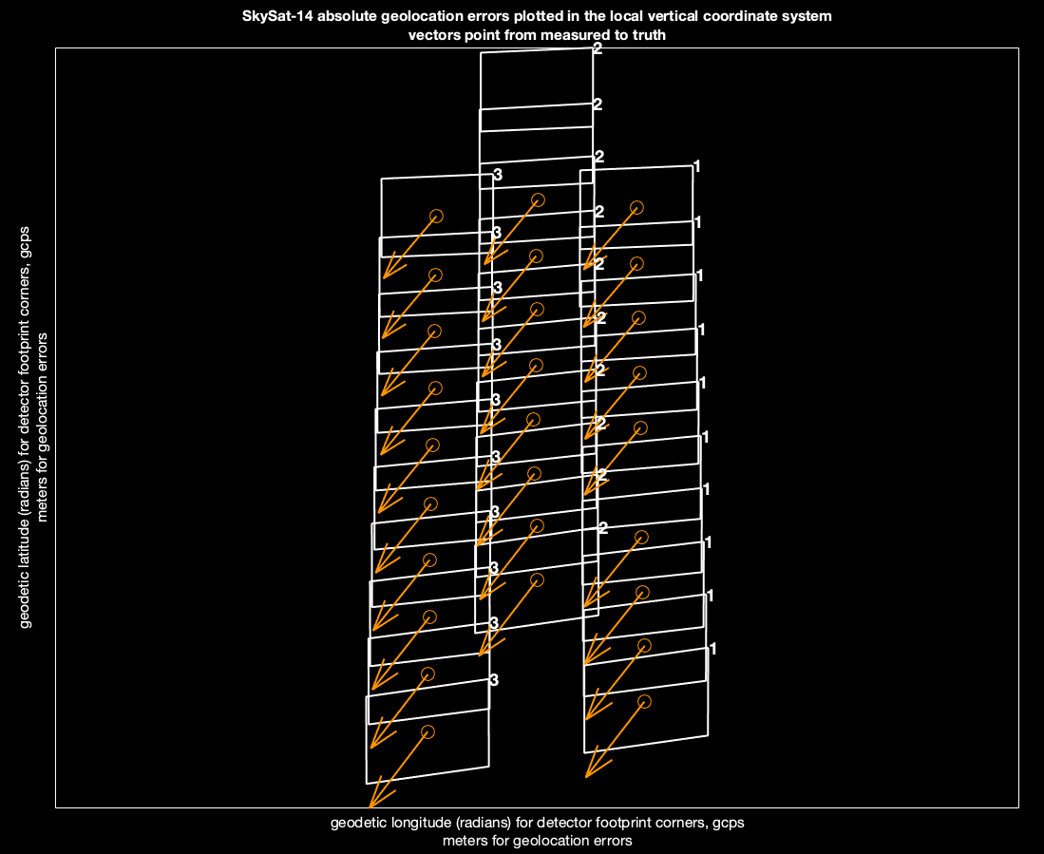
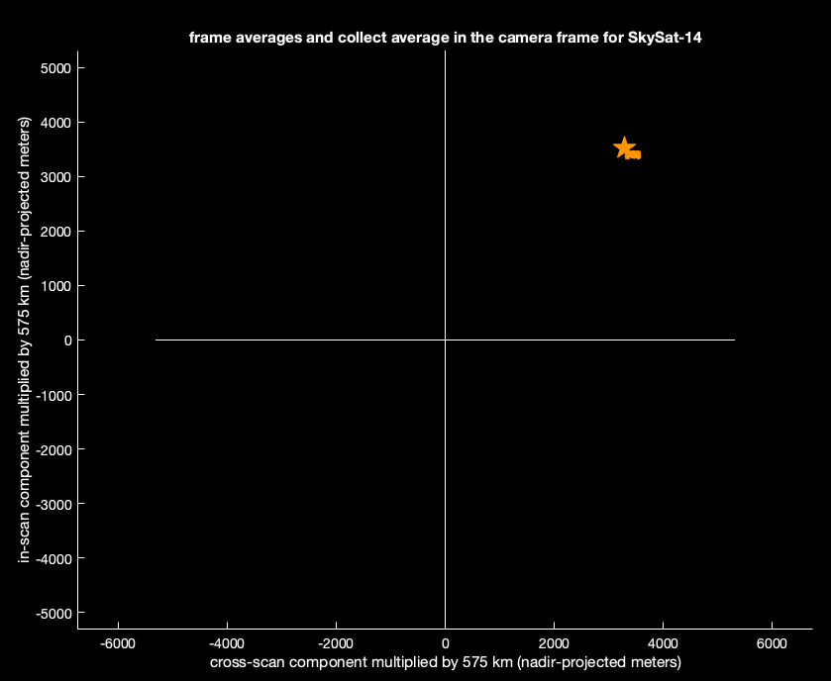
Each detector in every frame has a geolocation error
s112_20181219T102424Z
(boresight x)
4824.03
nadir-projected meters
projected location
the
SkySat-14
collect with the 6.8 km
bias from earlier
collect average
(boresight y)
true location
boresight coordinate system
ten frames, evenly spaced along the imaging event, were coarsely marked against a Landsat-8 PAN tile
local vertical coordinate system

Slide 14
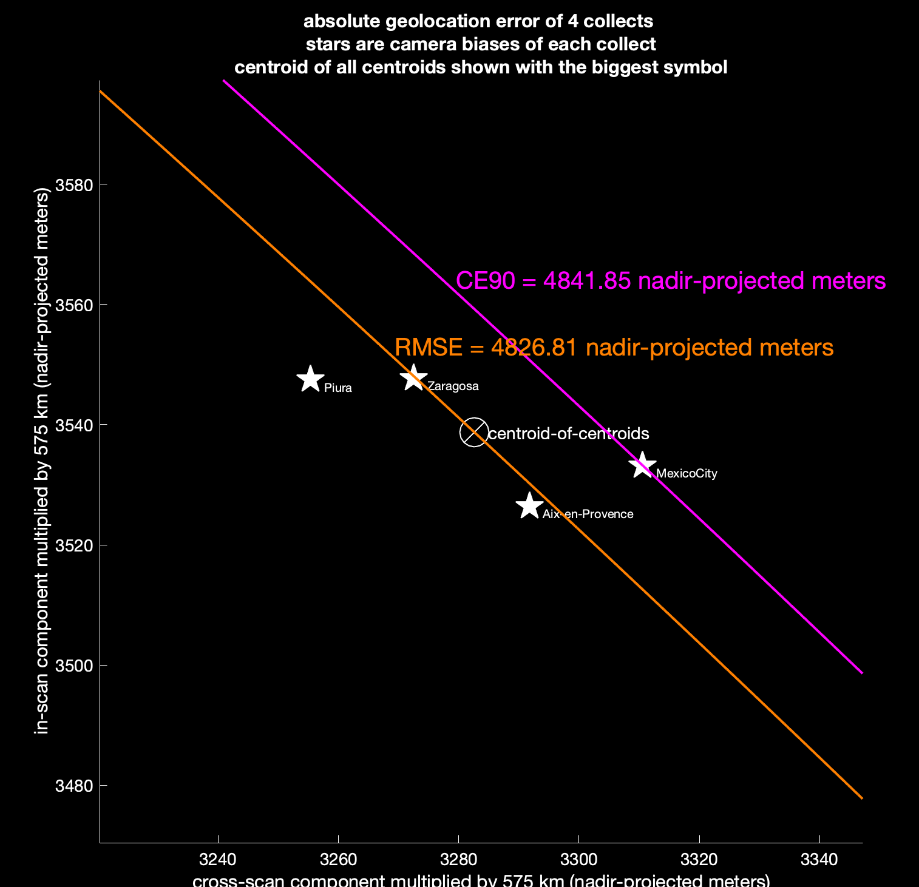
Multiple collects fully describe the pointing error
Many random factors perturb the pointing of individual collects
It takes a statistical approach to reveal the orientation of the true boresight frame
Actual SkySat-14 dataset used to fit the first post launch boresight, containing 4 collects
SkySat-14
(prelaunch) boresight coordinate system

Slide 15
Rotate into a better boresight
A least squares fit determines what additional rotations would minimize the pointing error.
Those same rotations are applied to GNC’s boresight definition, the “boresight-to-principal” quaternion.
Care is taken to compute cost in a way that respects yaw.
(translation: it’s easy to write cost functions that ignore yaw!)
roll
(boresight x)
pitch
(boresight y)
yaw
(boresight z)
y
z
x
2
3
1

Slide 16
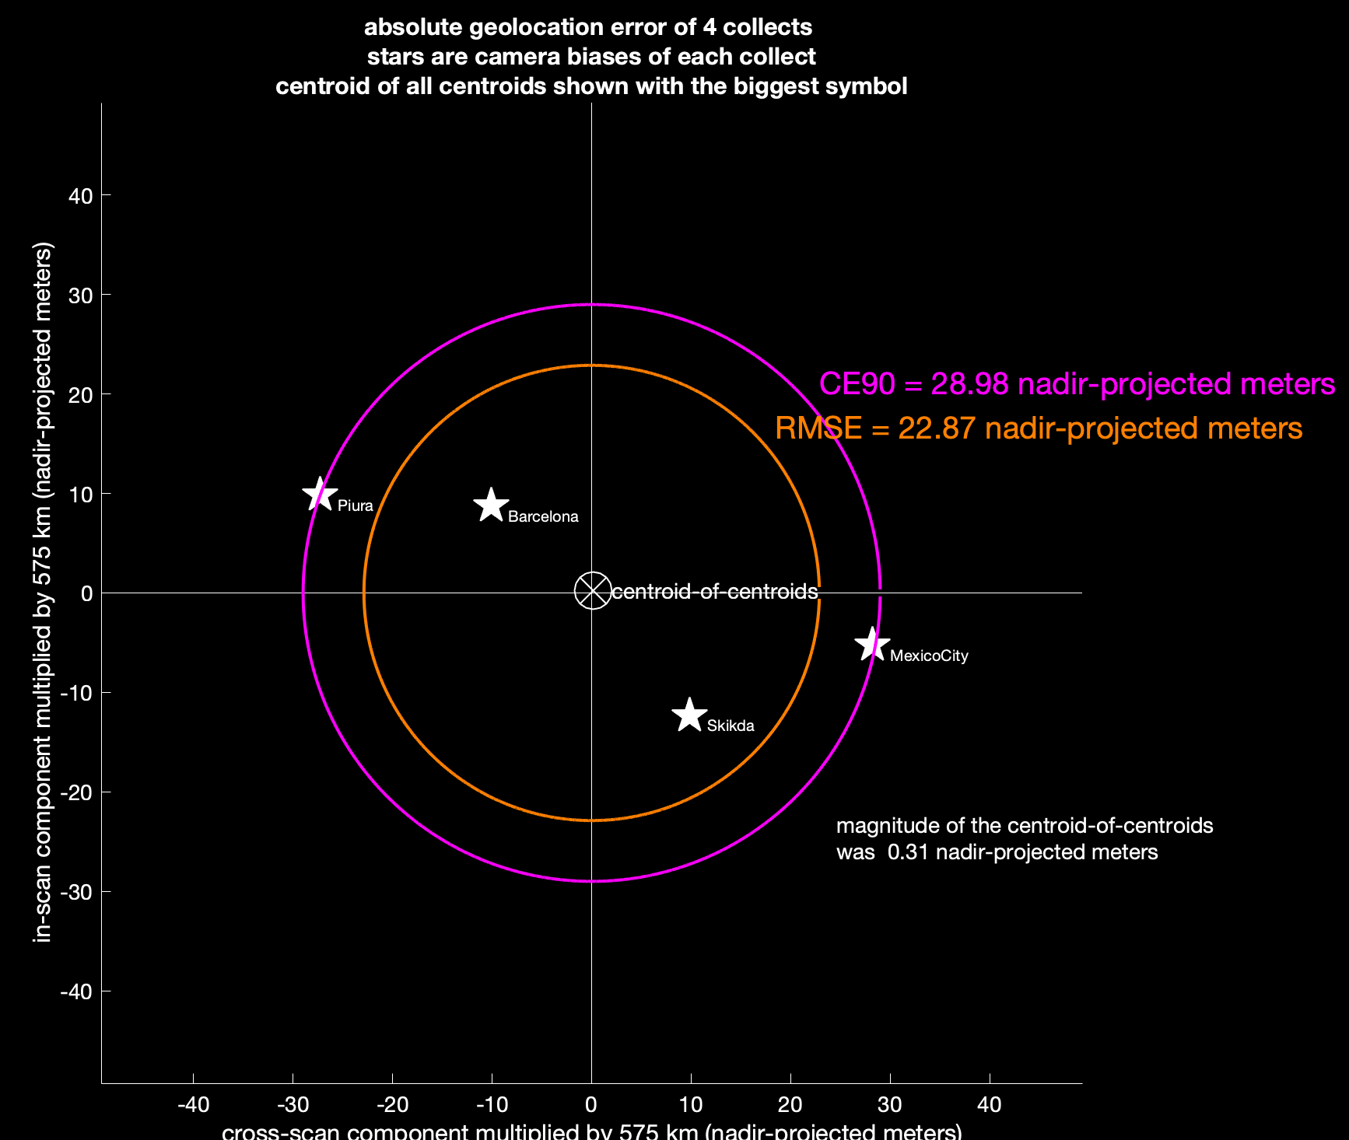
Ending CE90 is determined by the spread
Depending on how far along the GNC calibrations are:
gyroscopes
star trackers
the ending CE90 could be in the 1s of km,
or 10s of meters
In this SkySat-14 example, GNC was quite
far along, as the ending CE90 was only
29 meters at nadir
Actual SkySat-14 dataset used to fit the first post launch boresight, containing 4 collects
SkySat-14
(prelaunch) boresight coordinate system

Slide 17
INTERIOR CALIBRATION TECHNIQUES

Slide 18
The interior orientation is where the detectors live
rotation angles
(3 angles)
pivot point for all three angles is the center of the top half
translation
(2 components)
ppx
horizontal pixel size
pixel pitch
(2 components)
ppy
vertical pixel size
2+3+2 = 7 degrees of freedom
for each detector

Slide 19

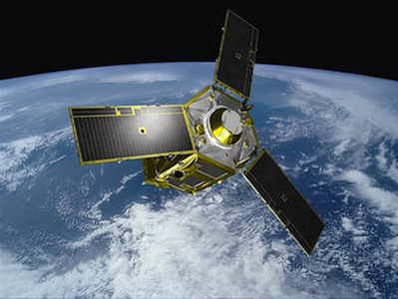


These are the SkySat focal planes
Pléiades-1A/B
(0.5 meter GSD, 10 meter CE90)
REFERENCE ORTHO
no GCPs!
Pléiades-1A/B
georeferencing not modified
(12 meter postings, 4 meter accuracy)

Slide 20
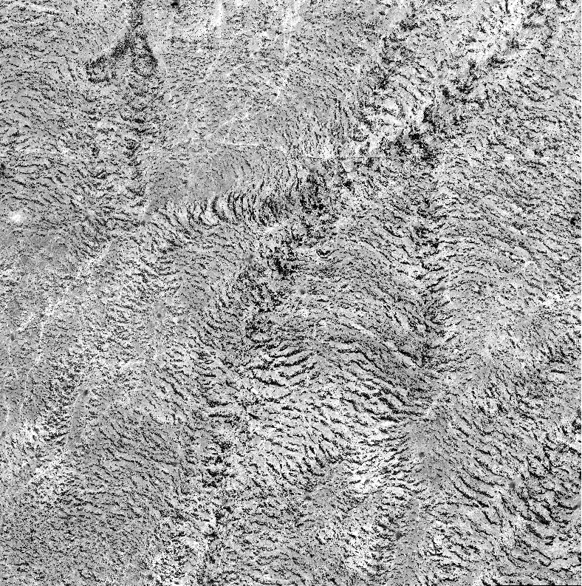
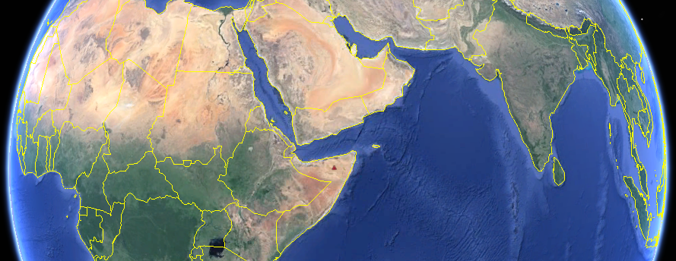
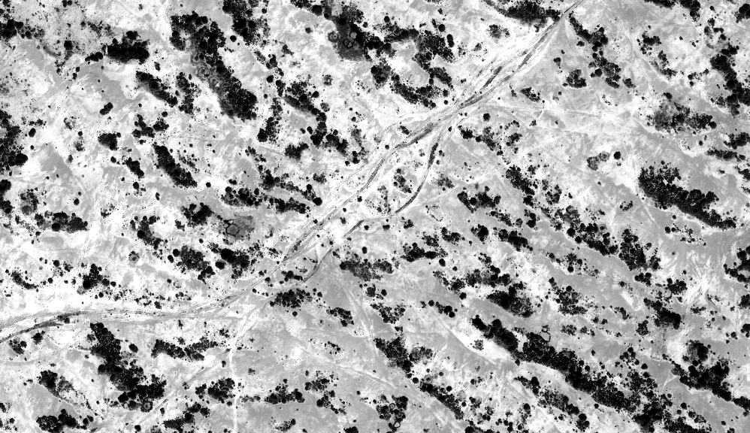

The high quality reference ortho looks like this
Somalia1
9.440416°N, 48.414754°E
| Somalia1
Finely patterned ground cover.
It’s easy to make tie points with this scene content.
a 10 km x 10 km reference image from
Pléiades-1A, orthorectified with WorldDEM

Slide 21

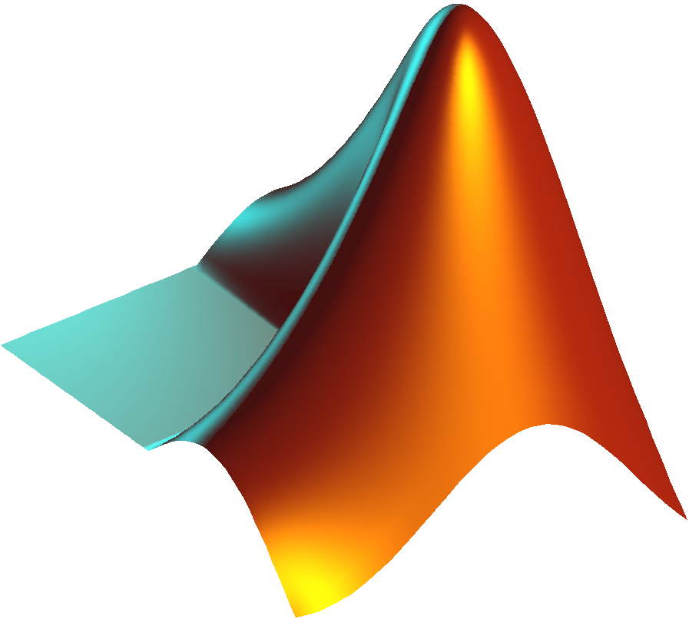
MATLAB orthorectifies the SkySat candidate images
SkySat
detector orthos
SkySat-14
(1.038 meter GSD, ~30 meter CE90)
It must be MATLAB!
the SkySat imageToGround, groundToImage transforms are coded in MATLAB!
(12 meter postings, 4 meter accuracy)
same WorldDEM tile as before!

Slide 22
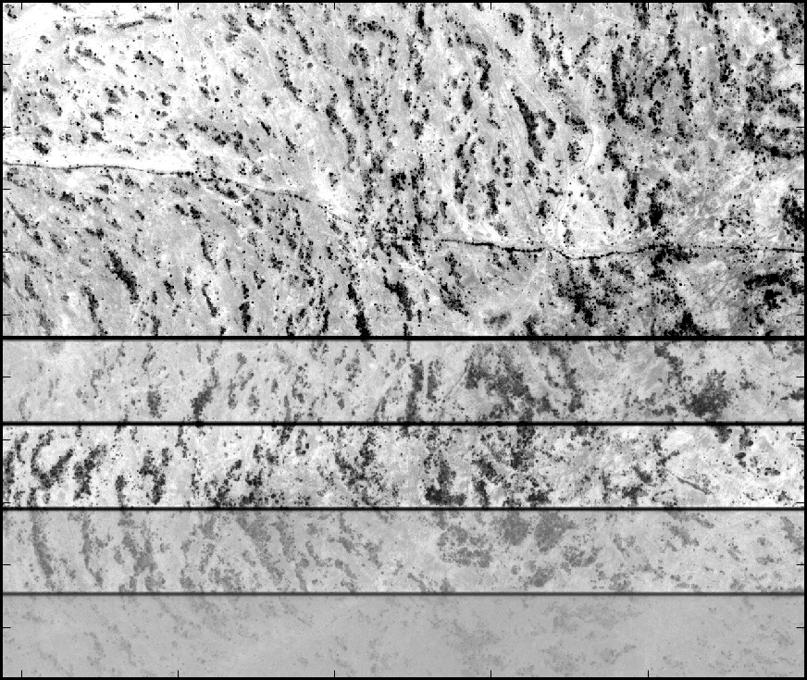

Orthorectified SkySat detector images look like this
for correlation to the reference ortho, raw SkySat detector images are orthorectified using the same WorldDEM terrain model as the Pléiades reference
s103_20161025T071412Z, raw
orthorectified
This is real orthorectification… terrain is most definitely being taken into account!

Slide 23
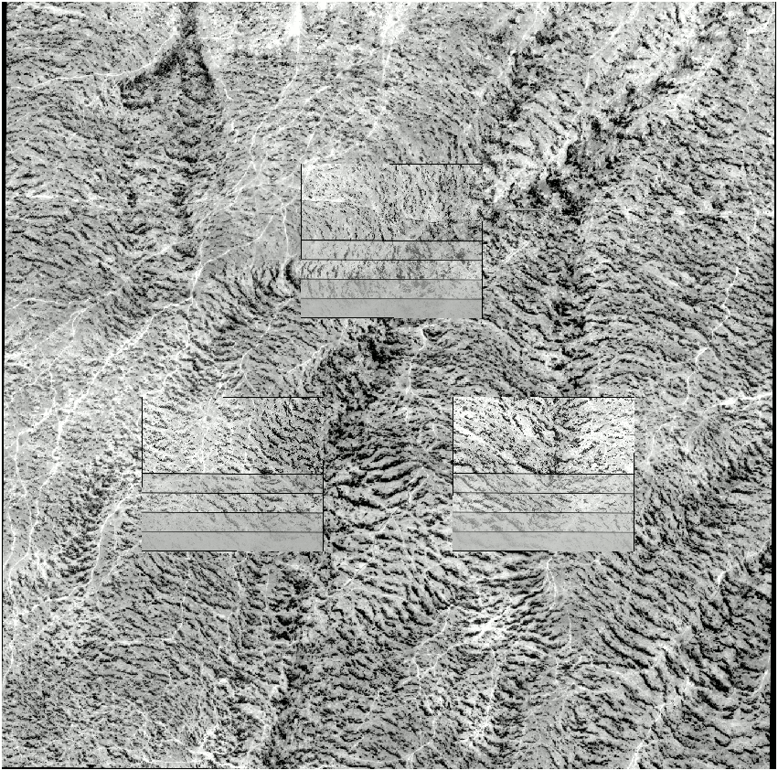

A single frame
reveals the issues
A single SkySat frame of s103_20161025T071412Z
frame = 300
Three detectors at
the same frame-time
Tie points between the SkySat and Pléiades images provide feedback for geometric calibration

Slide 24
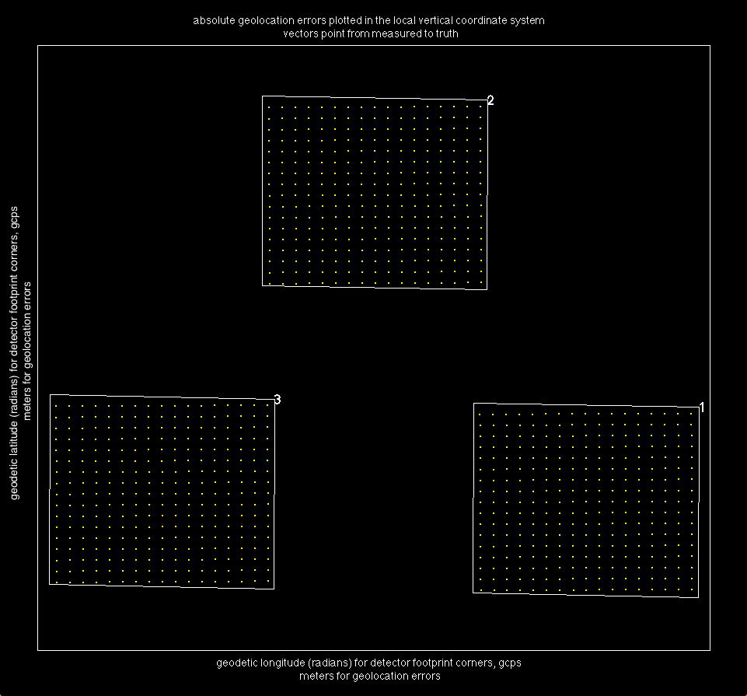
A grid of tie points are found in all three detectors
17 rows
17 x 17 x 3 = 867 total tie points
found between the SkySat detectors
and Pléiades reference
17 columns

Slide 25
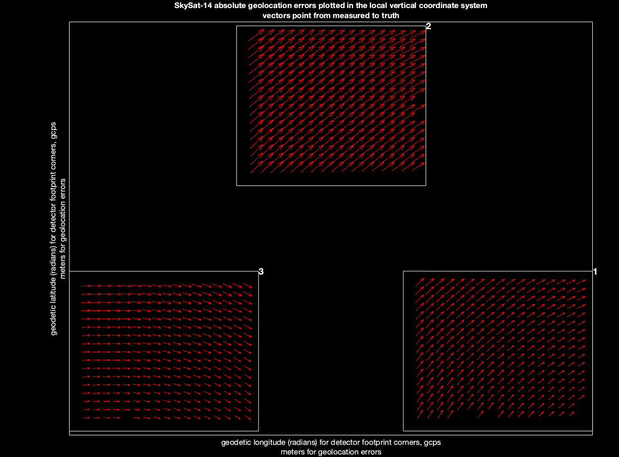
At first, a bias
is present that obscures the interior error
Immediately after correlation,
a bias is present
In this example, a bias of ~48 meters at nadir is superimposed on the interior error
CE90 = 80.02
nadir projected meters
actual SkySat-14 interior error plot
SkySat-14

Slide 26
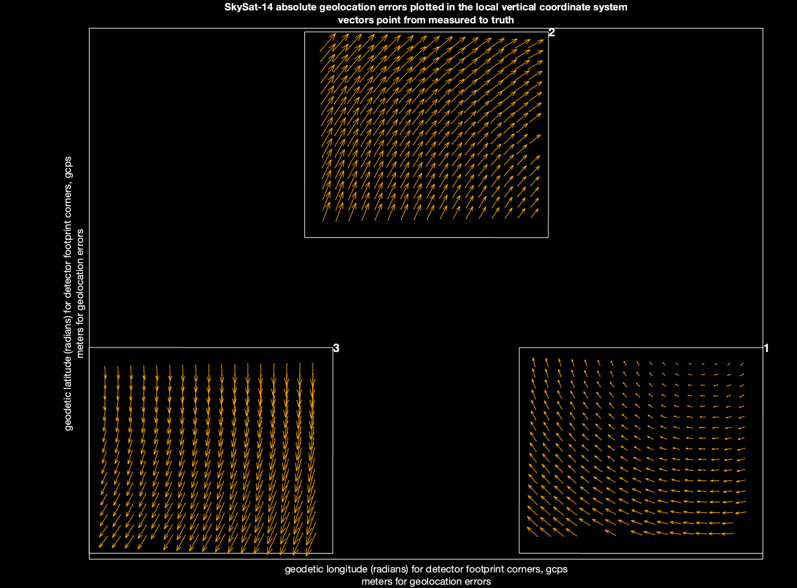
Removing the bias reveals the interior error
SkySat-14
changing the pose in a least squares sense removes all error that could be exterior
CE90 = 37.41
nadir projected meters
actual SkySat-14 interior error plot

Slide 27
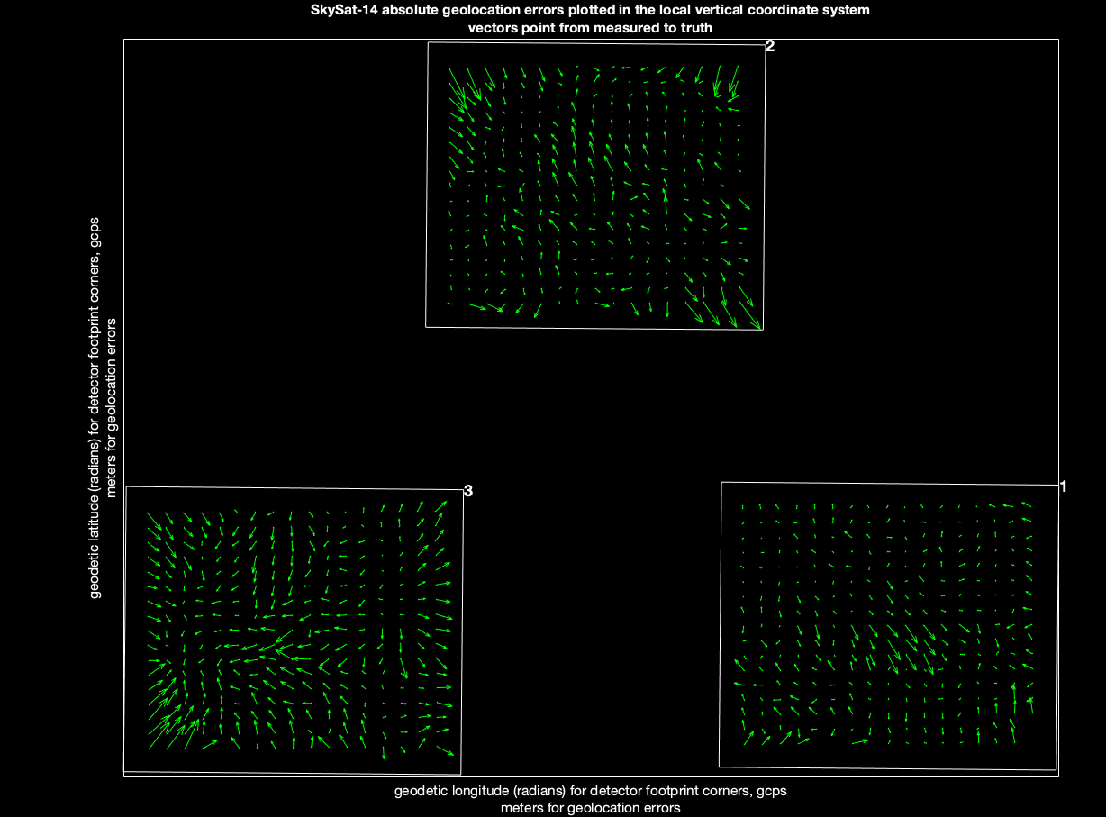
Good tie points yield sub-pixel results
fitting the interior parameters, including pixel pitch dimensions, yields a subpixel interior
CE90 = 0.356
nadir projected meters
CE90 ≈ 0.343
pixels at nadir (!)
actual SkySat-14 interior error plot
SkySat-14

Slide 28
CONCLUSIONS

Slide 29
CONCLUSIONS
On-orbit geometric calibration is crucial:
  Good boresight provides good geolocation, targeting, orthorectification;
  good interior prevents shear between detectors, enables good mosaicking.

