Slide 1
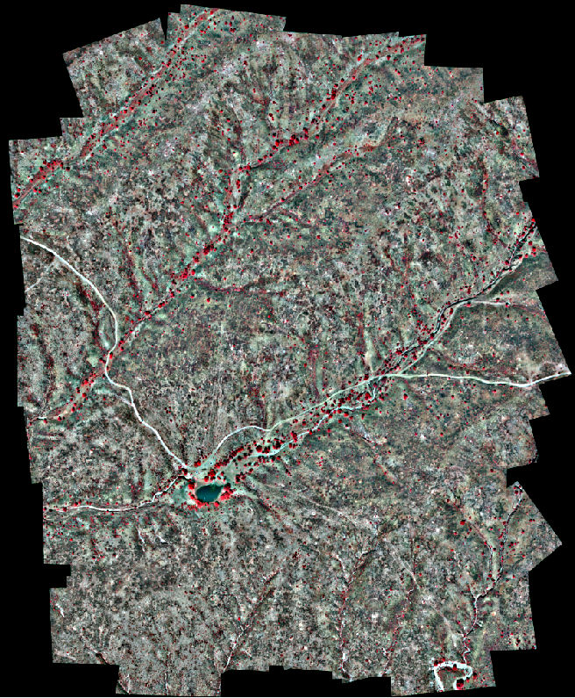
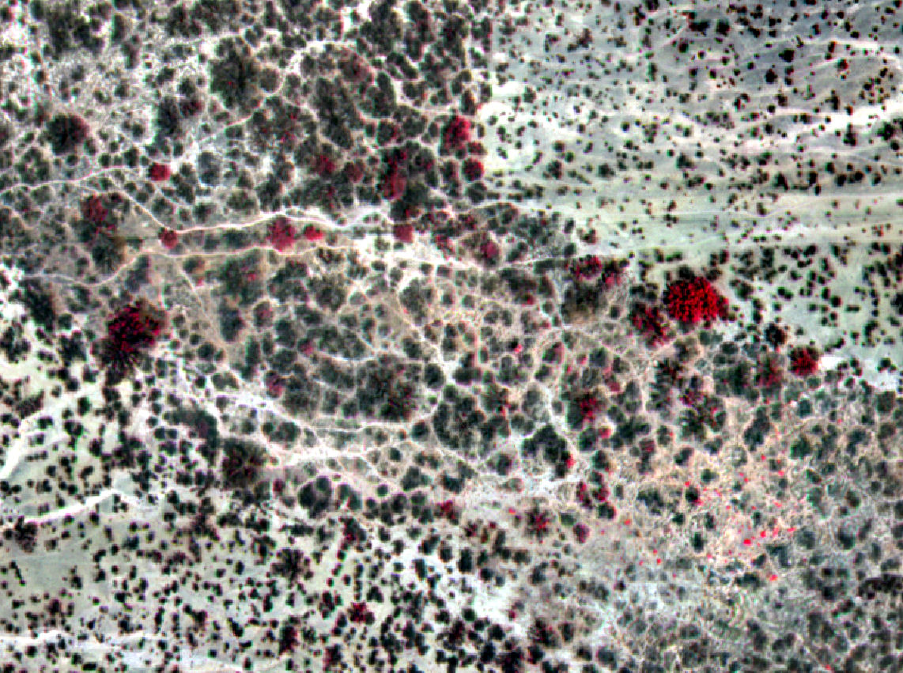



Multispectral Remote Sensing from Unmanned Aircraft: Development of Workflows and Comparison with WorldView-2 Data
Andrea S. Laliberte
earthmetrics, Brownsville, OR formerly with USDA ARS Jornada Experimental Range, Las Cruces, NM
earthmetrics
ASPRS 2012 Annual Conference, Mar. 19-23, Sacramento, CA

Slide 2
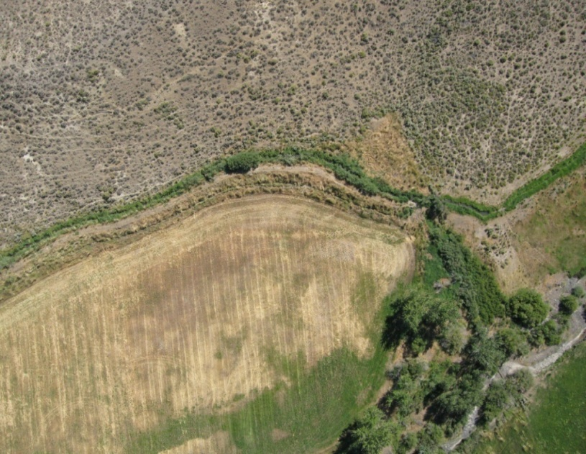
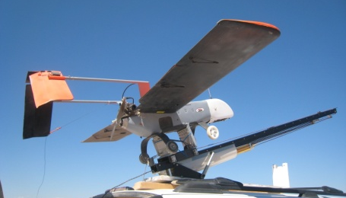
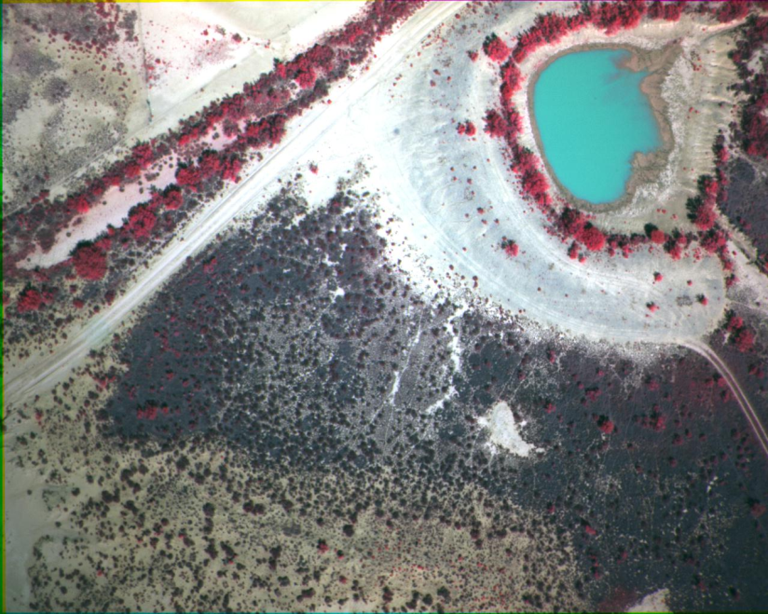
UAS for vegetation mapping
Increased interest in using UAS for natural resource remote sensing tasks
Smaller, light weight sensors for small UAS
Low operating costs, imagery with very high resolution, repeated deployment for change detection
FAA: Integration of UAS in National Airspace by 2015
Visible band imagery has limitations for vegetation mapping
Evaluate multispectral UAS applications
Compare with WorldView-2 data

Slide 3
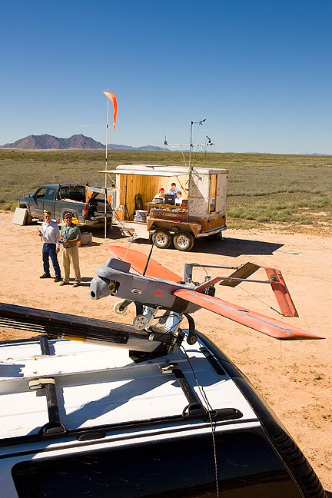
UAS Operations at the Jornada Experimental Range
Objectives: development of operational UAS-based remote sensing program for ecological applications
Operated 2 UAS since 2006
Operations in NM, ID, AZ (COA and in military airspace)
Areas of interests:
  Access to airspace
  Image acquisition
  Terrain extraction
  Orthorectification
  Mosaicking
  Vegetation classifications
  Geometric and classification accuracies
  Operational workflows

Slide 4
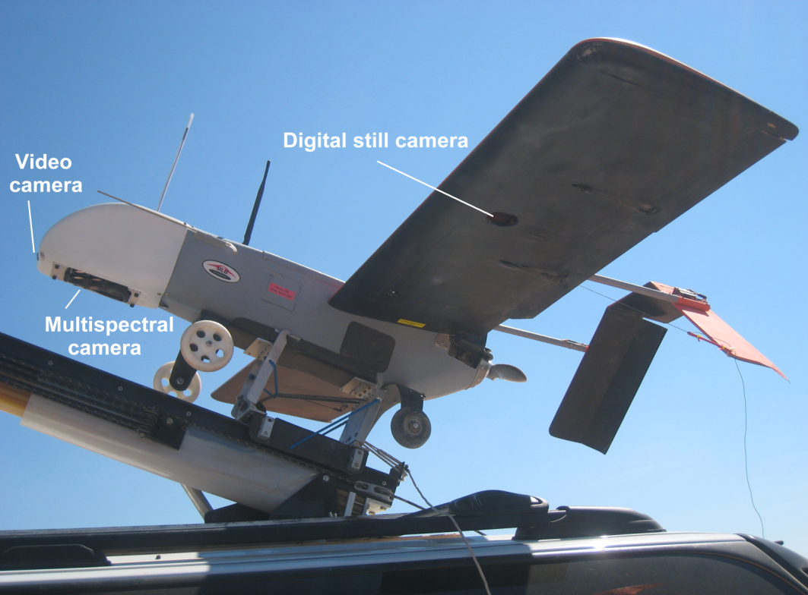
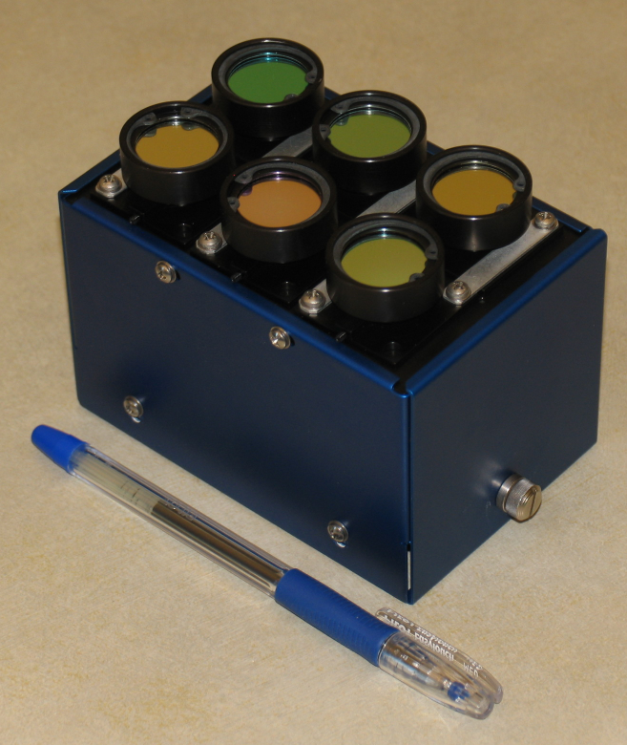
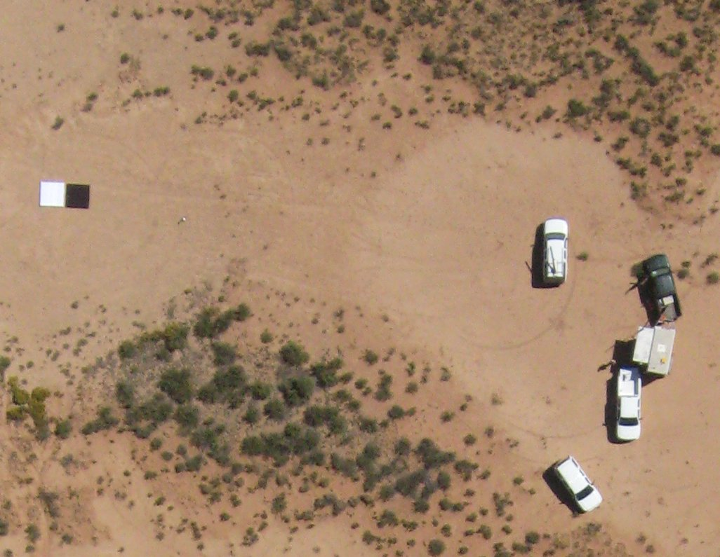
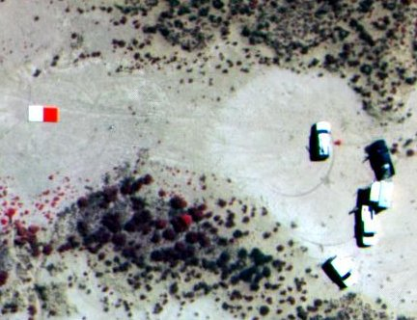
BAT 3 UAS
1.8 m wingspan, 10 kg weight
Flight duration: 2-5 hours
Sensors
Video camera
Canon SD900 10 mp
Tetracam MiniMCA, 6 narrow bands, blue to near infrared
Image acquisition
700 ft AGL
75% forward, 40% sidelap
Data file: X,Y,Z, roll, pitch, heading
Canon Multispectral
Footprint: 160m x 213m 145m x 182m
Spatial: 6 cm 13 cm
Spectral: 3 bands 6 bands
Radiometric: 8-bit 10-bit

Slide 5
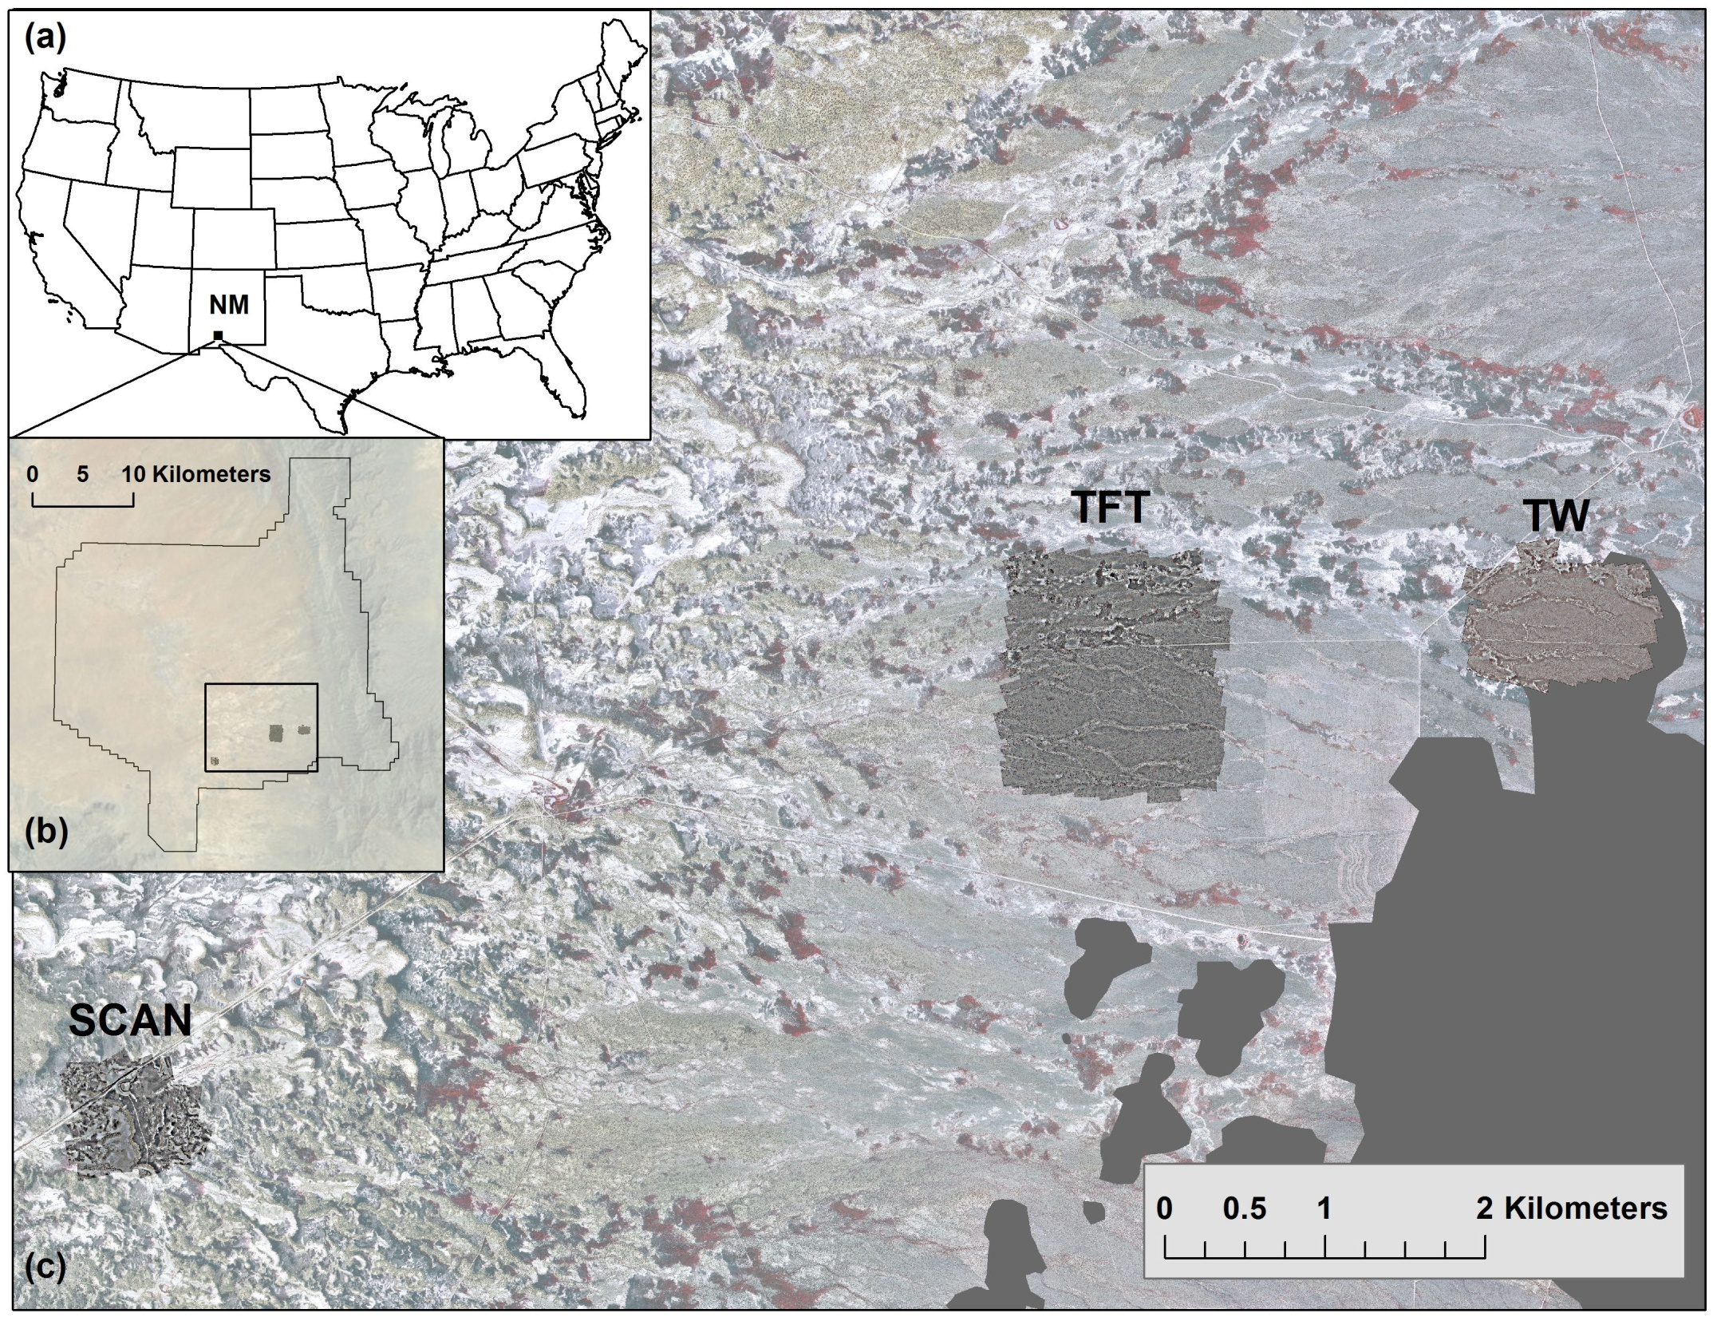
Image Type | Sites | Date | Number of UAS images
WorldView-2 | Western Jornada | 26 Oct 2010
UAS Aerial | TW | 10 Nov 2010 | 160
 | TW | 25 May 2011 | 160
 | SCAN |  | 77
 | TFT |  | 387

Slide 6
Multispectral image processing workflow
Issues encountered:
Proprietary file format incompatible with GIS/RS software
Software cannot handle 10-bit data in tif format
Poor band co-registration
Strong vignetting

Slide 7
Band to Band Registration
PixelWrench software band to band registration
  Rotation and scaling determined by length and angle of line between 2 points
  Translation determined by 1 X,Y position
Local weighted mean transfer (LWMT)
  Based on phase-correlation registration assessment
  Derives mis-registration statistics between master and slaves in 128 x 128 pixel blocks
  Filtering outliers and local averaging
  Able to compensate for locally varying pixel misalignments compared to polynomial approach
  Applied in batch mode using parallel processing

Slide 8
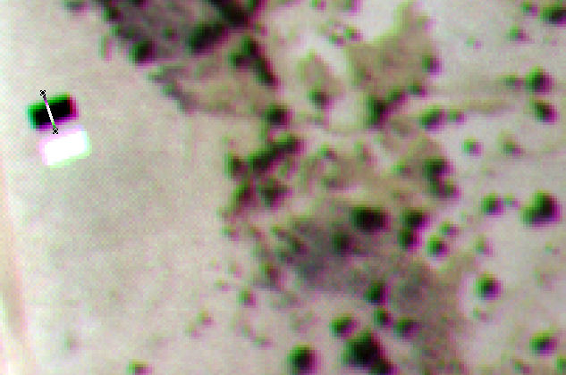
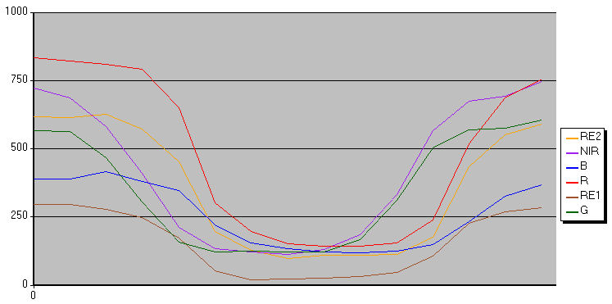
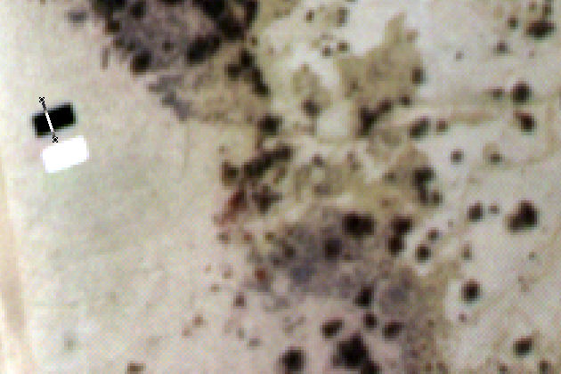
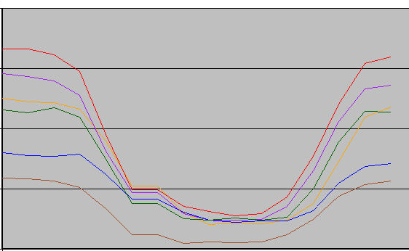
Band to Band Registration
1000
750
500
250
Digital Number
(c)
0
0
0.5
1.0
1.5
2.0
2.5
(a)
B
G
R
RE1
RE2
NIR
1000
750
500
250
(d)
0
(b)
0
0.5
1.0
1.5
2.0
2.5
Distance (m)

Slide 9
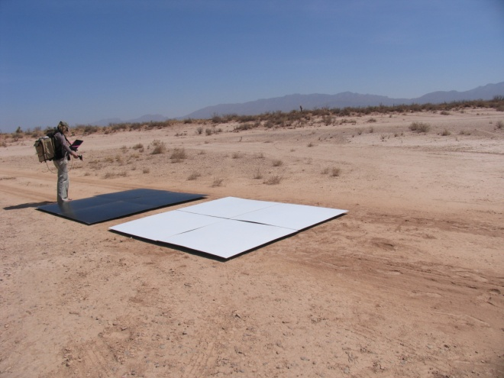
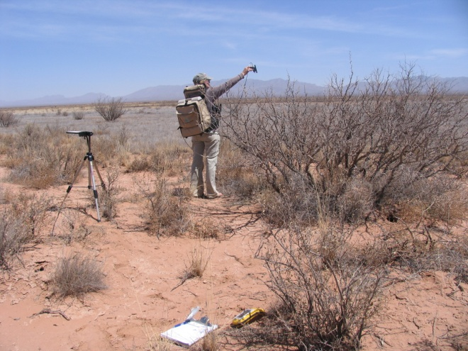
Radiometric calibration
Obtain ASD reflectance for calibration targets and dominant vegetation/soil
Empirical line method to derive coefficients to fit digital numbers to field measured reflectance spectra

Slide 10
Image reflectance versus ASD reflectance
6 bands x 6 vegetation species
Image with targets
Method 1: correct radiometry by image, then mosaic
Method 2: mosaic first, then correct radiometry
Better correlation, lower error

Slide 11
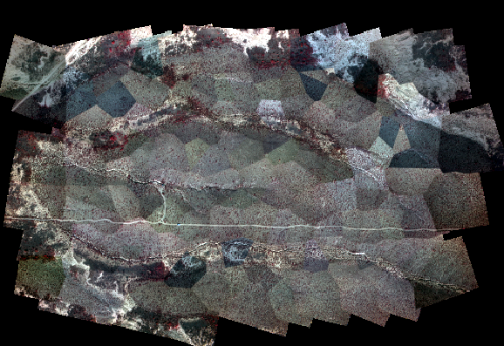
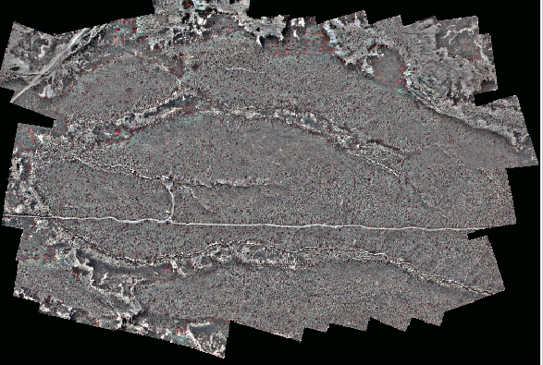
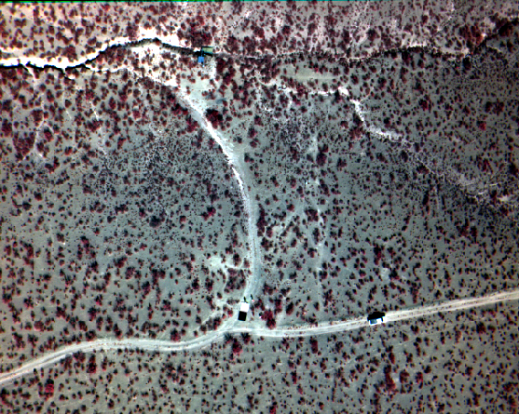
Color balancing
Image dodging approach during mosacking process in Erdas
1000 m
Anisotropic vignetting

Slide 12
Orthorectification and Mosaicking
PreSync
LPS
All UAV
Images
Final
Mosaic
Initial Tie Point Alignment
Rigid Block Adjustment
AutoSync
Generate
Autopano
tie points
Individual Image Adjustment
Mosaic
Initial EO
Realignment of Tie Points
Ortho
Images
Camera calibration
parameters
Repeat Rigid Block Adjustment
DEM
extraction
DOQ
1 m
Further alignment
required?
Yes
No
Aerotriangulation
DEM
5 m
Corrected EO and tie points
with ground coordinates
Automatic tie point
generation (optional)
Notes:
Search space: 50 m spatially, 10 deg. Roll/pitch, 20 deg heading
Use individ. Image registration again to reduce hinge-like flexing in overlap areas. This lets each image seek its preferred orientation within the local space.

Slide 13
Multispectral image classification
Object-based image analysis using eCognition 8.64
Recursive approach of segmentation, classification, merging
Determine shadow, bare/vegetation, sparse using rule-based approach
Determine species using training samples
Decision tree to determine optimum of 15 input features (NDVI, means, ratios, area, roundness)
1083 field samples for training/accuracy

Slide 14
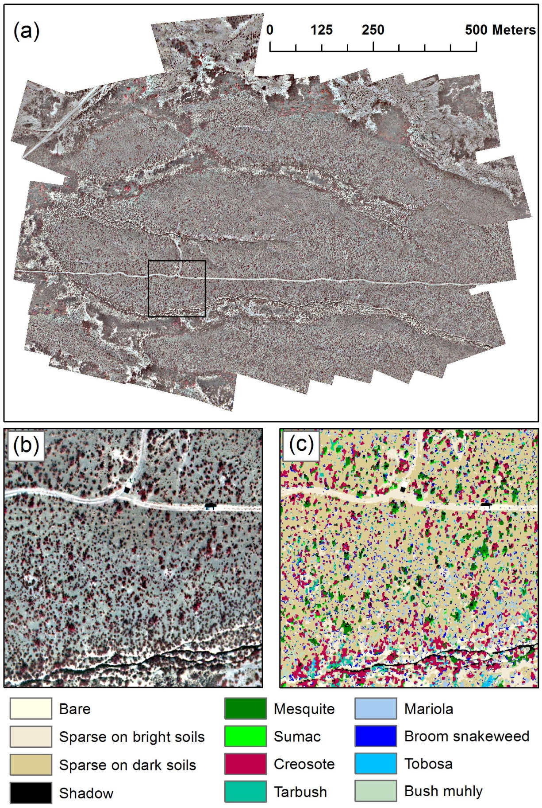
130m x 130m
Classification results
Class | Producers Acc. (%) | Users Acc. (%)
Tarbush | 52 | 83
Broom snakeweed | 72 | 73
Creosote | 94 | 79
Bush muhly | 79 | 72
Mariola | 86 | 81
Mesquite | 89 | 92
Sumac | 49 | 96
Tobosa | 93 | 98
Overall Acc. (%) | 87
Kappa | 0.83

Slide 15
Comparison: WorldView 2 and MCA imagery
Oct. 26, 2010
8 bands
2 m GSD
B
G
R
RE
NIR
Nov. 10, 2010
6 bands
0.16 m GSD
WV2 was radiometrically and atmospherically corrected using ATCOR2

Slide 16
425 480 545 605 660 725 835 950
Reflectance
WorldView 2 Oct. 26, 2010
Mixed grass
Wavelength (nm)
Spectral data for WorldView-2 and MCA
MCA reflectance
Bare
Sparse
Tobosa dense
Tobosa sparse
Sumac
Mesquite
Creosote
Mixed grass
WorldView-2 reflectance

Slide 17
Summary
Efficient workflow for obtaining orthorectified, radiometrically calibrated UAS image mosaics
Automated batch processing easily scalable for larger acquisitions
Challenges included file format incompatibilities, software, camera limitations
Need for high quality multispectral sensors for UAS
Comparison of airborne and WorldView-2 data demonstrates potential for multi-scale studies or upscaling

Slide 18
Future Work
Change detection with multispectral imagery
  Need for highly accurate co-registration
  Evaluate vegetation indices
Fuse optical data with terrain models extracted from stereo imagery
  Point clouds
Upscaling with WorldView-2 data
Scale these approaches to larger areas
Test additional UAS sensors
  Thermal, LiDAR, Hyperspectral

Slide 19
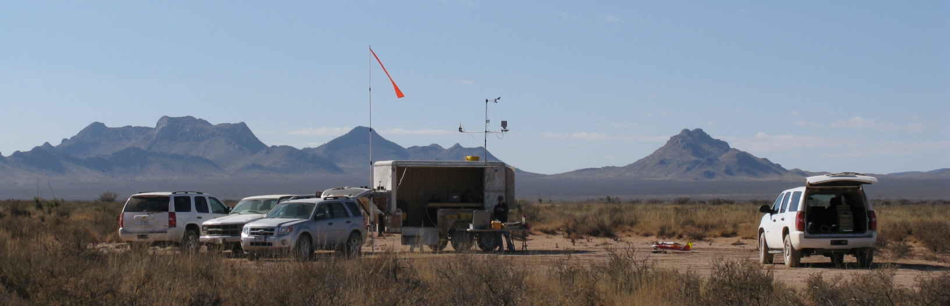
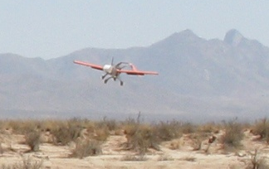
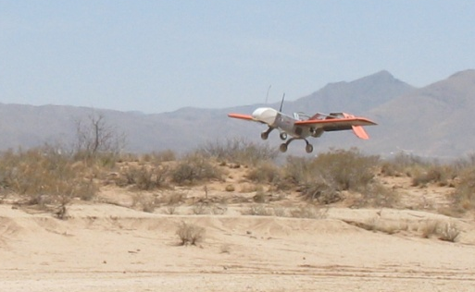
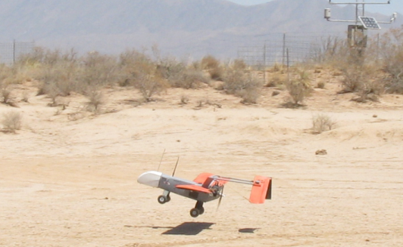
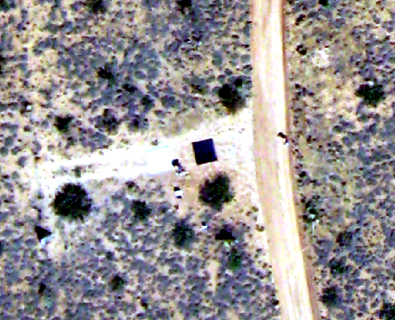
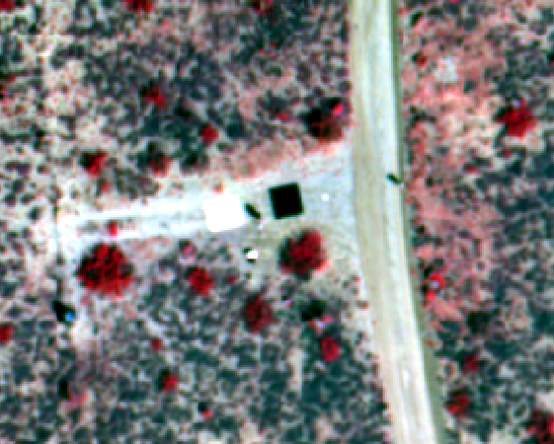
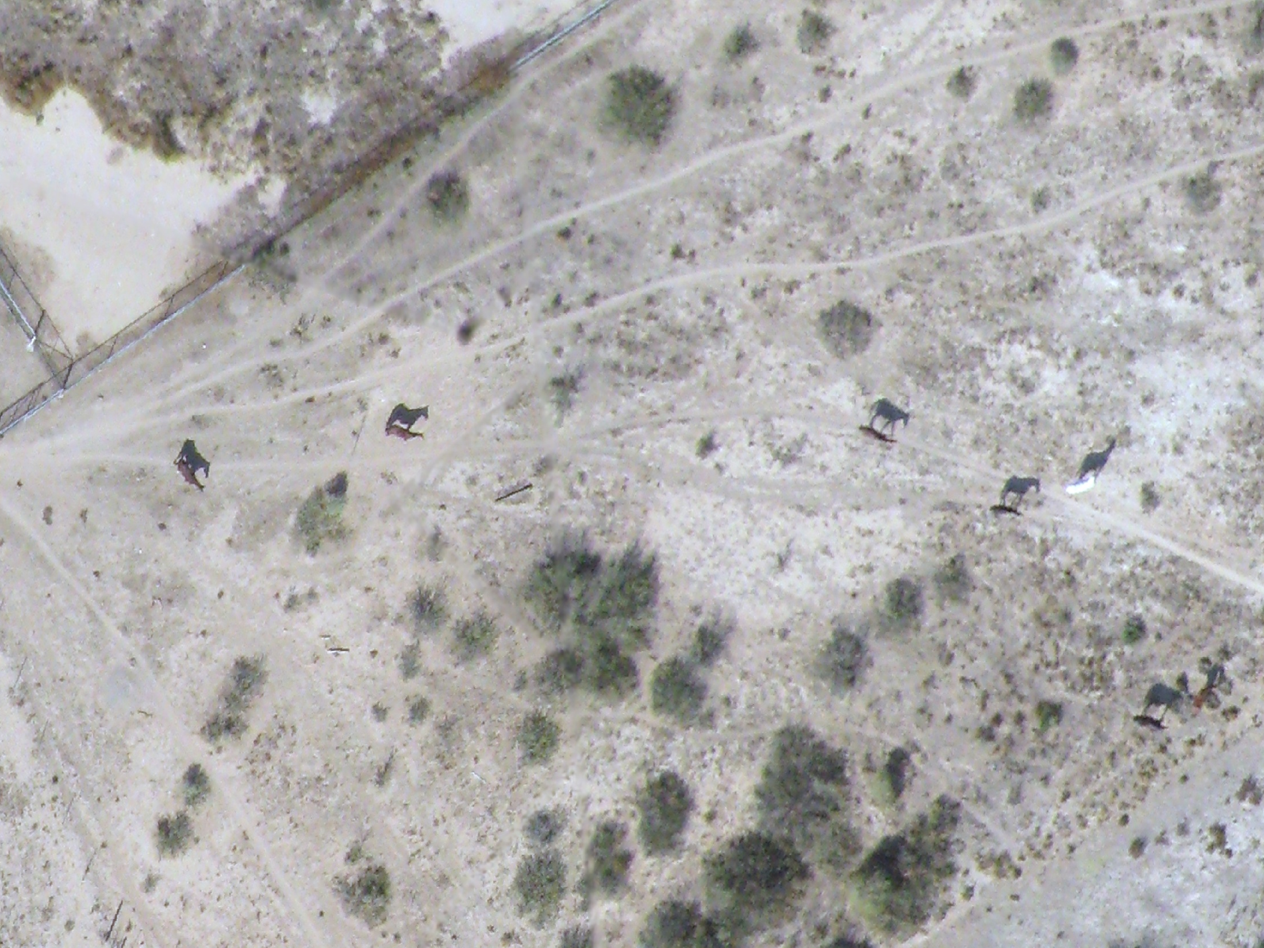
Thank
you!

