Slide 1
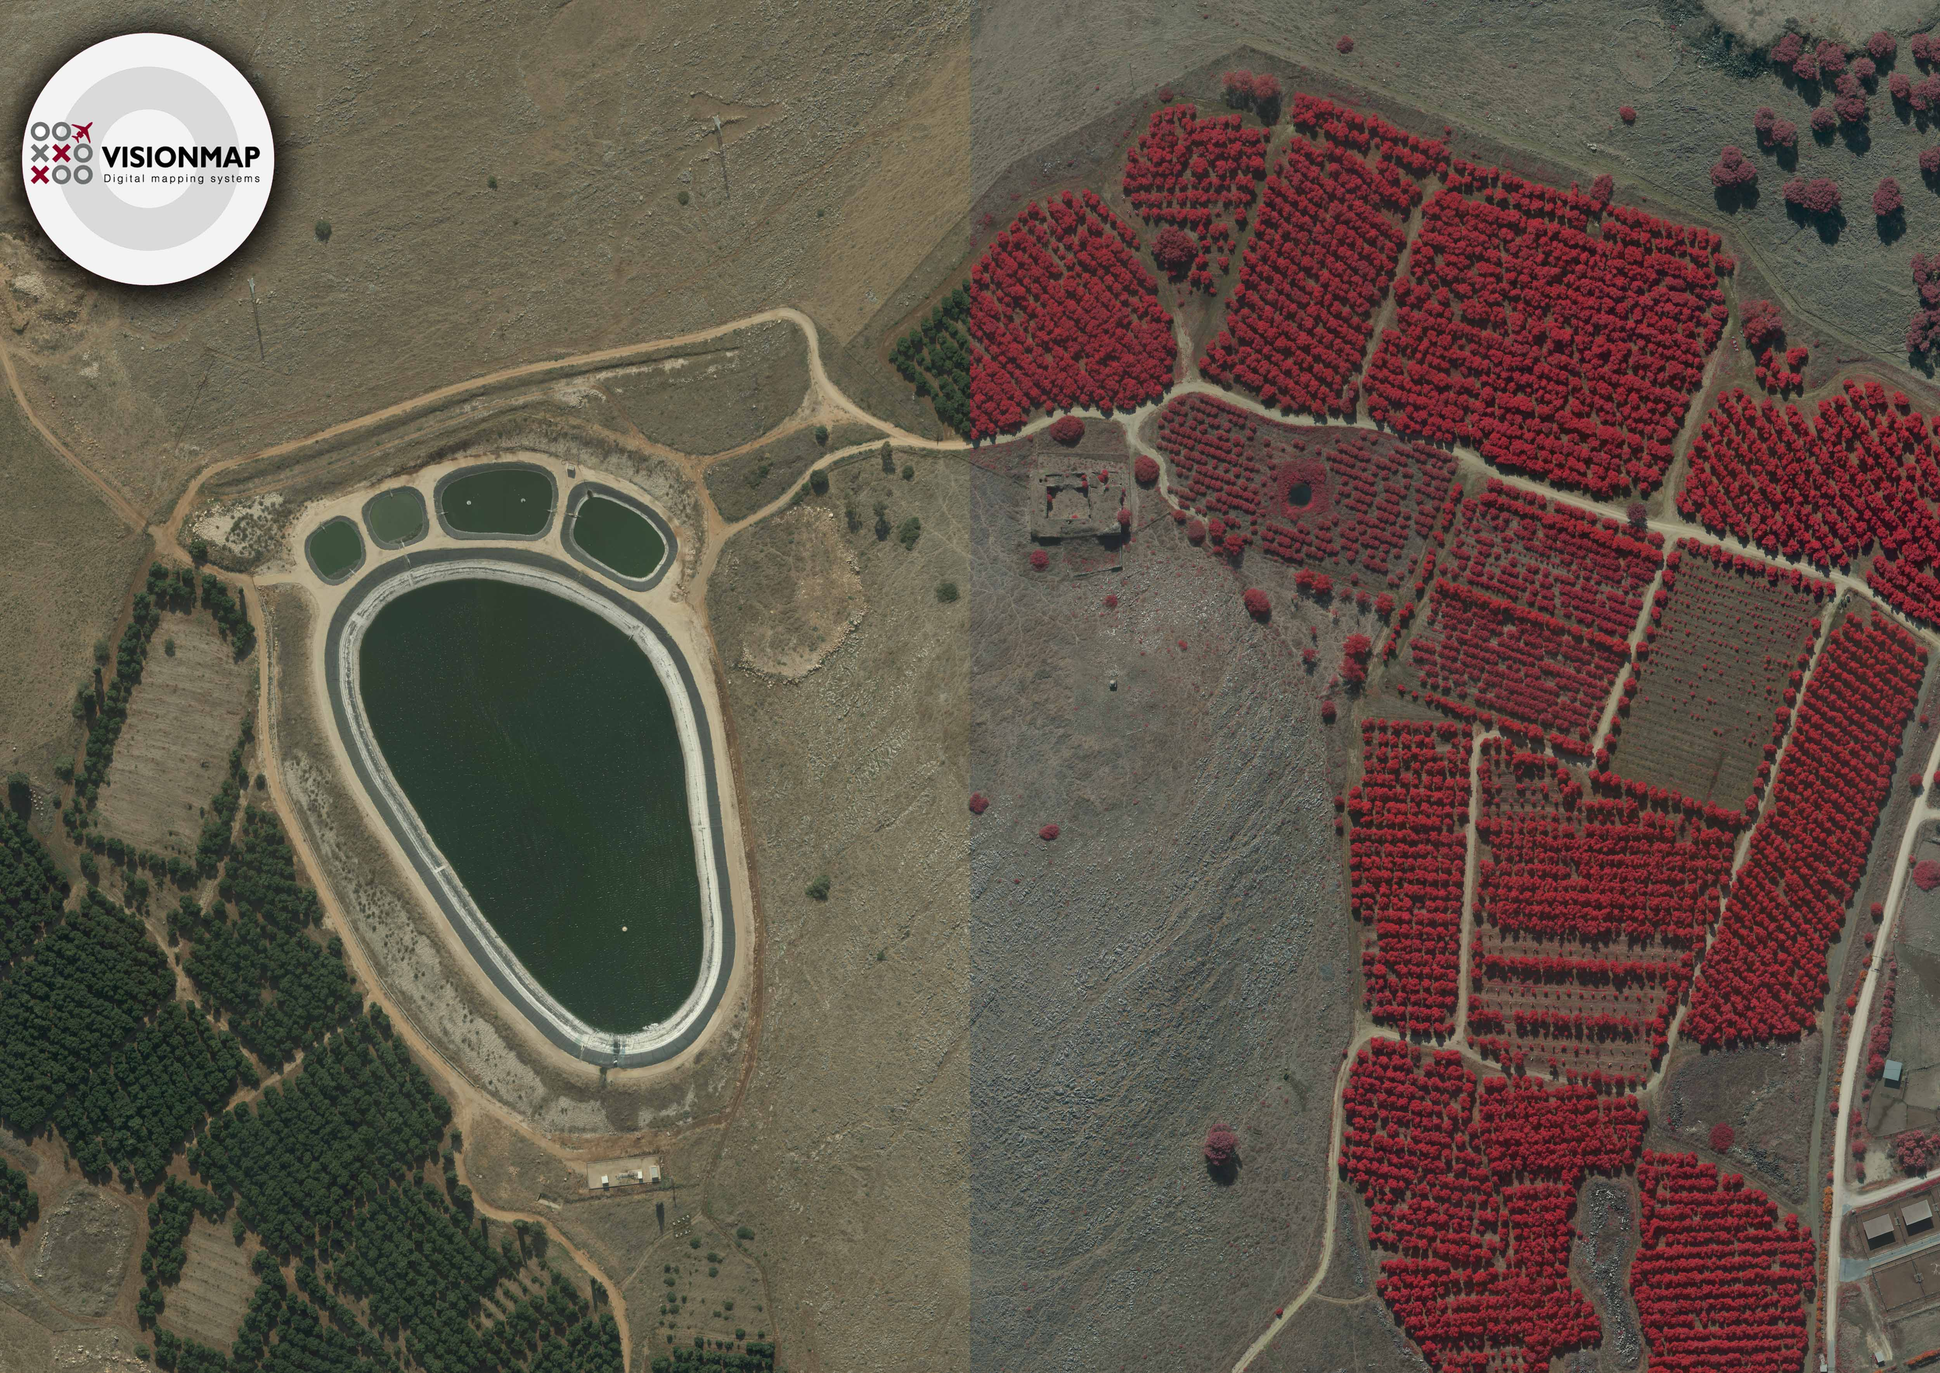
A3 Digital Mapping System
Largest footprint Fastest processing
ASPRS 2012
Sacramento, CA

Slide 2
What’s Required?
“We had less good weather days last year” – Larger coverage is needed.
“We need to turn around the data two weeks after we started flying” – Faster processing is required.
“We need dense surface model” – Surface models for large areas are required when not already available.
“Can we do obliques efficiently?” - New requirements for photogrammetric products emerge.

Slide 3
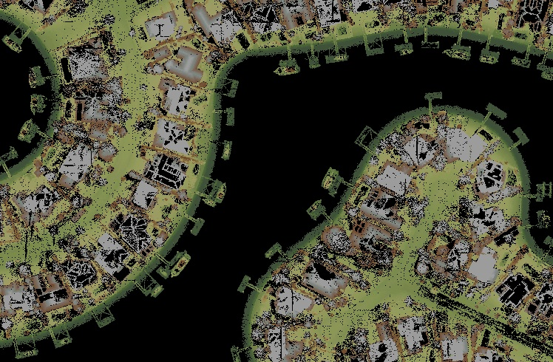
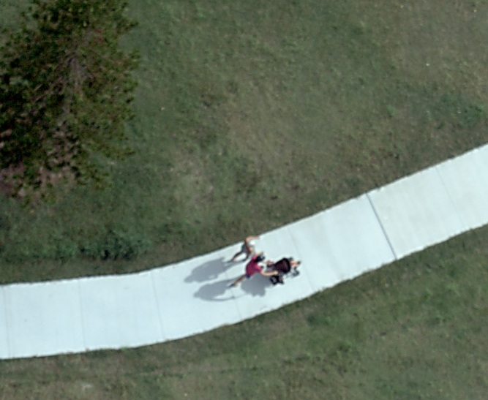
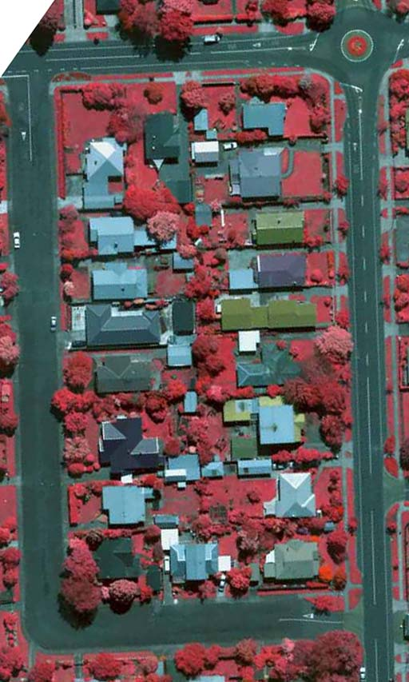
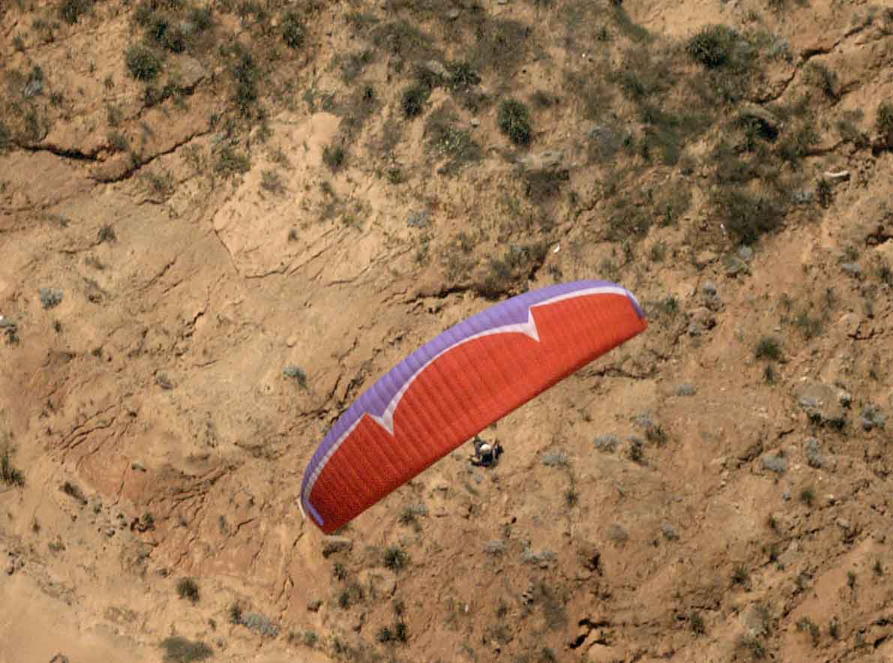
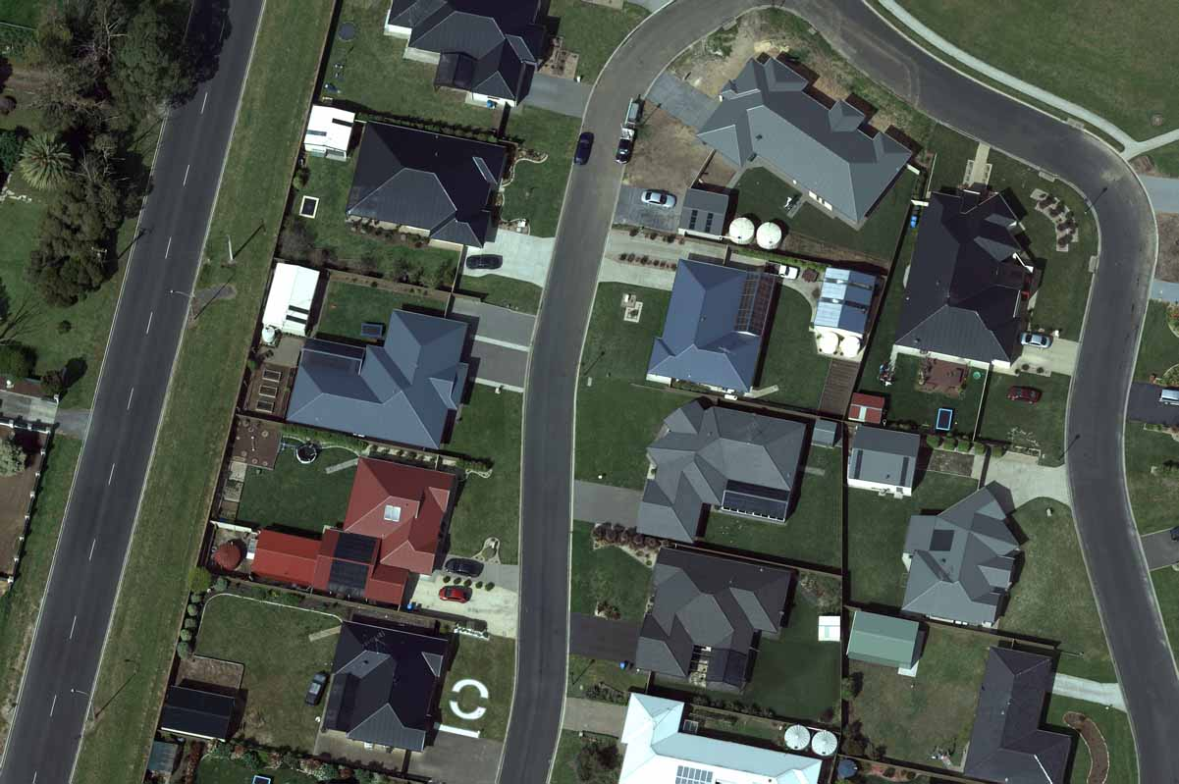
Versatility

Slide 4
The Solution

Slide 5
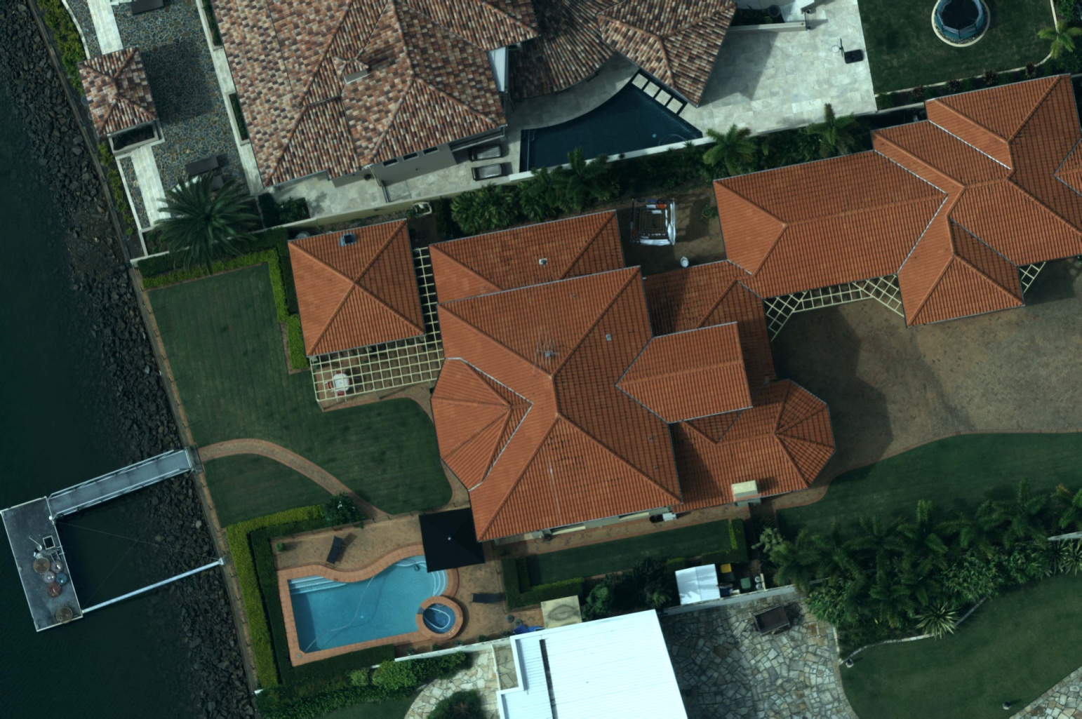
High resolution

Slide 6
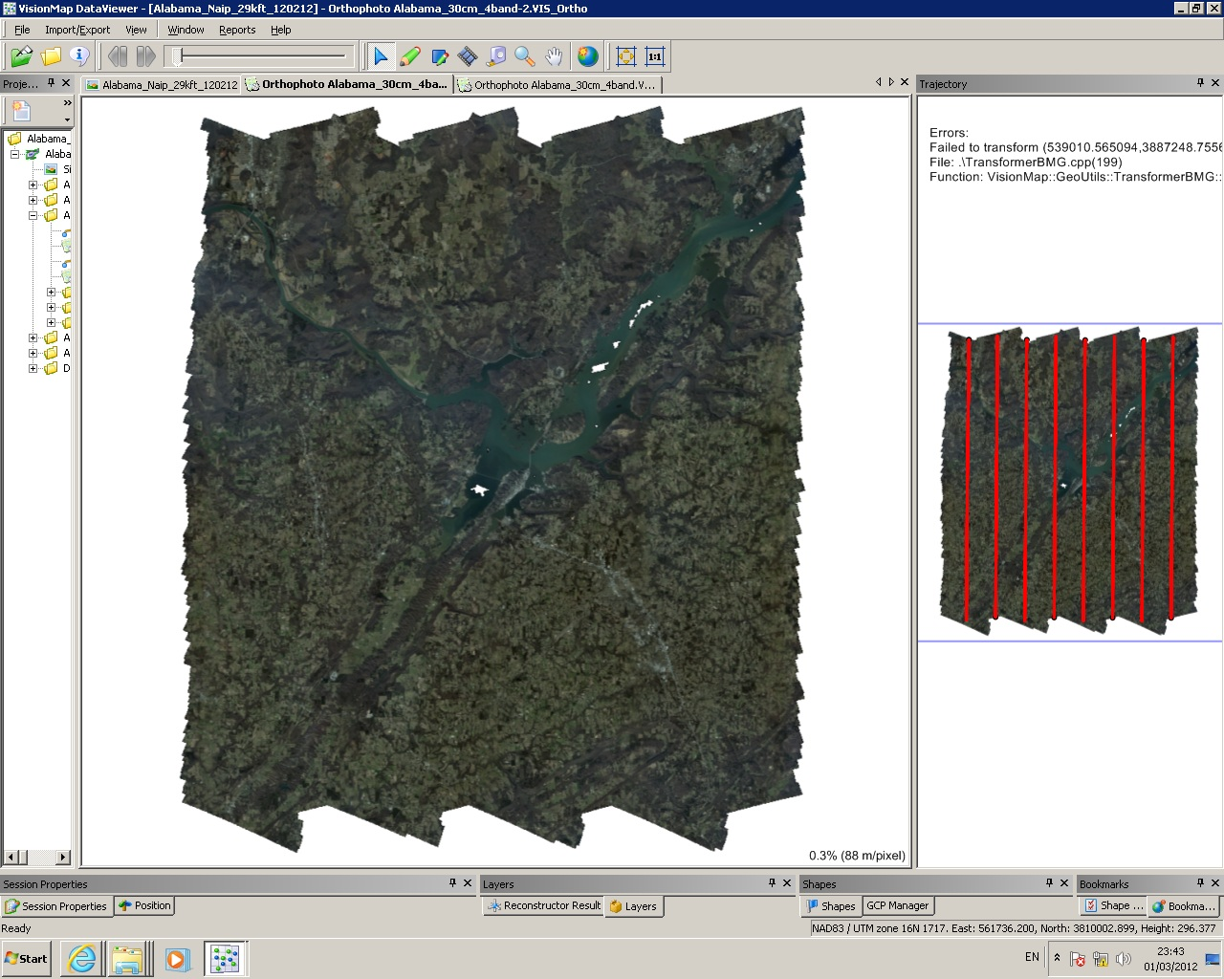
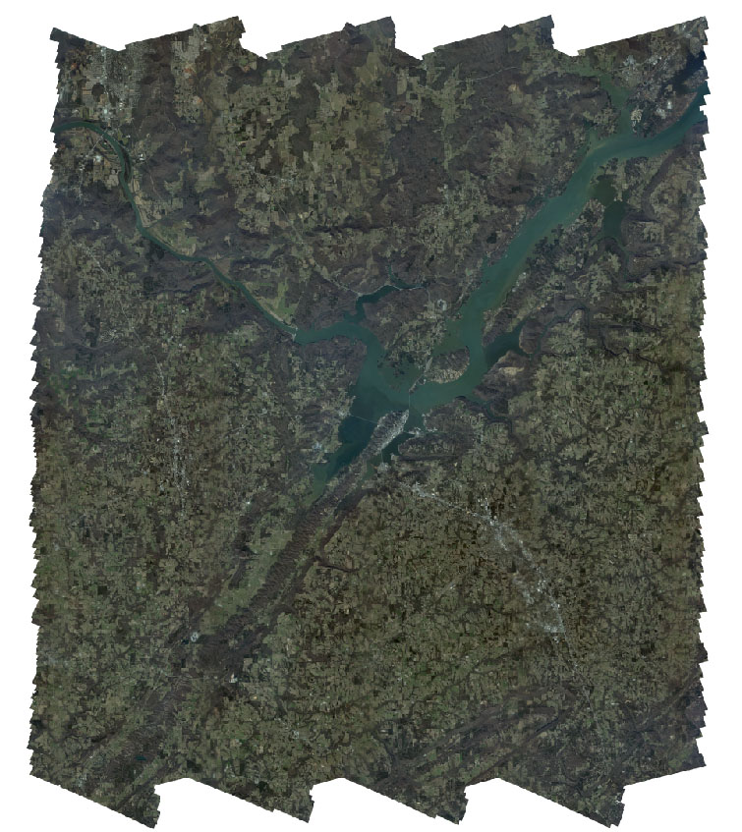
Statewide 4 Band Coverage

Slide 7
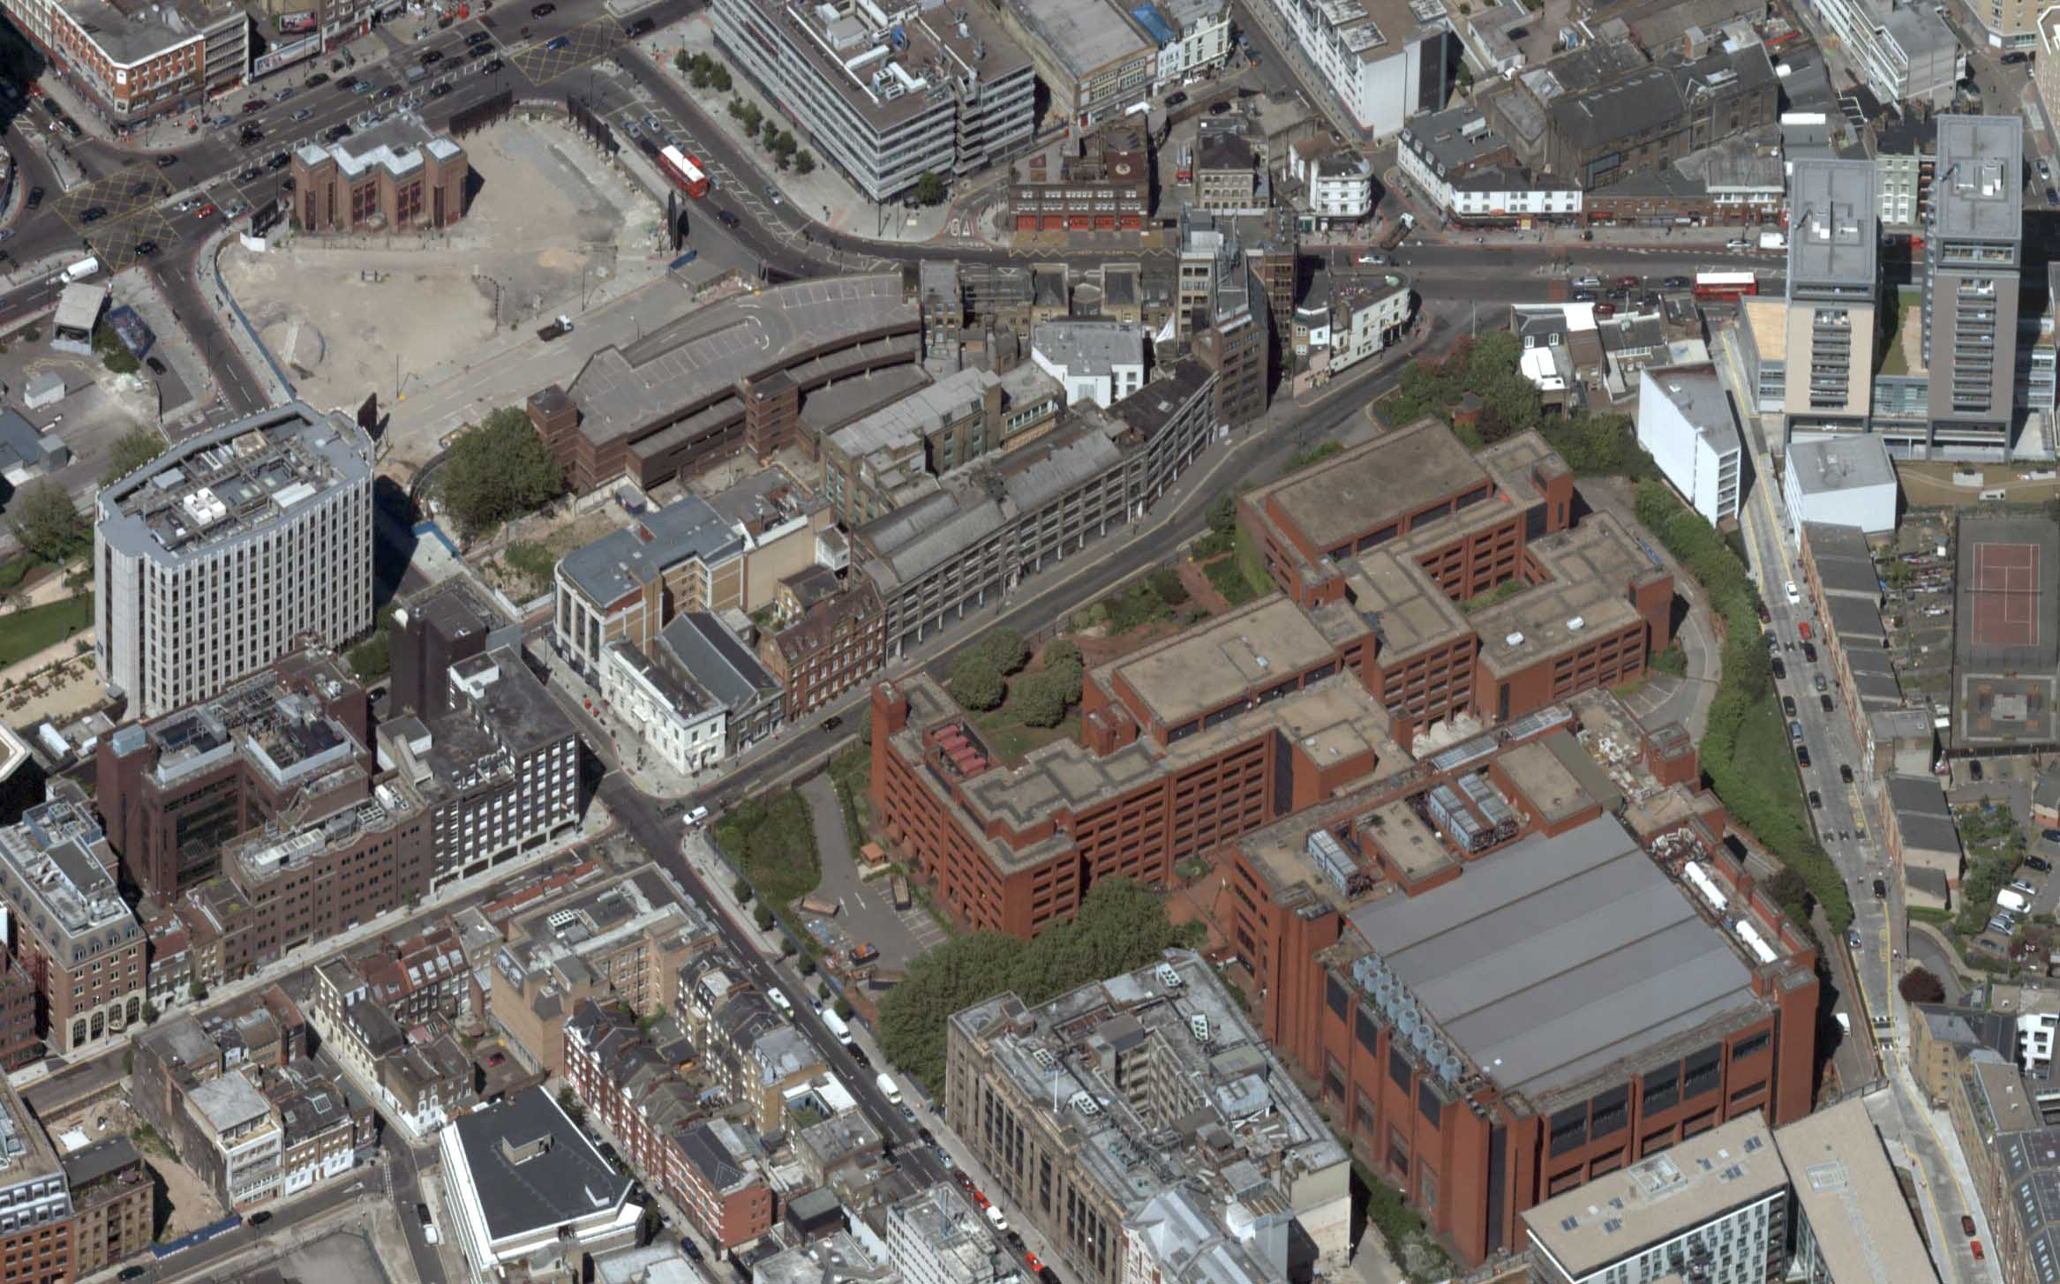
Oblique Imagery

Slide 8
Dense Surface Model

Slide 9
A3 Delivers
A3 family features the largest pixel footprint across track-
A3 Edge covers 80,000 pixels across
A3 covers 60,000 pixels across
A3 Core covers 40,000 pixels across
LightSpeed features the fastest processing
Quick turn around of data
Multiple products
One workflow operated by a lean team

Slide 10
Aerial survey productivity

Slide 11
Thank You!
www.visionmap.com

