Slide 1
Streamlining and Management of ASPRS
Stewart Walker, President, ASPRS

Slide 2
Objectives
Thoughts on ASPRS
Rationale and goals
Setting up the Task Force
The Work of the Task Force
What happens next

Slide 3
ASPRS: the governance
Like any society, ASPRS run according to bylaws
Series of standing committees ensure Society is administered correctly
Society’s members belong to Divisions, which do the real work of the Society
There are also Councils, which represent the interest of particular groups of members
Society also has regional structure, to give members local representation

Slide 4
ASPRS: the Divisions
GIS
LIDAR
Photogrammetric Applications
Primary Data Acquisition
Professional Practice
Remote Sensing
Unmanned Autonomous Vehicles
Divisions may have committees within them

Slide 5
ASPRS: the Councils
Students Advisory Council
Sustaining Members Council
Young Professionals Council

Slide 6
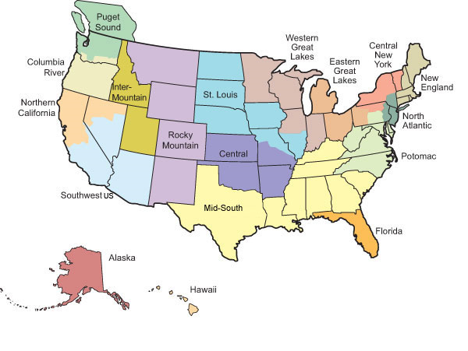
ASPRS: the Regions

Slide 7
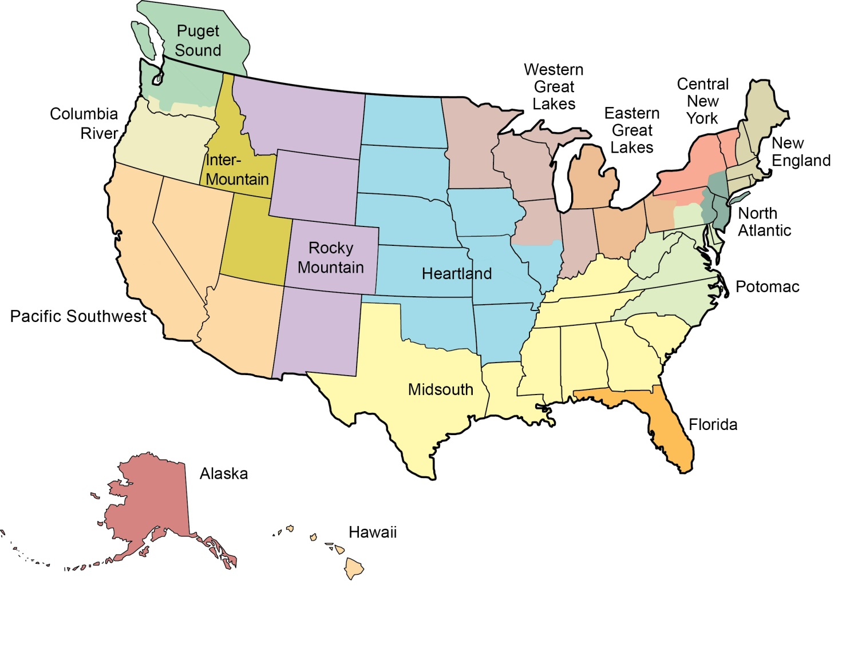
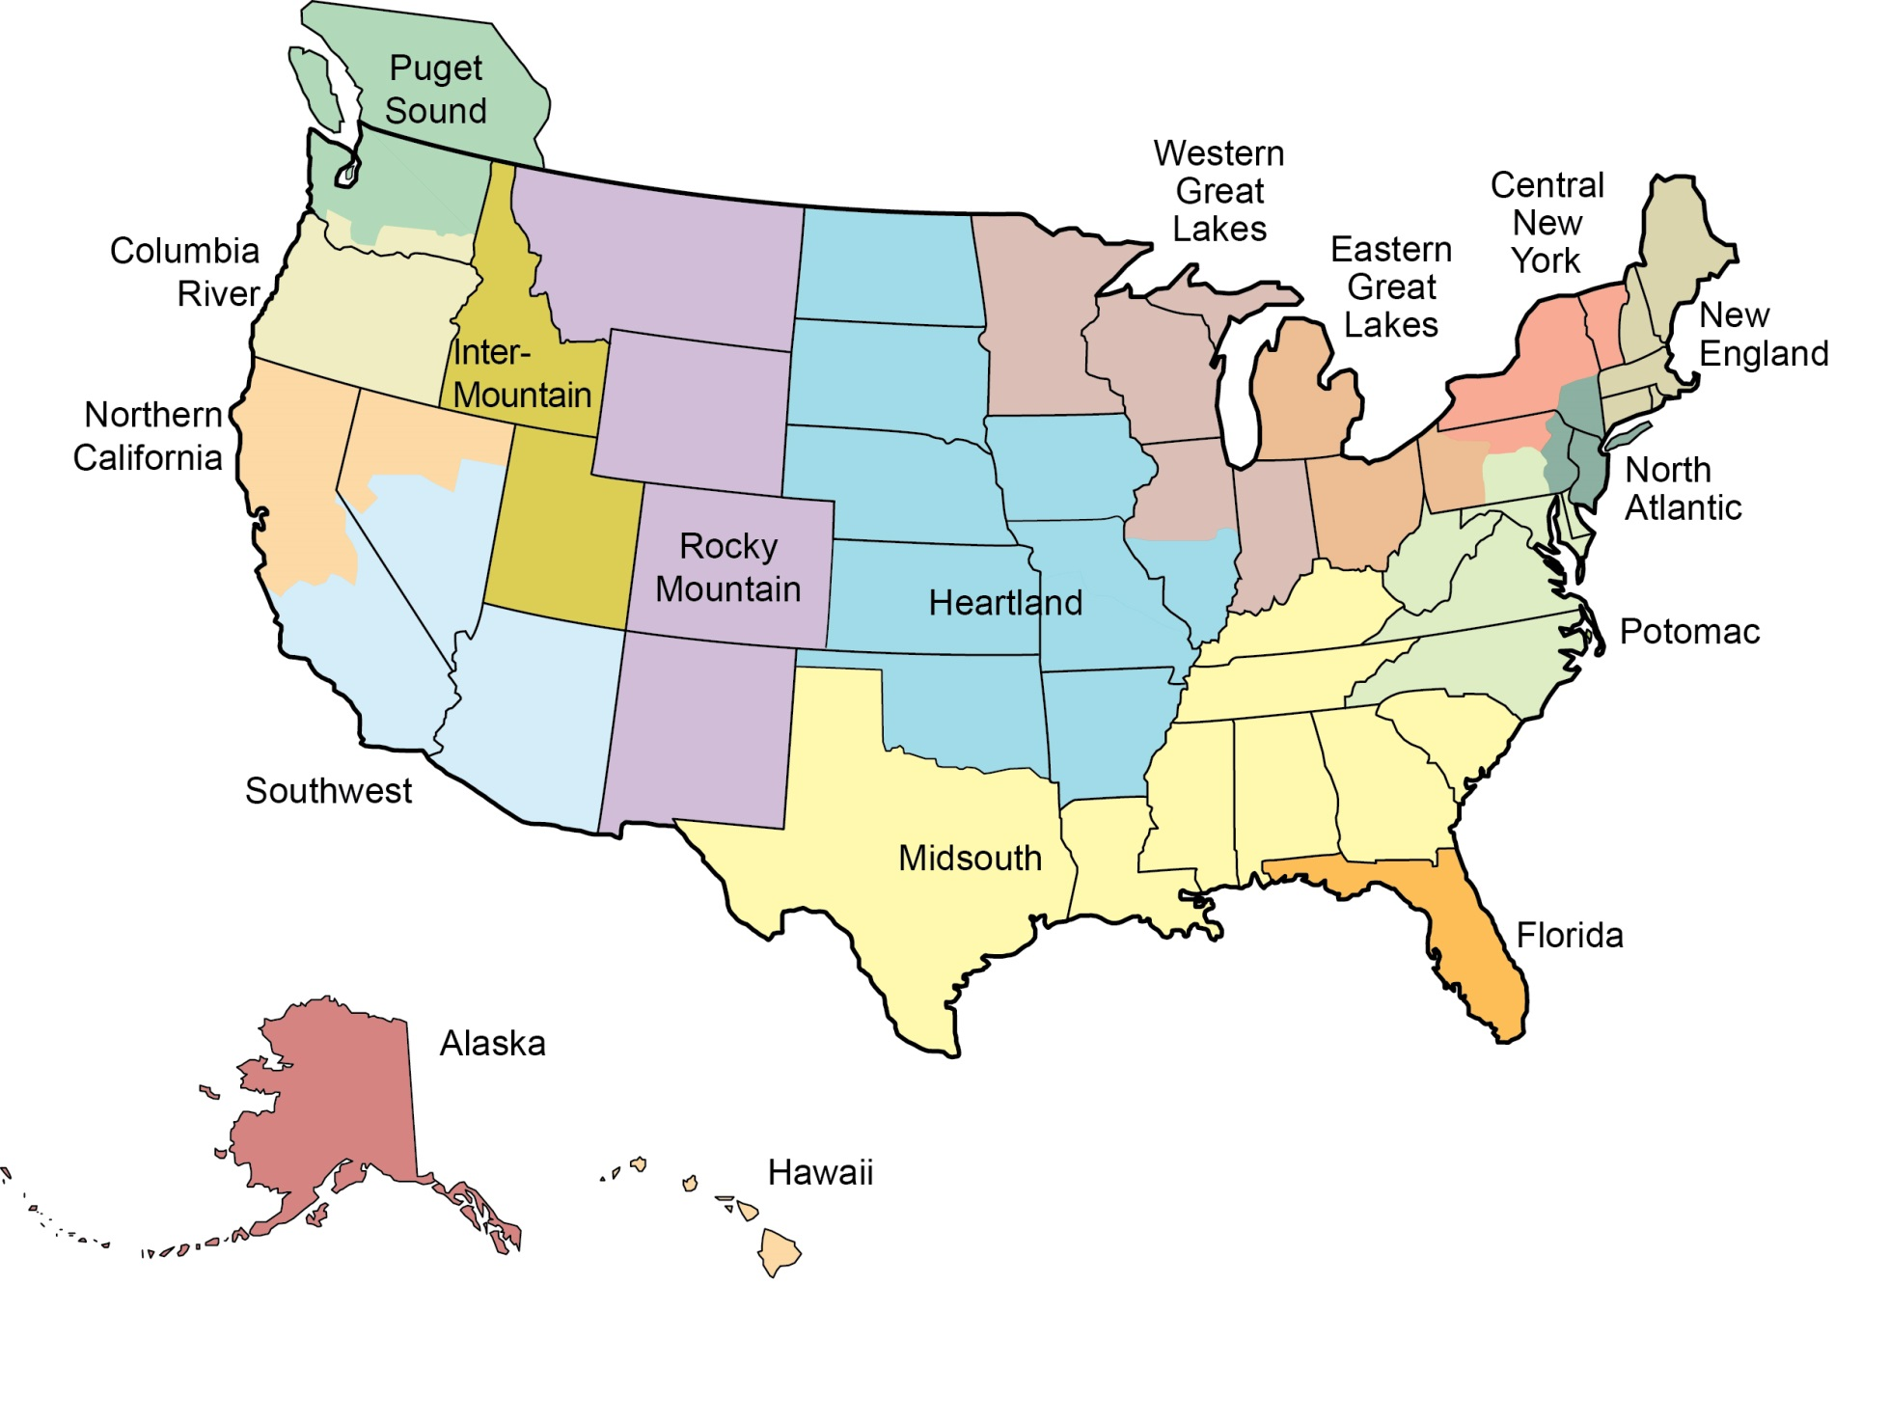
ASPRS: the Regions … 2

Slide 8
Rationale and goals
Reduced size of ASPRS and accompanying financial difficulties (covered in Michael’s talk)
Recognition that we have too many committees and too complex and organization for our size
Recognition that some regions, including this one, had troubles
Need for rapid action

Slide 9
Some of the reasons
Excessive size of Board of Directors
Excom and Board work through almost the same agenda only a few days apart
Do Excom and Board extract sufficient value from the many reports they receive?
Roles of standing committees and scope for consolidation
Roles of divisions and their subcommittees and scope for consolidation

Slide 10
Some of the reasons … 2
Dysfunctional regions and opportunities for consolidation
Membership responsibility divided amongst Membership Development Leader, Membership Committee and the councils of the regions, but could there be a more effective way?

Slide 11
Some of the reasons … 3
Conferences: the current approach, i.e. competition between regions; we also run joint conferences, e.g. CaGIS, JACIE
Organizational structure, roles and effectiveness of headquarters staff (this is a matter for Executive Director, but the task force should hear his views); suitability of the building
Effectiveness of the councils (SAC, SMC, YPC)
Make bylaws of the regions more similar, without it appearing as if the regions are subservient to the center, so that, for example, they all appointed officers at the same time of year?
Nationwide calendar of the Society, including all region meetings
Poll membership on willingness to work for Society: easier, for example, to form award juries

Slide 12
The solution
From a Working Group: “Task Force on Streamlining the Governance and Management of ASPRS”
Recommendation to Executive Committee (Excom), Louisville, KY, 22 March 2014
Work intensively on the problem
Provide recommendations to Excom and Board of Directors (Board)
Task Force set up spring 2014
Opening meeting on 6 June 2014
12th meeting on 13 February 2015 – minutes of all meetings on SharePoint

Slide 13
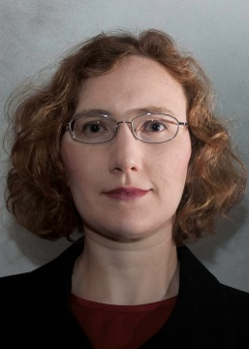
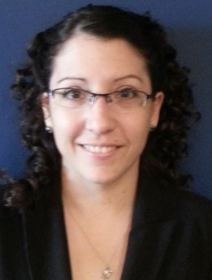
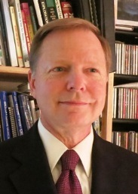
Membership
Streamliners
Ryan Bowe – Young Professionals, Quantum Spatial, Lexington, KY; Mid-South Region
Ekaterina (Kathy) Fitos – Young Professionals, Halcrow, Tampa, FL; Florida Region
Michael Hauck – Executive Director, ASPRS, Bethesda, MD; Potomac Region
Doug Smith – lots of Division experience, David Smith Mapping, Portland, OR; Columbia River Region
Stewart Walker – President, BAE Systems, San Diego, CA; Pacific Southwest Region
No requests to enlarge the membership

Slide 14
Areas for recommendations
Strategic Plan
Councils
Divisions
Regions
Committees
Board of Directors
Membership categories
Management (technology, structure etc.)

Slide 15
Areas for recommendations
Councils
Divisions
Regions
Committees
Board of Directors
Membership categories
Strategic Plan
Management (technology, structure etc.)

Slide 16
Membership categories
Existing
Proposed
Active
Associate
Student
Emeritus
Honorary
Fellow
Affiliate
Inactive
Sustaining
MUCs
Individual
Organization
Friend

Slide 17
Membership categories … 2
We have far too many categories, some empty!
Many other societies have individual and organizational categories
Many other societies offer concessions, e.g. students, unwaged
Low initial cost, with a la carte menu of services
Some societies blur members and donors
ASPRS needs much improved value proposition and statements of membership benefits – don’t lead with discounts

Slide 18
Membership categories … 3
Recommend that Individual and Organization categories have common and a la carte benefits
Dues vary according to sub-category:
Individual: professional, executive, student, unwaged, retired
Organization: sector - educational, government, military, commercial; size
Honorary Fellow of the Society
Elected
Could be non-member
Recognition, not membership category

Slide 19
Committees, Councils, Board
present | proposed
COMMITTEES AND COUNCILS
Executive Committee | ?Board of Directors
Membership Committee | -
- | ?Advisory Board
Division Directors Committee | TWG Directors Council/SIG Chairs Council
Student Advisory Council | Student Advisory Council
Young Professionals Council | Young Professionals Council
Sustaining Members Council | Sustaining Members Council
STANDING COMMITTEES
Nominating Committee | Nominating Committee
Tellers Committee (Special Committee) | -
Professional Conduct Committee | Professional Conduct Committee
Strategic Planning Committee (membership = Excom) | ?Strategic Planning Committee
Audit Committee | Audit Committee
Awards Committee | Awards Committee
Memorial Address Committee | Sub-Committee of Awards Committee
Honorary Member Nominating Committee | Sub-Committee of Awards Committee
Bylaws Committee | Bylaws Committee
National Technical Program Committee | Events Committee
Convention Planning and Policy Committee
Data Preservation and Archiving Committee (DPAC) | Data Preservation and Archiving Committee (DPAC)
Education and Professional Development Committee | Education and Professional Development Committee
Publications Committee | Communications and Publications Committee
Electronic Communications Committee
Journal Policy Committee
Evaluation for Certification Committee | Evaluation for Certification Committee
Standards Committee | ?Standards Committee

Slide 20
Committees, Councils, Board … 2
Big decision
Dissolve Board, expand Excom, form Advisory Board; or
Reduce Board, maintain Excom, dissolve Strategic Planning Committee
No change on Special Committees, Joint Committees, Working Groups
Open questions
Merge Education and Professional Development Committee and Evaluation for Certification Committee?

Slide 21
Committees, Councils, Board … 3
Awards Committee
Has a sub-committee for almost every awards
Fellows Committee is a sub-committee
Memorial Address Committee becomes a sub-committee
Honorary Member Nominating Committee becomes a sub-committee

Slide 22
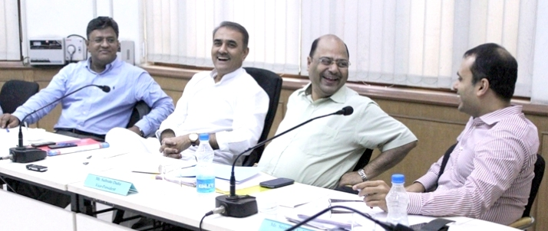
Committees, Councils, Board … 4
Division Directors Committee
Change to a Council
Name depends on whether we rename divisions
For continuity, and to ease the burden on Division Directors, President-Elect will be Chair and Vice President, Deputy Chair

Slide 23
Divisions
Leave current divisions as they are
UASD has been formally initiated
New officers being appointed or elected for PDAD
Consider alternative names
Technical Working Groups
Special Interest Groups
Upgrade Defense & Intelligence Committee?
Note earlier recommendation to create Division Directors Council

Slide 24
Regions
Recognize the success of the two amalgamations to date
Heartland
Pacific Southwest
Seek similar solutions elsewhere
Renew Society presence in New England
Synchronize region calendars
Simplify regional governance, i.e. officers and committees
Facilitation by ASPRS headquarters, e.g. websites, funding, electronic meeting facilities

Slide 25
Conclusions

Slide 26
Streamlining
Task Force’s findings and their implementation is part of Michael’s “Crawl, walk, run” strategy
Implementation requires
Discussion, refinement and approval by Excom
Discussion, refinement and approval by Board
Significant changes to bylaws
Amendment to bylaws currently in process will make future changes faster
Significant work required, perhaps by a Working Group, on value proposition and benefits

Slide 27
Parting thought

Slide 28
Thank you
Questions and answers
Opinions and improvements
Volunteers
Point of contact
Stewart Walker
BAE Systems, 10920 Technology Place, San Diego, CA 92127
(858) 592-1764
stewart.walker2@baesystems.com
The Streamliners want your Society to work better!

Slide 29
Streamlining Reports
Initial Report to Board in Denver
Report on Recommendation #2 Divisions
Report on Recommendation #3 Regions
Report on Recommendation #4 Committees
Report on Recommendation #6 Membership

Slide 30
Initial Report to Board in Denver
Outlines case for a simpler organizational structure
Discusses relationship of streamlining to:
Articles of Incorporation
Bylaws
Strategic Plan
Makes 7 specific recommendations
2 were subsumed into other recommendations
1 is being implemented by HQ
4 were explored further in additional reports

Slide 31
Recommendation #2 Divisions
Existing Divisions should continue and the officer positions should be filled
PAD and PDAD should discuss their respective names and interests (e.g. “Sensors and Acquisition”; and “Photogrammetry Applications” )
PAD and PDAD should consider merging into a single Photogrammetry and Sensors Division
The unit within a Division that is set up to work on a particular project, should be called a “Working Group”, not a “Committee”
Current Defense & Intelligence Committee should consider becoming a Division
Other interests to consider for Division status are the History of Photogrammetry and Remote Sensing, Transportation, Geodesy, and Markets and Policies. Under the current structure, these could also be as addressed by Working Groups of the existing Divisions.
Division Directors Committee should be raised in status to Division Directors Council, consisting of the Division Directors and Assistant Division Directors, with the President-Elect as Chair and Vice President as Deputy Chair.

Slide 32
Recommendation #3 Regions
Main purpose of Regions is to provide services to members on a local basis, for example face-to-face technical and networking events
Region officers should form the Region Officers Council, and be represented on the Board of Directors (no need then for National Directors)
Evaluate the concept of Metropolitan Affinity Groups as a replacement for Regions
Allow the number of regions to become smaller
Reduce the number of officers required for a region to operate
Instruct Headquarters to continue its ongoing improvements to support the regions (long list of specific support required is in the report)

Slide 33
Recommendation #4 Committees
Subject matter of this report subsumes Recommendation #1:
“Leave the Councils as they are, but consider converting the Division Directors Committee into another council.”
It also subsumes Recommendation #5:
“Consider replacing the Board of Directors by a slightly expanded version of the current Executive Committee and thus eliminate the latter. An Advisory Board could be convened to provide counsel from a wider congregation.”

Slide 34
Recommendation #4 Committees Smaller Board of Directors
Board of Directors (12) | Excom (7)
President | President, also serving as Deputy Chair of the Region Officers Council
President-Elect | President-Elect, also serving as Chair of the Division Directors Council
Vice President | Vice President, also serving as Deputy Chair of the Division Directors Council
Immediate Past President | Immediate Past President, also serving as Chair of the Region Officers Council
Executive Director | Executive Director
Treasurer | Treasurer
Secretary | Secretary
Representative of Sustaining Members Council
Representative of Young Professionals Council (or Early Career Professionals Council)
Representative of Student Advisory Council
Representative of Division Directors Council
Representative of Region Officers Council

Slide 35
Recommendation #4 Committees Emphasis on Councils
PRESENT | PROPOSED
COMMITTEES & COUNCILS
Executive Committee | Executive Committee (see Table 1 above)
Division Directors Committee | TWG/SIG Chairs Council
SAC | Student Advisory Council
YPC | Early Career Professionals Council
SMC | Sustaining Members Council
- | Region Officers Council

Slide 36
Rec. #4 Committees Streamlined Committees
PRESENT | PROPOSED
STANDING COMMITTEES
Strategic Planning Committee | -
Nominating Committee | Nominating Committee
Tellers Committee (Special Committee) | -
Professional Conduct Committee | Professional Conduct Committee
Audit Committee | Audit Committee
Awards Committee | Awards Committee
Memorial Address Committee | (Memorial Address Committee, a Sub-Committee of Awards Committee)
(Fellows Committee, a Sub-Committee of Awards Committee) | (Honorary Fellow Nominating Committee, a Sub-Committee of Awards Committee)
Honorary Member Nominating Committee
Bylaws Committee | Bylaws Committee
Membership Committee | -
National Technical Program Committee | Events Committee
Convention Planning and Policy Committee
Data Preservation and Archiving Committee (DPAC) | Data Preservation and Archiving Committee (DPAC)
Education and Professional Development Committee | Education and Professional Development Committee
Publications Committee | Communications and Publications Committee
Electronic Communications Committee
Journal Policy Committee
Evaluation for Certification Committee | Evaluation for Certification Committee
Standards Committee | Standards Committee

Slide 37
Report on Recommendation #6 Membership
The Society has too many categories of membership
There are no Affiliate Members, despite this category in the Bylaws
MUCs are a mixed blessing, but this category seems to be essential for some companies to pay its employees’ dues
Two categories of membership for those who have rendered distinguished service, Honorary and Fellow, seem to be overkill.
Reviews of other societies seem to have membership categories catering for individual and organizational members.
Most societies offer some concessionary membership categories, e.g. students, unwaged
There is a trend to offer members an a la carte menu of services, whereby they can join for a small fee then purchase further goods and/or services as they prefer
Should consider tightening the connection between members and donors in the benefits of membership and membership categories
The Society needs to create much improved benefits of membership, i.e. its value proposition, in order to attract members.

Slide 38
Report on Recommendation #6 Proposed Membership Categories
INDIVIDUAL MEMBER | ORGANIZATION MEMBER | FRIEND OF THE SOCIETY
Individuals | Organizations | Any entity
Common benefits All IMs enjoy the same IM benefits Online journal ? A la carte benefits Printed journal ? | Common benefits All OMs enjoy the same OM benefits Printed journal ? A la carte benefits Online journal site license ? | Benefits Customized per Friend Common benefits n/a A la carte benefits n/a
Dues Varies by career level (student, professional, executive, retired, unemployed) | Dues Varies by size and type of organization (educational, government, military, commercial) | Dues Customized, or None, as many of the arrangements with Friend members may be reciprocal

